Slide 1
PSE Programs
(and our clean little secret)
Beth Gilbertson,
Business Energy Management, Account Executive
Beth.Gilbertson@pse.com; 253-867-7965
October 2023

Slide 2
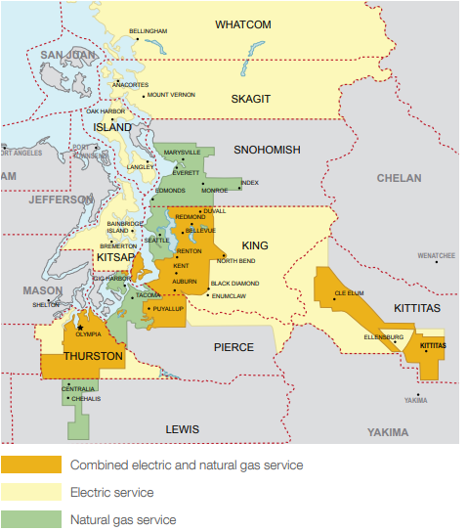
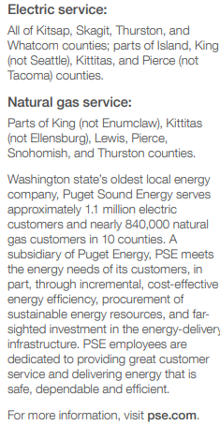
PSE Service Area

Slide 3
Deadlines & penalties
Compliance required by June 1 of each year below with 5 year review cycles
EMP and O&M program must be operationalized one year prior to deadline
1 year of energy data required and EUI must be at or better than target
June 1, 2025
June 1, 2026
June 1, 2027
Clean Buildings Portal - Washington State Department of Commerce

Slide 4
Recently Passed
SB 5722 – “Tier 2 Buildings”
Applies to multifamily residential, non-residential, hotel, motel, dorms, and commercial buildings with at least 20,000 square feet of conditioned space
Three components: Benchmarking, O&M plan, Energy Management Plan
No EUIt yet; Commerce must adopt by 2030
Notify building owners by July 1, 2025; First reports due July 1, 2027, followed by five year review cycle
Early Adopter Incentive: $0.30/sq. ft.
Noncompliance penalty: $0.30/sq. ft.
SB 5722
Notes:
Multifamily residential = 5 or more units
Commerce is supposed to define the requirements for the 3 components of compliance by end of 2023

Slide 5
Here are a few steps to get you started:
Log into the Clean Building Portal
Click on building profile, change Parcel Status to “ownership confirmed
Download copy of Standard
Visit How to Comply webpage
Videos, flow charts, information
Visit Support and Resources webpage
Commerce “How To’s”
Directory of professionals
What can I do to get started?
Go to the Department of Commerce Website
Clean Buildings Portal - Washington State Department of Commerce

Slide 6
PSE
Clean Buildings Accelerator Training
Designed to help PSE customers comply with the law
Achieve energy savings with participants own buildings (up to 3 buildings)
Program is no-cost to participants
Training session begins in Nov 2023, another in January 2024
Notes:
Compliance is building owner’s obligation, but PSE is here to help
Building needs to be over 50k sq ft, customers need to use PSE gas or electric for space or water heating

Slide 7
Path to compliance
Energy Manager tools and guidance
Hands-on ESPM(Energy Star Portfolio Manager) Bootcamp and Support
Energy Management Plan Practicum with Templates
O&M Program Tools and Ongoing Elevation Seminars
Guided EUIt assistance using ESPM

Slide 8
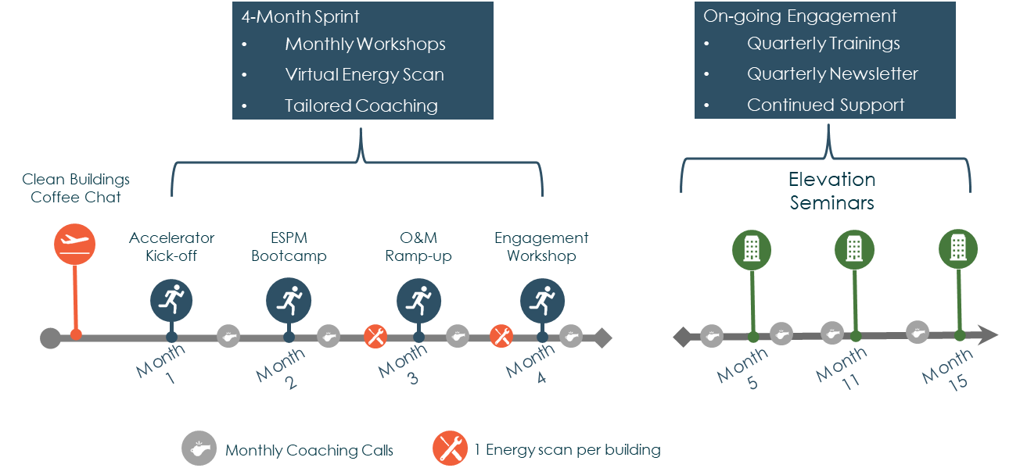
Training Timeline

Slide 9
Energy Management Plan
Operations & Maintenance Plan
Puget Sound Energy – Clean Building Accelerator Training Templates
Energy Management Plan
O&M Plan
PSE | Clean Buildings

Slide 10
Sign up for Orientations and Cohorts:
pse.com/CleanBuildings
Bookmark this page to find other valuable info you will need along the way
Orientations:
Tuesday, Nov. 14, 2023, 11 a.m. – noon
Tuesday, Dec. 12, 2023, 11 a.m. – noon
Next Cohorts (group training start dates):
Thursday, Nov 9, 2023 - 9-11 am
Tuesday, Jan 23, 2024 - 9-11 am
Watch our 3 minute video at www.pse.com/cleanbuildings
www.pse.com/cleanbuildings

Slide 11
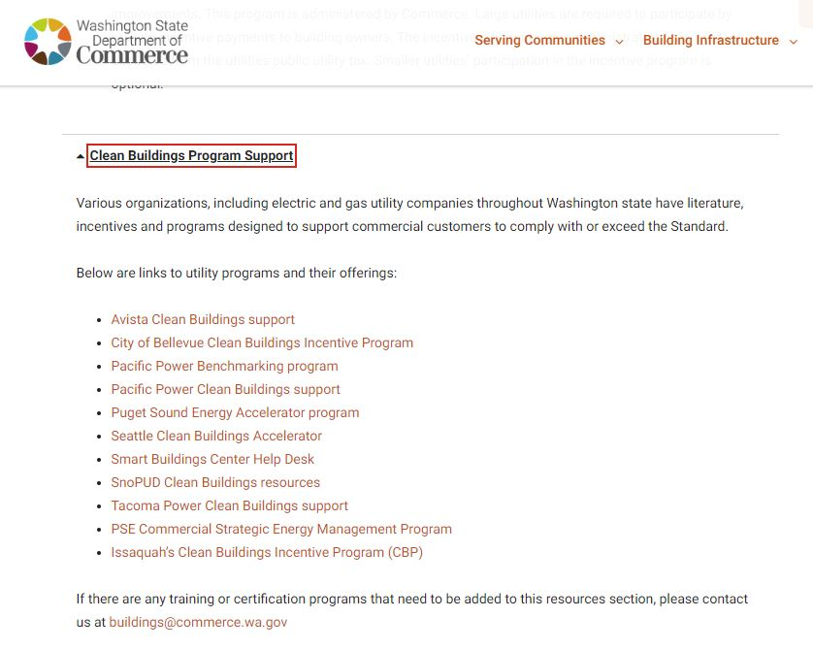
Utilities
Trainings
List from Dept. of Commerce Website

Slide 12
Utility Contact Information
Bonneville Power Assoc.(BPA)
Erik Boyer, ebboyer@bpa.gov
Debra Bristow, dabristow@bpa.gov
Puget Sound Energy
Beth Gilbertson, beth.Gilbertson@pse.com
Avista
Tracie Oergel, 509-495-4078 Tracie.oergel@avistacorp.com

Slide 13
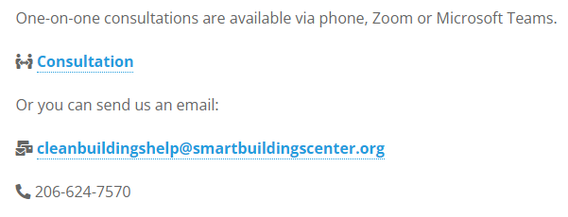
Smart Buildings Center
Clean Buildings Performance Standard Helpdesk
If you have a question, a specific scenario you would like to discuss or are looking for some more resources, then the one-on-one consultation is for you.

Slide 14
Lighting Survey Workbook
Developed in collaboration with Commerce and sponsoring utilities
Vetted by various industry stakeholders

Slide 15
PSE Business Energy Management Contacts & Resources
Clean Buildings Accelerator Trainings
pse.com/cleanbuildings
Commercial Strategic Energy Management Program
pse.com/csem
PSE Business Incentives
https://www.pse.com/en/business-incentives
Department of Commerce
https://www.commerce.wa.gov/growing-the-economy/energy/buildings
Beth Gilbertson, Acct. Exec., Major Accounts
Beth.Gilbertson@PSE.com, 253-867-7965
https://www.pse.com/en/business-incentives

Slide 16
Who is a CSEM Customer?
Commercial buildings
Examples – Colleges, universities, school districts, government facilities, office buildings
Eligibility: 1,000,000 kWh or 135,000 therms (annually)
Designate point of contact (“energy champion”)
New/existing employee
Suggest: administration employee, custodian, HVAC/ Building technician, property manager, consultant
PSE contact for energy saving actions performed through the year
Can reassign as needed
PSE CSEM Program Summary

Slide 17
Commercial Strategic Energy Management (CSEM) program targets energy savings at commercial buildings through low/no-cost measures. Examples:
Match operating schedules to occupancy
Verify set-points
Occupant engagement campaigns
Support facility maintenance teams
A no-penalty 3-year program provides incentives, training, support from PSE engineers and access to building energy use data.
Partners are supported to reduce energy by 3% in the first year, 5% in the second year, and 5% in the third year. (Targets)
What is CSEM?
PSE CSEM Program Summary

Slide 18
Grant incentives - annually
Performance incentive: $0.02/kWh and $.15/therm reduced
Target incentive: target savings are achieved (3%, 5%, 5%)
Training allowance: reimbursement for training, software, & software upgrades
Energy use software – i.d. energy waste, interval energy data, training & support
Professional trainings & workshops: Smart Buildings Center, Building Operator Certifications
(3) building assessments – “energy audits” identify no-cost & low-cost energy saving actions
Clean Buildings Act (House Bill 1257) compliance support: EUI reports, document templates, portfolio manager data upload, & trainings
Operating cost predictability & impacts: unforeseen circumstances – ex; extreme weather, COVID
Commercial Strategic
Energy Management
Benefits
PSE CSEM Program Summary

Slide 19
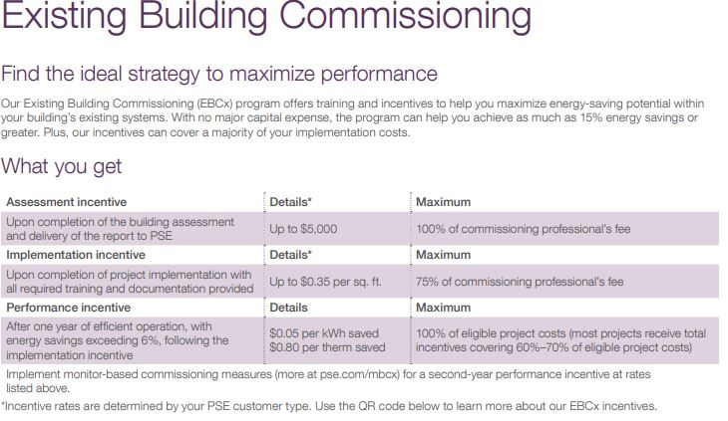
Existing Building Commissioning
Can covers100% of commissioning professional. fee
More incentives for implementation & performance
pse.com/ebcx

Slide 20
Building Tune Up
Low-cost/no-cost
In-house HVAC techs
Performance Incentive – pays for system upgrades
pse.com/tuneup

Slide 21
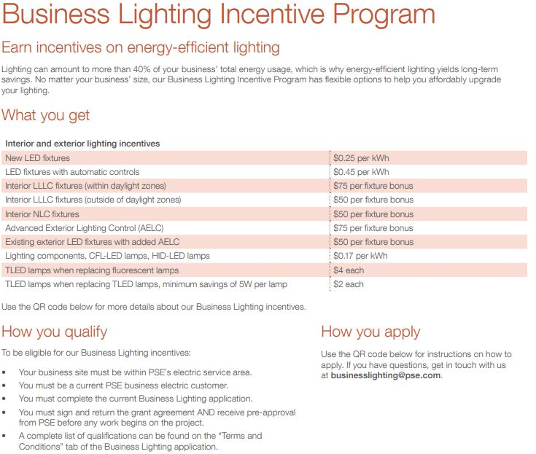
Lighting can amount to 40% to Building’s total energy use
pse.com/businesslighting

Slide 22
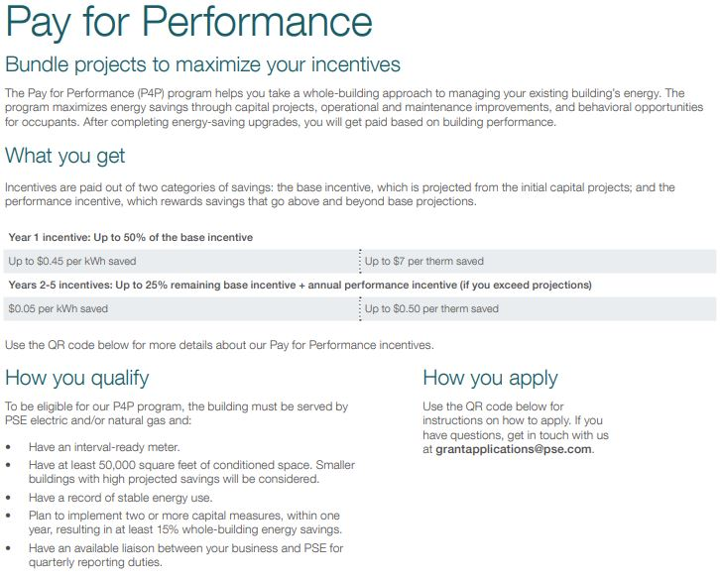
For whole building energy saving projects:
Windows
HVAC
Controls
Lighting
pse.com/p4p

Slide 23
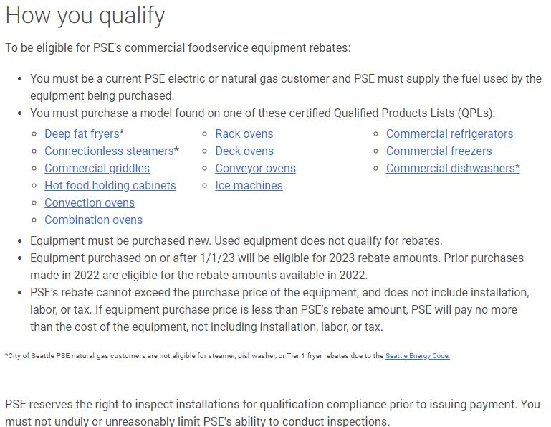
Foodservice
Equipment Rebates
Central Kitchens
Check in with Foodservice folks
Athletics
PSE | Commercial Foodservice Equipment Rebates

Slide 24
Commercial buildings over 50,000 sq. ft.
Examples: Schools, Supermarkets, Hospitals, Car dealerships, Churches, Office buildings, Non-profits, Warehouses
Does not include:
Industrial buildings (manufacturers), Federal buildings, Multifamily, Agricultural structures, Parking garage area
What buildings are eligible?
https://apps.leg.wa.gov/wac/default.aspx?cite=194-50-150
Notes:
Public buildings included

