Slide 1
Facility condition survey
Process & Overview
John Lyons
February 27, 2025

Slide 2
Survey Timeline & Purpose
The Facility Condition Survey is scheduled from February 2025 to February 2026.
Support documents are provided via Outlook invite and email.
Survey results will support a funding request of approximately $50M+ in the 2027-29 budget.
In 2023, the average repair funding per college was $1.4M.

Slide 3
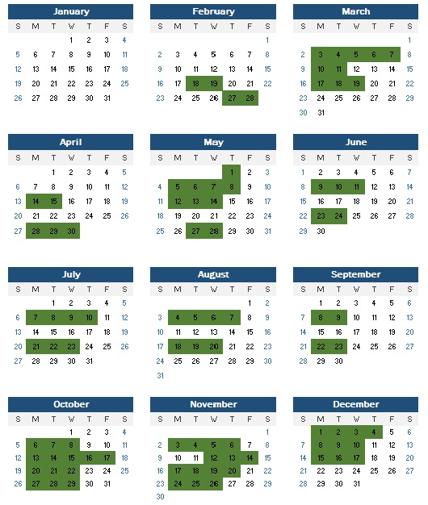
2025 Survey travel

Slide 4
Survey Process
The Facility Condition Survey is conducted every two years at each college.
All owned buildings are assessed and given a condition score.
Building and site deficiencies are evaluated, scored, and ranked.
A comprehensive report is generated and published by the end of the calendar year.

Slide 5
Pre-Survey Preparation
Review Pre-Survey Document
Gather supporting documentation for deficiencies that are not directly observable, such as:
Underground utilities
Electrical systems
Obsolete safety equipment (no longer supported)
Moisture damage assessment

Slide 6
Site Visit Process
Initial Interview
Meet with the facility director and business officer.
Review funded and previously identified minor works projects.
Discuss deficiency and maintenance management data.
Survey & Assessment
Inspect building and site conditions.
Score buildings and identify deficiencies.
Exit Report
Identify deficiencies to be included in the final report.

Slide 7
Budget Expectations
The system anticipates requesting $50M+ for repairs in the 2025-27 budget.
However, total identified needs are typically twice the available funding.
Colleges are expected to maximize the lifespan of major equipment through maintenance.

Slide 9
Asset Lifespan Expectations
HVAC systems & roofing: 20–25 years
Elevators: 40–45 years
Major electrical components: 50 years

Slide 10
Identifying Deficiencies
Consider re-conditioning efforts before full replacement.
Identify 2–3 times the expected funding per college (approx. $3–4M).
Engage lead maintenance staff to identify major concerns.
Verify deficiencies before the site visit—don’t rely on discovering them during the visit.
Focus only on repairs to existing assets, but consider if related improvements should be included.

Slide 11
System Support Considerations
Assess whether critical systems (fire panels, HVAC controls, elevators) have ongoing vendor support.
If a system is no longer serviceable, replacement may be justified even if it still functions.

Slide 12
Post-Survey & Infrastructure
Expect follow-ups!
Cost estimates and quantities of deficiency items can be refined after the site visit.
Local knowledge will be the primary source for all cost estimates
Infrastructure assets are typically replaced outside the FCS process to prevent failures.
However, failed or failing infrastructure (e.g., sewer line obstructions and damaged emergency roads) should be included as site deficiencies.

Slide 13
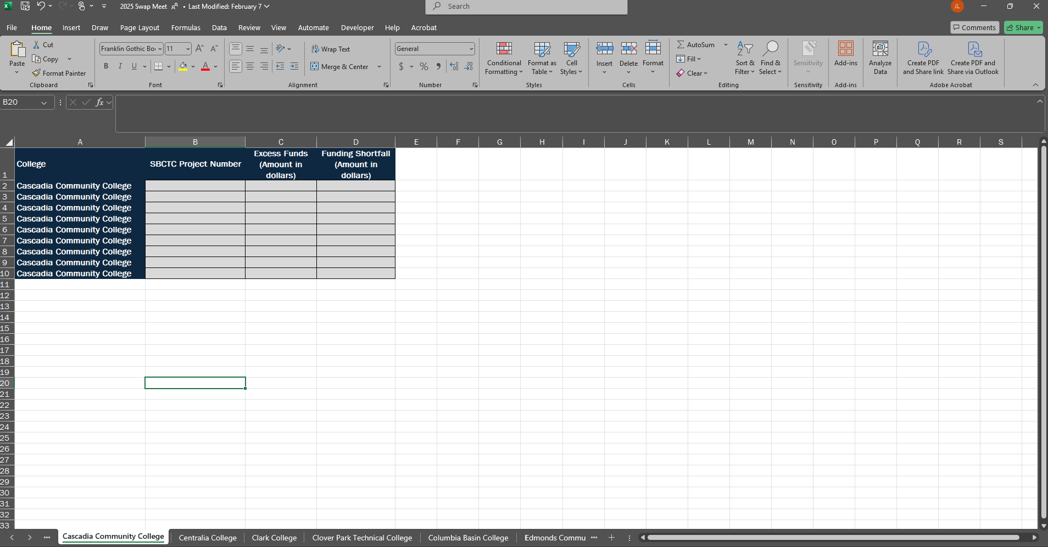
Swap meet

Slide 14
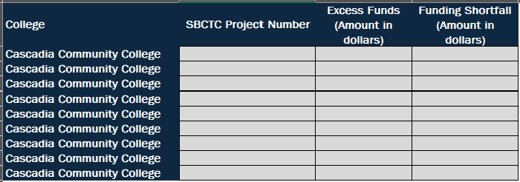
Swap meet

Slide 15
Questions & discussion

Slide 16
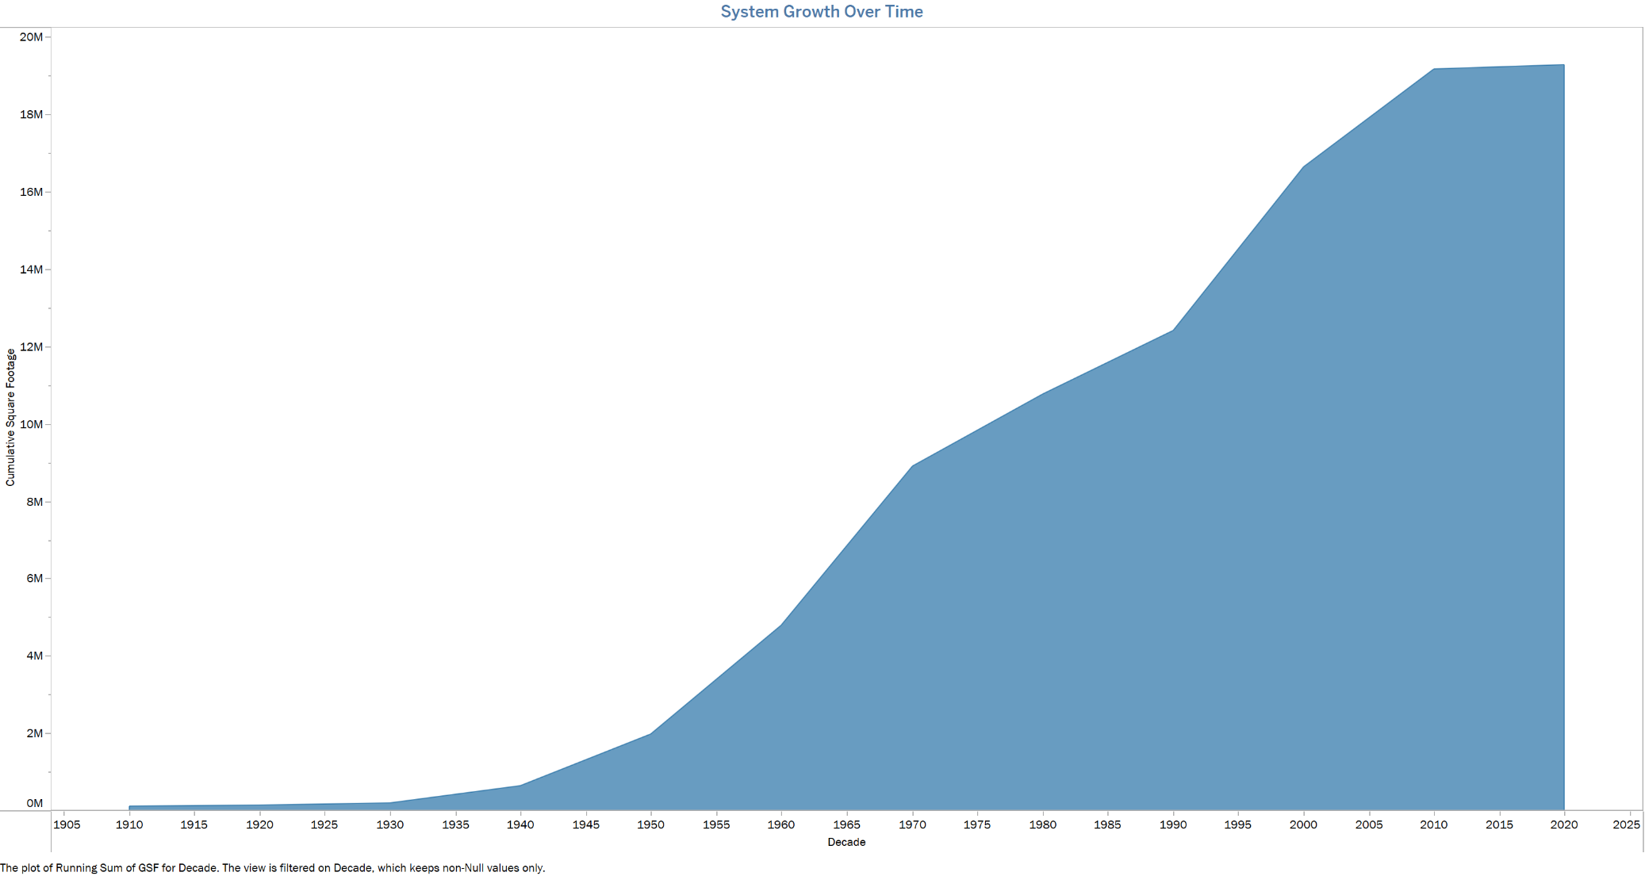

Slide 17
