Slide 1
Operations and Facilities Council – October 2025
Budget Analyst
Susan Locke
October 23, 2025

Slide 2
Captrack project schedules
  Adding/Updating project schedules
  https://captrack.sbctc.edu/Schedule
  User Name and Password
    College 3-digit code
  Project dates
    Estimate/Actual
    Design Start/Finish and Construction Start/Finish

Slide 3
Directline space coding
Z-list Report in QARS (updated ~15th monthly)
  A report that identifies rooms that do not follow typical expectations for space coding.
  The Capital Budget department prepares an annual report each fall which is reliant on accurate space coding.
    Use QARS, or contact Susan, to obtain the Z-List spaces for your college.
    Suggest taking this opportunity to review all your space coding and make any updates to better reflect accurate use of your spaces.
  Leverage your data sets/resources; 25Live can be used to true up instructional spaces as updates are made for how spaces are used and FAE & CIP matrix & list.

Slide 4
QARS
Quality Assurance Reporting System (QARS)
  Quality Assurance Reporting System (QARS)
  QARS Access Request Form (Fillable)
  QARS QRG
  QARS Report Guide

Slide 5
How did we do?
Reporting expenditures for:
  Roof, Facility, and Site repairs
  Infrastructure replacement
  Program allocations
  URF and emergency pool allocations
Allocations = $175.6 million
Expenditures = $166.8 million
  97.7% of allocations spent or reappropriated
  99.5% median (obligated funding)
Notes:
Expenditures don’t reflect SBCTC

Slide 6
% by College 2023-25

Slide 7
Reallocating minor funding
“Swap meet” to reallocate funding from colleges that will not fully spend to those that need more:
  Swap #1: $2.8 million
  Swap #2: $1.5 million
End of biennium journals
  $5.4 million “cash” to bonds

Slide 8
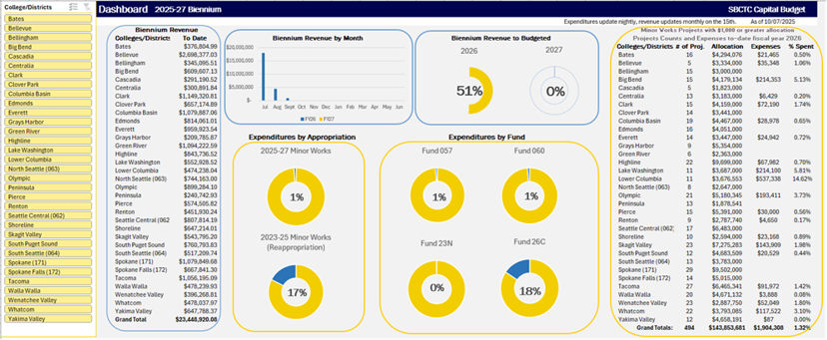
Capital Dashboard College/District-DRAFT

Slide 9
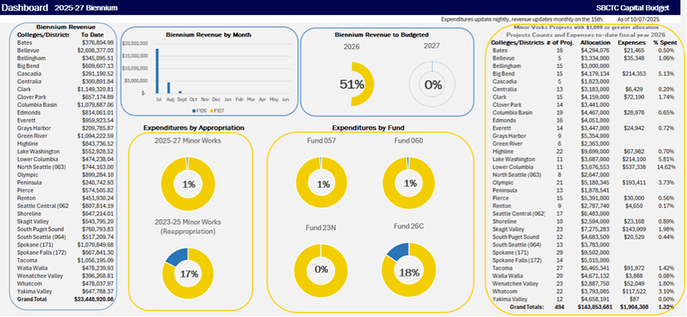
Capital Dashboard-DRAFT

Slide 10
Capital Budget Staff Contacts
Contact | Email/Phone
Darrell Jennings Capital Budget Director | djennings@sbctc.edu 360.704.4382 360.561.1385
John Lyons Principal Architect | jlyons@sbctc.edu 360.704.4395 503.267.6562.
Scott Morgan Sustainability & Energy Conservation Manager | semorgan@sbctc.edu 360.704.1073 360.951.0305
Kirk Knittle Functional Analyst | kknittle@sbctc.edu 360.704.1034
Susan Locke Capital Budget Analyst | slocke@sbctc.edu 360.704.4386

