Slide 1
More
rule
changes
Scott Morgan
Sustainability & Energy Conservation Manager
OFC – OCT 2025
Notes:
1 MIN
Everyone’s favorite topic, more red tape!
Fortunately, most of these changes should be relatively low impact.

Slide 2
Direct line standardization process
Please join our User Group: CMMS
Those users will help us check and clarify details as we roll out changes.
This is also a good way to stay informed of changes as everything rolls out.
We’re building/updating training guides
New User orientation in Canvas
QRG’s and videos in the ctcLink Reference Center will be updated as changes are made, in coordination with Megamation.
Some structural changes remain to be implemented before we begin updating the databases.
Notes:
I guess I should start with the changes I’m leading.
We’re reforming a user group that faded out in 2023-24. If you have anyone actively working on the inventory side of DirectLine, please encourage them to sign up.
Susan and I are updating old training guides and building new ones directly relevant to your O&M inventories.
Direct Line was originally built for work orders and financial/fiscal asset inventories. The existing rules and guidance are not directly applicable to what you need for O&M!
I’ll note that many standards that have been defined for years aren’t always followed, and it appears that many college staff aren’t aware of the existing training and resources. Part of this training development includes a process to ensure that everyone is informed of the standards and that our training/guidance is easy to find.

Slide 3
We want to start sharing best practices.
UW Bothell/Cascadia room entry screen check boxes.
If checked, these will appear on work orders defined for that space.
Work order status reports
Optional automated, weekly summary report
Send any other suggestions and/or requests to Susan or I and we’ll discuss with the user group
Notes:
The user group will review and select recommended changes.
The first change above provides two pieces of critical information that will show up on work orders issued for rooms where swipe/key card access is required, or where equipment is still under warranty.
Megamation also has an automated work order status summary report that may be emailed to you each week, if you choose. Reach out to Li Liang or Support at Megamation if you’re interested.

Slide 4
Recommendations for o&m inventories have been adjusted a bit.
Use built-in Fixed Asset fields:
Uniformat Level 3
Condition scores (we might adjust to align more with FCS)
Refrigerant-containing unit entry/class needs to be clarified.
We’ll add data fields for Expected Useful Life.
Notes:
The operations and maintenance inventory that you need for Clean Buildings compliance should be within the DirectLine Fixed Asset entries. I’ll note that CBPS also requires expected useful life and condition assessments for each item.
The State Board also needs standard classifications across all 32 databases so that we may run our analyses and respond to requests for information from other agencies or the Legislature.
Thanks to comments and discussions with various college staff, I’m recommending that we use the built-in Uniformat classifications and condition assessments.
It'll be simpler to use those than to change everyone's categorical classifications.
The State Board can use Uniformat to pull our reports without serious disruptions of your existing fixed asset classes.
We’ll still need to clean up the status codes and some fixed asset classes. Refrigerant-containing units should be a special class to facilitate your RAMP reporting.

Slide 5
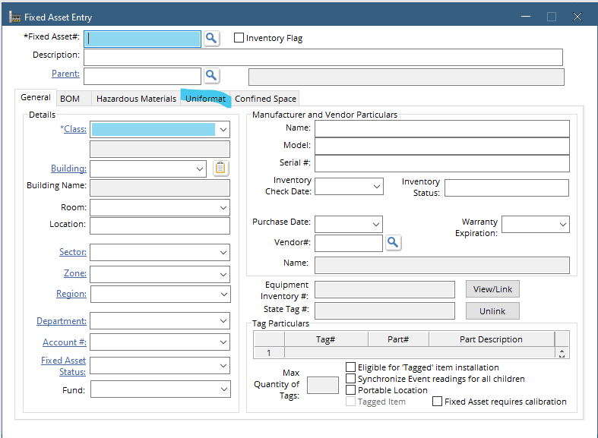
Use the uniformat tab in the fixed asset entry.
Built-in Uniformat codes extend through Level 4.
We want to standardize the databases to Level 3.
Additional levels are optional if they meet your purposes.
Notes:
This approach will be simpler than requiring everyone to change their categorical classes, and it’ll still meet our needs.

Slide 6
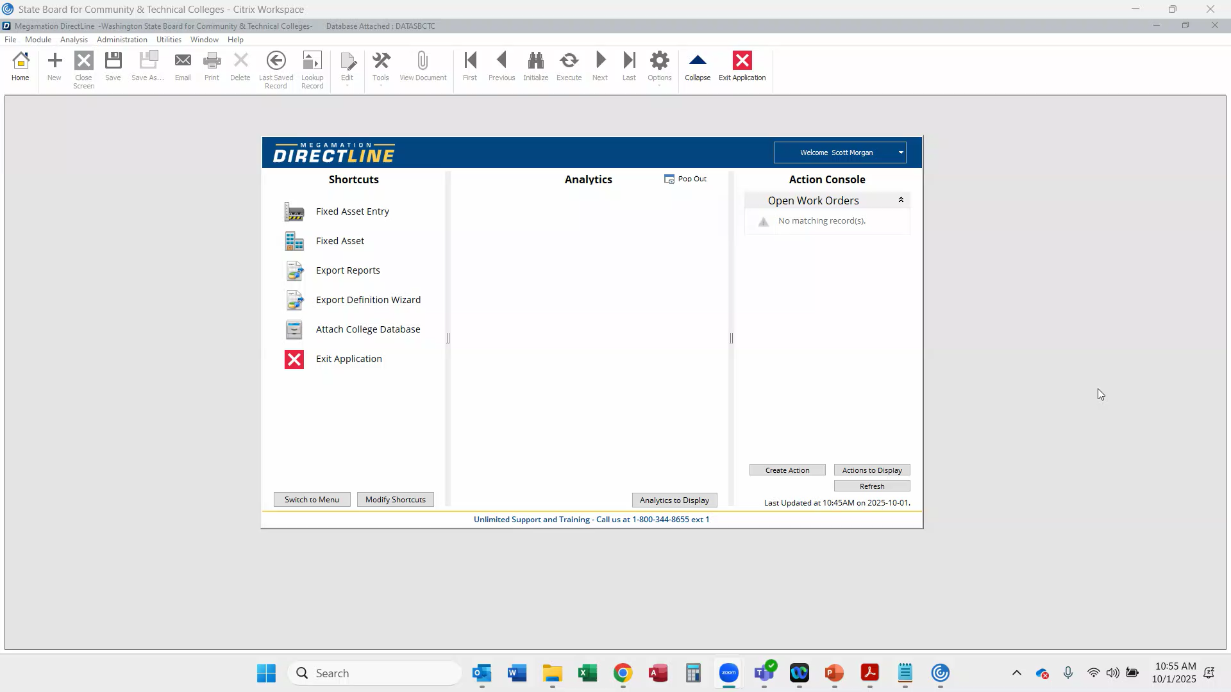
Notes:
We will develop a bulk update/upload process for everyone to update your existing inventory, but here’s a short video of where manual data entry occurs.

Slide 7
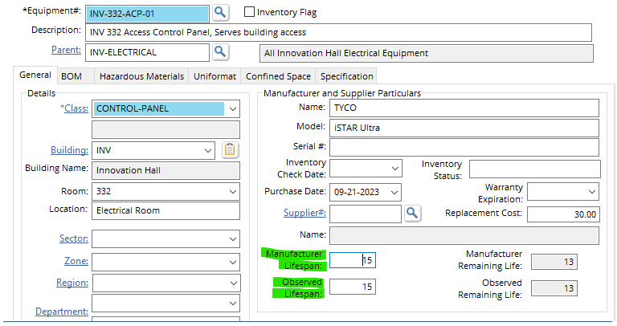
Expected useful life is now required by the CBPS.
Expected Useful Life is now defined by Commerce (BOMA standards).
Do not use the depreciation life built in for Equipment entry!
Notes:
There is no place to record the EUL for your fixed asset inventory in DirectLine. But this structure has already been built for Cascadia/UW Bothell.
Li has suggested, and I agree, that we simply roll it out to all the colleges.
I do expect to retitle the first field to match the CBPS language.
I would appreciate your thoughts/feedback.

Slide 8
Condition scores are required for clean buildings compliance and should match with our facility condition survey process.
DirectLine
Acceptable – no action required
Moderate – below acceptable standard
Poor – well below acceptable standard
Very Poor – imminent failure
Failed
Notes:
DirectLine also includes assessment scores for the impacts of failure and delay in repairing the unit. Those two assessments are not required by any current standards but could be useful to support your Facility Condition Surveys.
Any questions on DirectLine before I shift topics?

Slide 9
CBPS rulemaking update
Final draft rules have been released.
Full adoption of the new language should occur in December.
There are no plans for further changes until 2029 (fingers crossed).
The proposed changes include new exemptions, extensions, and compliance pathways, as well as clarification of some conflicts in the old rules.
Notes:
The most recent CBPS rulemaking process was triggered by HB 1543 in the 2025 session. It is nearly complete.
The final comment period will be this month, then Commerce will hold a public hearing in November. The new language will be filed in December.
I don’t expect that anyone will need to pursue an alternative compliance path but check with me if you’re thinking about it. I’ll provide support.
Commerce does not intend to make any other changes to the CBPS until roughly 2029, unless the Legislature says otherwise.

Slide 10
Some positive revisions to note
Campus-level compliance is triggered by the earliest relevant compliance date, not the largest building. Section Z 3.2
On-campus renewable energy production that feeds into the buildings is not included in the net energy use calculation (EUI). Section 5.2.1
O&M plans may now start on date of compliance for Tier 1, not 12 months prior as previously required. Section Z 4
EM plans are no longer required to review and limit tenant improvements from increasing net energy use but are still encouraged to include that review of all tenant improvements. Section 6.5

Slide 11
O&M proof should include:
Screenshots/examples of preventative maintenance logs that demonstrate a PM task was completed. Show what that task is, that someone was identified to complete it, any relevant condition indicators, and recurrence interval for the task to be performed.
Document all other required O&M elements. We don't necessarily need 'evidence' for everything other than PM requirements.
A service log combined with a service contract that highlights preventative maintenance planning and logs which demonstrate implementation in accordance with the O&M requirements would also suffice for proof of implementation.
Notes:
The best/easiest manner to prove O&M implementation would be including screenshots/examples preventative maintenance logs that demonstrate a PM task was completed to include what that task is, that someone was identified to complete it, any relevant condition indicators, and recurrence interval for the task to be performed (i.e. every quarter). We do not need to have volumes of logs to be submitted, instead just a singular example work ticket with the information above. Note that this should be preventative maintenance and not a work order response to reactive maintenance - i.e. light bulb goes out and needs to be replaced.
Include documentation of all required elements, don't necessarily need 'evidence' for everything other than PM requirements.
A service log combined with a service contract that highlights preventative maintenance planning and logs which demonstrate implementation in accordance with the O&M requirements would suffice for proof of implementation.
Occupant education simply needs to be in a manner that shows what training plan has been developed and if there's a schedule or registered classes, that would also be included. For the occupant information related to the implementatin of EEMs - that is included in the EMP which should be developed by the time of the compliance reporting date. The main evidence that we are looking for is that a preventative maintenance program has been implemented (for Tier 1) or developed (for Tier 2). This should be more than a reactive maintenance ticket system.

Slide 12
Compliance reporting is done through the Clean buildings portal.
Clean Buildings Portal details must be finalized
Confirm all relevant contacts/responsible parties
Confirm ownership of your buildings
Clarify/correct GFA
Create groups for connected buildings or campus-level
Add ESPM property ID
O&M and Energy Management plans are submitted as documents.
Notes:
Many of you still need to confirm and setup your properties in the Clean Buildings Portal. At minimum, you’ll need to:
Confirm the college contacts.
Confirm ownership and GFA details on all your owned properties.
Share your properties with your vendor, if you have someone else setting it up for your reporting.
I can support your team in that work.
Any questions on the CBPS before I shift topics?

Slide 13
Buy clean buy fair
HB 1282 –2024
RCW 39.116
Administered by the Department of Commerce’s State Efficiency and Environmental Performance (SEEP) office
Adds structural material source reporting requirements for state agency and higher ed construction projects for more than 50,000 gross square feet.
Notes:
Buy Clean Buy Fair is a new requirement for major capital projects.

Slide 14
It should be relatively low impact.
Only 14 of the 31 major projects in our current pipeline will qualify
11 colleges will be impacted
Renton Tech (2) Spokane College (2) Highline (2)
South Seattle Tacoma Columbia Basin
Clover Park Seattle Central Spokane Falls
Skagit Valley Lake Washington
Renton Tech and Spokane are likely to be caught in the early-learning period (if their projects are funded in the 2027-29 biennium).
Everyone else should see minimal impacts because DES will have standardized the processes before those projects get started.
Notes:
Whatcom was nearly impacted this biennium, but they should be able to start their project before the qualifying timeline.
If you’re on this list, when your project is funded you can expect your DES PM to include specific language in your RFP and construction contracts.
More details are included at the end of this slide deck for anyone who’s interested.
I’m also working with Commerce to coordinate support for our projects, so feel free to reach out if you need anything.
(2) "Awarding authority" means:
(a) Institutions of higher education as defined in RCW 28B.92.030;
"Institution" or "institutions of higher education" means:
(a) Any public university, college, community college, or technical college operated by the state of Washington

Slide 15
Notes:
2026 supplemental capital requests have been submitted.
The requests highlighted in teal are all for Climate Commitment Act funds. They include district energy decarbonization projects at 7 of the 8 affected colleges, and three grant programs.
Building Tune-up – retro commissioning
HVAC control-to-schedule upgrades
R22 equipment replacements
The session starts in January.

Slide 16

Who has successfully filed CBPS compliance early?
Who needs to file by next June?
Who’s done the best job maintaining their R22 chillers & air conditioners?
Who needs a $20+ million sub-station to decarbonize their campus?
Notes:
Clover Park, Cascadia/UW Bothell, and Columbia Basin!
Lake WA, Pierce Ft Steilacoom, Spokane College, Walla Walla, Bates, Seattle Central,
Renton Tech (79), Yakima (54), Clover Park (49); 638 R22 units have been identified across 25 of the colleges.
Maybe Tacoma. Cascadia and Edmonds may be facing a similar level of cost just to acquire the utility service necessary to support their projected electrical demand.

Slide 17
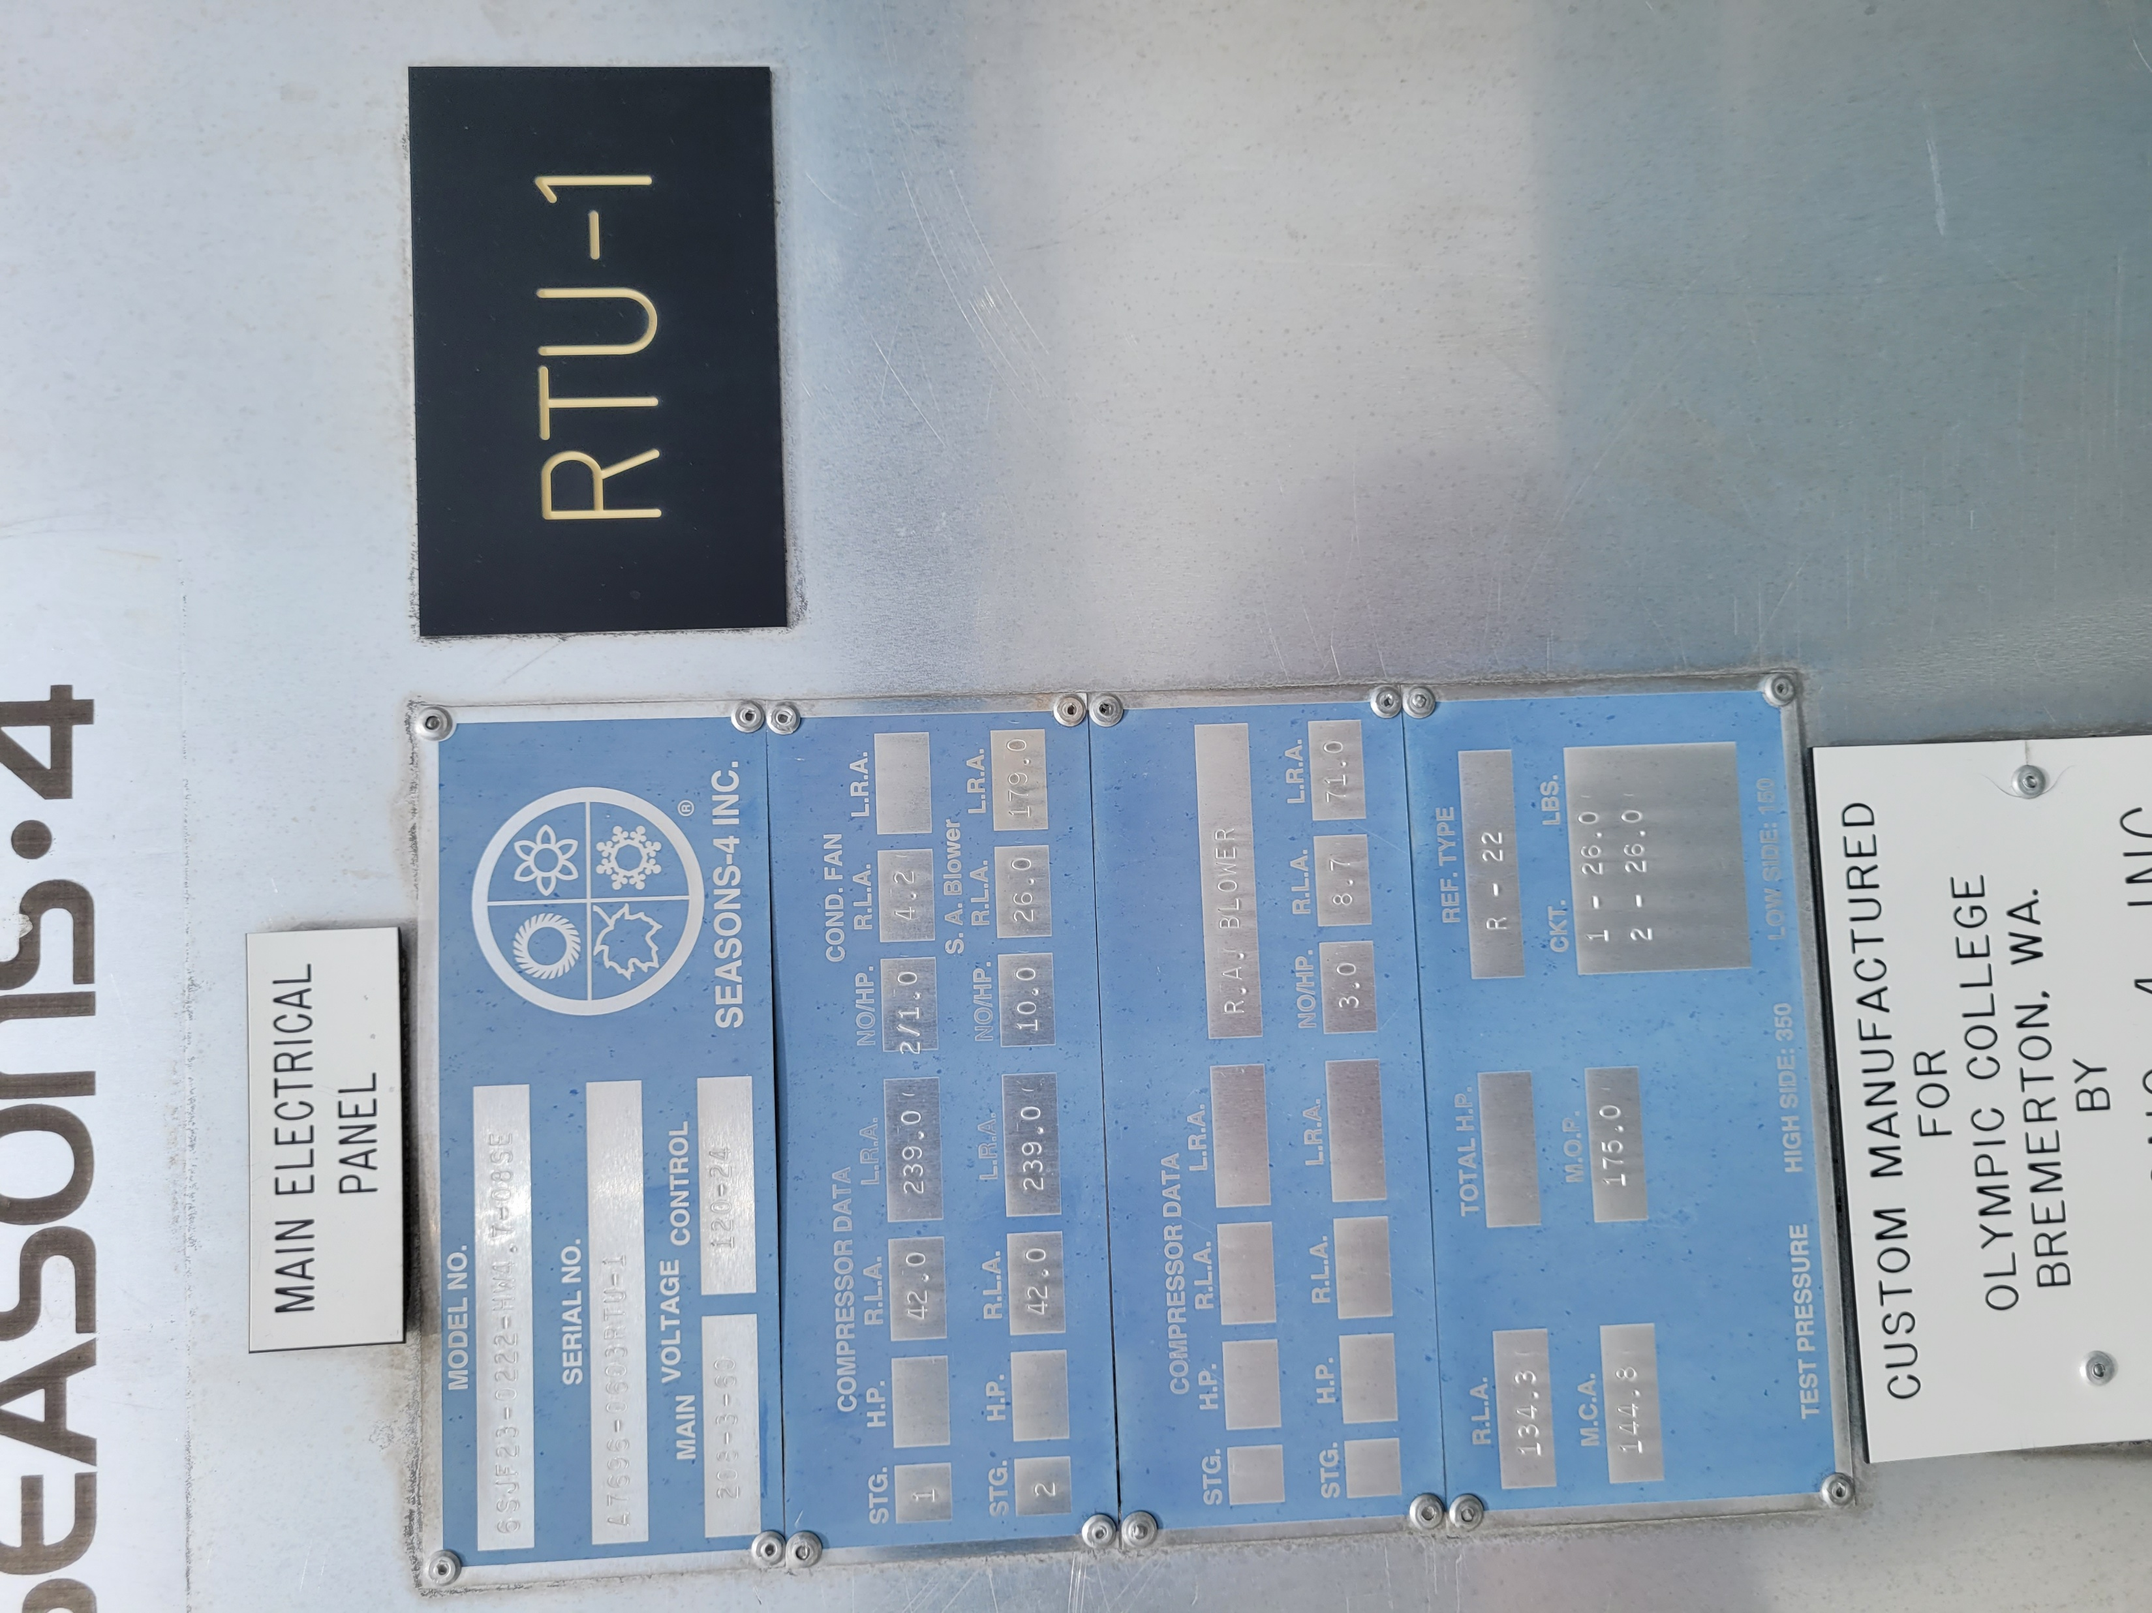
One more…
This RTU contains more than 50 lbs of refrigerant. Does it need to be reported in the RAMP?
Notes:
No. Each refrigerant-containing unit has a 26 pound charge, under the 50 pound threshold.

Slide 18
As usual, reach out for support.
semorgan@sbctc.edu

Slide 19
BCBF Requires embodied carbon reporting for structural materials used in major capital projects.
Applies to
“all newly executed construction contracts” after July 1, 2027, for new construction or major renovation projects greater than 50,000 gross square feet funded from the omnibus capital appropriations act.
all structural concrete, reinforcing steel, structural steel, and engineered wood products used in the construction.
Notes:
Feel free to reach out if/when you need to understand any details.
Covered projects
(a) A construction project larger than 50,000 gross square feet as defined in the Washington state building code, chapter 51-50 WAC; or
(b) A building renovation project where the cost is greater than 50 percent of the assessed value and the project is larger than 50,000 gross square feet of occupied or conditioned space as defined in the Washington state building code, chapter 51-50 WAC.

Slide 20
BCBF also limits specifications on concrete!
“…specifications for a bid or proposal for a project contract by an awarding authority may only include performance-based specifications for concrete used as a structural material.
Awarding authorities may continue to use prescriptive specifications on structural elements to support special designs and emerging technology implementation.”

Slide 21
The following declarations are required:
Product quantity;
A current environmental product declaration;
Health product declaration, if any, completed for the product;
Manufacturer name and location, including state or province and country;
Working conditions at the production facility(s);
Supplier code of conduct, if any; and
Office of minority and women-owned business enterprises certification, if any.

Slide 22
Responsible parties:
The college, as the “awarding authority” must ensure that these requirements are written into the project specifications for bids.
Commerce and DES A & E have drafted the required contract language for RFQ’s and construction contracts.
The contractor is responsible for collecting and providing all the required declarations to the college.
The college (awarding authority) is responsible for ensuring that all declarations are reported within a new Commerce database.
Commerce is assuming that the contractors will upload the declarations, that remains to be clarified.
Notes:
(2) "Awarding authority" means:
(a) Institutions of higher education as defined in RCW 28B.92.030;
"Institution" or "institutions of higher education" means:
(a) Any public university, college, community college, or technical college operated by the state of Washington

Slide 23
Commerce has developed support materials
https://www.commerce.wa.gov/seep/bcbf/
https://deptofcommerce.app.box.com/s/b1qt16ubz0hu5lkc2tax9w3edzjyrrsa
RCW 39.116

