Slide 1
Energy Program – ESPC
Kirsten G. Wilson, PE
2.26.26

Slide 2
Topics covered
What is ESPC?
Qualifying Projects
Anatomy of an energy project
Project Management Considerations
Benefits - Challenges

Slide 3
What is ESPC
Energy Savings Performance Contracting (ESPC)
Fully collaborative process
Fully negotiable process
Provides guarantees
Emphasizes achievement of energy savings

Slide 4
QUALIFYING PROJECTS
Projects resulting in less energy use, less carbon emissions, cost savings, or benefits:
Energy efficient lighting retrofits
High efficiency HVAC systems
Boiler and chiller systems
Motor and pumping systems
Solar, wind and co-generation
Water and Wastewater Treatment Plants
Water efficiency projects
EV charging
Demand response & grid resiliency
Submetering

Slide 5
Anatomy OF AN ESCO PROJECT
Initiate Interagency Agreement
Preliminary Audit
Design & Construction
ESCO Selection
Investment Grade Audit
Measurement & Verification

Slide 6



ESCO SELECTION
DES pre-qualifies Energy Service Companies (ESCOs) every biennium and creates a registry through an RFQ
The client reviews qualifications and chooses the ESCO that is right for them
ESCO Interviews are optional

Slide 7
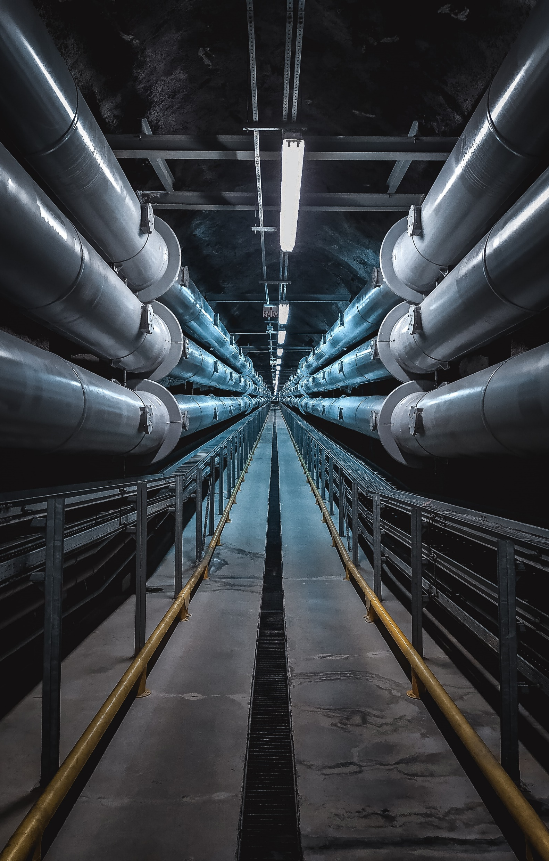
PRELIMINARY AUDIT
Walkthrough to identify facilities and systems to study
Project team determines desired project outcomes
Client establishes cost-effectiveness criteria
ESCO provides preliminary audit results
Project team review list of energy efficiency measures proposed

Slide 8
INVESTMENT GRADE AUDIT & ESP
ESCO and DES sign investment grade audit agreement, Client signs funding authorization.
ESCO conducts detailed site investigation, energy analysis, and cost estimation of proposed scope.
Client may identify preferred subs and equipment.
IGA report delivered identifying energy savings and costing for each measure investigated.
Energy Services Proposal (ESP) outlines scope, guaranteed savings, detailed budget, guaranteed costs, schedule etc. for measures agreed to.
Client and DES review energy services proposal. ESP is basis for construction contract set.

Slide 9

DESIGN AND CONSTRUCTION
ESCO and DES sign construction contract set
Client signs funding authorization and IAA amendment
DES issues notice to proceed to ESCO
Client and DES review design documents
Project documents prepared by ESCO
Sub-contractors and equipment selected
DES PMs provide project management services

Slide 10



MEASUREMENT AND VERIFICATION
First year measurement and verification (M&V) is part of every project. ESCO to provide report.
Longer term of M&V is recommended for systems which require frequent adjustments, such as controls systems.

Slide 11
Benefits and Challenges
Benefits
Single point of accountability
Collaborative process
Guarantees around cost, savings, and performance
Ability to choose contractors and equipment manufacturers
CBPS compliance assistance
Challenges
Not a good fit for extensive remodels
Project schedule slide potential
Proper risk mitigation

Slide 12
Considerations
Project initiation is not through PWR, but direct request to program
DES Energy PM will not recommend an ESCO, selection is sole responsibility of college
Construction Cost set prior to design completion
Measurement and Verification invoicing may fall outside funding cycle for project

Slide 13
Thank you
kirsten.wilson@des.wa.gov
energyteam@des.wa.gov
509.370.0216
des.wa.gov/services/energy-efficiency

