Slide 1



Only
A FeW
more rules
Scott Morgan
Sustainability & Energy Conservation Manager
OFC – FEB 2026
Notes:
We have multiple environmentally motivated rules and standards to navigate. There are some long-term benefits from these requirements, but they’ll all feel like extra work up front.
This is high level, feel free to ask questions on anything specific to your campus.

Slide 2
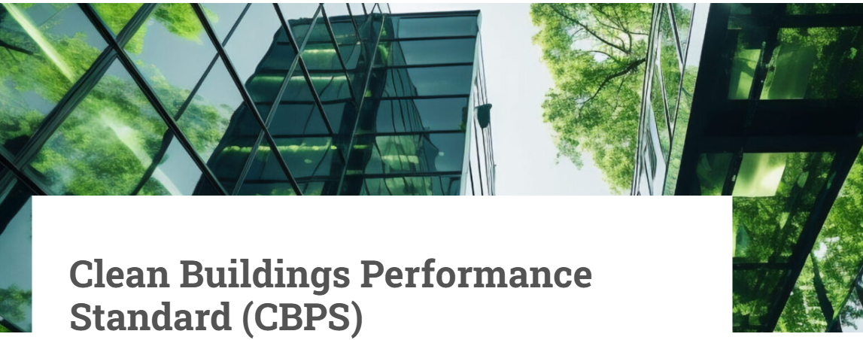
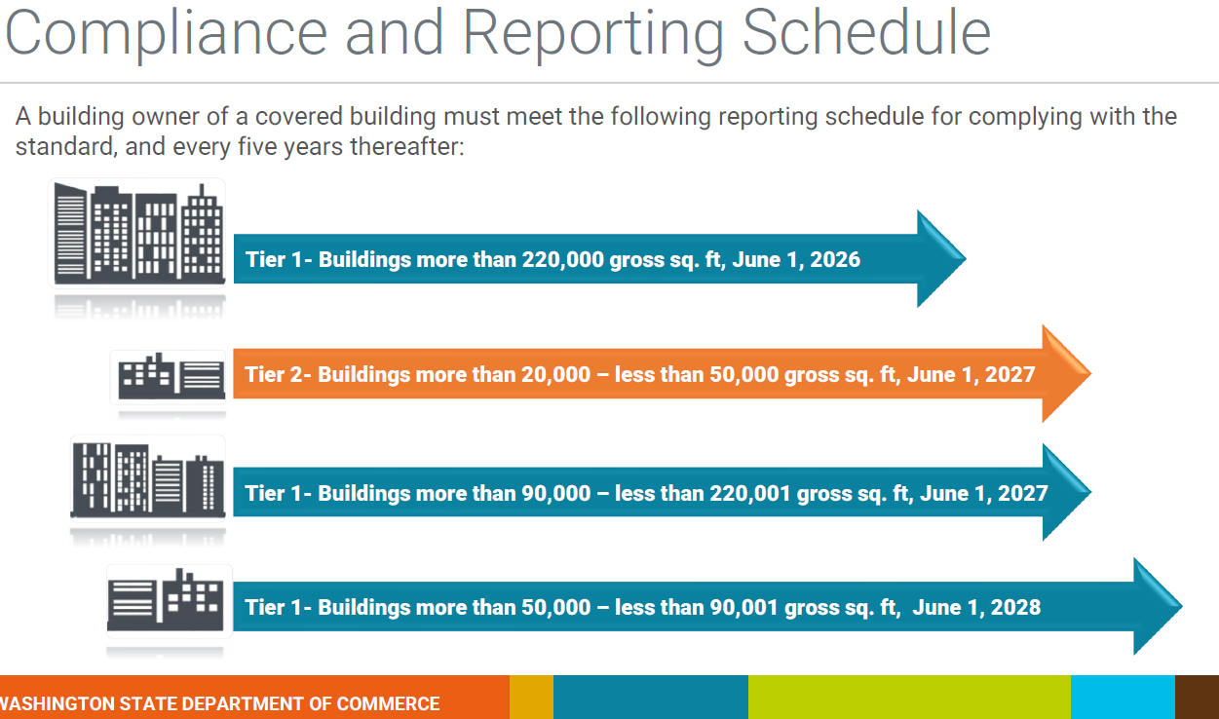
Clean BuildingS deadlines are here.
Commerce is a bit behind…
Notes:
The Clean Buildings Performance Standard requires proactive building operations and maintenance. This is a big plus in an industry that owns their buildings for life, but it hasn’t quite been the reality on most campuses for a decade or so.
It isn’t necessarily easy to manage all the documentation and reporting requirements, but most of you are or have been already doing your best to move out of the reactive maintenance space. You might be able to leverage your compliance requirements to
Commerce is behind schedule on several CBPS actions:
CR102 – final public comment should be released before the end of March
They hope to have the final integrated rules available by July
No direct feedback on decarbonization, yet
They also haven’t completed the summary report that was due in December
First deadline for buildings larger than 220,000 gsf is this July
Also, the state energy benchmarking report is due this year, your ESPM energy data should be current for the past two years.
Finally, the current BEACON cohort ends in March. That program is supported by a Federal grant and Commerce has announced that they may need to pause the program until the grant funding is assured. In the meantime, 8 fellows have been working on CTC campuses since last July.

Slide 3
Compliance status
 | Compliance Year
 | 2025 | Early Comp. | 2026 | 2027 | 2028
Cascadia | Decarb | Tier 1
Columbia Basin |  | Campus
Highline | Decarb | Campus
Lake WA |  | Campus
Walla Walla |  | Campus
Clover Park |  | Tier 1 |  | Tier 2
Renton |  | Tier 1 |  | Tier 2
Spokane CC |  | In process | Tier 1A | Tier 1B, 2 | Tier 1C
Pierce Ft Steilacoom |  | In process | Tier 1A | Tier 2 | Tier 1C
Pierce Puyallup |  | In process |  | Tier 2 | Tier 1C
Spokane Falls |  | In process |  | Tier 2 | Tier 1C
SPSCC |  | In process |  | Tier 2 | Tier 1C
Bates |  |  | Tier 1A | Tier 2 | Tier 1C
Seattle Central | Decarb |  | Tier 1A | Tier 1B, 2 | Tier 1C
Bellevue |  |  |  | Tier 1B, 2 | Tier 1C
Big Bend |  |  |  | Tier 1B, 2 | Tier 1C
Clark | Decarb |  |  | Tier 1B, 2 | Tier 1C
Edmonds | Decarb |  |  | Tier 1B, 2 | Tier 1C
N Seattle | Decarb |  |  | Tier 1B, 2 | Tier 1C
S Seattle |  |  |  | Tier 1B, 2 | Tier 1C
Yakima Valley |  |  |  | Tier 1B, 2 | Tier 1C
Bellingham Tech |  |  |  | Tier 2 | Tier 1C
Centralia |  |  |  | Tier 2 | Tier 1C
Everett |  |  |  | Tier 2 | Tier 1C
Grays Harbor |  |  |  | Tier 2 | Tier 1C
Green River |  |  |  | Tier 2 | Tier 1C
Lower Columbia |  |  |  | Tier 2 | Tier 1C
Olympic |  |  |  | Tier 2 | Tier 1C
Peninsula |  |  |  | Tier 2 | Tier 1C
Shoreline |  |  |  | Tier 2 | Tier 1C
Skagit Valley | Decarb |  |  | Tier 2 | Tier 1C
Tacoma | Decarb |  |  | Tier 2 | Tier 1C
Wenatchee Valley |  |  |  | Tier 2 | Tier 1C
Whatcom |  |  |  | Tier 2 | Tier 1C
5 colleges done until round 2 in 2030-33
8 decarbonization plans completed
2 colleges done with Tier 1 compliance
5 on schedule to file this month
2 with July 2026 deadline
20 with 2027-28 deadlines
Notes:
This chart is based upon self-reported status updates. Let me know if I’m missing anyone.
Everyone will need to file within the next year! Either individually for all buildings between 20 – 50K, and 90 – 220K gsf, or at the campus level for all your affected buildings.
Most, though not all, colleges have been in communication as they develop their required data and programs.
Three colleges have confirmed that they are applying for Tier 2 early adopter incentives. Most of you can qualify; think about going after those, if you haven’t already.

Slide 4
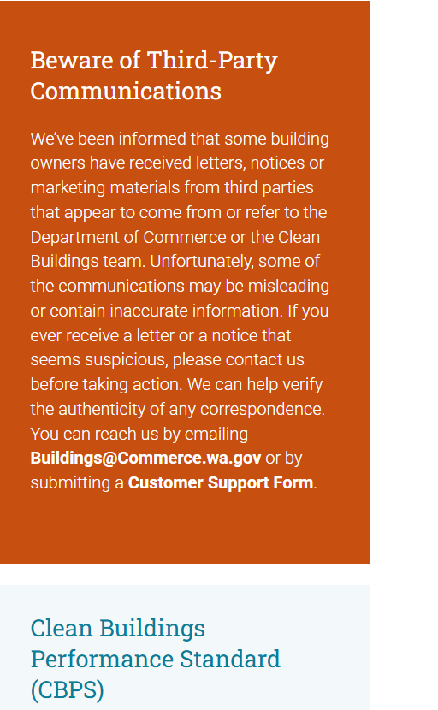
Watch out for scams!
Buildings@commerce.wa.gov
Notes:
We’ve received a couple letters saying that buildings are out of compliance and fines will be assessed.
The letters were not from Commerce, deadlines were wrong, and the sender was a third party. Please check directly with Commerce if you receive any warning letters or emails.

Slide 5
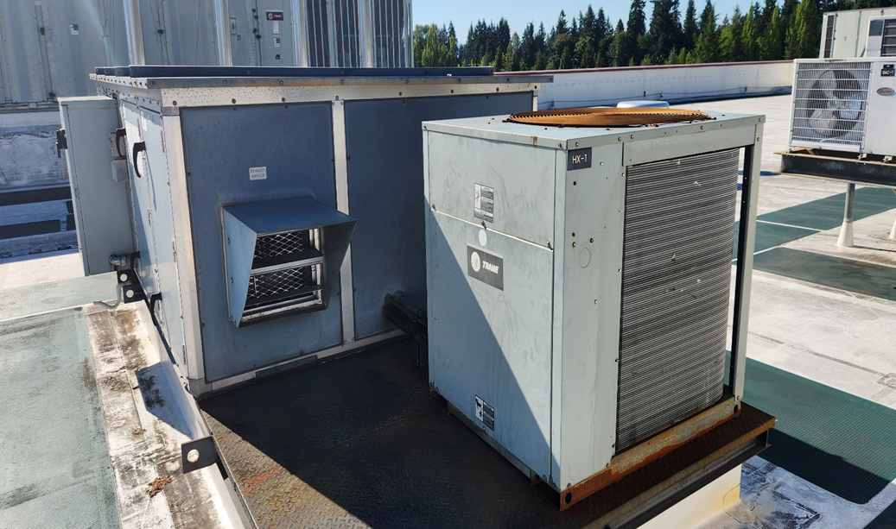
The Refrigerant management program deadline is now.
If you have a single “refrigerant containing unit” with more than 200 but less than 1,500 pounds of charge, you are required to register with Ecology within the next two weeks.
Data records need to be current as of JAN 2026
Data collection guidance and a spreadsheet tool are available.
Notes:
Refrigerant Management is a greenhouse gas mitigation effort.
The RMP sets requirements on maintenance and repair of air conditioning and refrigeration equipment, as well as the purchase of replacement refrigerants and new equipment.
YOU SHOULD BE AWARE that many of your common refrigerants are now banned in new equipment. You may have a vendor who’s able to sell you equipment that was manufactured before the date of restriction, but you will carry the risk of finding replacement refrigerant years after it’s been banned for sale in the state for any such systems.
We’re exploring suggestions for DirectLine, but nothing new has been built yet. Most of what you need to track can be recorded in existing DirectLine data fields.
Most of you should have registered with Ecology by now. If your largest system is smaller than 200 lbs but greater than 50, you have another year.
I’ll note that Ecology is recommending at least two people with administrative user privileges so that you aren’t dependent upon one reporter. I’ve also learned that refrigerant purchased for on-site stock must be included in your annual reports, even if it’s sitting on the shelf.
Finally, just queuing up future planning, many of today’s commonly used refrigerants are scheduled for a phased down restriction on new/virgin materials in 2030 – 33. You can expect more attention to reclaiming used refrigerants and more of what’s available on the market will be reclaimed or recycled.

Slide 6
RMP data management is a bit complex.
Registration of all affected buildings and systems
On-site records/documentation of all pertinent systems, maintenance, repairs, refrigerant purchases, and equipment replacements.
Documented regular leak detection (quarterly for mid-sized systems),
14-day response window for leaks and related repairs.
Immediate leak notifications to ECY.
Annual reports of all relevant PMs, maintenance, repairs, replacements, and purchases of stock refrigerant.
Notes:
There are three levels to this data management:
Building out a complete internal inventory of every qualifying system (and definitive documentation for those that don’t).
Registering with Ecology and filing that data in RAMP.
Building an internal data & document management system/process/workflow.
I recommend taking one step at a time, unless you’re able to spread the work across a multi-talented team.
Thanks to Spokane Colleges and Cascade/UW Bothell for breaking ground on data management. I’m sure there’s been a lot of other work that I just haven’t heard about.
Is anyone interested in forming up a user group to share practices and insights as you get everything going this year? I could schedule regular calls for the next few months to help folks share ideas and talk through common solutions.

Slide 7

Mercury-containing light bulbs are phasing out (Hb 1185, 2024).
Compact and linear fluorescent bulbs will not be available for sale after JAN 2029.
Disposal of such bulbs is regulated as a dangerous waste, but they may usually be treated as universal waste.
Pay attention to:
  Shops & outbuildings still using legacy 70’s – 80’s lighting fixtures.
  Your stockpile of linear and compact fluorescent bulbs.
Notes:
The mercury in fluorescent bulbs is an environmental toxin and potential local hazard if bulbs are broken.
HB 1185 extended and tightened existing restrictions on the use of fluorescent light bulbs (which date back to 2004). General space lighting is affected. Some special purpose bulbs, mostly health and science equipment related, will not be affected.
Start phasing these out, if you haven’t already.
Tap into utility incentives and ESCO projects to convert to LEDs.
Change out those old fixtures in your mechanical rooms, grounds and fleet shops that have been ignored.
Search out the boxes of replacement bulbs stuck in the back corners of your custodial supply closets or stacked in front of that electrical panel that hasn’t been opened in the past few years.

Slide 8
WA building energy code
2021 Code became effective last year,
2024 Code is scheduled for adoption this year, effective November 1.
2021 restricts replacement of existing natural gas equipment; not onerous, but it could seriously impact an emergency replacement.
2021 also requires solar PV on new buildings and major renovations greater than 10,000 gsf.
  2024 Code drops that requirement to projects 5,000 gsf or larger.
Notes:
WA’s first mandatory building energy code went into effect in 1986. Roughly half of the buildings currently owned by the CTC system were built before building energy codes existed.
Some of you are very familiar with the challenges involved in heating or cooling those buildings. Today’s energy code is pushing hard on both energy efficient construction and greenhouse gas mitigations.
Replacing heating equipment, particularly natural gas fired boilers, may trigger requirements to select smaller or more efficient systems. C503.4.6, exception 7
New construction greater than 10,000 gsf is required to include renewable energy system(s), with just a few exceptions.
Other energy efficient and renewable energy standards are defined for new construction, most of which will be addressed during design.
2024 Code drops the RE requirement to buildings 5,000 gsf and larger, with a few limited exceptions (heavy shading or rooftop mechanicals). Also triggers thermal insulation requirements for renovation/repair work that opens up roofs, walls, or floors.

Slide 9
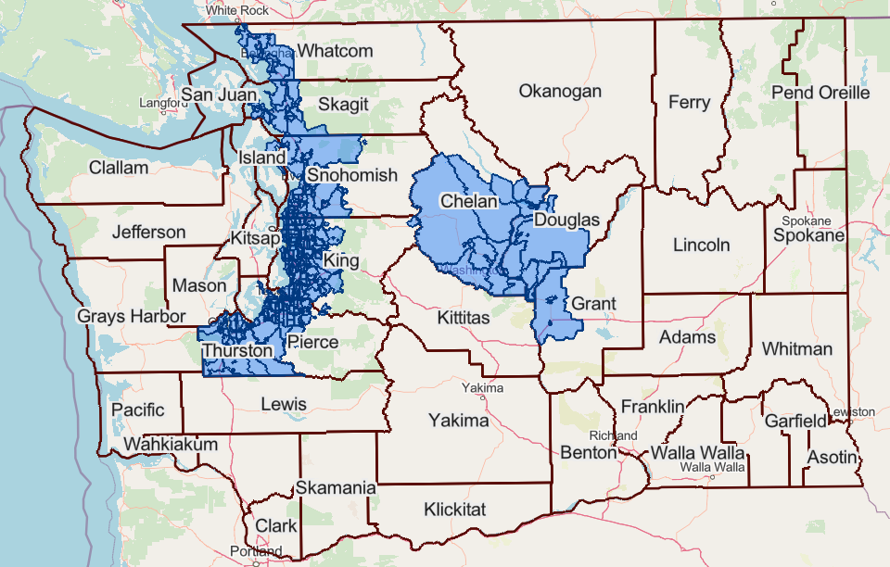
Business organics management
If your local waste management authority has an organics waste collection and diversion program, you are required to participate if you produce > 96 gallons of organic waste/week.
Ecology updates this requirement annually.
Notes:
Organic waste is the primary source of landfill methane and has value in other local uses. So, there’s an active emphasis upon diverting organics from the landfills.
In most places, this is just food and yard waste. Don’t get caught up in all the potentially compostable organic materials in your waste stream. Your local waste hauler will have a list of what is and is not acceptable.
Best practice is to set up your collection in food prep kitchens, not post-consumer, to meet those requirements. Beware of contamination! You might face additional fees every time the organic waste must be sent to the landfill. Plastic bags are a very common contaminant, because no minimum wage kitchen aide wants to dump heavy bags of food waste by hand.
AFFECTS: Wenatchee Valley, SPSCC, the Pierce Colleges, Tacoma, Bates, Clover Park, Highline, Green River, Renton, Lake WA, Bellevue, Cascadia, the Seattle Colleges, Shoreline, Edmonds, Everett, Skagit Valley, Bellingham Tech, and Whatcom.
NOT: Peninsula, Grays Harbor, Olympic, Centralia, Lower Columbia, Clark, Yakima, Columbia Basin, Walla Walla, Big Bend, and the Spokane Colleges.

Slide 10
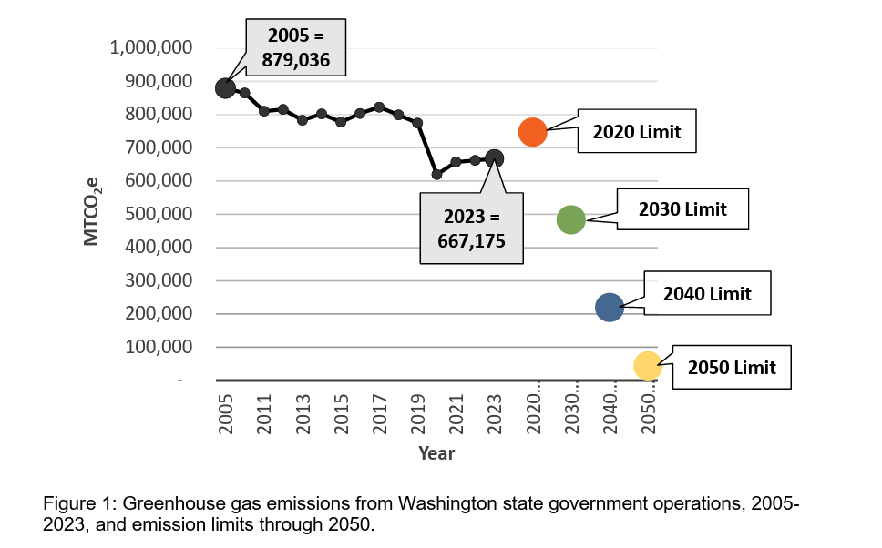
Greenhouse gas emissions
Per RCW 70A.45.050. state agency emissions limits are:
15% below 2005 levels by 2020
45% below 2005 levels by 2030
70% below 2005 levels by 2040
95% below 2005 levels by 2050; achieve net zero
Notes:
These targets are specifically aimed at emissions from onsite combustion of fossil fuels – natural gas, heating oil, propane, gasoline, and diesel – and emissions associated with purchased electricity (statewide average emissions factor).
Only the Seattle and Spokane districts are required to report their GHG emissions to Ecology each year. Everyone else is a small emitter.
I have the 2005 baseline levels for everyone except Clark, Green River, and Yakima, for whom Ecology didn’t have any records.
While most of you don’t currently need to file an emissions report, it would be a good exercise to see where you stand today. This is a good student internship project or class exercise, if you have an interested faculty member. I can provide support if anyone wants to give it a try. Data collection takes longer than the calculations.
We have also developed a strategic decarbonization framework to incorporate decarbonization planning into your normal minor works and capital planning. This aligns with John’s work to remove the like-for-like expectation in minor works projects and our budgetary realities. I intend to share that out soon but wanted to mention it now as you start thinking about your minor works request for the next budget cycle.

Slide 11
What about grants & incentives?
Commerce Grants
  Multiple grants and plenty of hoops to jump through.
ECY VW Settlement
  Mostly medium & heavy-duty vehicles right now.
Utility incentives
  Lighting, energy efficiency, recommissioning, strategic energy management…
Federal Direct Pay
  Limited availability, but some solar projects might still qualify.
Notes:
My personal recommendation is to leverage everything possible available through your utility.
I share out grant announcements when I see them, but the state programs are once a year and their criteria change just about every year. The Federal incentives are mostly expiring, and there are other complications with those. If you can qualify and apply, do it. Use them before they’re gone.

Slide 12
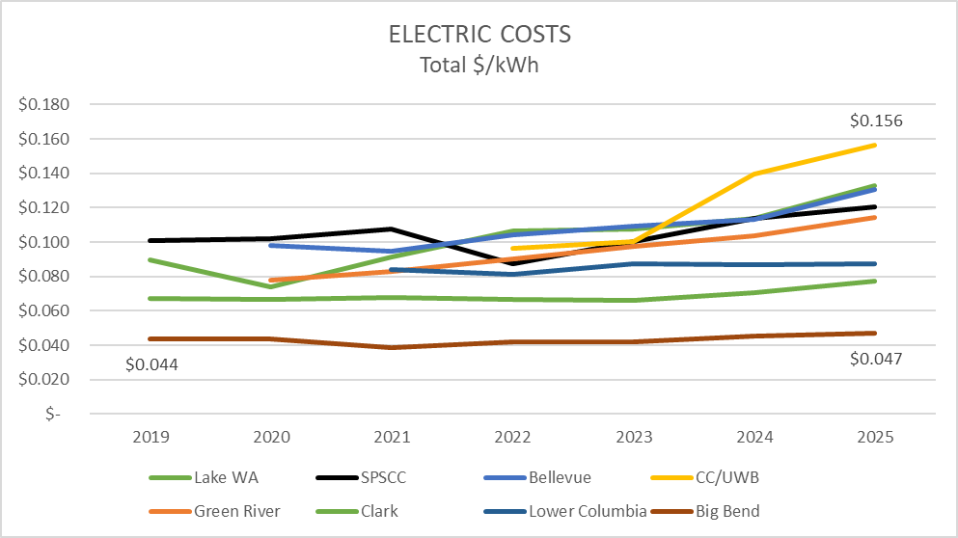
SomE Electric rates are increasing.
Notes:
I’ve received a few responses to the energy utility cost and consumption survey and wanted to take a moment to share some insights.
You can see that electric rates are increasing, but mostly just for PSE customers. The three PUD examples I have so far are showing lower costs and less of a steady increase.

Slide 13
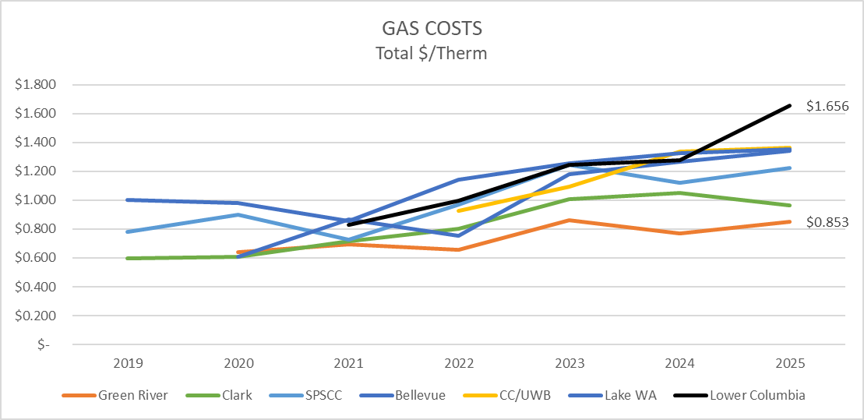
So is the cost of gas.
Notes:
Gas costs have always been more volatile though they would generally return to a stable level for the last decade or so. They are now climbing all over.

Slide 14
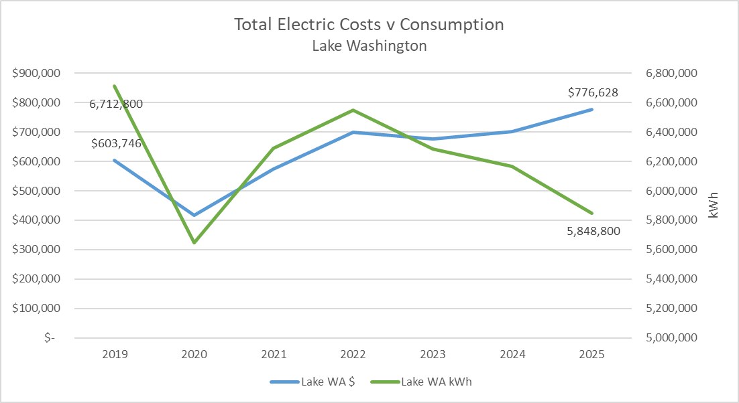
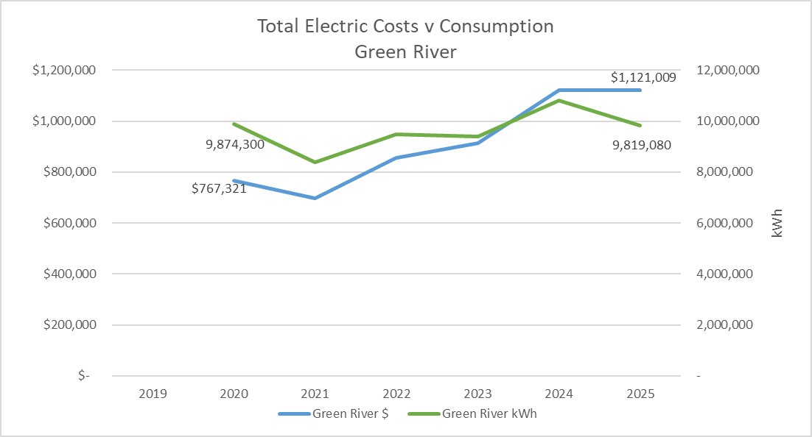
You need active energy management…
2022 peak consumption would have cost $870,000 in ‘25, nearly another $100,000.
2024 peak consumption would have cost $1,233,000 in ‘25, a bit over another $100,000.
Notes:
Not everyone is able to make this point yet, but this is the story you want to be able to tell. You are managing, if not actively reducing, your energy consumption, and yet the total costs continue to rise.
This is an argument for aggressive energy efficiency and management projects. At the same time, we’re taking these messages to the Legislature (as is K12). There doesn’t seem to have been much appetite for the discussion this session, but we’re already getting ready for next year.

Slide 15
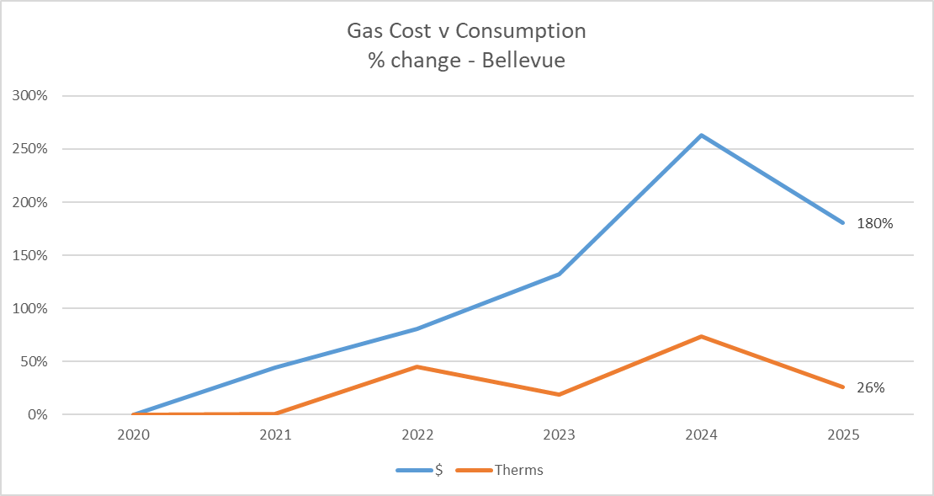
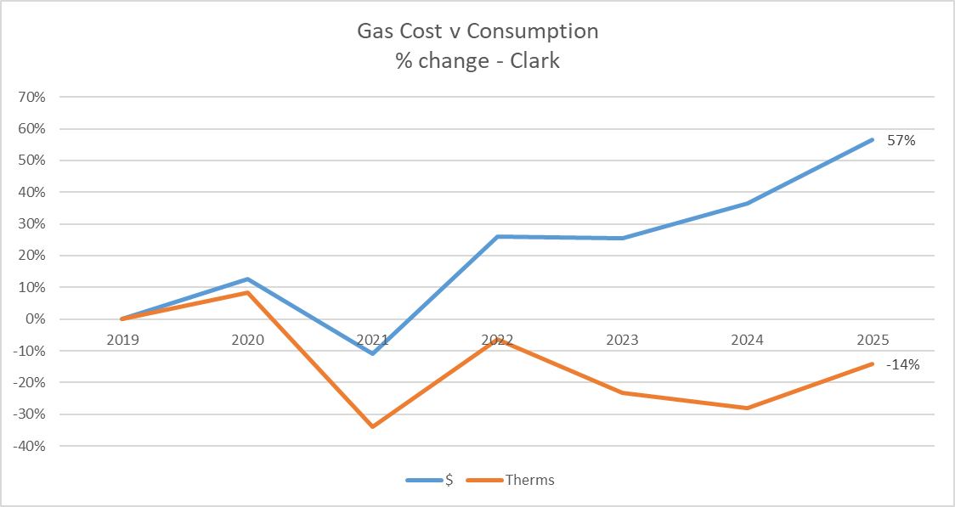
Gas costs are even scarier…
Percent change in total costs and consumption from baseline (first year of data). Consumption is being controlled, costs are out of your control.
Notes:
It was easier to tell this story by showing the percent change in total costs and consumption since a baseline year (the first year of available data). You can see that both colleges are managing, even reducing, their total consumption compared to that baseline, yet their total costs continue to increase.

Slide 16
A few other details
We’re developing support and guidance, please reach out if you have suggestions for content or other questions.
Join the DirectLine User Group (CMMS) to participate in change decisions and updates.
Notes:
If you have a RCx project, that is CCA funding and we are required to report specific details to Ecology. I will be sending out a summary and guide for those projects soon, I hope.

Slide 17
As usual, reach out for support.
SBCTC Capital Budget Sustainability
semorgan@sbctc.edu

