Slide 1
Operations and Facilities Council – February 2026
Capital Budget - DirectLine
Capital Budget Analyst
February 26, 2026

Slide 2
Z-List - friend or foe
Where does the Z-List originate
Data Exported from DirectLine Room Entries (~15th monthly)
“Rules” applied by our Data Services partners to check for anomalies in coding
Why is the Z-List important to you?
Space Use data is used for reporting and can impact funding
How to obtain the Z-List…

Slide 3
QARS
Quality Assurance Reporting System (QARS)
Quality Assurance Reporting System (QARS)
QARS Access Request Form (Fillable)
QARS QRG
QARS Report Guide
QARS Z-List QRG

Slide 4
Tools
QARS
Source of quality assurance data elements, Z-List.
25Live Administrator
Partner with your 25Live administrator to true up instructional spaces as updates are made for usage changes.
Building Plans, Renovations and other sources of changes
Work orders, and other local procedures for when spaces are changed.
The “Rules”
FAE Manual & Space Coding Matrix

Slide 5
Directline – z-List corrections
You have the Z-List, now what?
Path A:
Review the list, identify the details of the corrections to be made to resolve.
Complete the space coding in DirectLine Rooms.
Path B:
Review the list, identify details of the correction to resolve.
Complete the template and send to DirectLine for upload.
Note: Either path has merit, user preference. Changes will be available after the next import is processed, not dynamic or immediate.

Slide 6
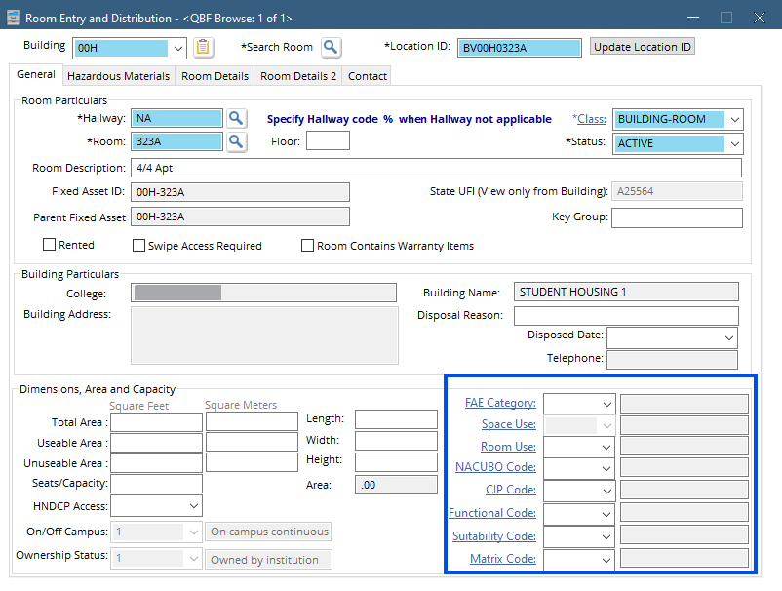
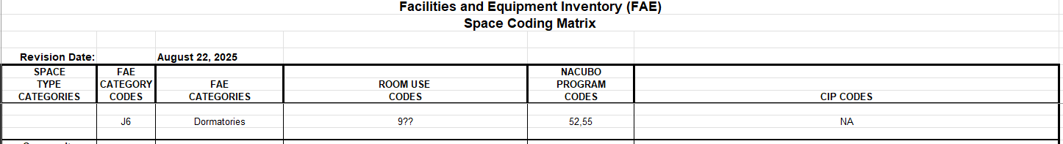
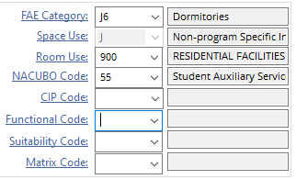
Example – student housing
Questions:
How did this end up on the Z-List?
What should the coding be to resolve?
Solutions:
Missing all coding elements.
Use the FAE Coding Manual and Space Coding Matrix to guide the required fields:
FAE = J6
Room Use = 900
NACUBO = 55

Slide 7
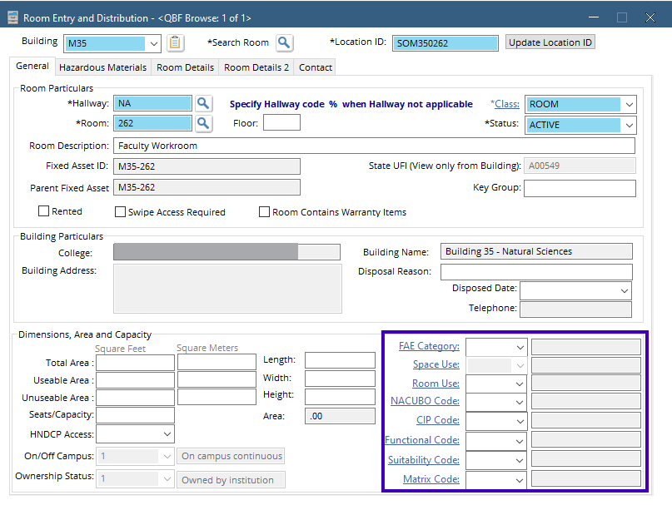
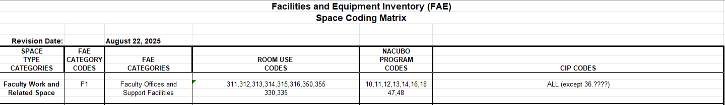
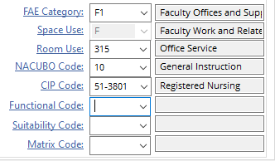
Example – faculty workroom
Questions:
How did this end up on the Z-List?
What should the coding be to resolve?
Solutions:
Missing all coding elements.
Use the FAE Coding Manual and Space Coding Matrix to guide the required fields:
FAE = F1
Room Use = 315
NACUBO = 10
CIP = 51-3801

Slide 8
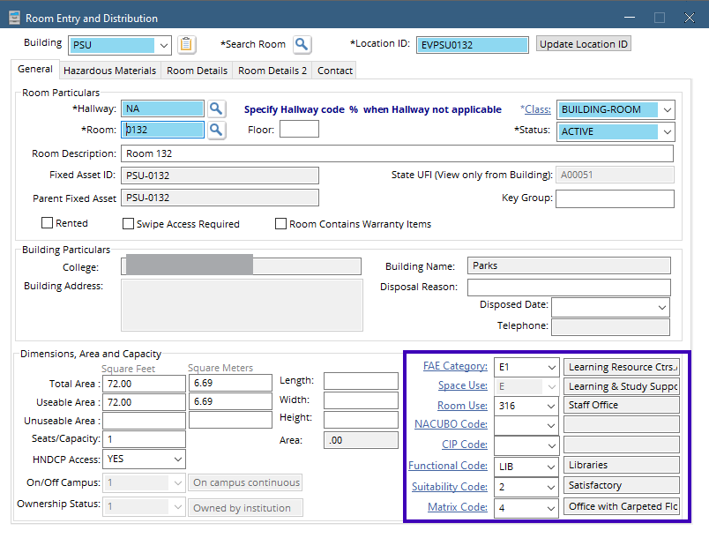
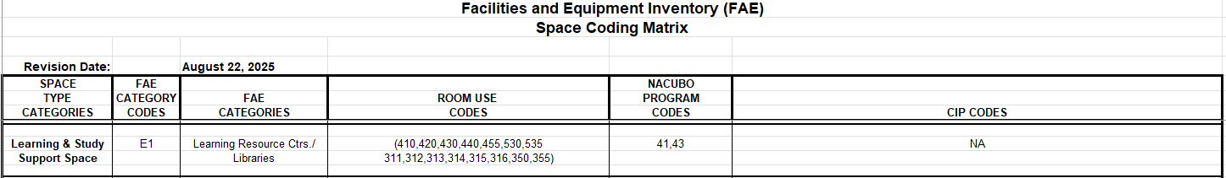
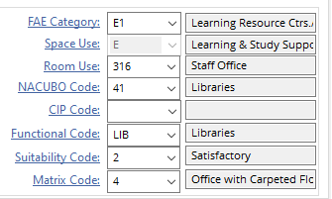
Example – staff office
Questions:
How did this end up on the Z-List?
What should the coding be to resolve?
Solutions:
NACUBO missing.
Use the FAE Coding Manual and Space Coding Matrix to guide the required fields:
FAE = E1
Room Use = 316
NACUBO = 41

Slide 9
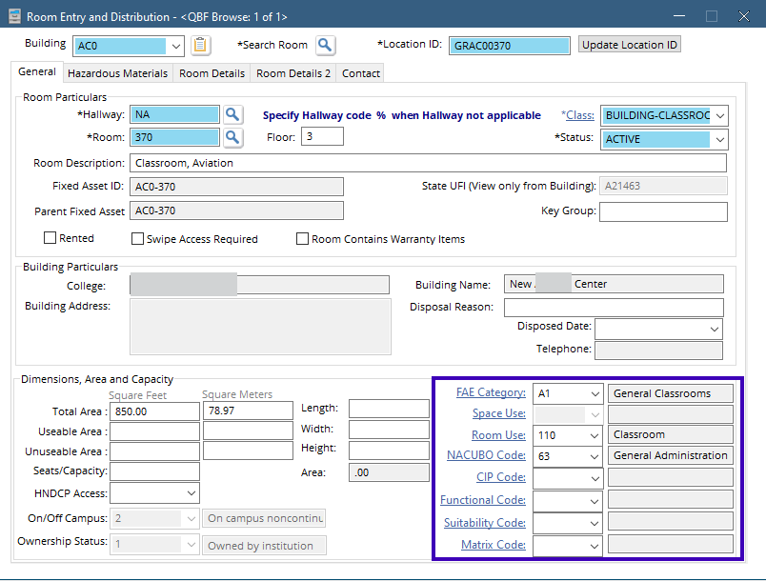
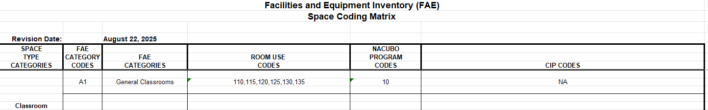
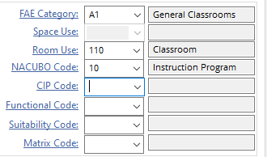
Example – classroom
Questions:
How did this end up on the Z-List?
What should the coding be to resolve?
Solutions:
NACUBO anomaly.
Use the FAE Coding Manual and Space Coding Matrix to guide the required fields:
FAE = A1
Room Use = 110
NACUBO = 10

Slide 10
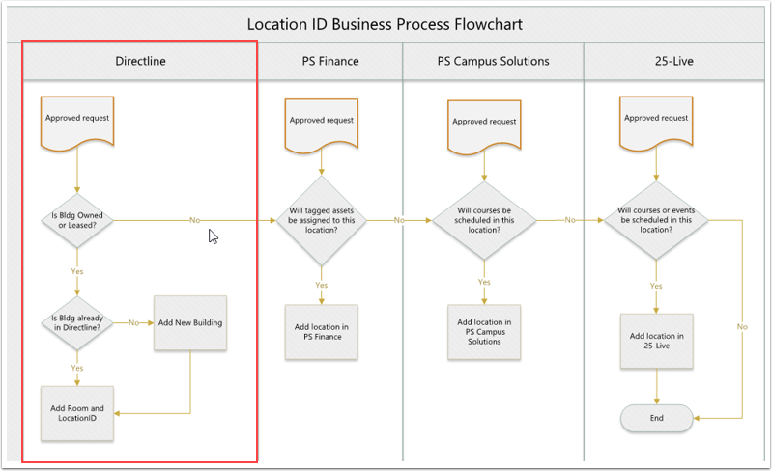
New Building

Slide 11
Add/Update Building in Directline
New Space Entry (Building)
What to collect before beginning
Building-Property details, examples:
Building/Site details (3-character value)
State UFI# (FPMT assigned)
Status (Active, Inactive, Demo, and TOS)
Parcel # (Land (property) record)
Address (Physical or campus address)
Note: Your partners in Finance (Business Office) will have user permissions that allow them to enter details on the Finance tab.

Slide 12
Add/update cont.
New Space Entry (Building)
What to collect before beginning
College definitions (some fields will offer a pick list that guides user to correct selections)
Building/Site Name (known as)
Facility ID (2-character code for college)
Detail as much as possible, though save is allowed where required fields incomplete.

Slide 13
Add/update building cont.
Edit Space Entry (Building)
What to collect before beginning
Details of what has changed, examples:
Status
Building Name
Renovation – which often will include date, occupancy, area, and building condition.
Note: Your partners in Finance (Business Office) will have user permissions that allow them to enter details on the Finance tab.

Slide 14
Add/update building resources
Resources:
DirectLine new building/room template – alternative to completing within the system. Populate and send to Megamation for import.
Add/Edit Building in DirectLine – Quick Reference Guide (QRG) provides comprehensive instructions.
Facilities Portfolio Management Tool (FPMT) – Resources such as wizards and job aids for adding and updating buildings.
Facility and Equipment Inventory (FAE) Coding Manual – definitions and overarching guidance.
Space Coding Matrix Guide – resource for assigning spaces to align with usage.

Slide 15
Add/update rooms in directline
New Space Entry (Room)
What to collect before beginning
Building-Room details
Dimensions, Area, Capacity
College definitions
Room numbering, Room Description, Room Use, etc.
Tips:
Entries in the system allow for built in parameters to help the user complete applying correct “rules” such as [Fill in Location ID]

Slide 16
Add/update rooms cont.
Edit Existing Space Entry (Room)
What to collect before beginning
Building-Room details
Dimensions, Area, Capacity
College definitions
Room numbering, Room Description, Room Use, etc.
Tips:
Maps and walking through the building and spaces will help to inform and guide the updates.

Slide 17
Add/update room resources
Resources:
DirectLine new building/room template – alternative to completing within the system. Populate and send to Megamation for import.
Add/Edit Rooms in DirectLine – Quick Reference Guide (QRG) provides comprehensive instructions.
Facility and Equipment Inventory (FAE) Coding Manual – definitions and overarching guidance.
Space Coding Matrix Guide – resource for assigning spaces to align with usage.
Note: Partner with 25Live administrator to ensure unity between data sets.

Slide 18
Capital Budget Staff Contacts
Contact | Email/Phone
Darrell Jennings Capital Budget Director | djennings@sbctc.edu 360.704.4382 360.561.1385
John Lyons Principal Architect | jlyons@sbctc.edu 360.704.4395 503.267.6562.
Scott Morgan Sustainability & Energy Conservation Manager | semorgan@sbctc.edu 360.704.1073 360.951.0305
Kirk Knittle Functional Analyst | kknittle@sbctc.edu 360.704.1034
Susan Locke Capital Budget Analyst | slocke@sbctc.edu 360.704.4386

