Slide 1
Energy conservation
Scott Morgan – SBCTC
Phil Roice – DES Energy Services
OFC – MAY 2026

Slide 2
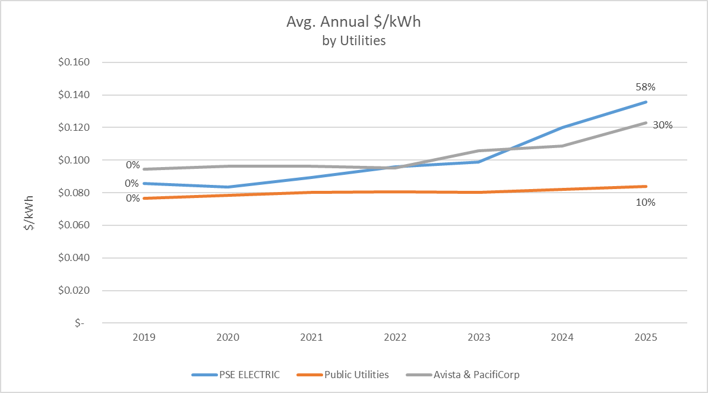
Private utility Electric rates are increasing.
Notes:
These are high level average costs, based upon information from 30 colleges.
Electrical rate increases are mostly a concern for those on private utilities, although a few of the PUD rates have also started to climb.

Slide 3
We’re seeing a wide range of impacts.
<10%: Big Bend, Centralia, Lower Columbia, N Seattle, Peninsula, Pierce Ft Steilacoom, Grays Harbor
10 – 20%: Clark, Columbia Basin, Edmonds, South Seattle, SPSCC
20 – 30%: Bates, Everett, Seattle Central, Spokane Falls, Tacoma, Wenatchee, Yakima
30 – 50%: Green River, Highline, Lake WA, Spokane, Walla Walla, Whatcom
50 – 80%: Cascadia, Skagit Valley
Over 100%: Bellevue, Pierce Puyallup
Notes:
These are based on average, annual total cost per kWh from 2019 through 2025. That’s important, as I’ll point out in a moment.
Some of you have seen some notable jumps, and some of you are still feeling that 30% is not a trivial increase. But not everyone is feeling the same level of pain.

Slide 4
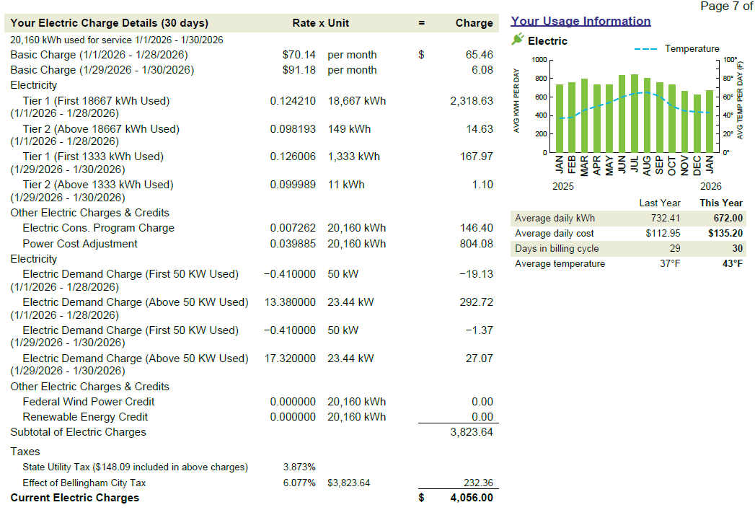
This changed in January at PSE.
+ 3 cents per kWh
+ %485 (line item)
+ ~ %20 total cost
Notes:
I’ll note that PSE bumped up their Power Cost Adjustment (Sched 95) in January by 3 cents (485%). That adjustment factor is a per kWh charge. These costs are not included in the analysis I just reviewed, so this year’s costs are going to be even higher at PSE.
Thanks to Mark Young (formerly at SPSCC) for uncovering this.
Rate structures are defined by your service connection (high or low voltage) and your consumption levels. Those structures define the various costs of usage.
Most of those costs are all related to your total consumption. But PSE and Avista also charge for peak draws, the highest kW in a 15 min interval each month. Demand charges are only a major issue for some of you, primarily those campuses on a high voltage service (PSE Commercial 31).

Slide 5
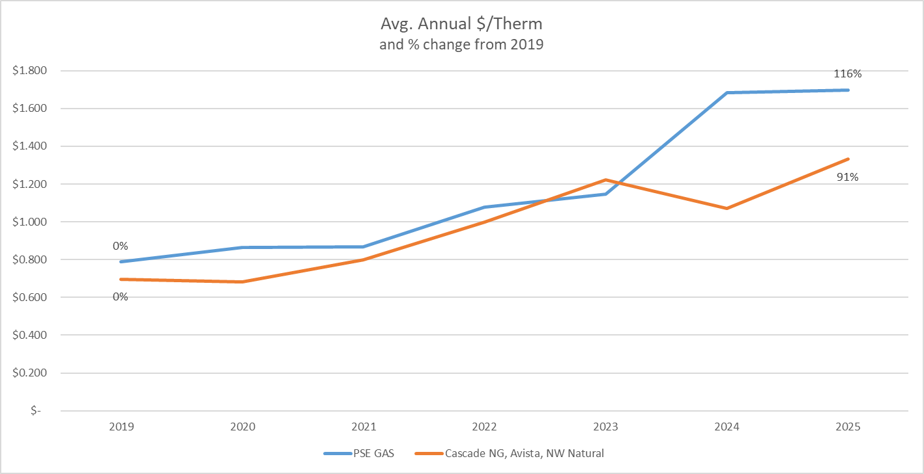
Natural Gas costs are also climbing.
Notes:
Gas costs have always been more volatile though they would generally return to a stable level for the last decade or so. They are now climbing all over.

Slide 6
Multiple factors are impacting energy costs.
Clean Energy Transformation Act (CETA) – hitting private electrical more than public utilities.
Climate Commitment Act Cap & Invest fees are also hitting the private utilities more, both electric and natural gas.
Changes in seasonal precipitation are starting to affect hydropower generation, mostly public electric utilities.
Increasing user demands – data centers, manufacturing, and decarbonization – are overwhelming regional electrical generation/supply for all utilities.
Notes:
Don’t assume that either utility market will stabilize. Most of these stressors will continue and there are other uncertainties that could add more. The current administration has talked about privatizing Bonneville, which could have a large impact on PUD rates. The regional electrical grid simply isn’t large enough to meet emerging demand, and building out the grid is a very slow process. If winter snowpack continues to be low, regional hydropower production will suffer.
Electric costs include many line-item details, not just the cost per kWh. From your perspective, it’s important to pay attention to both your total use and any other line-item costs directly associated with that use.

Slide 7
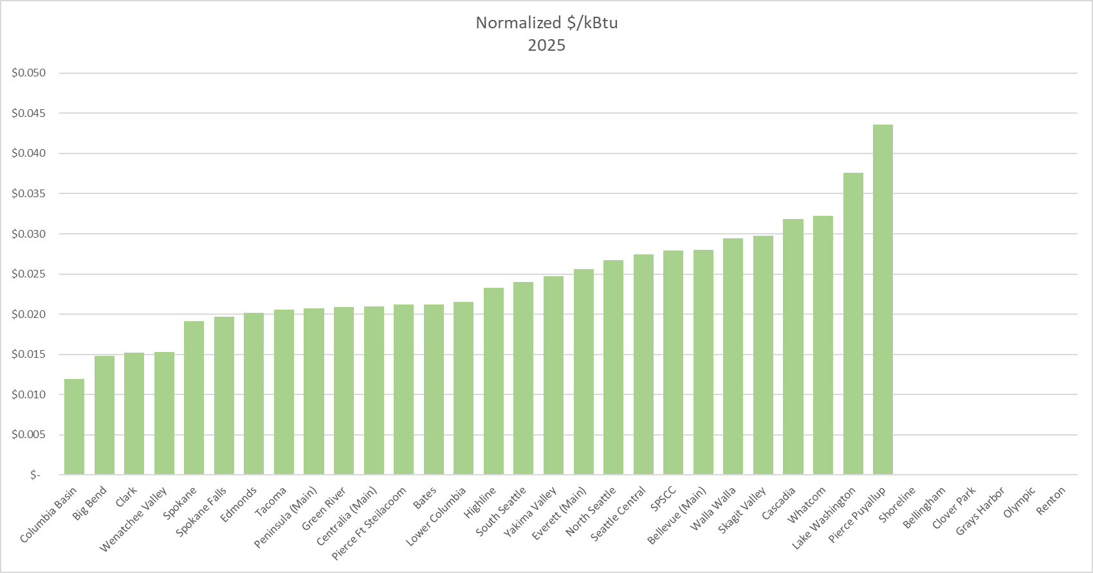
This is your cost for building energy.
Notes:
This shows the normalized cost per unit (kBtu) of the energy you’re using – electric, natural gas, propane, and steam. You can see that many colleges are paying similar costs per kBtu even though you’re on very different utility supplies, but we still have quite a wide range across the system.
To repeat, this is the cost of your energy supply.

Slide 8
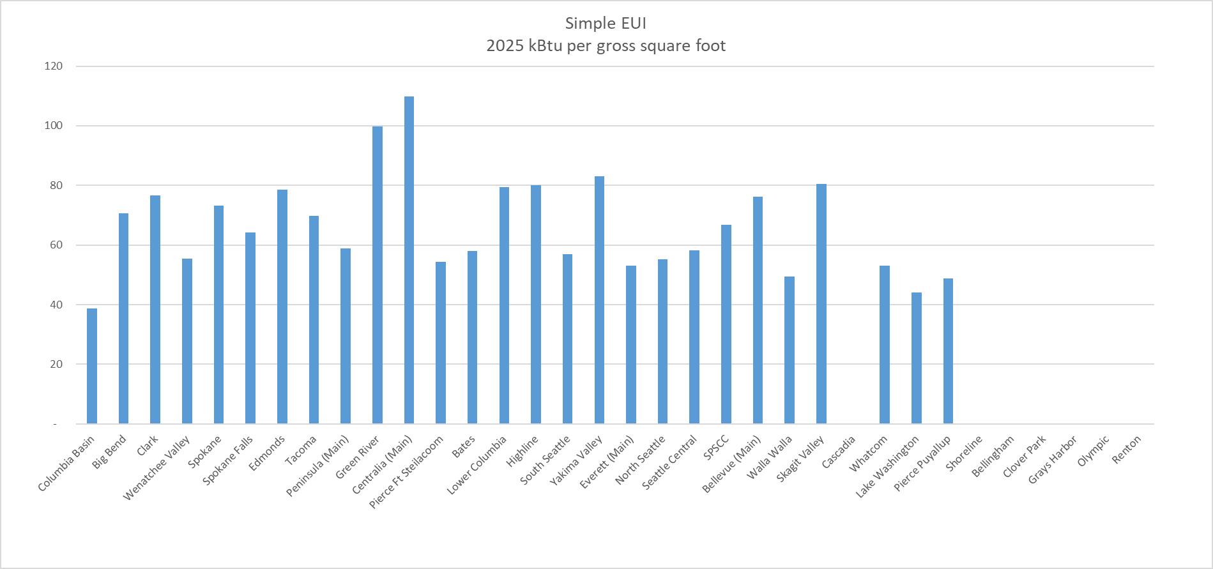
This shows how much you’re using (EUI).
Notes:
This is how much energy you used, kBtu’s per square foot, in 2025.
I did my best to sort out parking garages and satellite buildings (and quaint student cottages in Yakima) that weren’t included in the utility data I received.
I’ve maintained the same order as in the previous slide, from low to high $ per kBtu. I want to point out those three low EUI’s on the right, doing what they can to mitigate high costs per kBtu.

Slide 9
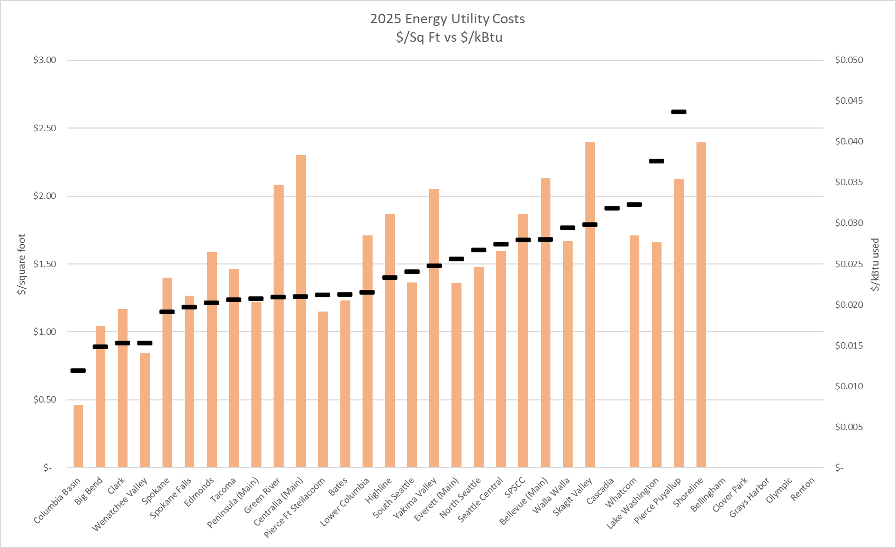
This is the cost of how much you’re using.
Notes:
And this is your real energy cost in $ per square foot. Same order as the other slides.
The black bars are $/kBtu and the orange columns are simply your total energy utility costs divided by your gross square footage.
You can only truly compare yourself to those colleges with similar costs per kBtu. Some of you appear to have a lot of opportunity for energy conservation savings.
I’ll also point out Columbia Basin, way down there at $0.46 per sq ft. Either my data is inaccurate (possible), they have a secret nuclear reactor providing free power (maybe), or they’re rocking a perfect storm of low energy costs (1.2 cents per kBtu) and highly efficient building operations (simple EUI of 39).
This provides a sense of perspective on how you compare and who to talk with about effective energy efficiency efforts. It also provides a basis for explaining your utility costs and how to respond to them.

Slide 10
Energy savings performance contracts
Three Guarantees
  Maximum Project Cost (GMax)
  Minimum Energy Savings (M&V)
  Equipment Performance (Standards of comfort)
Managed by DES Energy Services
Notes:
Maximum project cost you will hear referred to as Gmax. This cost is determined upfront and can’t be changed without owner and DES approval.
Minimum Energy Savings is determined during the IGA/ESP process and then verified during M&V to make sure it was achieved.
Equipment Performance: During the IGA process you get to set what standards you want to meet. If you want to keep a room at 80 year-round that can be requirement of the equipment. It won’t save energy, but you have a voice in how you want your buildings to work. You get a project manager and a contract specialist.
The DES procurement process satisfies all other procurement requirements, but does require DES to manage it. The DES project manager is involved start to finish development through construction and then closeout and 1 year M&V. This can make the process easier. There isn’t bidding and awarding that has to be done, because it already occurred during the biennium ESCO selection. The DES Energy project manager is a resource for you to use to help with expertise.

Slide 11
Projects must be “cost-effective”.
"Cost-effective" means that the present value…of the benefits reasonably expected to be achieved or produced…is greater than the net present value of the costs of implementing, maintaining, and operating such facility, activity, measure, or piece of equipment over its useful life, when discounted at the cost of public borrowing.
RCW Chapter 39.35C.010 3(a).
Notes:
Funding may be a mix of grants, utility incentives, local funds, and some occasional capital funding. ESCO’s don’t always look for the utility incentives. It is important to ask them if they have investigated this.
If your ESCO hasn’t already attempted to pitch you on grant or incentive opportunities, then you should ask. Part of ESPC is for the ESCO to help identify every possible way to fund new projects.

Slide 12
Espc – Energy conservation goals
  Energy consumption
    Envelope
    HVAC
    Lighting
    Solar and Solar with Storage
Notes:
Envelope: When discussing envelope we often think of improved insulation or sealing of the building, but shading could also be a factor. Solar screens and awnings could provide reduced heating in the summer while allowing for winter sun to provide heating.
HVAC: This seems to be the go to for the ESCO’s that DES Energy works with. But it doesn’t have to be a complete replacement to get value of this solution. You can have the ESCO’s do a Net Present Value to determine which options are the best for your buildings. As we have seen over the last year Retro-commissioning can be a good source or reduced cost. Either through maintenance or make sure the system is running in the most efficient manner. Another option for HVAC could be to use a scheduling software integrated with the HVAC controls. When the room is schedule for use the HVAC is running, but if nothing is scheduled then the HVAC can be reduced to save on costs.
Lighting: This is becoming less and less of a need because most of the lighting has been converted to LED, which is a good energy reduction. With lighting controls that now use daylight harvesting and occupancy sensors.
Solar and solar with storage:Per PURPA, projects less than 1MW are exempt from filing for qualifying facility (QF) status with FERC, above that they must file and can be up to 80 MW in size. The under 1MW are qualifying small power production facilities. For QSPPFs, the connected utility must pay for production at wholesale rate. The owner will be responsible to pay for the interconnect costs. WAC 480-106 applies to Investor-Owned Utilities regulated by WUTC. For the publics, RCW 80.60 gives the rules around net metering and interconnect. Solar water heating is a viable option as well. This is another area that ESCO’s could help develop.

Slide 13
Espc – indirect energy costs
  Other Energy costs
    Water and Sewage
Notes:
Energy Costs: We often think about electrical power when we discuss energy cost reductions, but other options could be Smart Irrigation. If you are running HVAC that is humidifying or dehumidifying, work with smart irrigation controls so that the sprinkler isn’t making the HVAC work harder. There are water and wastewater utilities that give incentives if you can reduce the water usage or sewage discharge of your facility. Having the ESCO investigate these options can help to reduce energy costs.

Slide 14
EspC – niche energy costs
  Demand peaks
    HVAC Controls
    Solar
    EV Charging
Notes:
Demand Peaks: This could be done with demand response or through load shifting. This is another opportunity to use HVAC controls to change how it runs during peak times or to stagger equipment starts to reduce instant demand spikes. Could be power offset with solar or solar and storage. The more power that you could offset during peak times the more money saved. Now that Washington State is electrifying it’s fleet vehicles there could be opportunities to use the fleet EV charging to offset peak demand. If you have dedicated fleet charging you could plug in fleet vehicles at the end of the day and use software to discharge vehicle batteries to offset during the evening peak demand. The fleet could then be charged by the morning to resume usage. Another option would be to schedule charging of the fleet during off peak times.

Slide 15
Espc – energy related goals
  GHG emissions
    Carbon Capture
    Steam to Hot Water
Notes:
GHG Emissions: The phrase we hear a lot right now is carbon capture. Carbon capture has been around for a while, but it has definitely been ramping up over the last few years. DES Energy is working on a few of these projects. Changing systems from steam to hot water or ground source are good ways to work towards reduction.

Slide 16
Energy savings performance contracts
Conservation Projects goals
Retro-commissioning
Notes:
Retro-commissioning:
One of the key conservation methods that is often forgotten is Retro-commissioning. If all the different systems in a building are not running as intended then there are savings to be gained. It could be as simple as identifying the fixes that need to occur and using your own maintenance personnel to perform the work. One of the recent projects I worked on invested 100k in retro-commissioning for 16k a year in savings. That’s a pretty good payback when a lot of the HVAC work can be much more costly.

Slide 17
Best opportunities
Electrical Conservation
Thermal Conservation
Water Conservation
Take some time to assess the different conservation metrics, you may find an opportunity that hadn’t been obvious.
Notes:
Electrical Conservation: Electric rates are increasing across the state. Reducing usage or reducing peak demand can help.
Thermal Conservation: Keeping more heat in or heat out. Insulating piping, envelope, etc. Solar water heating or ground source. Lots of things to consider.
Water Conservation: Utility incentives or drought areas.
Despite the sales pitches, ESCO’s tend to be conservative and stay with what they know, since they must guarantee the outcome(s). But the ESPC process should be used to investigate all opportunities. If there are things I haven’t mentioned that you would like to look into let DES Energy or your ESCO know. There is a lot of technology out there and I don’t know all of them. The more we share with each other the better opportunities for all of us.

Slide 18
A few other details
Building Tune-up program
Schedule to control startup grants

Slide 19
As usual, reach out for support.
SBCTC Capital Budget Sustainability
semorgan@sbctc.edu

