Slide 1
AWB Institute
Workforce Education Council
April 27, 2023

Slide 2
How would you rate the current Washington economy?

Slide 3
How healthy would say your business is at this moment?

Slide 4
In the next 6 months, will your business experience ...

Slide 5
Do you expect the Washington economy to enter a recession in the next year?

Slide 6
When do you expect the Washington economy to be in a recession?

Slide 7
What are the most important challenges facing your business today?

Slide 8
What are the most important challenges facing your business today?

Slide 9
What are the most important public policy issues facing Washington state?

Slide 10
Is your business experiencing difficulty finding enough workers?

Slide 11
If you are experiencing difficulty hiring workers, at which skill level are you experiencing the most difficulty?

Slide 12
How many open positions are you attempting to fill now?

Slide 13
What is your starting wage or salary for the positions you’re seeking to fill?

Slide 14
Do most of the jobs you're attempting to fill require a:

Slide 15
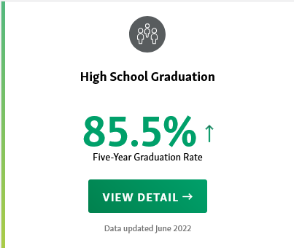
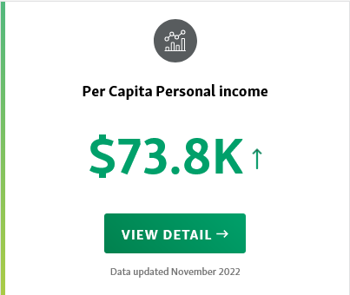
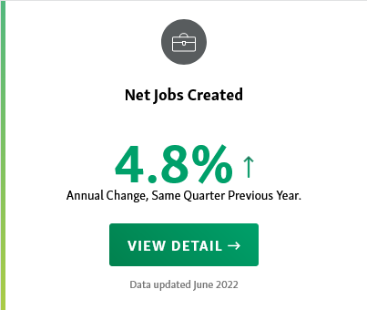
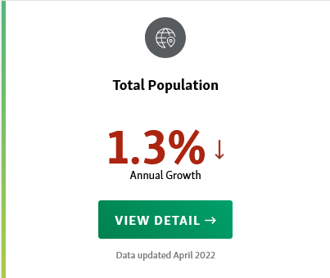
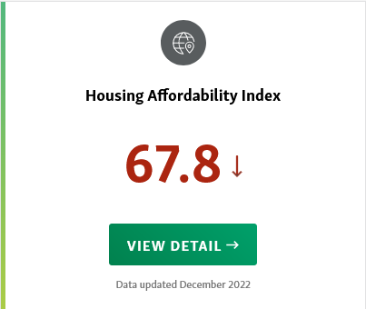
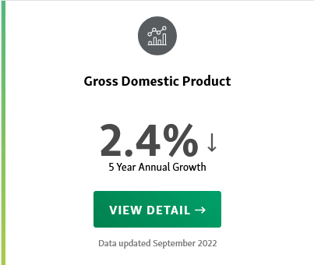
Our Vitals: Washington employees are talented and prepared.
Our Vitals
Measuring progress toward our desired future – Washington’s Vitals provide the most current data that can be used at the state and community level to track progress.

Slide 16
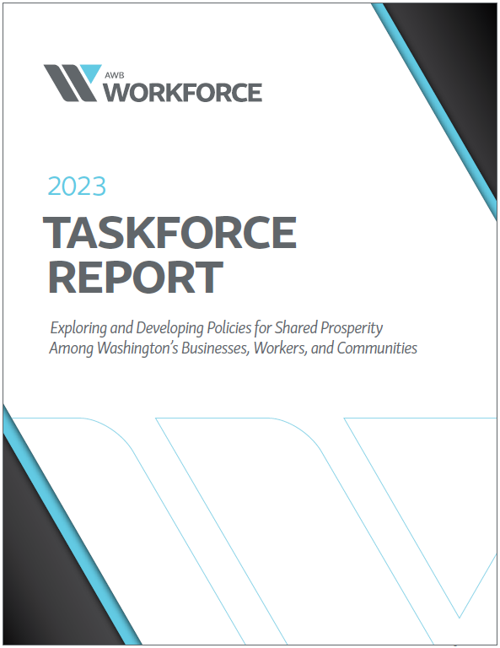
Workforce Taskforce Report
As the state business association, AWB is uniquely positioned to address this workforce crisis through policy, developing solutions for industry-specific gaps, and working to build the partnerships to support high-school graduates enrolling and completing post-secondary training.
The Association of Washington Business’ (AWB) Workforce Taskforce is challenged to:
Support and Affirm the Development of a 2030 Workforce Report detailing AWB’s commitment to addressing Workforce in the state of Washington.
Commit to participating in a series of meetings between May 2022 and October 2022.
Champion the Report and Workforce needs as AWB takes a public stance on an employer led Workforce strategy in Washington.

Slide 17
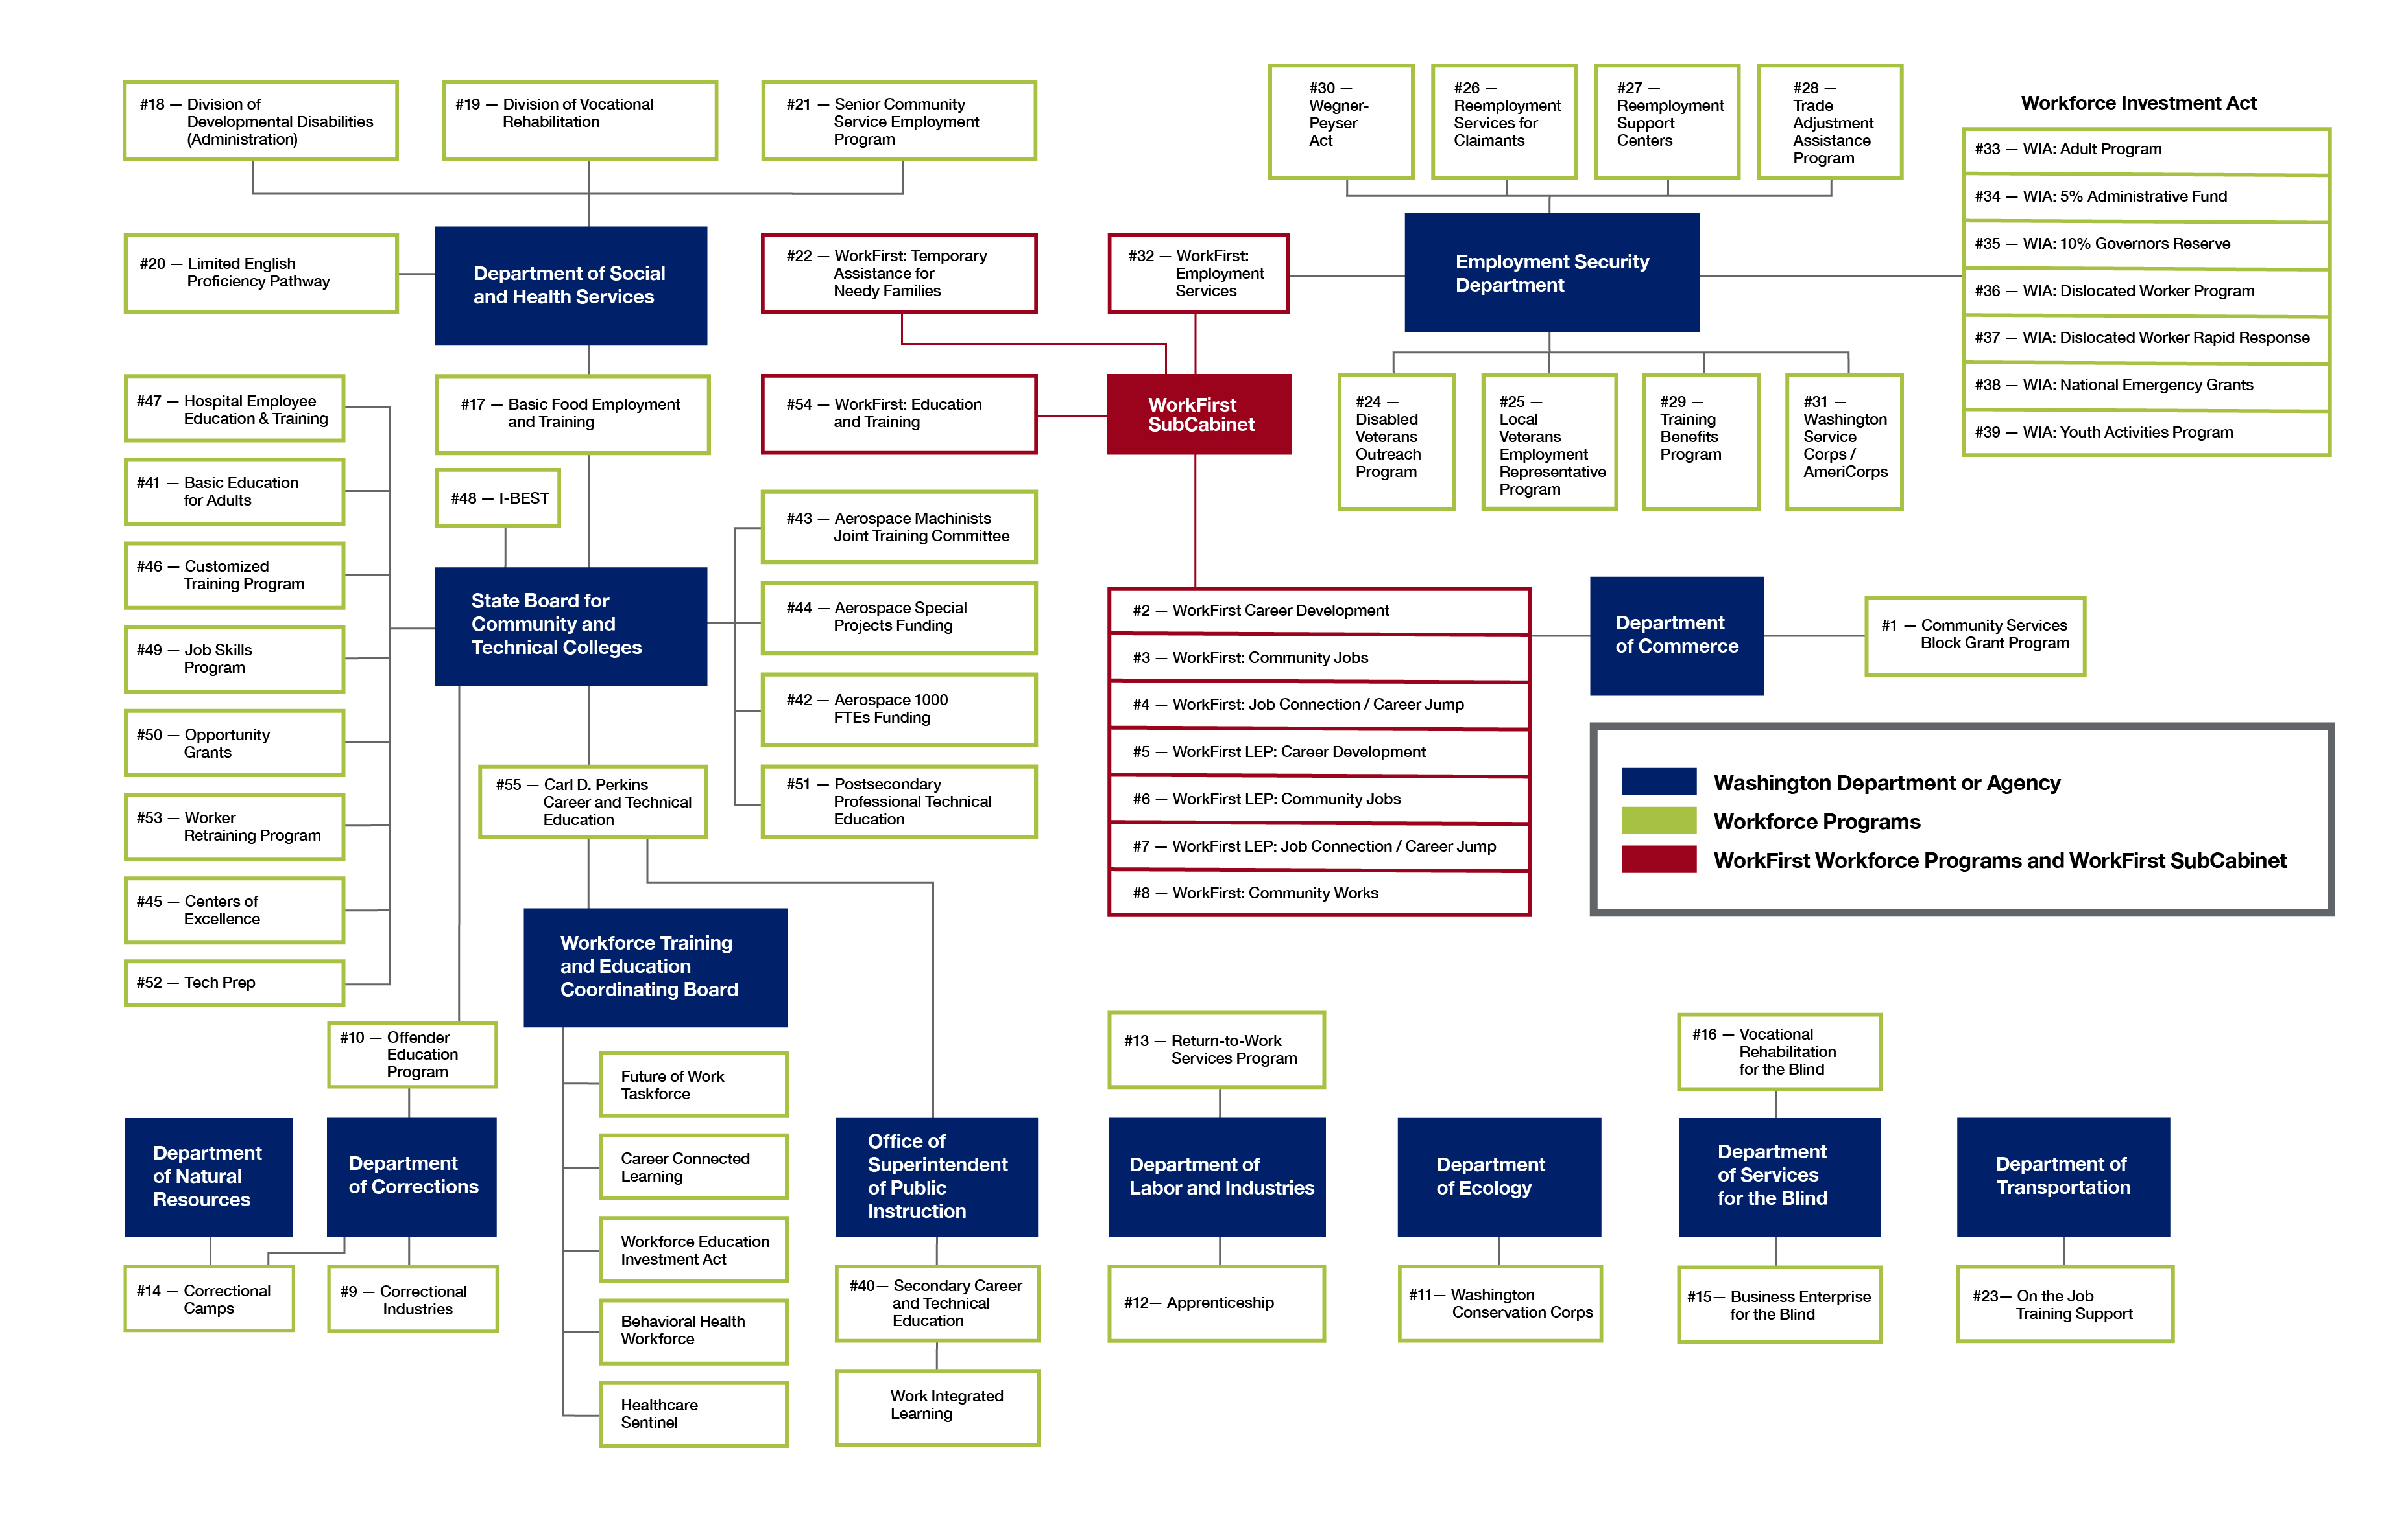
Workforce Taskforce Report
Guiding Principles:
Emphasize the Here and Now- Employers need short-term actionable solutions to support on the ground workforce shortages—while keeping in mind the need to ALSO make strategic long-term investments.
Scale and Local Connection- Approaches must take into account the distinct needs of Washington’s diverse communities and at the same time seek areas of commonalities where AWB can be an effective champion in Olympia and beyond.

Slide 18
Workforce Taskforce Report
The AWB Workforce Task Force divided its approach to Workforce into four overarching goals:
Goal 1 Workforce Retention
Goal 2 Immediacy in Workforce Attraction
Goal 3 Career Preparation
Goal 4 Career Awareness Early and Often
The goals are prioritized this way to reflect the most immediate needs facing employers and recognizing the ongoing opportunities and challenges required to impact the workforce difficulties facing employers.
Within each of these large goals, AWB is prepared to provide an array of programming, services, resources, and advocacy in support of Washington business.

Slide 19
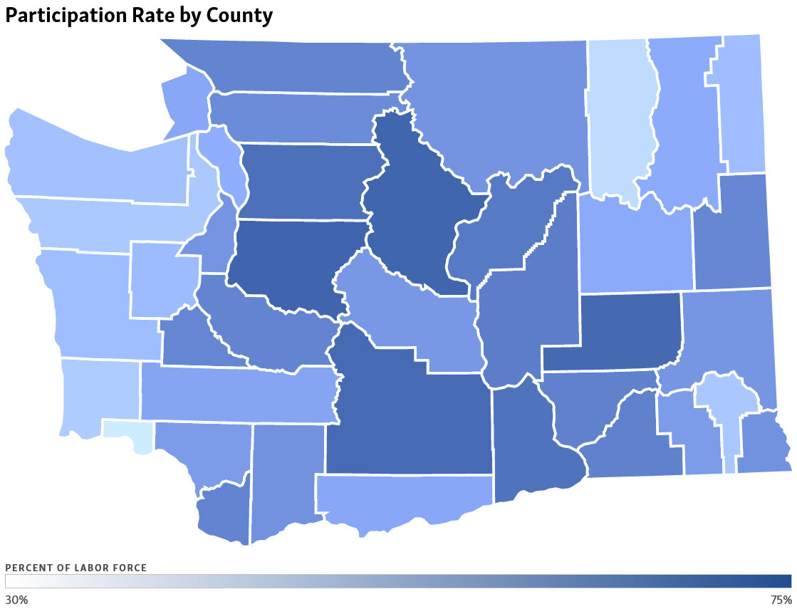
Workforce Taskforce Report
Washington employers are facing an unprecedented workforce crisis. Nearly three years after the start of the pandemic, they continue to report difficulty finding enough skilled workers, even as they simultaneously contend with rising inflation and concerns about a possible recession.
Like many other challenges, this crisis was not created by the pandemic, but it was exacerbated by it, fueling a shift to remote work and leading to early retirement and unprecedented levels of resignation as employees change careers or exit the workforce.

