Slide 1
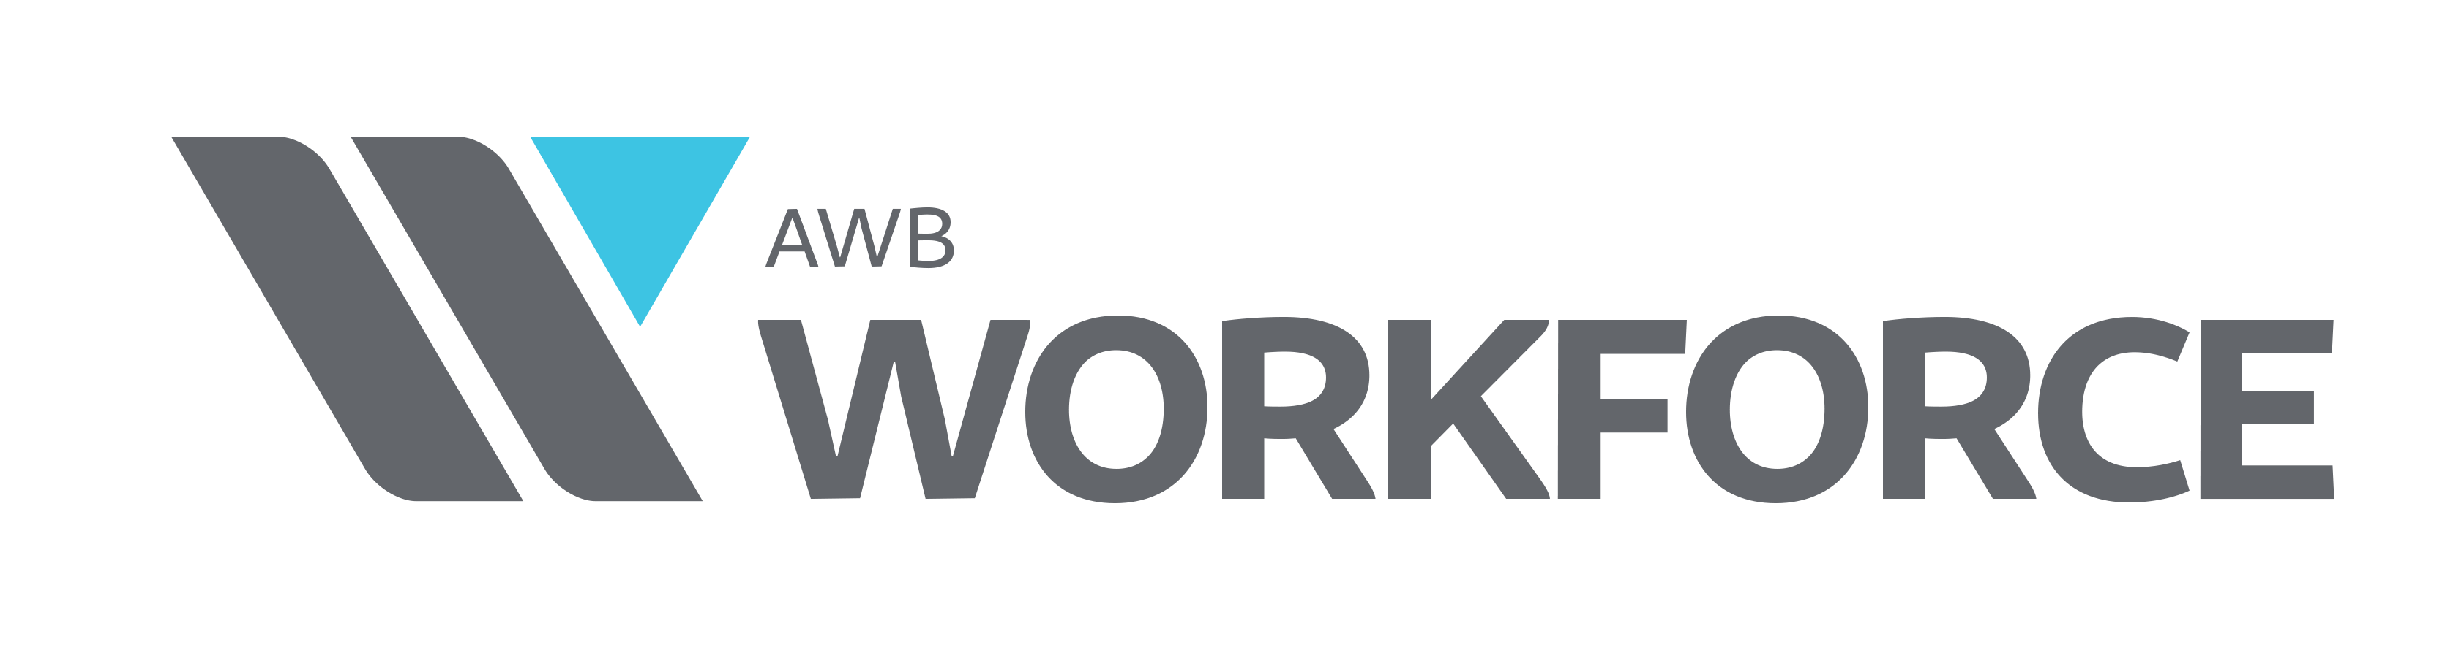
Association of Washington Business
Employer Update
February 10, 2023

Slide 2
Most Important Challenges: Spring Survey - 2022

Slide 3
Most Important Challenges: Summer Survey - 2022

Slide 4
Most Important Challenges: Winter Survey - 2023

Slide 5
Experiencing difficulty finding enough workers?
Source: AWB Winter Survey

Slide 6
Which skill level are you experiencing the most difficulty?
Source: AWB Winter Survey

Slide 7
How many open positions are you attempting to fill now?
Source: AWB Winter Survey

Slide 8
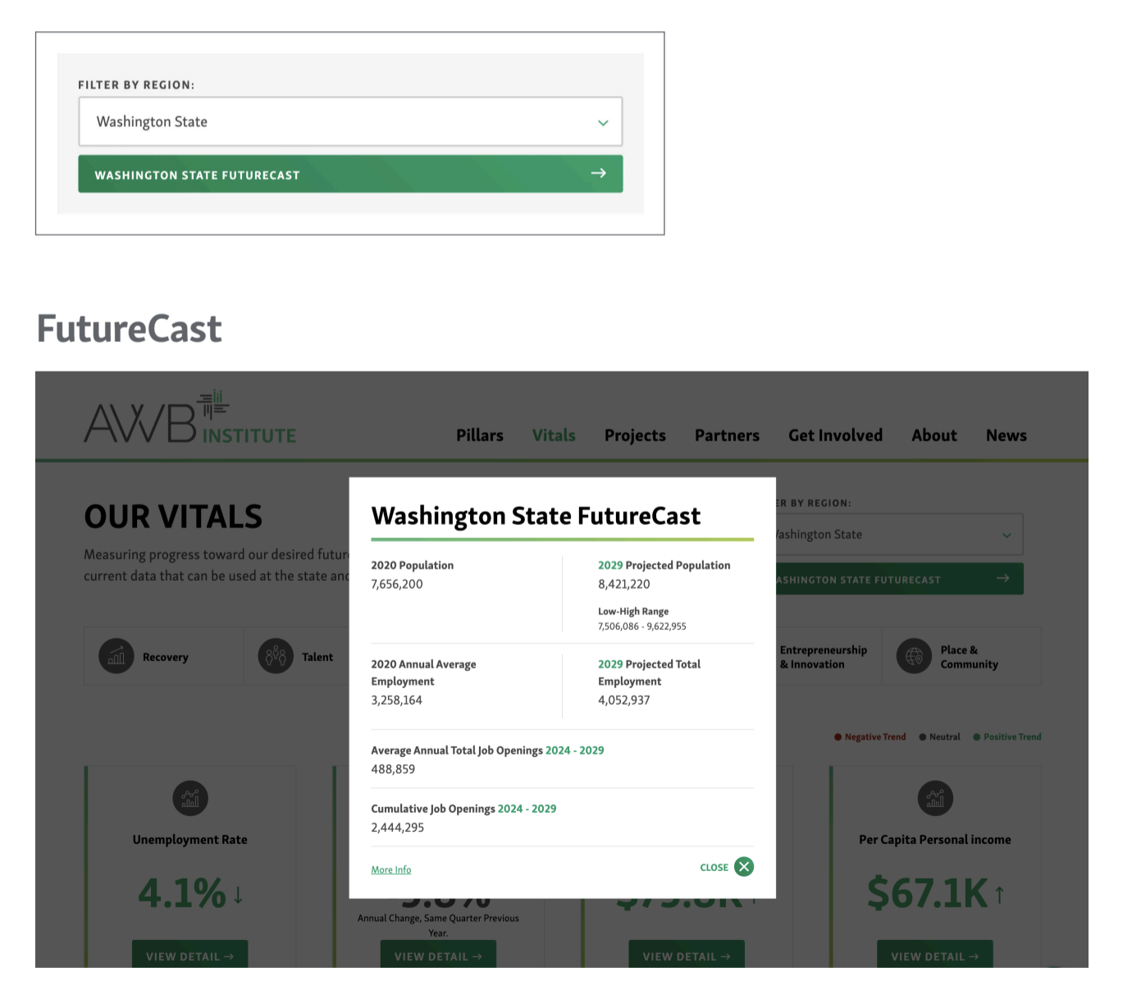
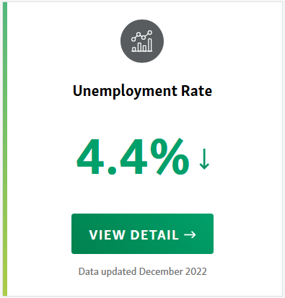
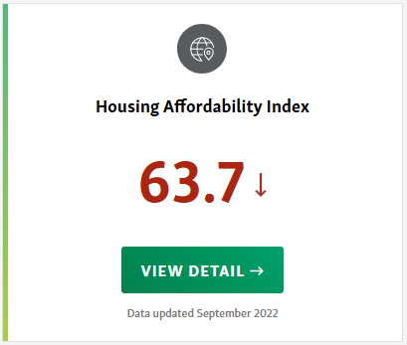
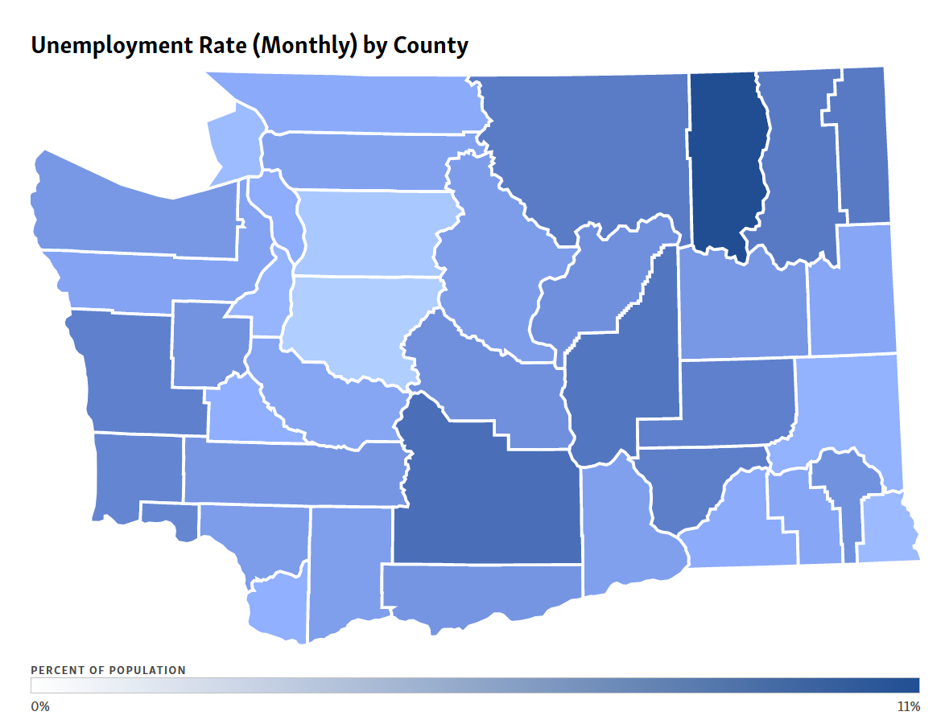
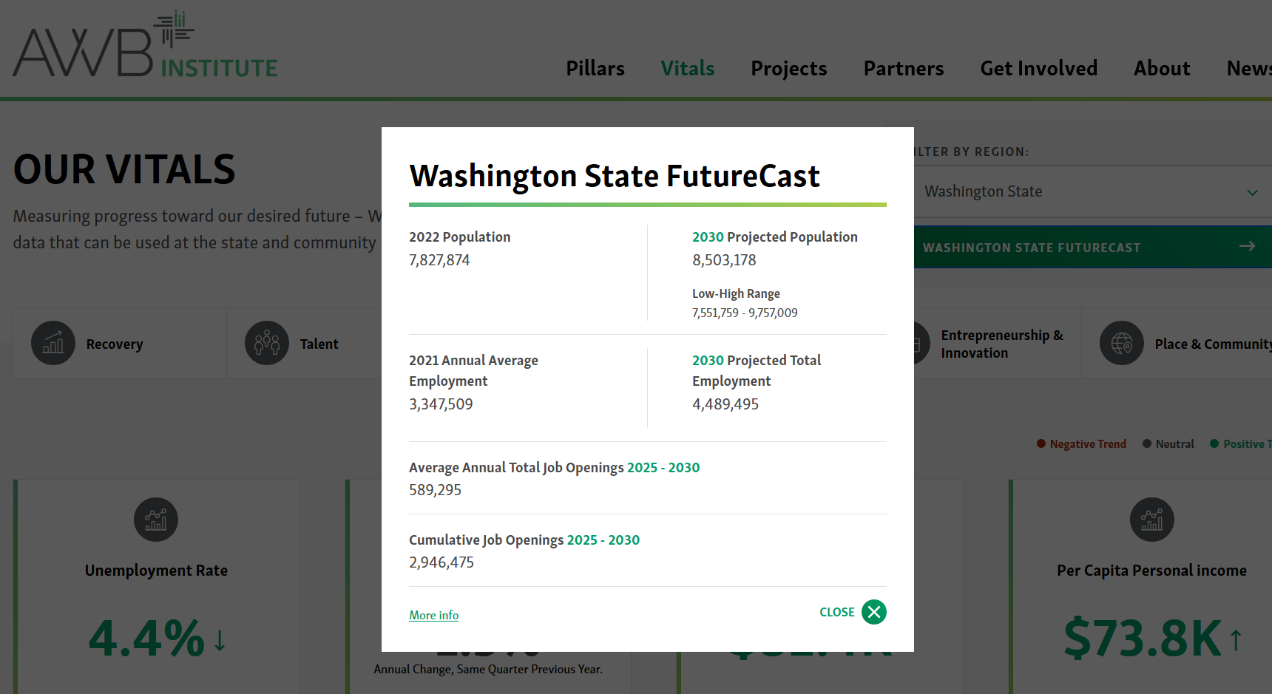
AWB Institute – FutureCast and Vitals

Slide 9
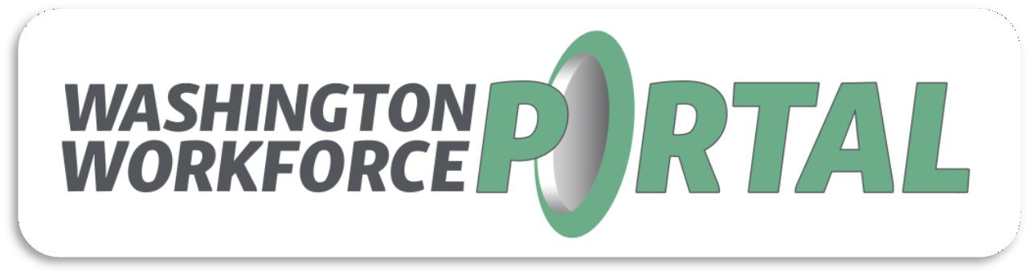
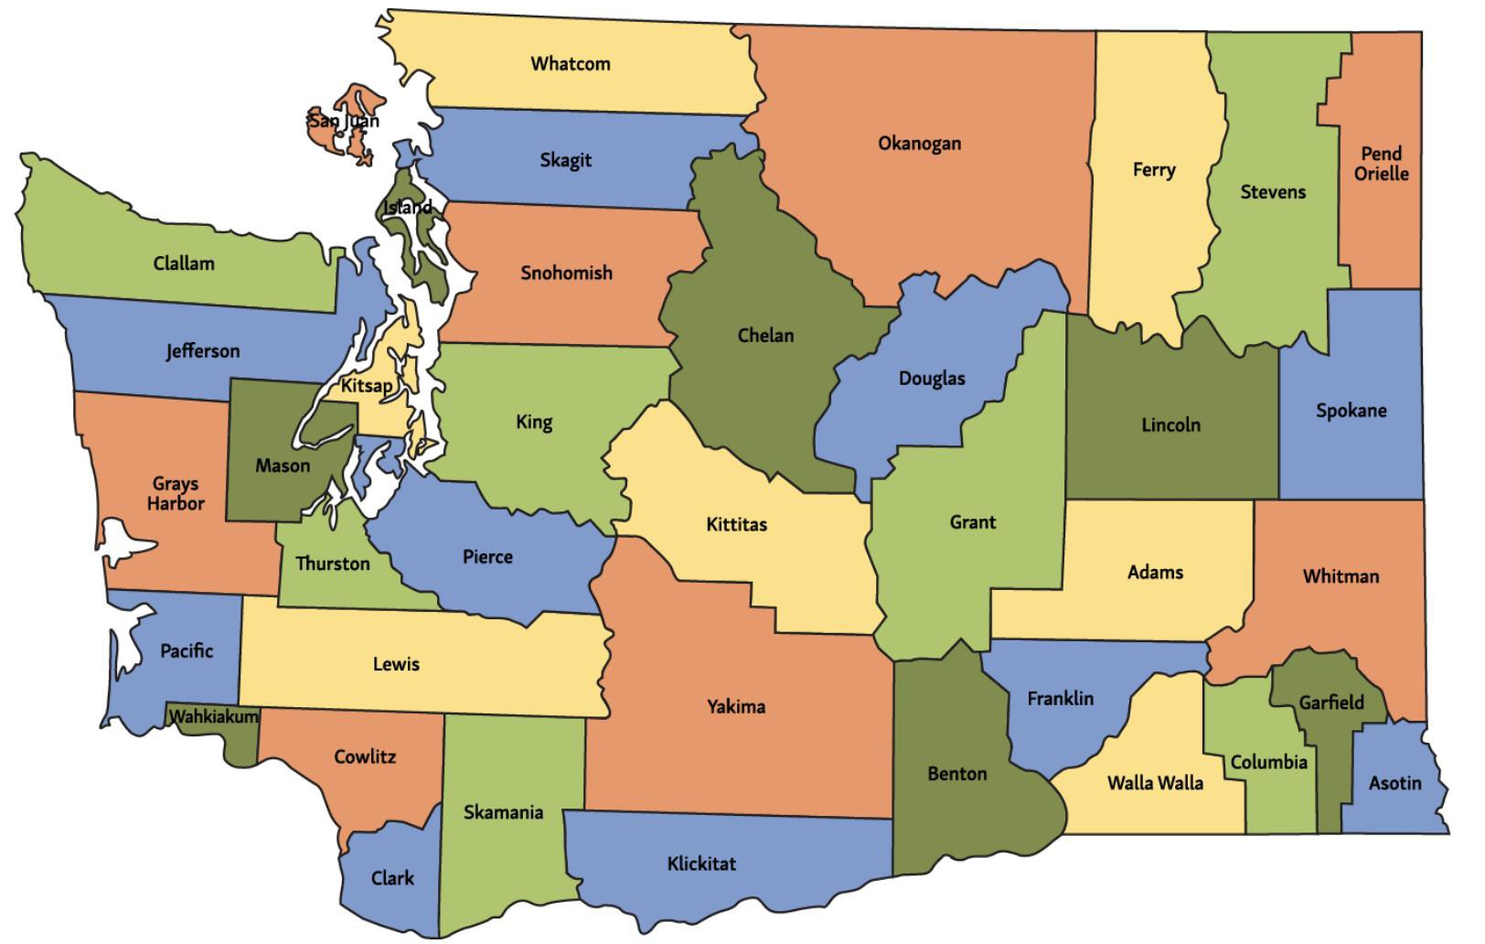
Washington Workforce Portal
Category | Active | To Date
Students | 143 | 775
Employers | 193 | 201
Open Opportunities | 40 | 210

Slide 10
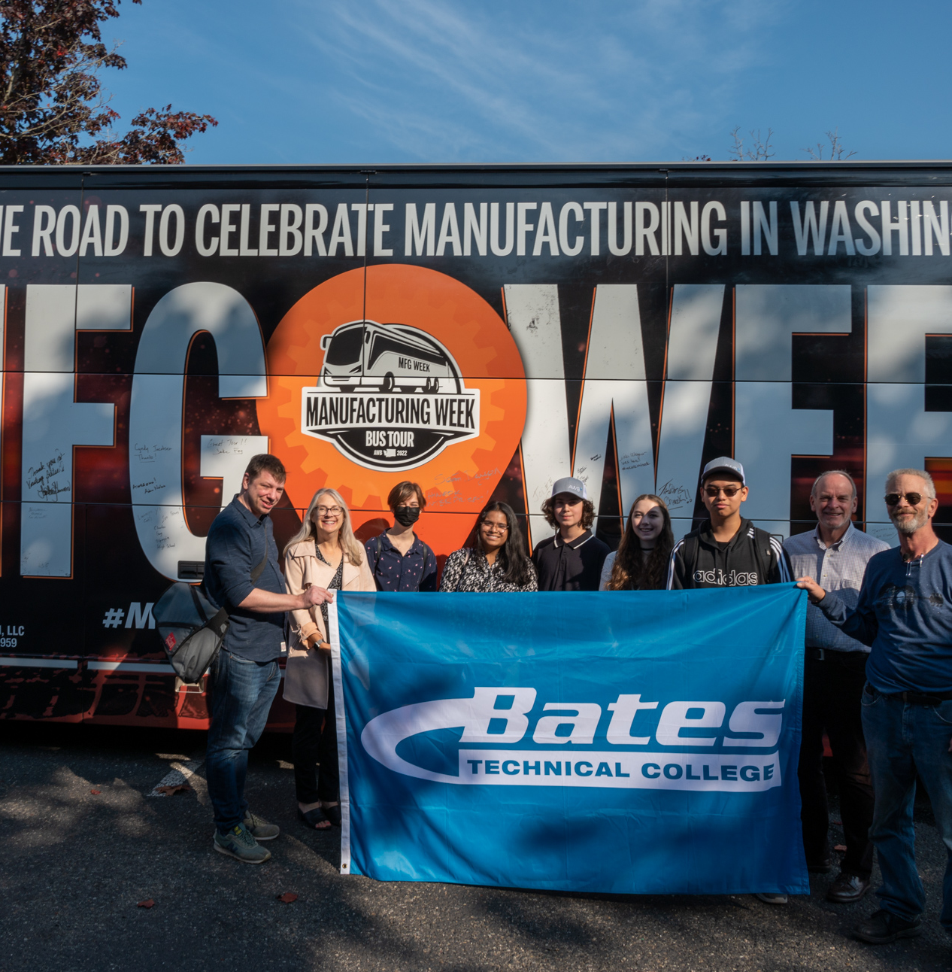
MFG Week Recap
From October 6th - 13th, AWB held its sixth-annual Manufacturing Week bus tour
New this year, AWB Institute coordinated student tours, inviting students, teachers, and employers to join
20 students and 4 teachers joined us in Lakewood (Bates Technical College), Spokane (Hotstart), and Yakima (Kwik Lok)
MFG Video

Slide 11
What is the Business Community Doing – UPDATE
AWB Board Level Taskforce – report due in February 2023
Increased Programming focused on effective Recruitment/Retention and long-term policy solutions
With a focus on small to medium sized business
Remote Work Certificate with WSU-Extension
Workforce Summit – Thursday, June 1st, 2023, at the Museum of Flight
HR and Employment Law Webinars
Engagement of Grassroots Alliance – NET Meetings

Slide 12
Thomas Gill
Program Manager, AWBI
thomasg@awbinstitute.org

