Slide 1
Washington’s Community and technical colleges
SBCTC Fall 2023 WEC Update

Slide 2
SBCTC Fall Update
Friday, October 13
Agenda Topics:
  System Updates
  Funding Opportunities
  Project & Program Updates
  Staff and Resource Updates

Slide 3
SBCTC system update
Marie Bruin, Director of Workforce Education

Slide 4
System strategic Plan (updated)
Equitable Student Success
  Goal 1: Increase access and retention among populations who can benefit the most from college. This includes young adults, working adults, low-income people, people of color, immigrants and refugees, individuals with disabilities, LGBTQ+ identifying individuals, rural residents, and single parents. We must be intentional in eliminating inequities in college access and retention for students institutionally marginalized in higher education.
  Goal 2: Improve completion and transfer rates for all enrolled students across all types of programs and credentials — workforce degrees, transfer degrees, certificates, apprenticeships, and bachelor’s degrees. We aim to improve completion rates across-the board for all students and to improve completion rates faster for students of color. Students must also receive necessary guidance and support about how to efficiently transfer to continue their educational journeys.
Agile, Career-Relevant Learning
  Goal 3: Provide flexible career-training options that are responsive to the needs of businesses and industries, offer Washingtonians access to well-paying jobs and career mobility, and lead to a more resilient and diverse workforce.
Institutional Financial Health
  Goal 4: Secure resources and develop systemwide strategies to support colleges’ financial sustainability and resiliency.

Slide 5
Supplemental operating budget Request FY24
Bachelor of Science in Computer Science Degree Expansion - $9M
  SBCTC staff recommends a $9 million supplemental operating budget request to create at least 15 new Bachelor of Science in Computer Science degree programs at Washington community and technical colleges. With appropriate funding support, these programs would expand access to computer science bachelor’s degrees for historically underserved populations and align with existing and emerging industry needs.
Washington Open Prof Tech Project Expansion - $600K
  SBCTC is reaching the final year of the Washington Open Prof-Tech project funded by the U.S. Department of Education. Staff recommends an operating budget request of $600,000 to provide funding to develop another set of open textbooks, offering financial relief from the high cost of textbooks for students and sustaining the momentum and growth of open-source materials in professional technical programs.

Slide 6
Funding updates

Slide 7
Project & program updates

Slide 8
Industry Demand (Carolyn)
Industry Demand: Meets the needs of employers and related partners across industries
Team Members: Carolyn McKinnon, Danny Marshall, and Vicky Chungtuyco
Team Projects:
  Incumbent worker strategies, micro-credentials, non-credit credentials
  Data Governance Committee – Continuing Education (CNED) Work Group
  Law enforcement & corrections workforce needs assessment (2023 Legislature)
  Firefighter/Fire Sciences/Emergency Services Training & Education Committee
    Homeland Security/Emergency Services COE, State Fire Marshal's Office, large group of fire chiefs and leaders
Programs:
Job Skills Program (JSP) | Customized Training (CTP)
Workforce Development Funds | Invest in Washington
Centers of Excellence | Continuing Education Council (CEC)
Business (AWBI) & Labor (WSLC) Liaisons | Economic Development

Slide 9
Employee training funding
Job Skills Program
FY24 funds are fully awarded; we are NOT accepting applications
FY 24 Round 1 had 49 Proposals with 35 Projects Awarded
Next application will be FY 25 Round 1*
*if current projects return money during the year, SBCTC will open a new funding round for applications. Please contact Danny Marshall and check program webpage before applying.
Job Skills Program Grant | SBCTC
Customized Training Program
Funds are fully awarded, we ARE accepting applications
4 businesses scaled their JSP proposal to participate in a CTP training contract
Current waitlist has 3 projects; applications are being accepted
Please contact Danny Marshall with any questions
Customized Training Program | SBCTC

Slide 10
Funding opportunities
Career Launch Equipment Funding
$5Million for capital equipment in the current biennium
Competitive grant process through OMGS.
First round of requests open October 19th and closes November 30th.
Webinar for potential applicants is scheduled for October 26th at 1:00pm.

Slide 11
Sector Response (Anna)
Sector Response: Support colleges as they deliver career and sector-based educational opportunities to students
Team Members: Anna Nikolaeva, Shanna McBride, and Megan Harper
Worker Retraining Updates
  Worker Retraining Funding Formula Workgroup
  Nursing/Allied Health DTA WRT Eligibility
Nursing: SB 5582 Implementation
Programs:
Hospital Employees Education & Training (HEET) | Health Workforce Council
Early Achievers Grant (EAG) | Early Learning
Worker Retraining | Behavioral Health & Dental
Health Sciences Deans & Directors | Cybersecurity

Slide 12
Work-based Learning (Genevieve)
Work-based Learning: Assist colleges as they provide experiential learning opportunities.
Team Members: Genevieve Howard and Karin Gitchel
Highlights related to E2SSB 5764
  Response to WSATC regarding the creation of an institution, or centralized program, for related supplemental instruction.
  Apprenticeship inventory – We are working toward getting all apprenticeship programs entered in ctcLink.
  Apprenticeship Coding
    NOAWS to PRFTC this will enable the distribution of WCG-A and the use of OAAP
    Coding links to state ID number resulting in broader more accurate data.
Programs:
Aerospace 1,000 FTE | Career Connect WA
Aerospace Apprenticeship FTE | Apprenticeship
Aerospace Contract | Aerospace Pipeline Committee
Career Launch Equipment & FTE | Aerospace Legislation
Career Launch Endorsement | Aviation & Aerospace Advisory Committee

Slide 13
Program support (Bill)
Program Support: Provide overarching program support to strengthen business, industry and colleges.
Team Members: William Belden, Kimberly Ingram, and Shelby Means (Education Division)
Highlights
  Dual Credit
  Perkins
  Program Approval
Programs:
Carl D. Perkins | CTE Dual Credit
Comprehensive Local Needs Assessment (CLNA) | High Demand Grant
Program Approval Review & Program Inventory | Workforce Education Council (WEC)
Prof-Tech Certification | Customer Advisory Committee (CAC)

Slide 14
FY24 Perkins applications
FY24 Perkins Plan Final Award Budget Revisions Due October 18th
FY24 Special Projects App Due November 30th
Update contact information
  OGMS: New application and during Follow-Up status
  OBIS: Anytime
Notes:
Email sent on October 3rd with final funding award

Slide 15
FY25 Perkins Plan Application
Dates TBA
OCTAE Requested Application Revisions
Initial CLNA due January 31, 2024
Alignment from CLNA Summary to Funding Requests
CLNA Monthly Virtual Collaboration

Slide 16
Perkins Data Dashboard
21-22 data expected to be available by beginning of November
Reporting Year 2021-2022 State Targets
  1P1 = 39.5%
  2P1 = 53.5%
  3P1 = 19%
Renaming Non-Trad Fields for consistency

Slide 17
Perkins State-determined Performance levels
(state targets)
Performance Indicator | RY 20-21 (PY 21-22) |  | RY 21-22 (PY 22-23) |  | Average Actual % RY 20-21 & 21-22 | Proposed RY 22-23
 | SDPL % | Actual % | SDPL % | Actual %
1P1 | 39 | 39.27 | 39.5 | 39.91 | 39.59 | 40
2P1 | 53 | 50.68 | 53.5 | 49.55 | 50.12 | 50.5
3P1 | 18 | 20.54 | 19 | 20.12 | 20.33 | 20.5
Reporting Year 2022-2023 State Targets Available for Comment
  Send Comments: kingram@sbctc.edu or wbelden@sbctc.edu
RY = Reporting Year, PY = Program Year
Notes:
State Targets must be higher than the average of the last two years.

Slide 18
Program Approval and Inventory
Pre-Nursing DTA/Pre-Allied Health Pathways
  Seeking input from WEC membership (Val Sundby)
New College Partnerships
PAR Website and Program Inventory
  https://www.sbctc.edu/colleges-staff/programs-services/professional-technical/default.aspx
  Gathering VPI authorization for new PAR online application
  Web tutorial to be issued this fall
System-wide Program Inventory
  Public Inventory is pulled directly from ctcLink
    Common Attribute Framework: Credits, shared programs, apprenticeships, etc
    Inactive Status
    Branded College Inventories w/ Max Credit Values

Slide 19
Dual credit
Running Start Changes
Substitute House Bill (SHB) 1316 increased the combined monthly full-time equivalent (FTE) and annual average FTE (AAFTE) enrollment limit from 1.20 to 1.40 and directed OSPI to adopt rules to allow participation in Running Start during the summer term.
An “after-exit” Running Start proviso was also included in the state budget to permit eligible high school graduates to participate in summer quarter Running Start to complete their associate degree at their local community and technical college for summer 2023 and 2024. Funding is limited.
College in the High School Changes
Substitute Senate Bill (SSB) 5048 Eliminates College in the High School fees for all students in 9th grade through 12th grade that attend a public high school or charter school and are enrolled in a public institution of higher education.

Slide 20
Dual credit
CTE Dual Credit Proviso Update
  Pilot Colleges
  NWESD 189
Dual Credit Updates
  Stephanie Rock, Program Administrator
  Adult Reengagement & Strategic Enrollment Initiatives
  College in the High School Program Guidance

Slide 21
Additional project updates
Workforce Data Project
  Workforce Enrollment Dashboard Tableau
  Program and Course Data
  Implications for Data Consistency/Coding (Carmen)
    Naming conventions, etc

Slide 22
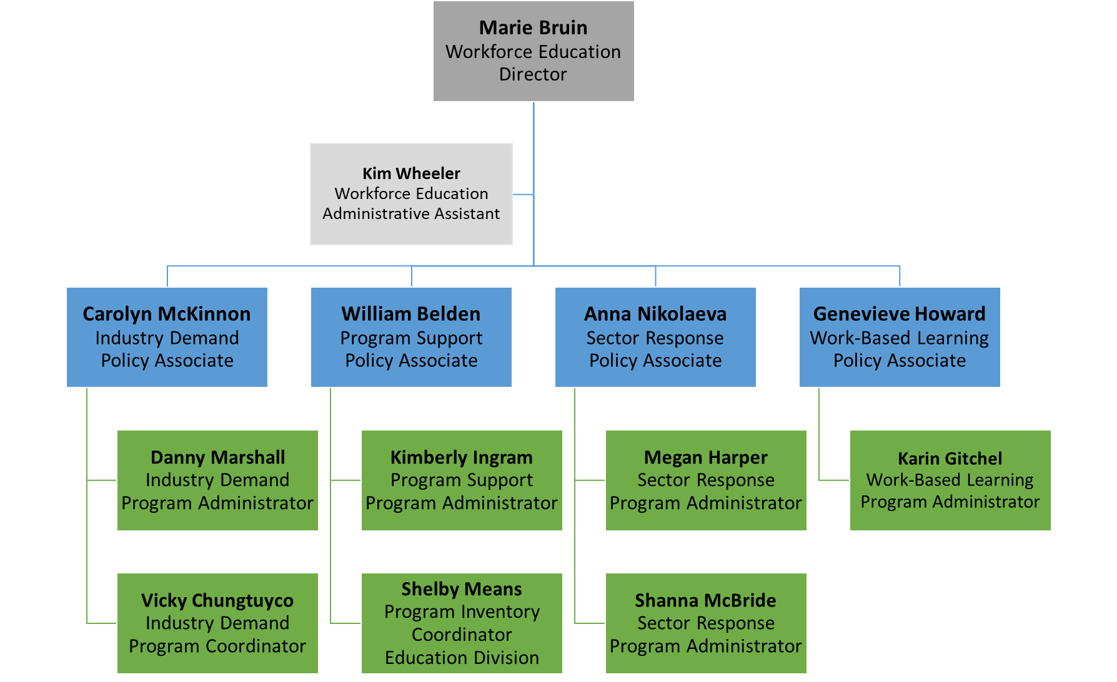
Workforce Education Organization Chart

Slide 23
Workforce contacts
Department Leadership
  Marie Bruin, Director; mbruin@sbctc.edu
  Kimberly (Kim) Wheeler, Workforce Assistant; kwheeler@sbctc.edu
Industry Demand: Meets the needs of employers and related partners across industries
  Carolyn McKinnon, Policy Associate; cmckinnon@sbctc.edu
  Danny Marshall, Program Administrator; dmarshall@sbctc.edu
  Vicky Chungtuyco, Education Program Coordinator; vchungtuyco@sbctc.edu
Program Support: Provide support to strengthen business, industry and colleges.
  William (Bill) Belden, Policy Associate; wbelden@sbctc.edu
  Kimberly Ingram, Program Administrator; kingram@sbctc.edu
  Shelby Means, Program Inventory Coordinator; smeans@sbctc.edu
Sector Response: Support delivery of career and sector-based educational opportunities.
  Anna Nikolaeva, Policy Associate; anikolaeva@sbctc.edu
  Megan Harper, Program Administrator; mharper@sbctc.edu
  Shanna McBride, Program Administrator; smcbride@sbctc.edu
Work-based Learning: Assist colleges as they provide experiential learning opportunities.
  Genevieve Howard, Policy Associate; ghoward@sbctc.edu
  Karin Gitchel, Program Administrator; kgitchel@sbctc.edu

