Slide 1
Making Education and Training Accessible for All Through Partnership
Crystal Bright, WorkSource System Coordinator,
WorkSource Columbia Basin
Scott Koopman, CBC Director for the Workforce Education Center

Slide 2
The Goal of Workforce Efforts
Outcomes: Changed Lives
Outputs:
appointments, enrollment, FTE, applications, training, meetings
Inputs:
funding, programs, staff
Notes:
A presentation about making training and education accessible assumes one critical truth: people want to move forward, but something is in the way. As workforce practitioners, we act to clear the way (which is the point of this session), but we can get caught up in “clearing” the way. As an administrator, I focus on the <click 1> INPUTS… As frontline service providers, we can get overly focused on <click 2> OUTPUTS… But the real goal of the work we do is NOT the work we do. <click 3> It’s the lives that change.

Slide 3
What are the hurdles?
For clients?
For practitioners?
Notes:
We know there are hurdles in the work we all do. <click 1> Help us identify the hurdles our clients face. [audience brainstorm] [if someone mentioned a programmatic hurdle, use it to segue…] If you will allow us, we want to focus on<click 2> the hurdles we face within our programs. The battles we fight within our institutions and between our institutions that make service delivery a challenge. Help us identify practitioner hurdles… [listen for mentions of inter-agency communication or clients getting the run-around—highlight these]

Slide 5
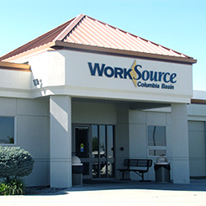
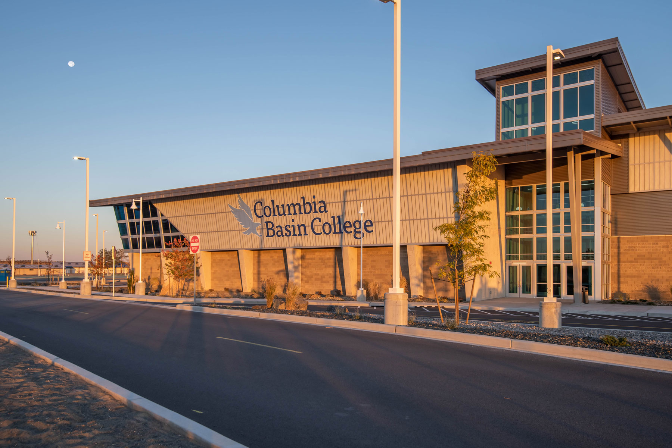
Effort 1: Co-Located Outreach and Training Specialist
Notes:
The change: shift from case management for Worker Retraining to Outreach for CBC. Meet and Greet sessions; info workshops, info videos; DSHS tabling

Slide 6
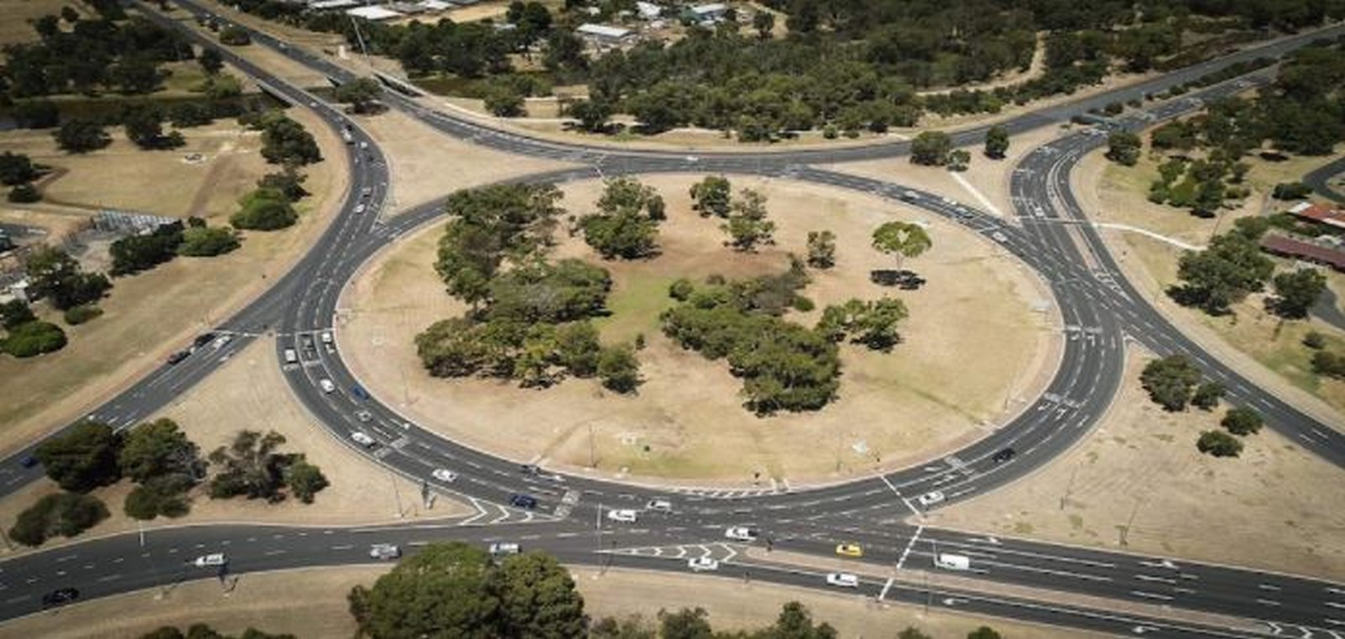
It’s a NEW DAY
Historical Path
Current Trajectory
Notes:
Effect: greater access to training options; more transparency; CBC brand value added to WSCB; service delivery integration

Slide 7
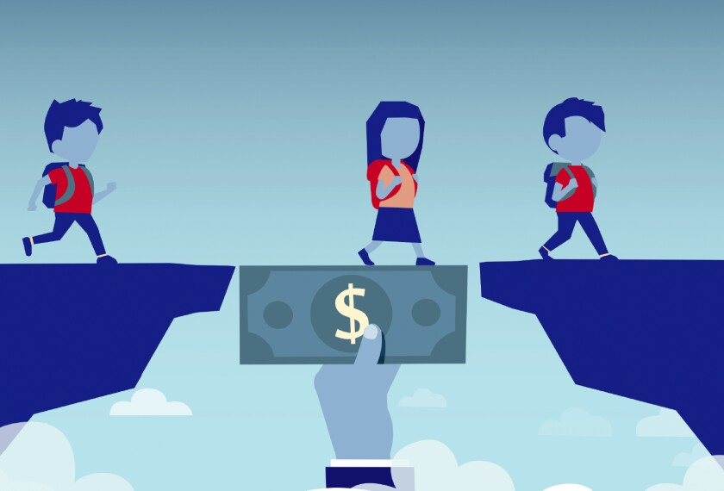
Effort 2: Inter-Agency Funding Committee
Notes:
The change: bring several people to the table at once; share funding priorities; share student knowledge

Slide 8
Then….& Now
Our New Way
The Old Way
Notes:
Effect: better customer experience for applicants; more funding leveraged; all funding leveraged; more holistic approach to student

Slide 9
Effort 3: Workforce Collaboration Committee
Notes:
The Change: shared knowledge and vision between industry-community-agency-college

Slide 10
How We Do Business Makes ALL the Difference
Collaborative
Silos
Notes:
The effect: transparency; pro-active planning; wider vision; elevation of issues/concerns/pain points

Slide 11
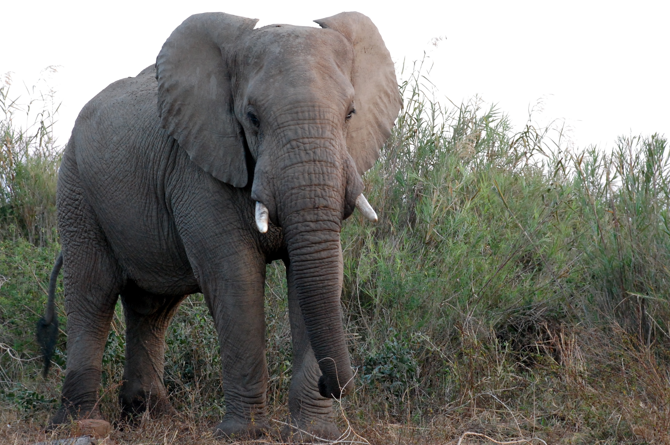
Encouraging Change
Create space
Engage stakeholders
Identify pain points, common goals
Implement solutions

Slide 12
Thank you!
Crystal Bright
WorkSource System Coordinator
WorkSource Columbia Basin
P. (509) 734-5887
E. crystal.bright@esd.wa.gov
Scott Koopman
Director for the Workforce Education Center
Columbia Basin College
P. (509) 542-4443
E. skoopman@columbiabasin.edu
“Alone, we can do so little; together, we can do so much.” ~Helen Keller

