Slide 1

Labor Liaison
WEC
Rachel McAloon
360.515.1335
RMcAloon@WSLC.org

Slide 2
Legislative
Priorities

Slide 3

Registered Apprenticeship 101
  What is Registered Apprenticeship?
  CTCs, High School Counselors, EDCs, CTEs, Employers
  Hosted at Educational Service Districts
  Event 5/8/24 in Richland at LiUNA

Slide 4


Registered Apprenticeship FYI
WSATC
Meets quarterly (Jan/April/July/Oct)
Wednesday Meetings
  Day before Thursday Council meeting
  Childcare Taskforce (11am) , Apprenticeship Coordinators (1pm), Joint Retention & Recruitment Committee (2pm)
  Great way to network and connect with Registered Apprenticeship Community
  Upcoming dates:
    July 23, 2024
    L&I HQ
    7273 Linderson Way SW Tumwater, WA
Registered Apprenticeship 101 Presentation available, reach out to schedule

Slide 5
“Labor Leader Needed for Advisory Committee”
Community College name?
Advisory Committee?
  How often/when does the committee meet?
  Is there a specific union or trade you are interested in?

Slide 6
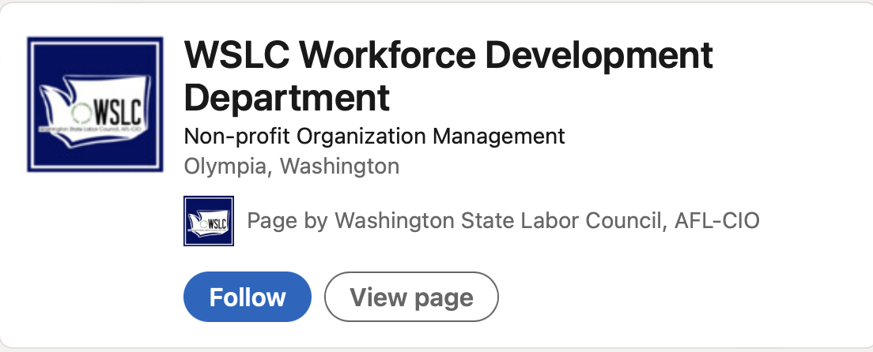


Ways to Connect with the WSLC
Social Media (LinkedIn & Facebook):
Quarterly Newsletter:
Send an email to Lpoplack@wslc.org to sign up!

