Slide 1
Washington’s Community and technical colleges
SBCTC Fall 2024 WEC Update

Slide 2
ProCert Update
Thursday, October 17
Greg Gamble, SBCTC Application Development Team
William Belden, SBCTC Workforce Education

Slide 3
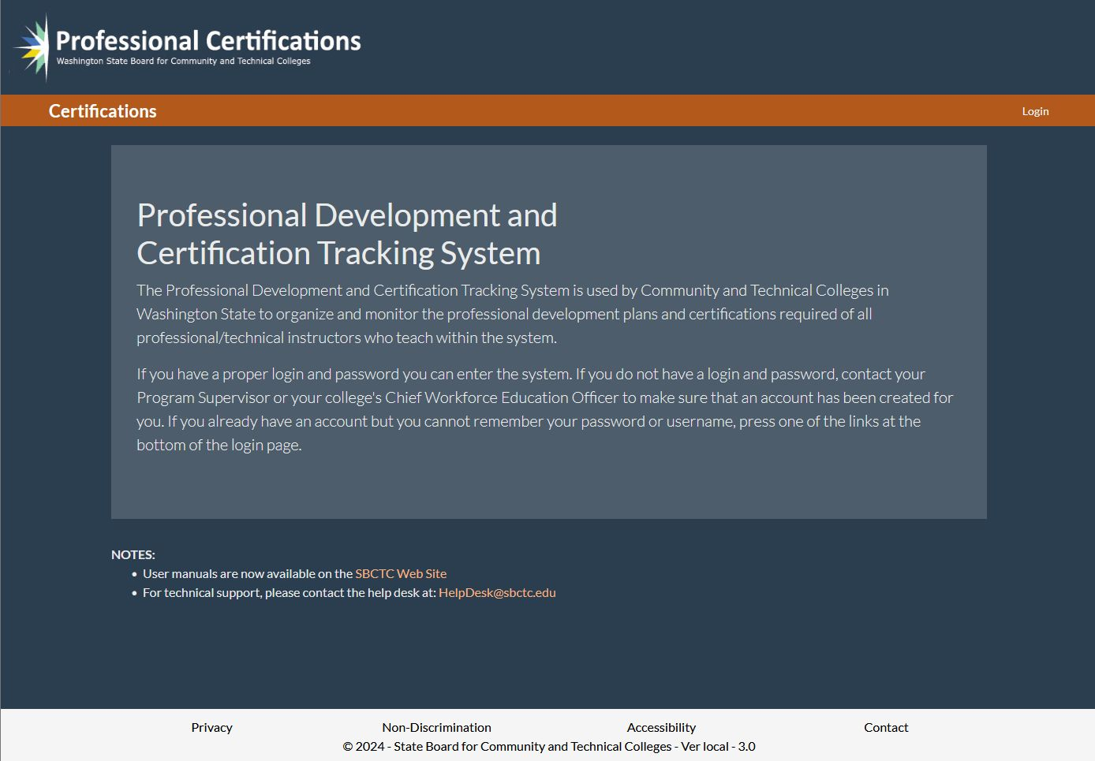

Slide 4
Expiration Dates for Certifications
ProCert uses the following dates as the end-of-term for purposes of tracking certification expirations. These dates are based on the instructors first teaching term.
  Fall Term: December 31
  Winter Term: March 31
  Spring Term: June 30
  Summer Term: December 31 (same as fall)
First term of teaching must be identified in ProCert. Certification end date will be calculated for reminders of certification expiration.

Slide 5
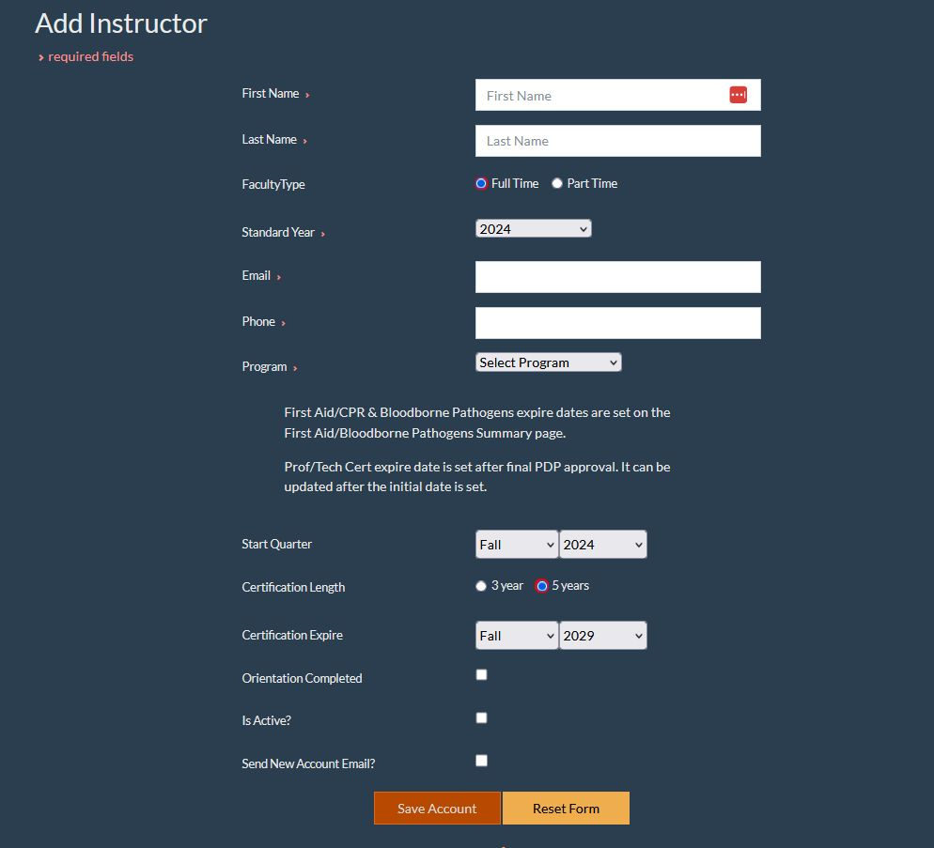

Slide 6
Faculty Self-Attestation/Assessment
Faculty completing the Skill Standards survey will be asked to self-attest they have completed their required orientation. Supervisors verify and confirm the accuracy of the entries prior to approval.
For each legislatively required Standard, faculty must self-assess their level of proficiency (baseline, intermediate, and mastery-level) for each Key Activity under that standard. Based on their self-assessment, the faculty will need to select one Key Activity for the PDP.

Slide 7
Administration*
Set 2012 or 2024 Skill Standards for the college.
Set required Critical Work Functions (standards) for the college.
Set survey requirements (level of proficiency) separately from inclusion in PDP for each standard.
Supervisor adds faculty to ProCert prior to or during the new faculty’s first term of teaching.
Institutions manage the exemptions or verification of first aid/bloodborne pathogens requirements. Must be documented in the first term of employment.
Set notification/reminder defaults for the college.
*Documentation of these elements/decisions must be reflected in college policy.

Slide 8
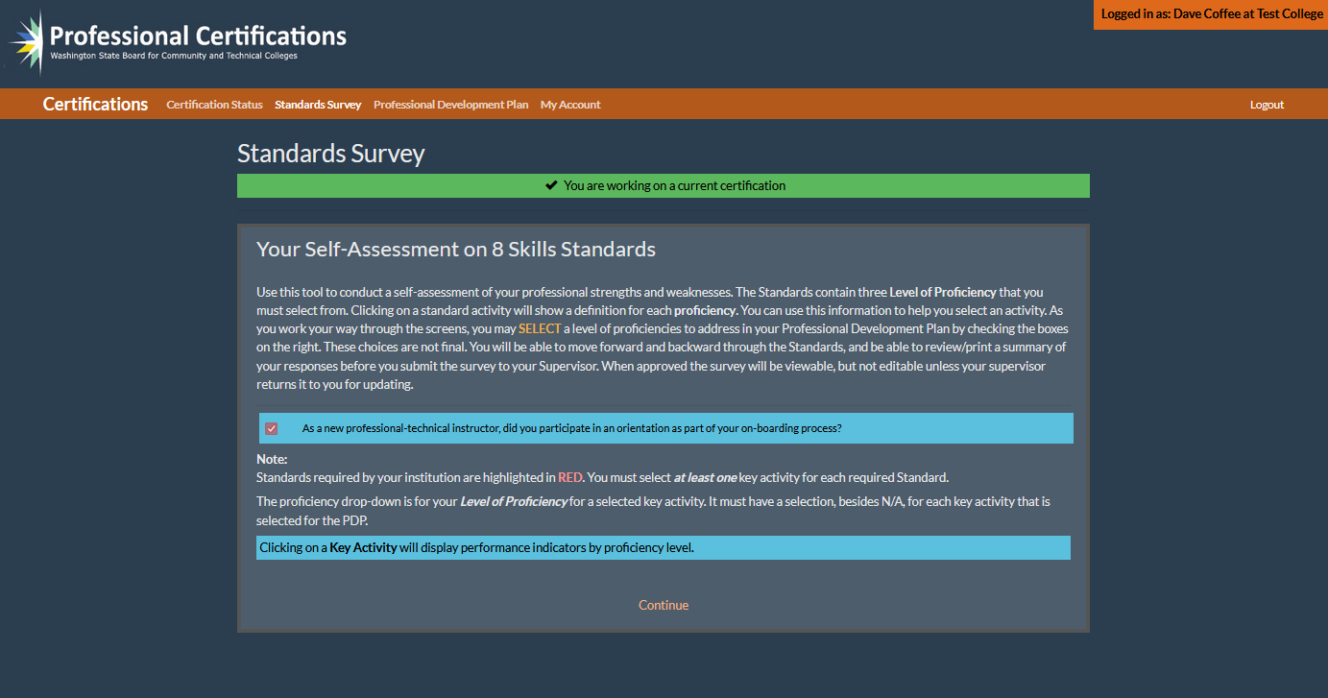

Slide 9
2024 Skill Standards
ProCert has been updated with the 2024 Skill Standards. The updated standards will be the only option effective June 30, 2025.
  Faculty PDPs created under 2012 Skill Standards will be able to complete their initial or recertification under those standards. Managed at the college level.
Legislation requires the following three standards be included in the certification process and professional development plan: A. Manage learning environments; B. Develop outcomes, assessments, and curricula; and D. Provide student instruction. Colleges have the option to include additional standards without removing any of the legislatively defined standards.
Each assigned standard requires faculty to complete a self-assessment of their current skills for each Key Activity under that Critical Work Function. The aligned Performance Indicators are built into ProCert with examples of baseline, intermediate, and mastery-level proficiency.

Slide 10
Functionality
Report generation (Perkins reporting, raw data export files to excel, etc.)
  Not currently available, WEC executive can inform? Need to build attestation/security statement for use of reporting. Remove personally identifiable information?
Note fields available after plan is approved. Ability to add (not delete) information and upload documents.
Administrator and assistant administrator are both able to unlock PDP for changes.
Reminder messages for expiring certifications.
Extended lock-out to 1 hour.
Label to indicate 2012 or 2024 Skill Standards.
  Selecting 2012 locks all new PDPs under the prior standards.

Slide 11
Functionality, cont.
Require assignment of five Key Activities for initial certification and recertification.
Tenure-track and adjunct faculty indicators vs. full and part time.
Ability to sort/view certifications by most recent/active.
Notification/reminders be set by colleges for both first aid/bloodborne pathogens and vocational certification. (instructor and supervisor notifications)
Ability to modify faculty program, supervisor, etc.
  Remove alert, requirement to restart certification.

Slide 12
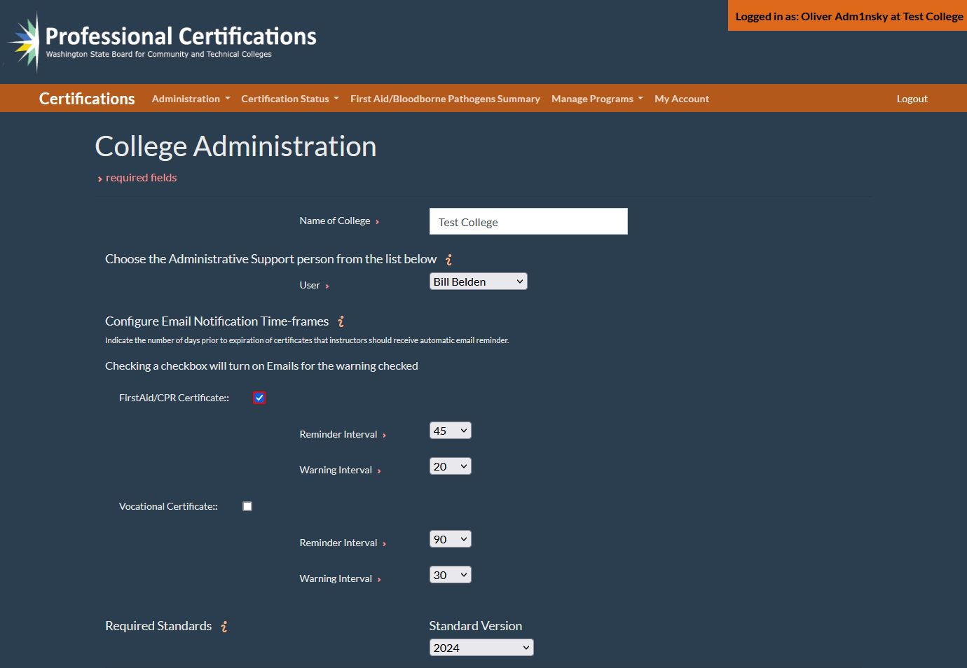

Slide 13
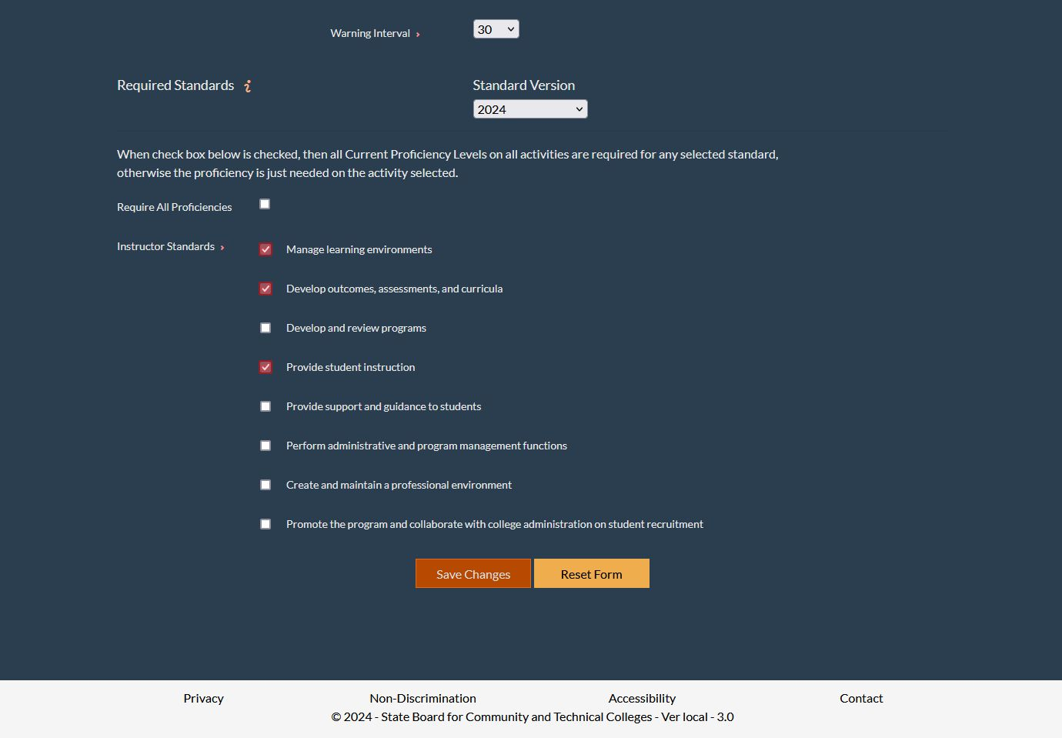

Slide 14
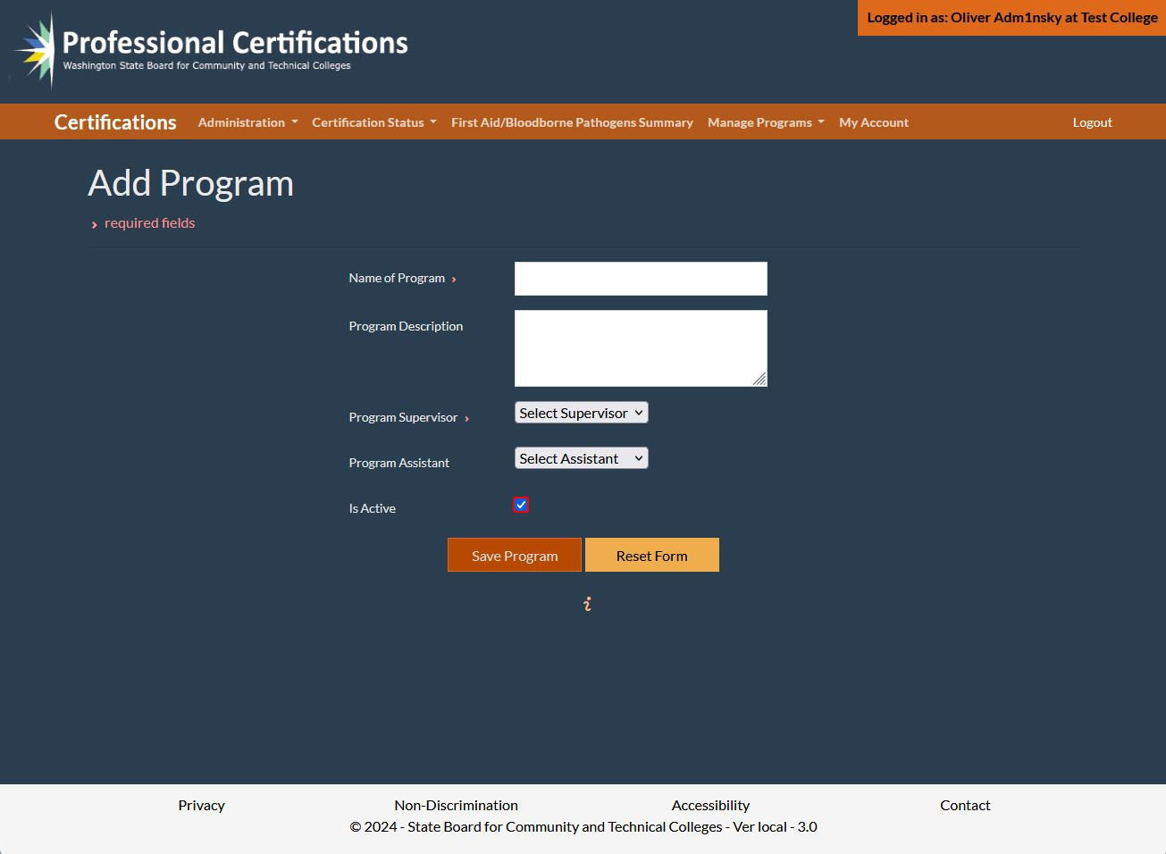

Slide 15
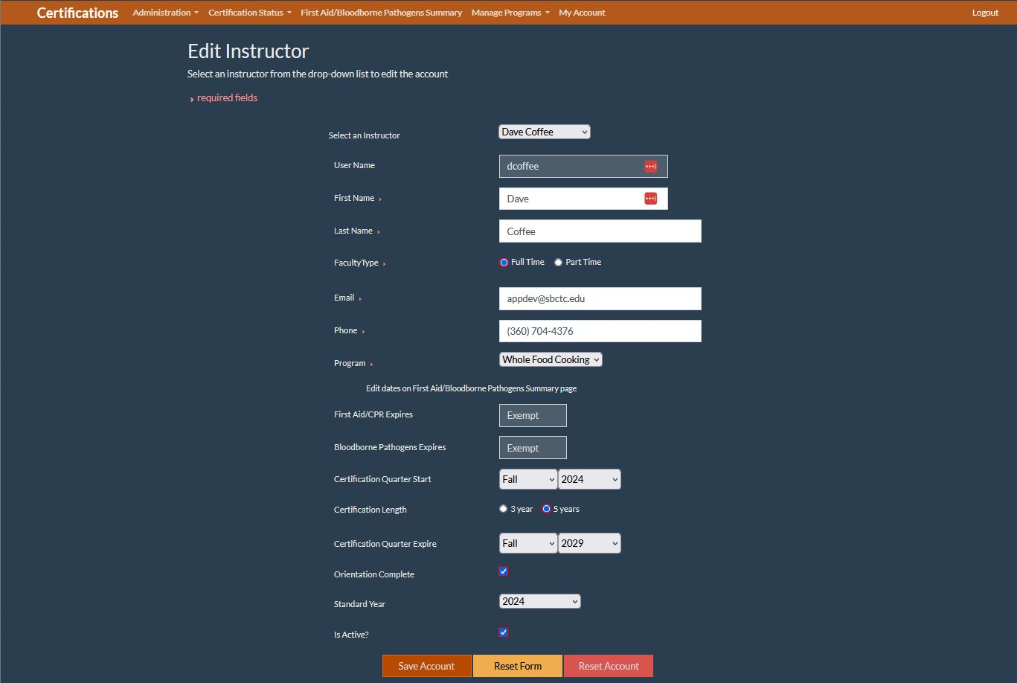

Slide 16
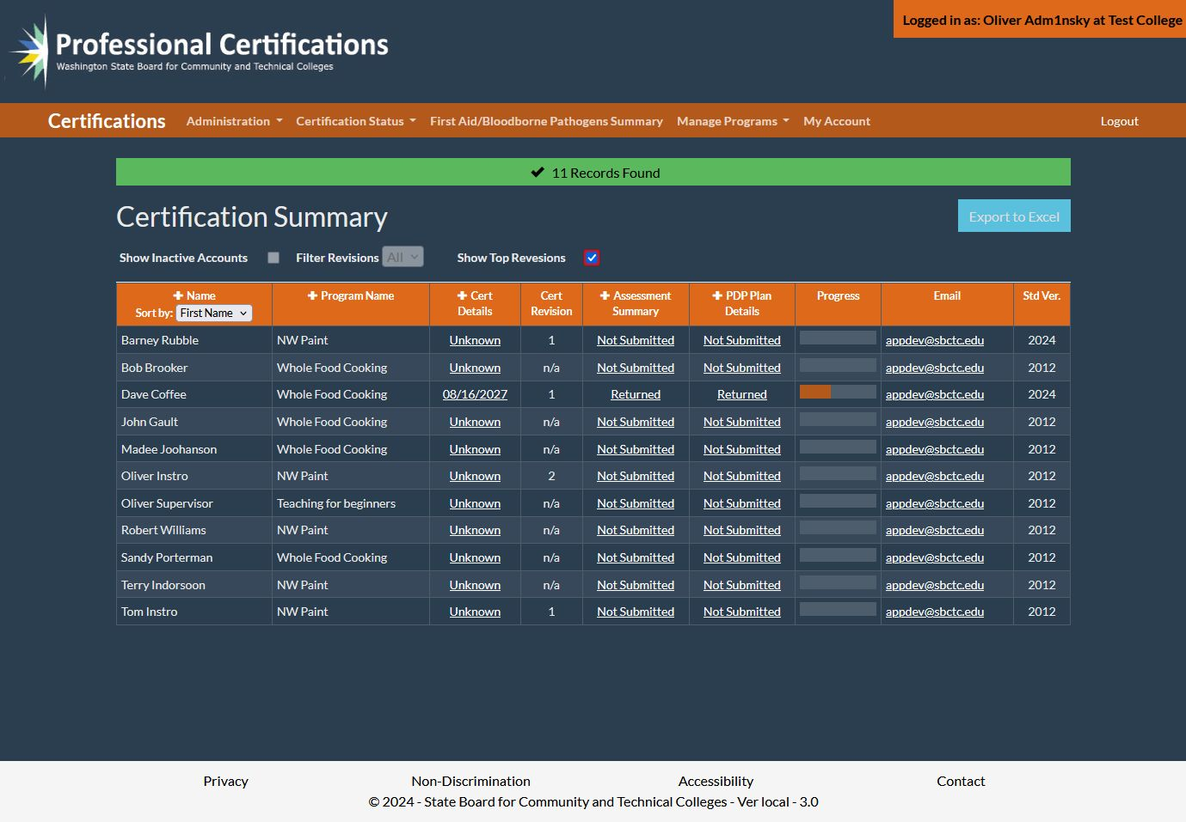

Slide 17
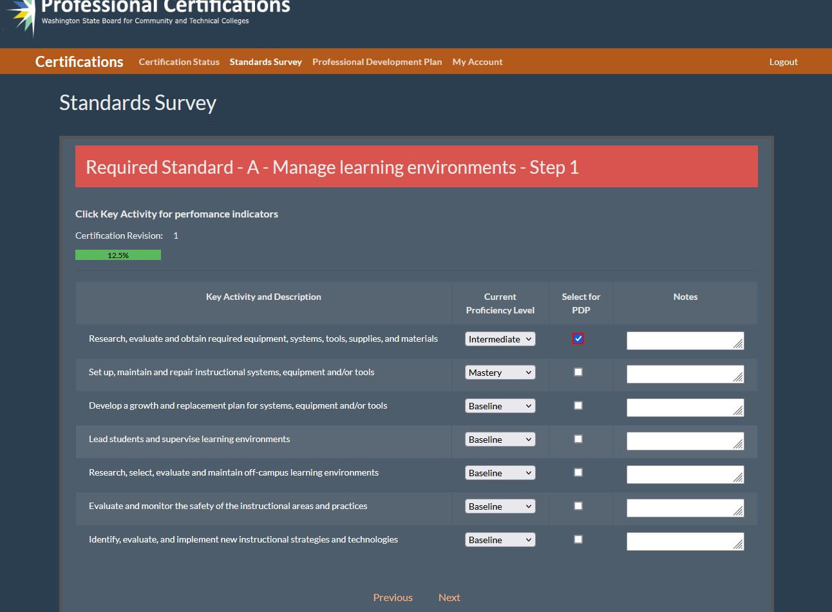

Slide 18
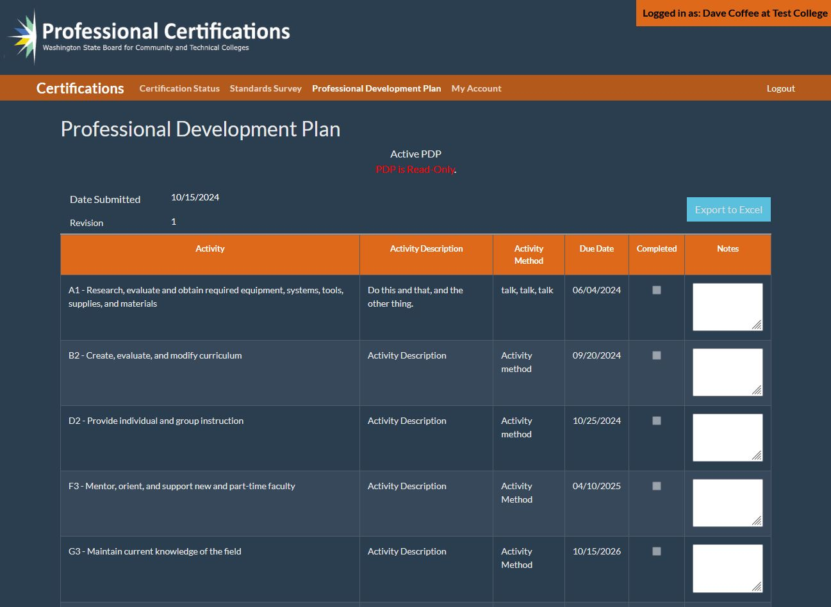

Slide 19
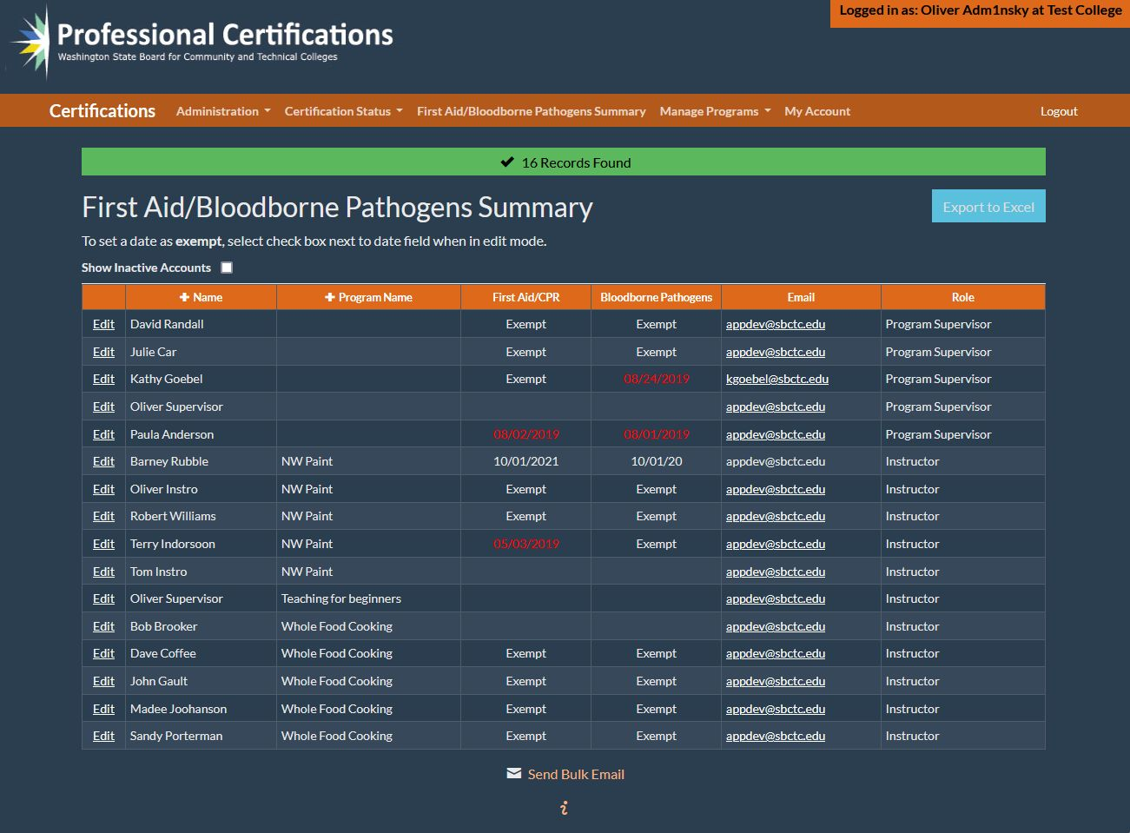

Slide 20
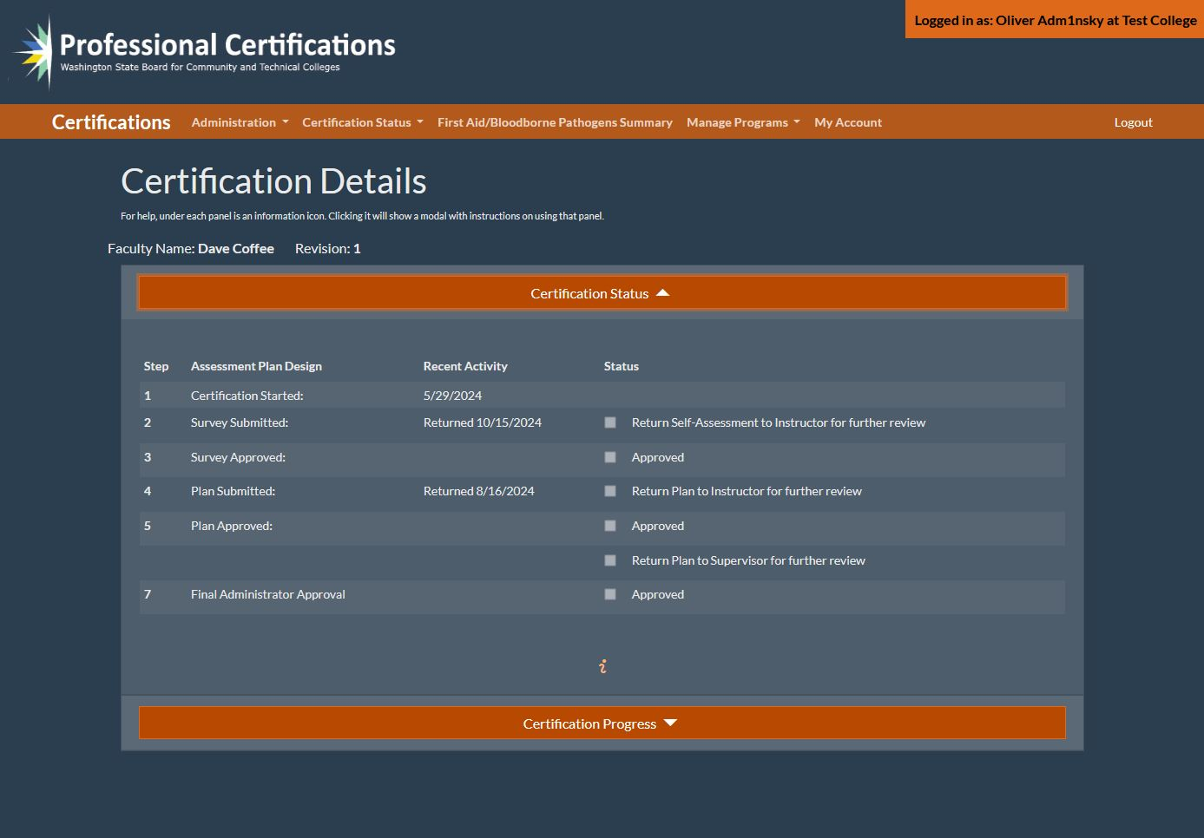

Slide 21
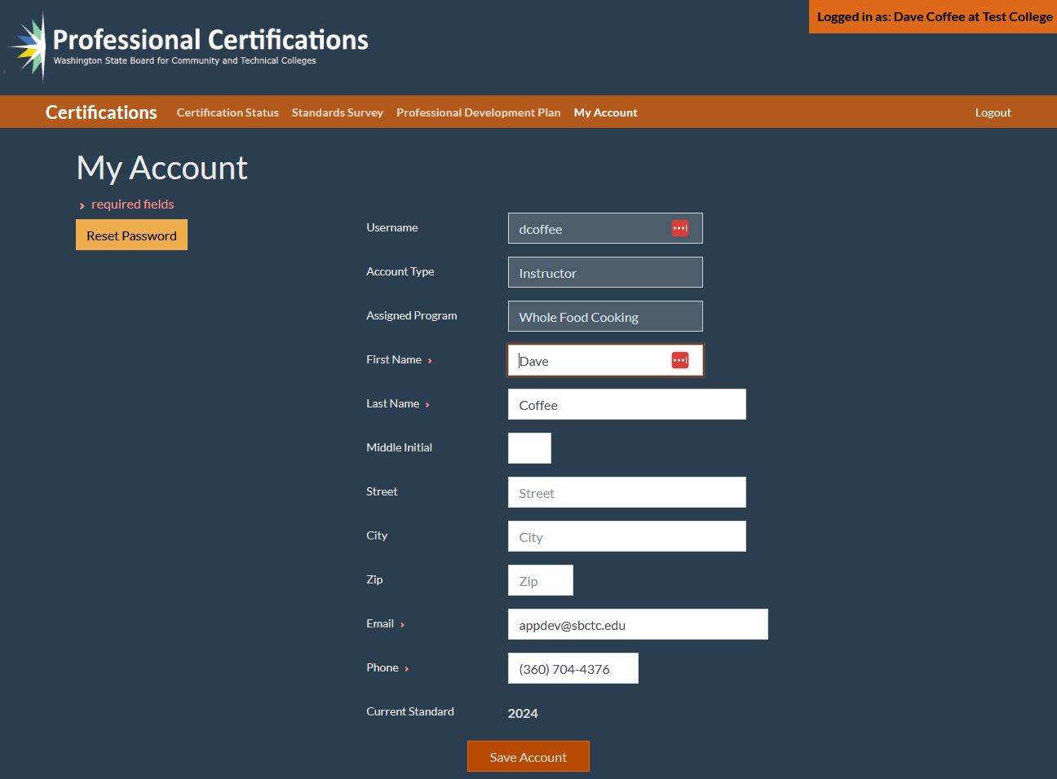

Slide 22
SBCTC Fall Update
Friday, October 18
Agenda Topics:
  System Updates
  Project & Program Updates
  Funding Updates
  Staff and Resource Updates

Slide 23
Infrastructure funding agreement (IFA) Data Overview
Carmen McKenzie, Director of Data Services
Travis Dulany, Associate Director of Policy Research

Slide 24
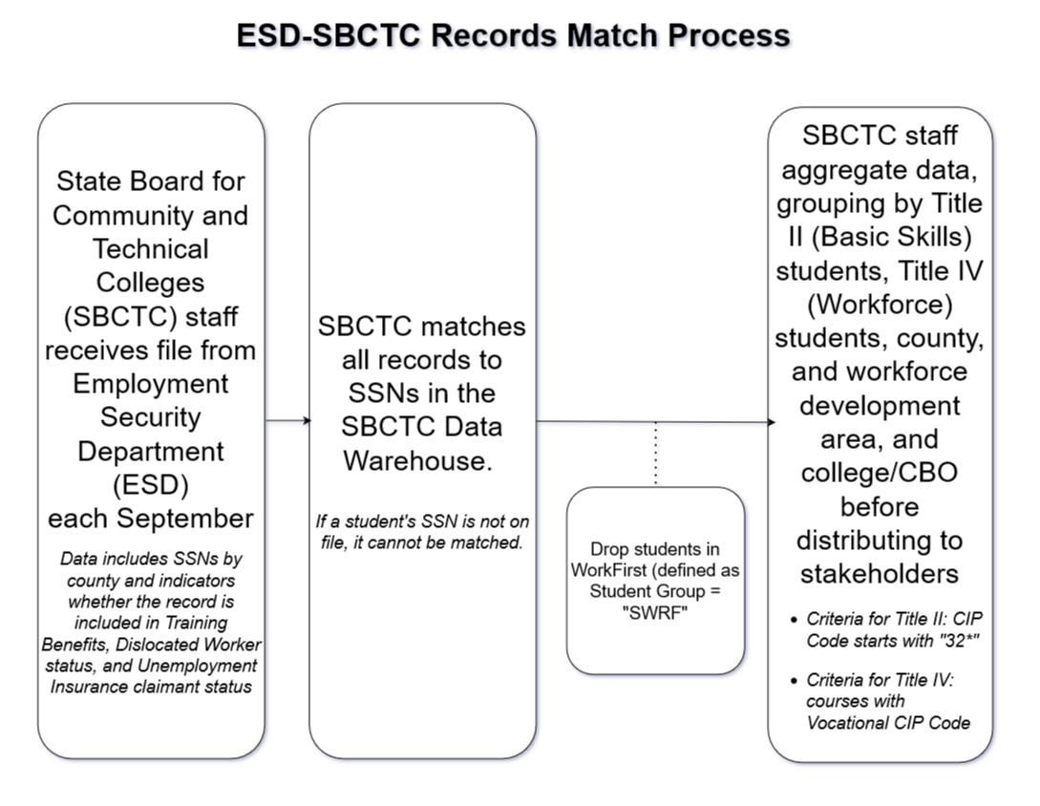

Slide 25
ESD-SBCTC records match summary
Source: ESD records matched to SBCTC data warehouse records for the 2018-19 thru 2022-23 school years.
Note: records were matched based on a participant reporting the same SSN identifier to ESD and one of the colleges or CBOs
*2019-20 data unavailable
Unduplicated State Totals
School Year | All ESD Records | Students in Title II classes, not WorkFirst | Students in CBO Title II programs | Students only in CBO Title II programs | Students in Workforce classes, not WorkFirst
2018-19 | 162,023 | 2,677 | 22 | 6 | 7,810
2020-21 | 96,243 | 1,223 | 3 | 1 | 4,632
2021-22 | 116,854 | 1,185 | 4 | 2 | 4,635
2022-23 | 110,043 | 1,165 | 6 | 0 | 3,988
2023-24 | 129,747 | 1,299 | 12 | 4 | 4,454
Five Year Total | 614,910 | 7,549 | 47 | 13 | 25,519
% of All ESD Records | -- | 1% | 0.01% | 0.00% | 4%

Slide 26
Workforce Development Area Totals
Academic Year 2023-2024
Note: *Totals include duplicates for people receiving services in more than one county or at more than one college/CBO
WDA | All ESD Records | Students in Title II classes, not WorkFirst | Students in CBO Title II programs | Students only in CBO Title II programs | Students in Workforce classes, not WorkFirst
Benton-Franklin | 8,045 | 151 | 0 | 0 | 291
Eastern*** | 4,735 | 44 | 0 | 0 | 192
North Central | 10,036 | 100 | 0 | 0 | 280
Northwest | 7,213 | 67 | 5 | 2 | 385
Olympic | 6,784 | 47 | 0 | 0 | 382
Pacific Mountain | 9,353 | 85 | 18 | 2 | 247
Seattle-King | 28,485 | 285 | 26 | 9 | 1,193
Snohomish | 10,521 | 49 | 0 | 0 | 310
Southwest | 11,444 | 122 | 0 | 0 | 193
South Central | 11,792 | 128 | 0 | 0 | 201
Spokane*** | 8,823 | 104 | 0 | 0 | 394
Tacoma-Pierce | 12,513 | 144 | 33 | 3 | 488
Total * | 129,744 | 1,326 | 82 | 16 | 4,556

Slide 27
Gainful Employment update
Summer Kennesson, Director of Policy Research
Diana Knight, Policy Research Analyst

Slide 28
update
New deadline: January 15, 2025!
  But there is a staged process, so we are working with RPC to have some elements (student and completers lists) complete by December 15 at the latest.
Notes:
Summer

Slide 29
Reporting Components
Completer List
  Sent to IRS for earnings data
Student List
  Used to calculate debt
Program List
  Used to determine which programs require FVT/GE reporting
  User guides
Notes:
Diana
Mention the overview also linked in agenda (thank Shawn and Angie)
Completers and student lists are different students
User guides also linked in overview document

Slide 30
Clearinghouse
Supports colleges in quarterly federally-required enrollment reporting
  Sends NSLDS student enrollment and financial aid data each quarter
Created a platform to support colleges in FVT/GE reporting
Colleges submit their FVT/GE data, NSC validates and submits to NSLDS
We can only support 'transitional' (2 year) reporting
Notes:
Diana
Important to understand the role of NSC in enrollment reporting to NSLDS because it explains why they have some data already available
Colleges submit enrollment records to NSC and NSC also collects financial aid records from servicers
Utilizing their records to support the colleges in meeting reporting requirements
Have a platform set up that colleges can use to validate their data, provide additionally required data, and submit
There are two different kinds of reporting for the student list: transitional is the less burdensome, and allows colleges to report graduates/withdrawn students for 2022-23 and 2023-24 only
This is what we are expecting all colleges will select and the only kind of reporting SBCTC is able to assist with

Slide 31
Clearinghouse
Completer list: NSLDS Completer list
  Colleges need to validate - not available yet
Student list: Compiled from enrollment reporting data
  Colleges need to validate and augment with additional data
Program list: Compiled from enrollment reporting data
  Colleges need to validate and augment with additional data
Notes:
Diana
What NSC is providing and what colleges need to do at a high level (will get to what WA CTCs need to do soon)

Slide 32
SBCTC
Working with CTCLink FA team and Query team
Working on building query/ies to support colleges in additional reporting requirements
  Exact fields/layout still underway
Goal is to cover almost all required fields but colleges will be responsible for some additional fields
Notes:
Diana
Our goal is to ease the burden where possible
Fields have been identified and query-building is commencing, more details to come (including updating the overview doc)
Colleges will still need to be prepared to pull and prep data to some extent
Some fields colleges will pull themselves
Query data will likely need to be merged with NSC data

Slide 33
colleges
RPC is primary point of communication for queries, but a GE listserv has been requested
RPC will have a GE workgroup for this year and upcoming years
Completers list – when available, review and apply exclusions and identify missing completers. Exclusions include:
  Deceased students
  Students enrolled in a CTP program
  Students enrolled in approved prison programs

Slide 34
colleges
Student lists
  Run SBCTC query and merge with the Student List
  Pull any remaining fields
    CTP program indicator
    Prison program indicator
    Invalid flag
    GE program flag (Summer will assist with this)

Slide 35
colleges
Program lists
  Won’t be available until student lists are complete
  State licensure (but SBCTC is compiling a list of programs and will help with collecting data where available) - not required if unavailable
  Industry accreditation

Slide 36
Metrics
In January, DoE will do calculations of Debt to earnings (D/E) and Earnings Premium (EP) calculations using Employment Security data. Metrics are aligned with WA state data for thresholds.
Programs that fail one or both metrics will have mandatory notification process – SBCTC will provide guidance and communication materials.
Support for GE programs that fail one or both metrics will be available
Notes:
Summer

Slide 37
One other thing
The proposed changed to reduce maximum length of Title IV programs to 100% (from 150%) of hours described for licensure or certification is still on hold.
No need to take any action at the moment!
Notes:
Summer

Slide 38
Useful links
GE/FVT User Guide - describes fields
Notices – read the notices – titles are misleading and not updated
First analysis of program metrics
National Student Clearing House - NSC reference pages
Notes:
Summer

Slide 39
questions
Bear with us while we let CTCLink FA team support FA offices at start of fall quarter
We are happy to meet with colleges/college teams if you need us to walk through things with your college groups.
A 'GE/FVT' listserv has been requested.
Skenesson@sbctc.edu
Notes:
Summer

Slide 40
Legislative, program & Funding updates

Slide 41
2025 legislative session
105 days - "long session" to write the biennial budget
January 13 - April 27, 2025
Revenue Forecast and Ballot Initiatives
Overview of SBCTC Priorities
  Competitive Compensation
  Increase General Purpose Funding

Slide 42
2025 legislative session
Provide Fully Funded, Competitive Compensation ($183 million)
Community and technical colleges prepare students of all ages, backgrounds, and skills to enter careers and universities, building a stronger workforce and economy for Washington. Faculty and staff are at the heart of our students’ success, but we are losing them to better paying jobs in private industry, K-12 schools, and other colleges and universities. Along with faculty, we are struggling to hire and retain administrative and classified staff who serve in crucial roles in financial aid, business operations, and advising.
The hollowing out of our employee ranks has a direct impact on students, who need access to programs and the personal touch of experienced staff. A salary increase of 6.5% for each year of the biennium, for a total wage increase of 13%, would help colleges provide competitive compensation, fill vacant positions, and reduce turnover. We are very grateful for the Legislature’s decision to provide full funding for compensation in the 2023-25 budget and urge you to continue this vital policy.

Slide 43
2025 legislative session
Support College Operations ($90 million)
Community and technical colleges urgently need additional, core operational support to cover the true cost of running a college. College operating costs have increased dramatically over the past five years and Washington’s tuition formula has not kept pace with the increases. Rising costs and capped tuition rates have squeezed college operating budgets and, within those narrow funding margins, colleges must dedicate a significant portion to unavoidable costs: About 80% of college funding is dedicated to salaries and a significant amount is tied to specific purposes under legislative provisos.

Slide 44
Industry Demand
Industry Demand: Meets the needs of industries, employers, and incumbent workers.
Team Members:
  Carolyn McKinnon, Policy Associate; cmckinnon@sbctc.edu
  Danny Marshall, Program Administrator; dmarshall@sbctc.edu
  Vicky Chungtuyco, Educ. Program Coord.; vchungtuyco@sbctc.edu
Programs:
Job Skills Program (JSP)/Customized Training (CTP) | Commercial Drivers Licensing Fund/Grant
Workforce Development Funds | Invest in Washington
Centers of Excellence | Continuing Education Council (CEC)
Business (AWBI) & Labor (WSLC) Liaisons | Economic Development

Slide 45
funding Updates
Job Skills Program
Look for grant applications starting mid-to-late March 2025, due early-to-mid May
Funds for this year, FY25, fully awarded. with upcoming funding surveys for possible adjustments. If you have a very short-term project, get in touch w/ Danny ASAP.
Maintenance request for additional funding FY25-27 ($4.8m)
Commercial Drivers Licensing Fund (CTCs)/Grant (Private Career Schools/Colleges)
Funding to expand CDL training capacity in Washington
CTC grants were awarded through competitive application for development of CDL expansion over three years. Based on FY24 expenditures we were able to add support for two additional CTCs for a total of 10, FY25 is the final year of the initial funding awards.
PCS/C grants are awarded through a competitive annual application, $1M to 8 schools.
Workforce Development Funds
13 projects started on July 1, 2024.
2 of the projects funded met the new "Invest in Washington" funding criteria supporting manufacturing & production occupations.

Slide 46
Program Updates
Centers of Excellence Site Reviews
Thank you to our recent site review volunteers from WEC !
We need WEC volunteers for 4 upcoming reviews – 1 exec committee rep and 1 member-at-large for each visit.
These are virtual events lasting 3.5 hours and the only qualification is an interest to participate
  Cybersecurity COE, November 20, 2024 (reps filled).
  Clean Energy COE, February 19, 2025.
  Global Trade & Supply Chain Manufacturing COE, March 10, 2025.
  Aerospace & Advanced Manufacturing COE April 9, 2025.
Send an email to Danny: dmarshall@sbctc.edu or Vicky: vchungtuyco@sbctc.edu.

Slide 47
Industry demand initiatives
Law Enforcement & Corrections Workforce Study, legislative proviso report delivered Oct. 1.
Retail Industry Work Group, Senate Bill 6296 started on Oct. 15. Outreach to CTC retail programs underway. Contact us if you want more information or to participate.
Micro-pathways Fellowship, Education Design Lab wrapping up soon, with SBCTC system steering committee continuing to meet.
  Work products to include a framework for how CTCs can implement micro-pathways, technical assistance in the form of design tools for identifying and developing micro-credentials & pathways, and a prototype micro-pathway (Computer Support Specialist – Help Desk w/ Cloud Computing).

Slide 48
Program support
Program Support: Provide overarching program support to strengthen business, industry and colleges.
Team Members:
  William Belden, Policy Associate; wbelden@sbctc.edu
  Kimberly Ingram, Program Administrator; kingram@sbctc.edu
  Shelby Means, Program Inventory Coordinator; smeans@sbctc.edu
Programs:
Carl D. Perkins | CTE Dual Credit
Comprehensive Local Needs Assessment (CLNA) | High Demand Grant
Program Approval Review & Program Inventory | Workforce Education Council (WEC)
Prof-Tech Certification | Customer Advisory Committee (CAC)

Slide 49
Program Updates
CTE Dual Credit Proviso Discussions
  December legislative report.
  Related projects: WA Limitless (Career Connected Learning), Launch (K12 to Postsecondary Career Transitions).
  Streamline dual credit conversations – integration across RS, CiHS, and CTE DC.
  Focus articulations on meaningful progress (10+ quarter credits) in specified pathway.
    Moving away from all dual credit is good dual credit – differentiate experiential from pathway aligned.
    Consider Common Course Numbering
  Advocate for staffing/financial support of CTE DC.
    Most equitable participation (race, socioeconomic), no dedicated state funding.
  Alignment of advising/career clarity between K12 and CTCs.
Resources
  Career Cluster Framework - updates to be released October 2024.
    Possible bridge/common framework between K12 and CTCs.
    Credentials of Value/IRC alignment between K12 and CTCs.
  ERDC Dual Credit Program – Enrollment and Credit Attainment Report.
  Big Blur research from Jobs for the Future.

Slide 50
Program Updates
Advisory Committee Procedures
  Overview of changes, highlight membership clarifications
  Program approval requirement
Professional Technical Faculty Certification
  Updates to ProCert – user input and 2024 Skill Standards
Perkins Regional Approach to CLNA
Skills Gap - The Great Misalignment
Customer Advisory Committee (JSP/WRT)
  Seeking recommendations for Business Member
Perkins Special Projects

Slide 51
Perkins updates
Perkins
  Perkins Plan budget revisions ---> include CLNA question that clearly identifies need for budget request
    OBIS—Timely and Accurate Revisions
  Monitoring 25 colleges/districts in October and November
  CLNA Partner Engagement: Survey and Interview Question
    https://www.surveymonkey.com/r/CLNAEngagement
State Determined Performance Levels (SDPLs: 1P1, 2P1, 3P1)
  Change: SBCTC must submit annual SDPL to WTECB every December
  Email in Nov. to solicit feedback for proposed State Target for SDPL
  Based off the state's previous two year's performance
Perkins Tableau Data Dashboard
  Email will be sent when dashboard is updated

Slide 52
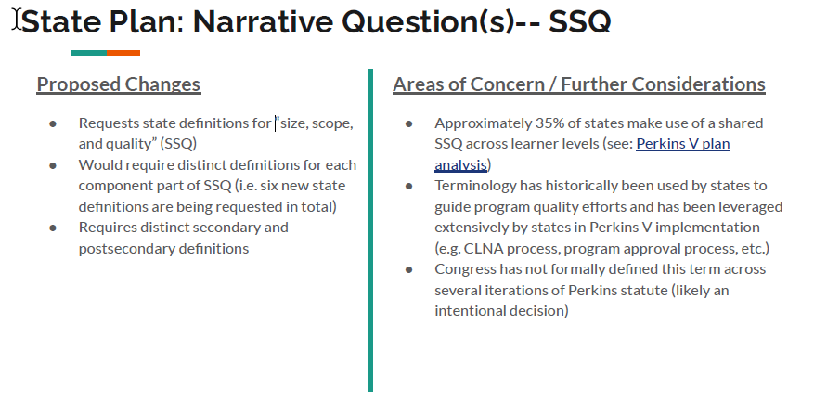
Perkins v proposed changes
Slides adapted from Advance CTE Presentation
Referenced Link: https://careertech.org/wp-content/uploads/2023/01/State_CTE_PerkinsV_2020.pdf

Slide 53
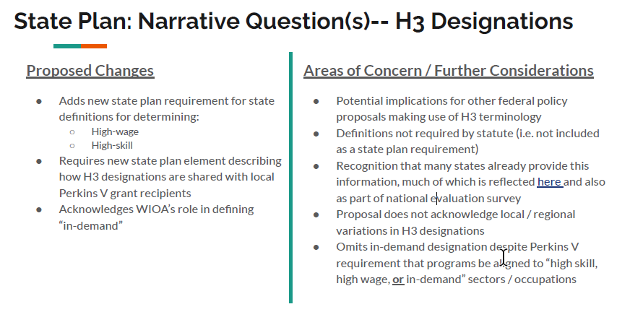
Perkins v proposed changes
Slides adapted from Advance CTE Presentation
Referenced Link: https://careertech.org/wp-content/uploads/2023/01/Aligning_Opportunity_HighSkill_HighWage_InDemand_0.pdf

Slide 54
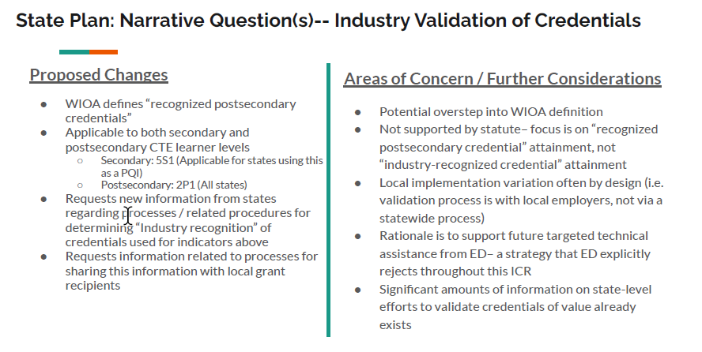
Perkins v proposed changes
Slides adapted from Advance CTE Presentation

Slide 55
Perkins v proposed changes
Slides adapted from Advance CTE Presentation
Performance Indicators:
1P1 – Post college employment or continuing education
  State Plan Guide:
    Requires inclusion of all CTE concentrators exiting in reporting period, not just those that graduated or completed a program
    Allows states to use preceding reporting year to expand window for data collection to 16 months
  CAR Report:
    Require states to disaggregate by placement type (i.e. further ed / training, military, volunteer service, unsubsidized employment)
    Requires states to disaggregate based on education and training type (i.e. certificate, AA, BA, apprenticeship, licensure, etc.)
    Require states to disaggregate employment placement based on H3 designation (i.e. employment in high skill /wage sectors)
https://blog.careertech.org/ed-proposes-significant-changes-to-perkins-v-implementation-legislative-update/

Slide 56
Perkins v proposed changes
Slides adapted from Advance CTE Presentation
Performance Indicators:
2P1 – College completion
  Primarily focuses on creating greater consistency within the measure’s denominator (states currently using too many variations for reliable basis of comparison)
  Changes mostly center on time of CTE concentrator exit / completion
3P1 – Enrollment in non-traditional fields
  Significantly shifts denominator to focus only on CTE concentrators in non-traditional fields (not all CTE concentrators)
  Further narrows basis of comparison to full CTE student concentration (i.e. 2 courses in a single program area) versus broader enrollment in these same programs (i.e. student only takes one course in a non-traditional field)
https://blog.careertech.org/ed-proposes-significant-changes-to-perkins-v-implementation-legislative-update/

Slide 57
Perkins v proposed changes
Slides adapted from Advance CTE Presentation
Impact on Local Grant Recipients
All ICR components will have comparable in-state requirements (i.e. data reporting will change to facilitate/support new state reporting requirements and approaches)
Local school districts / other Perkins V grantees will need to track and obtain data in new /different ways (ex. Placement measure disaggregation, related tracking of industry alignment etc.)
  Access to necessary data and information is lacking in key areas
Will likely precipitate re-negotiations of local performance targets as states set new SDPLs
Elimination of certain local programs may be accelerated
Local and regional processes and policies for ensuring program alignment to the needs of the labor market may be superseded (focus of ICRs is surfacing statewide processes and procedures for ensuring compliance– likely friction with “local control” states to some degree)
Capacity/opportunity costs

Slide 58
Perkins v proposed changes
Slides adapted from Advance CTE Presentation
Emerging Themes of the ICR
Significant new state and local level administrative burdens (i.e. right after the most recent four-year planning process has concluded).
Implications for racial equity priorities by undermining ability to evaluate long-term impact of Perkins V on student subgroups/special populations (i.e. longitudinal data comparisons will be unworkable).
Perkins V data becomes less actionable/useful for timely program improvement (and appears to be more focused on streamlining federal data collection/reporting efforts).
Reduces alignment and coordination with other education and workforce systems (e.g. changes to the academic indicators, planning cadence disruption, etc.).
Technical assistance/monitoring is a more appropriate strategy for ensuring data quality and supporting ED oversight of Perkins V implementation (and is acknowledged in the ICR justification).
Key point of emphasis during Perkins V reauthorization centered around “Secretarial Authority” and the ability of ED to subsequently regulate on many of these issues (i.e. some of these proposals have the practical effect of regulation).
ED has failed to demonstrate that it has exhausted other avenues for collecting this information (e.g. Perkins V’s mandated national evaluation).

Slide 59
Program Approval Updates
New PAR Site
  Since it launched end of April of 2024, we've had about 200 requests come in from various colleges (this includes modification requests, program status updates, and new plan requests)
  Currently this site is just for professional technical programs
    Work will begin on implementing apprenticeships and academic transfer degrees this year
  Additional focus on advisory committee membership and documentation
  Reach out to programapproval@sbctc.edu with questions or access issues.
Program Inventory
  Inventory alignment and program status updates
    Managing the movement of plans to inactive status.
  Documentation of maximum credits for all active plans.
  CIP/SOC codes
  P/TCCN updates
Resources Located at:
  https://www.sbctc.edu/colleges-staff/programs-services/professional-technical/default.aspx

Slide 60
Advisory committee procedures
Updates Include
  Aligning guidance across Program Approval, Perkins Legislation, and Worker Retraining.
  Documentation of legislation and policies.
  Update of committee roster to replace member’s residence with employers location (city).
  Clarification of ethics training requirement – each term of service requires new training.
  Information organized by Committee Structure, Committee Management, and Committee Membership
  Updated language clarifying “labor” representative.
  Included language on resources to identify labor and industry representative
    Association of Washington Business, Washington State Labor Council, and Centers of Excellence
  Clarification of role of college representatives/employees serving on committees.
  Modified advisory committee duties.
  Document is posted to WEC fall meeting resources for your review and feedback.

Slide 61
Policy Guidance
Professional-Technical Instructor Initial Certification
WAC 131-13-170 through WAC 131-16-094 provide faculty certification requirements for both tenure track and adjunct professional-technical instructors.
Initial certification requirements in WAC 131-16-092:
  All tenure-track professional-technical instructors.
  All adjunct professional-technical instructors that teach a two-thirds full-time load for more than the equivalent of three quarters.
    This equates to an average of 10 or more credits over their four most recent quarters, excluding the summer term. An adjunct professional-technical faculty member teaching more than 40 total credits over the four most recent quarters must be certified.
    Colleges should only consider the last two years of employment for adjunct faculty.
    The number of credits is based on completed teaching assignments.
    Teaching quarters to be averaged are the last four quarters of completed assignments.
  Adjunct professional-technical instructors teaching less than a two-thirds full-time load are not required to complete certification.
    College are required to assess their ability to provide student instruction, supervise learning environments, and implement curriculum, outcomes, and assessments.
  Document is posted to WEC fall meeting resources for your review and feedback.

Slide 62
Sector Response
Sector Response: Support colleges as they deliver career and sector-based educational opportunities to students.
Team Members:
  Anna Olson, Policy Associate; aolson@sbctc.edu
  Megan Harper, Program Administrator; mharper@sbctc.edu
  Shanna McBride, Program Administrator; smcbride@sbctc.edu
Programs:
Allied Health | Cybersecurity
Early Achievers Grant (EAG) | Early Learning/Parenting Education
Hospital Employees Education & Training (HEET) | Nursing Expansion
Worker Retraining (WRT)

Slide 63
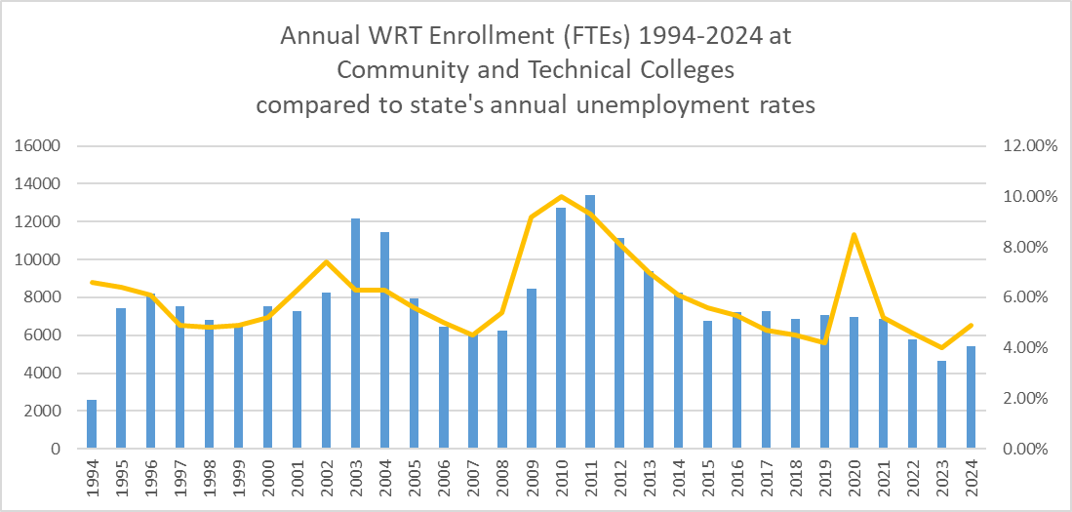
Funding & Program Updates
Worker Retraining
  Policy update: documentation of previous policy change for Displaced Homemakers 48-month eligibility
  Redistribution policy suspended due to incremental implementation of the new base allocation; funding survey for voluntary redistribution coming early next week
  Enrollment: enrollments are up by 14%, to 5439 in 23/24 from 4666 in 22/23
Updated 9/24

Slide 64
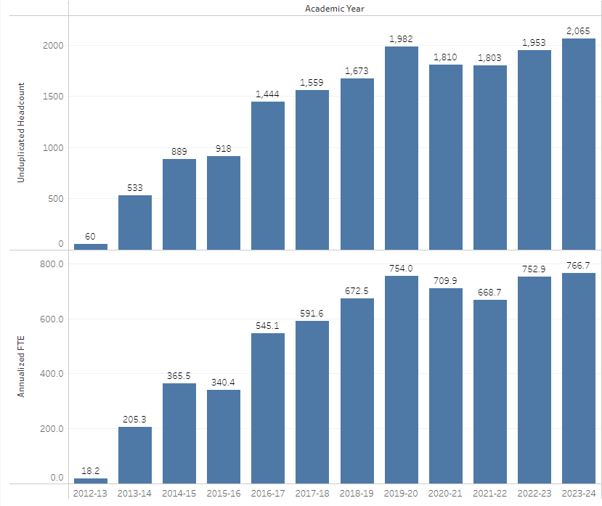
Funding & Program Updates
Early Achievers Grant
Enrollment Update:
Headcounts and FTEs are up
2023/24 FTE target: 568
2023/24 actual FTE: 767
Goal exceeded by 34% or 199 FTEs
Funding Update:
737 FTEs awarded in FY25.
All colleges' requests were fully funded
Funding survey due 10/18 (today!)
Updated 9/24

Slide 65
SB5582 Nursing Workgroup
Led by 6 nursing deans/directors/faculty, with input from faculty, students, and consultation from external stakeholders
Report due to the Legislature on December 1:
  Focuses on areas of influence of programs
  Highlights examples of excellence and innovation
  Encourages to maintain investments and strategies that led to significant gains achieved since 2019
  Proposes system improvements related to faculty and director support, simulation, and admissions practices
  Recognizes changing student needs.
*WABON Data Dashboard

Slide 66
Work-based Learning
Work-based Learning: Assist colleges as they provide experiential learning opportunities.
Team Members:
  Genevieve Howard, Policy Associate; ghoward@sbctc.edu
  Karin Gitchel, Program Administrator; kgitchel@sbctc.edu
  Irene Shaver, Program Manager Climate Solutions, ishaver@sbctc.edu
Programs:
Aerospace 1,000 FTE | Career Connect WA
Aerospace Apprenticeship FTE | Apprenticeship
Aerospace Contract | Aerospace Pipeline Committee
Career Launch Equipment & FTE | Aerospace Legislation
Career Launch Endorsement | Aviation & Aerospace Advisory Committee

Slide 67
funding & program Updates
Career Launch Endorsement Application
Application has been significantly streamlined and is live on the Career Connect Washington website.
Programs with or seeking Career Launch Enrollment Expansion FTES (monitored or otherwise) must maintain a current endorsement.
Endorsements are valid for three-years and then must be renewed.
  Career Launch Enrollment Expansion FTES
  24 FTES available for redistribution @ $8,000 per FTE
  Applications were due on October 10, 2024.

Slide 68
Student support Programs
Student Supports Team:
Jennifer Dellinger, Policy Associate, jdellinger@sbctc.edu
Becky Wood, Program Administrator, bwood@sbctc.edu
Sheila Acosta, Program Administrator, sacosta@sbctc.edu
Dylan Jilek, Integrations Coordinator, djilek@sbctc.edu
Rebecca Kay, Relationship & Compliance Analyst, rkay@sbctc.edu
Integrated Student Supports Team:
Yokiko Hayashi-Saguil, Policy Associate, yhayashi-saguil@sbctc.edu
Christine McMullen, Policy Associate, cmcmullen@sbctc.edu
Laura Coghlan, Program Administrator, lcoghlan@sbctc.edu

Slide 69
Student Support Programs & Policy areas
Core Programs/Areas:
Basic Needs Act
  Benefits Navigation
  Campus Basic Needs & Hunger Free Strategic Plans
  Free/Reduced-Price Meal Pilot Program
Basic Food Employment & Training (BFET) Program
WorkFirst Delivery Agreement
Compliance & Monitoring
Integrated Service Delivery
Integrated Programs:
Mental/Behavior Health Pilot
Opportunity Grant
Supporting Students Experiencing Homelessness Program
Student Emergency Assistance Grants Program
Policy Areas: postsecondary student basic needs, WA state poverty reduction, and equitable access

Slide 70
FY/FFY24 SSP Enrollments
SEAG
Total Students Served 5,694*
SSEH
Total Students Served 6,424*
WorkFirst
Annual Enrollment 2,997
11% Increase From Previous Year
BFET
Annual Enrollment 6,836
13.5% Increase From Previous Year

Slide 71
Program & Grant Updates
Student Emergency Assistance Grants and Supporting Students Experiencing Homelessness Program
SSEH & SEAG - Summer Quarterly Report and Funding Survey
  Due 10/31
  Additional 1-time funding for SSEH available
SSEH – all 34 CTCs are either offering the program or in their planning year and expected to apply as a permeant program next year
SEAG - 27 CTCs offering the program. The remaining 7 are in the process of entering into a planning grant for next year

Slide 72
Program & Grant updates
Basic Food Employment and Training (BFET) Program:
Fall funding survey open
  Due 11/1
Quarterly Billing
  CtcLink queries and support
Benefits Promotion Pilot
  pilot promoting food benefits for low-income students (WSAC – lead, SBCTC – collaboration)
  WSAC data share agreement with DSHS
  Direct connection to SNAP and BFET
Expanding Leveraging Capacity
  Strategic Support on Time and Effort
WorkFirst Delivery Agreement:
Fall funding survey open
  Due 11/1
Expanded allowable programs
  AA/AAS, AA-DTA, and Transfer
Focus on increasing WFWS programs
Both WorkFirst & BFET:
Increased training and workshop offerings to system
Program & Fiscal Monitoring:
Begins next week and runs through July, 2025 – hybrid model
WorkFirst & BFET visits are split

Slide 73
Program & Grant updates
Opportunity Grant
Fall Funding Survey
  Release next week
Health Care Funds
  Sunsets 6/30/25
  Program Approvals will remain
Canvas Community
  Included in the Student Support Programs Canvas Community
  One-stop shop
  Sunset listserv
Program Approval
  Notice will go out via Canvas with instructions & timeline
  Looking to find a streamlined formal structure for program approvals

Slide 74
Program & Grant Updates
Benefits Navigators and Campus Hunger Free and Basic Needs Strategic Plan:
Allocation increased in FY25 for Benefits Navigators
Campus Strategic Plans are developed, and CTCs are working on implementing
SBCTC, WSAC, CTCs and Publics are working on data metrics for state-level report due Dec 1, 2025
WA Student Experience Survey
2nd state-wide cross-sector census survey on basic needs
10/28 - 11/22 - emailed directly to students
Free/Reduced-Price Meal Pilot Program:
4 CTCs and 2 Publics
Year 2 of the 3-year pilot
SBCTC, WSAC, CTCs and Publics are working on data metrics for year 3

