Slide 1
Labor Liaison February WEC Emmanuel Flores
Notes:
EF in for RM
RM is out on medical leave, will be back for the next WEC

Slide 2
Legislative Priorities
Notes:
UI for Striking Workers- levels the playing field for those on the strike lines
Child Labor On Job Sites- allows LNI to revoke minor worker permits for negligent employers
Child Care workforce standards- creates child care workers standards board with LNI and DCYF
Pubic Sector AI- Allows public workers to bargain around AI scope
Minimum wage and paid vacation- single, full time adult needs $25.60/hr
Permitting and Siting- Increase efficiency and reduce backlog for permitting
Fund State CBA

Slide 3
WSLC Workforce Development Department
Unemployment Insurance Navigator
Rapid Response
Direct Worker Supports
Labor Liasions
https://www.wslc.org/workforce-development/

Slide 4
Registered Apprenticeship FYI
WSATC
Meets quarterly (Jan/April/July/Oct)
Wednesday Meetings
Day before Thursday Council meeting
Childcare Taskforce (11am) , Apprenticeship Coordinators (1pm), Joint Retention & Recruitment Committee (2pm)
Great way to network and connect with Registered Apprenticeship Community
Upcoming dates:
April 17th, TBD
Registered Apprenticeship 101 Presentation available, reach out to schedule
Notes:
Read slide

Slide 5
Advisory Committees Scan QR Code and Enter Advisory Committee information
Notes:
Those with empty labor seats, scan the QR code and enter your information here.

Slide 6
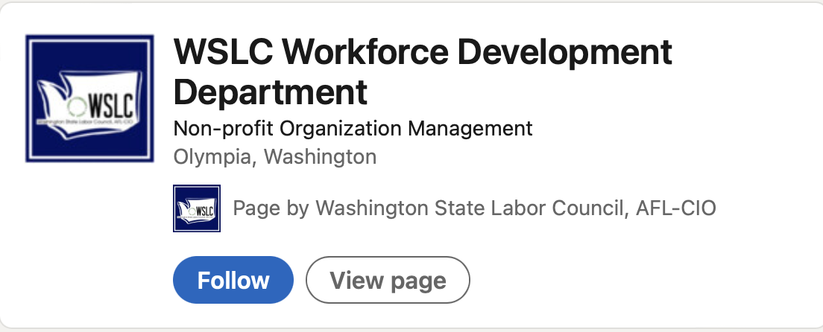
Ways to Connect with the WSLC
Social Media (LinkedIn & Facebook):
Quarterly Newsletter:
Send an email to rmcaloon@wslc.org to sign up!

