Slide 1
Washington’s Community and technical colleges
SBCTC FALL 2026 WEC Update

Slide 2
Program, Funding, & System updates

Slide 3
Work-based Learning
Work-based Learning: Assist colleges as they provide experiential learning opportunities.
Team Members:
  Genevieve Howard, Associate Director; ghoward@sbctc.edu
  Karin Gitchel, Program Administrator; kgitchel@sbctc.edu
Programs:
Aerospace 1,000 FTE | Career Launch Endorsement
Aerospace Contract | Aerospace Pipeline Committee
Apprenticeship

Slide 4
Apprenticeship
Washington College Grant for Apprenticeship (WCG-A)
14 apprenticeship colleges are set up to award the WCG-A to eligible apprentices.
For FY27, the Legislature reduced the WG-A award to 50% of the Washington College Grant CTC maximum. The top award is now $2,548 for apprentices at 0–60% MFI.
SBCTC and WSAC published an updated WG-A QARS Quick Reference Guide and an updated Apprenticeship Programs Business Process guide, both in the ctcLink Reference Center:
  https://ctclinkreferencecenter.ctclink.us/m/133966

Slide 5
Apprenticeship
Community of Practice - Apprenticeship
The CoP meets the 2nd Wednesday of each month at 1:00 PM on Zoom. It is open to apprenticeship coordinators and the staff who support them.
Upcoming topics:
  October 14: Washington College Grant for Apprenticeships, including a campus spotlight on lessons learned from the WG-A rollout
  December 9: MOT Articulation Pathways
  January: Partner Engagement
  March: ctcLink Apprenticeship Administration
The March session will be on transcripts and completion with the ctcLink team. Coordinators will need to bring their registrar or records staff.

Slide 6
Aerospace High Demand 1,000 FTEs
Aerospace High Demand 1,000 FTES redistribution
  30 FTES ($240,000, at $8,000 per FTES) are available.
  Eight eligible applications were received, requesting about 93 FTES (roughly $742,000).
  A review committee of SBCTC staff and industry representatives from the Aerospace Pipeline Committee will meet in October to score the applications and make recommendations.
  Tentative timeline:
    Recommendations go through SBCTC approval Oct/Nov.

Slide 7
Program support
Program Support: Provide overarching program support to strengthen business, industry and colleges.
Team Members:
  Genevieve Howard, Associate Director; ghoward@sbctc.edu
  Kimberly Ingram, Relationship & Compliance Analyst; kingram@sbctc.edu
  Shelby Means, Program Inventory Coordinator; smeans@sbctc.edu
Programs:
Carl D. Perkins | Program Approval Review & Program Inventory
Comprehensive Local Needs Assessment (CLNA) | Workforce Education Council (WEC)
Prof-Tech Certification

Slide 8
Perkins updates
Perkins Grants
  Non-Trad and Special Projects FY27 Applications = CLOSED
Perkins Tableau Data Dashboard
  Email will be sent when dashboard is updated (Oct or Nov)
  Reporting Year 24-25 State Target feedback solicitation (Nov)
Perkins Technical Assistance
  Virtual Office Hours (1st Friday of the month)
  Trainings offered monthly
Monitoring
  Spending Snapshot in December
  Selected colleges will be notified by end of October

Slide 9
Program Approval Updates
Program Inventory
Since fall of last year about 60 new programs have been approved and added to inventory in the following areas:
  Agriculture
  Air Traffic
  Automotive
  Business: Management, Taxation, Operations, Finance, Entrepreneurship, Human Resources
  Communication
  Construction
  Cosmetology
  Culinary
  Early Childhood Education
  Forest and Wildlife
  Health Professions: Medical Billing & Coding, Medical Assistant, Paramedic, EMT, Substance Use Disorders, Massage Therapy
  Manufacturing
  Marketing
  Natural Resources
  Visual Arts
  Viticulture and Enology
  Welding
  Apprenticeships:
  Laborer
  HVAC
  Wireman
  Mechatronics
  Tool & Die Maker
  Heavy Duty Diesel Mechanic
  Project and Production Manager

Slide 10
Program Approval Updates
Program Inventory: CAF (Common Attribute Framework) Updates
Expanding CAF information to better reflect how programs are identified in the inventory.
Incorporating new CAF values:
Fully Online Designator: Identifies programs offered fully online
Program Types: Identifies short-term programs, options, and primary programs
Next Steps: Begin outreach to colleges in October, with implementation planned to begin in early 2027.

Slide 11
Program Approval Request (PAR) Survey
Fielding questions regarding PAR process.
Workforce Education will be creating a survey to gather feedback on the PAR process.
  Process timeline
  Definitions
  Requirements
Use this feedback to identify potential changes and efficiencies to the process.
Any potential changes will need to be reviewed and approved through the Council structure.

Slide 12
WORKFORCE PELL
  Pell for Short-Term Training Programs
  Short-term training programs (8-14 weeks, 150-599 clock hours) with one or more years of operation may be eligible or WF Pell designation, allowing Pell Grant funding for students.
  Programs must result in credentials that are stackable and portable, and are aligned with a list of 123 Occupations in Demand created for WF Pell (available on the PAR Portal)
  Program Performance Requirements
  70 percent completion rate (within 150 percent of normal time to earn credential)
  70 percent job placement rate (within two calendar quarters)
  WF Pell Designation Pilot – Fall/Winter 2026
  WF Pell programs are designated by the Governor, but the PAR Portal is the first stop! Qualifying programs with one or more years of operation can access the WF Pell Eligibility Verification form on the PAR Portal. Programs with an Eligibility Verification letter may apply for designation via the WSAC website
  First pilot cycle October-December 2026, second cycle for designations in early 2027

Slide 13
Baccalaureate Programs
Bachelor's Degree Programs: New program approvals, existing program modifications, support to design, build, and evolve high quality community college baccalaureate programs with an ecosystem of partners.
Team Members:
  Ken Hang, Policy Associate; khang@sbctc.edu
  Sally Heilstedt, Director of Transfer Education: sheilstedt@sbctc.edu
Programs and Adjacent Work:
Bachelor's Degree Program Approval | Academic Credit for Prior Learning
Baccalaureate Leadership Council (BLC) | Washington MESA
WACSE & WCERTE: Computer Science and Engineering Related Education (Transfer) | Impacts of AI on CS/IT/Cyber
Course Sharing: CS + Sustainability | High-Impact Practices

Slide 14
Baccalaureate program approval: 2026-2027
Notifications of Intent of Proposal (“one-pager”) can be sent any time by email to degreeprocess@sbctc.edu
Program Proposals reviewed 3 times per year→
Details and new templates on website at Bachelor's Degree Program Approval Process
Quarter | Program Proposal Submission Deadline for Review | Presentation and Vote at State Board Meeting
Fall | Aug 3, 2026 | Oct 7-8, 2026
Winter | Nov 30, 2026 | Feb 3-4, 2027
Spring | Feb 1, 2027 | Apr 7-8, 2027

Slide 15
Bachelor’s Program Modification
Some modification requests can now be submitted online in the PAR website:
  Change of the program title, program CIP code
  Change in the maximum number of credits
  Change of the program's status (e.g. teach-out)
All other modification requests can continue to be submitted via email, including program subplan/specialization requests

Slide 16
Sector Response
Sector Response: Support colleges as they deliver career and sector-based educational opportunities to students.
Team Members:
  Anna Olson, Policy Associate; aolson@sbctc.edu
  Megan Harper, Program Administrator; mharper@sbctc.edu
  Shanna McBride, Program Administrator; smcbride@sbctc.edu
Programs:
Allied Health | Cybersecurity
Early Achievers Grant (EAG) | Early Learning
Worker Retraining (WRT) | Nursing Expansion

Slide 17
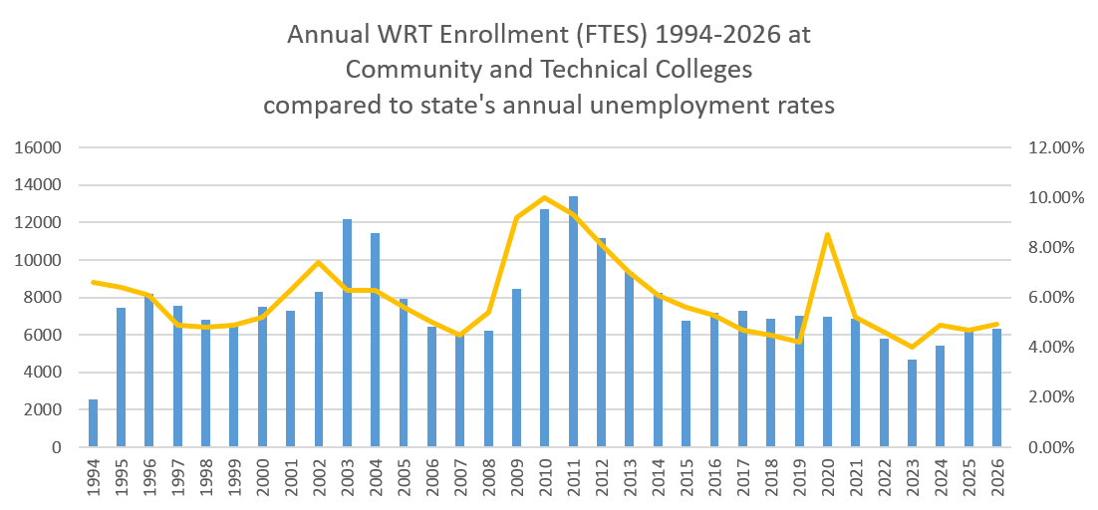
Worker Retraining
  Detailed layoff notice information is available via the Employment Security Department
  Individual program enrollment monitoring starts in the current 2026/27 year

Slide 18
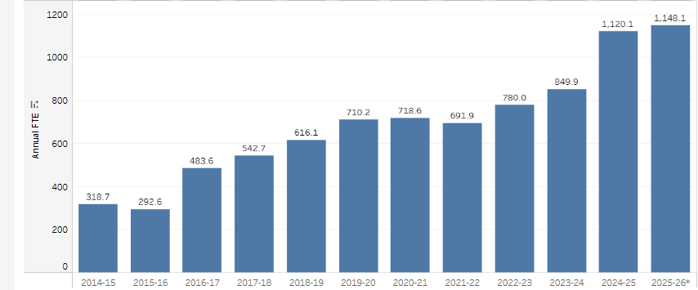
Early achievers

Slide 19
Student support Programs
Core Student Supports Team:
Jennifer Dellinger, Policy Associate, jdellinger@sbctc.edu
Austin Gillihan, Program Administrator, agillihan@sbctc.edu
Yesenia Lopez, Program Administrator, sacosta@sbctc.edu
Shanna McBride, Program Administrator, smcbride@sbctc.edu
Dylan Jilek, Integrations Coordinator, djilek@sbctc.edu
Rebecca Kay, Relationship & Compliance Analyst, rkay@sbctc.edu
Integrated Student Supports Team:
Jessica Perez, Policy Associate, jperez@sbctc.edu
Christine McMullen, Policy Associate, cmcmullen@sbctc.edu
Laura Coghlan, Program Administrator, lcoghlan@sbctc.edu

Slide 20
Programs & Grant Updates
Postsecondary Student Basic Needs
Benefits Navigation
  Next Legislative Report is due December 2027
    Working with colleges on meaningful data collection
  Student Status Confirmation Form (in testing)
    Supports SNAP exemptions for homelessness and disabilities
    Not intended for BFET or WorkFirst
  Fall Cohort Meeting – 10/16
26-27 Basic Needs Survey
  Anticipated release is Winter quarter
  Colleges will receive their data
  Systemwide dashboard will be updated
  Updates include:
    BEdA students in the distribution
    Survey items consistent for longitudinal analysis
    Modified informed consent to improve accessibility
Notes:
Benefits Navigators will begin reporting on the navigation data this June in preparation for the legislative report due 12/25
Participating Colleges in the Benefits promotion pilot are starting to launch their targeted efforts to conduct outreach to low-income students
Winter learning community is 2/25, where we will have the opportunity for practice exchange
SBCTC research has offered to assist any college that needs support in matching student list data with contact information. You can reach Diana at dknight@sbctc.edu.

Slide 21
Program & Grant Updates
Basic Food Employment & Training (BFET) & WorkFirst Programs
Important Dates
  10/30 - BFET FFY27 Final Invoice Due, WorkFirst September Invoice Due
  10/30 - BFET and WF Fall Quarter Funding Survey Due
  11/4 - Student Support Programs Coffee Chat
Fiscal & Program Monitoring
  WorkFirst – November - February
  BFET - February – July
Program Updates
  10/1 - Welcome Yesenia Lopez, BFET Program Administrator (First Day)
  10/16 - Welcome Austin Gillihan, WorkFirst Program Administrator (First Day)
Notes:
Survey release is going to be delayed. Fiscal is working through quarterly invoice approvals – if you have had your invoice returned, we has that you pretty please get that turned back in asap.
Our team will follow up with colleges early next week with an updated survey time line. We are sorry for this inconvenience.
First quarter billing - SSP team brought together a few colleges to discuss queries in use, better understand how colleges are developing their invoices, and make recommendations. Our next steps are working with our ctcLink colleagues on BFET specific queries for colleges to utilize.

Slide 22
Program & Grant updates
Opportunity Grant Program
Fall Funding Survey Due 10/30
  Note the change to Microsoft Forms
OG Student Group
  Went into effect Summer Quarter 2026
    OG student group definition finalized and added to Coding Manual
  Standardize queries, reporting, year-to-year comparison
OG Engagement and Coordination
  Announcement shared via Canvas on the week of 10/5
  Focused on bringing together OG administrators across the system to support coordination, information sharing, and consistent implementation
Notes:
Survey is in development and we are working on readying for release. You can expect mid-feb.
Thank you to colleges for working with SSP team to cleanup the approved inventory. Once our team has made all the updates provided by the colleges, we will be working on cleaning up the health care inventory and readying that to be merged with general OG inventory. The goal is to have 1 inventory that is up-to-date, and tracks approvals.
We know that years ago, OG providers used to receive data on their OG program. We are working with research staff to understand what data is being collected on OG and how we can build processes to access, analyze, and share the data with Colleges again. Our goal is to begin the next program year with college data.

Slide 23
Program & Grant Updates
Student Emergency Assistance Grants and Supporting Students Experiencing Homelessness Program
Fiscal Year 26 final expenditures showed the following:
  SEAG had about 33K unexpended (0.7% of total 4,750,000 in funding)
  SSEH had about 40K unexpended (1.1% of total 3,718,000 in funding)
With the final 4 colleges (Big Bend, Cascadia, Whatcom, and Yakima Valley) launching their SEAG programs this year (FY27); we now have all 34 colleges participating in BOTH SEAG and SSEH!
Enrollments (most recent 2 quarters)
  SEAG Spring 26, 1986 students awarded; up 14% over Spring 25
  SEAG Summer 26, 837 student awarded; down 4% compared to Summer 25
  SSEH Spring 26, 2643 students supported; up 20% over Spring 25
  SSEH Summer 26, 1315 students supported; up 17% over Summer 25
Notes:
Notice of important dates
Welcome to our last two colleges to come onto SSEH! Bates and South Seattle are running planning grants this year and will beginning FY26 with full SSEH programs.
Welcome to Shoreline, Spokane Falls, and Wentachee Valley to SEAG. These three colleges are running planning grants this year and will beginning FY26 with full SEAG programs.

Slide 24
What's The 26-27 Happs in SSP
Basic Needs Awareness Week (Nov 15-21)
  Raise awareness, reduce stigma, generate donations & resources, connect students to supports, etc.
  PSBN is seeking proclamation from Gov. Ferguson
Cross-Sector Work Groups
  Student Parent Data (Sept – Jan)
  Student Parent Campus Practices (Sept – Jan)
  PS Basic Needs Strategy (Oct – Jan)
  Navigation 2.0 Cohort (Jan – June)
In Progress
  WorkFirst Funding Formula and Tack Back
  Benefits Navigation Data Collection
  AA-DTA and BAS for BFET
  BFET & WF Application/Grant Process
  Annual Expenditure & Enrollment Trends

Slide 25
Industry Demand
Industry Demand: Meets the needs of industries, employers, and incumbent workers.
Team Members:
  Megan Haper, Program Admin: mharper@sbctc.edu
  Vicky Chungtuyco, Ed Program Coordinator: vchungtuyco@sbctc.edu
Programs:
Job Skills Program (JSP) | Continuing Education Council (CEC)
Customized Training (CTP) | Economic Development
Workforce Development Funds (WDF) | Business (AWBI) & Labor (WSLC) Liaisons
Invest in Washington | System Noncredit Task Force

Slide 26
Job Skills Program
$1 for $1 matching grant for customized contract training.
FY27
Application opened in OGMS on March 26, 2026.
Application closes on April 30, 2026.
Expecting annual funding of $7.5 million, with quarterly application rounds until fully awarded.
Check program website for resources (guidelines, application webinar recording, Q&A) https://www.sbctc.edu/colleges-staff/grants/job-skills-grant

Slide 27
Customized Training Program
Interest-free loan and B&O tax credit for contract training.
Seven (7) projects in repayment status
Four (4) projects with training ongoing.
Check the program website for the current fund balance, number of projects on the waitlist, and the next fund replenishment schedule:
https://www.sbctc.edu/colleges-staff/programs-services/customized-training/

Slide 28
Workforce Development funds, high demand & Invest in Washington
15 Applications received; $1.9M
Balance remaining will be made equally available to all colleges that didn’t submit applications. Updates coming soon.
Funding levels:
  $1.5M for WDF
  $82,000 for Invest in Washington
  $1M for High Demand Enrollment Funds

Slide 29
Updates
Continuing Education Council (CEC)
CEC website – updated & more robust
Business (AWBI) & Labor (WSLC) Liaisons
New liaisons:
  Shondae Chapman, Washington State Labor Council, AFL-CIO
  Britney Martin, Association of Washington Business Institute
Advisory committee member recruitment.
Helping you gain insights from employers and workers.

Slide 30
Noncredit task force
Learn more here: https://www.sbctc.edu/colleges-staff/programs-services/noncredit/default.aspx
Co-chaired by presidents Jenni Martin (Spokane) and Jim Lemerond (Bellingham Tech).
Representation:
  WEC: Wendy Fox (Olympic) and Skye Field (Yakima).
  Councils: Workforce Education, Continuing Education, Financial Aid, Admissions and Registration.
  Commissions: Diversity and Equity Officers, Instruction.
Strengthen data.
Improve pathways to credit.
More intentionally align noncredit education with system mission, vision and strategic priorities.

Slide 31
Noncredit task force
What do we mean by “bridging noncredit to degree pathways”?
Bridges to credit pathways are specific, applied strategies and practices that allow students to convert learning from noncredit into credit-bearing programs. Key types of bridges include:
Academic credit for prior learning.
Articulation agreements.
Course equivalencies.
Noncredit competency-based training.
Noncredit Certificates (C00) as defined in SBCTC’s PAR guidelines.
Transcription of noncredit courses.

Slide 32
The recommendation
Move workforce-focused noncredit offerings and enrollments into the UGRD career in ctcLink to achieve data consistency.
Why:
A more unified view of workforce education,
Ability to compute outcome metrics for students, like employment and earnings, the same as prof-tech programs.
Readiness for emerging or potential federal and state resources.
Notes:
A 2-career model
UGRD Career: workforce-oriented noncredit, alongside credit instruction
CNED Career: personal enrichment offerings, unchanged

Slide 33
System Updates
SEADS Work Group
System Efficiency, Access and District Structure
Identify opportunities to reduce costs and duplication that do not clearly support student success.
Work group is an advisory body to SBCTC State Board who is responsible for developing recommendations that:
  Improve efficiency.
  Streamline costs and administrative processes.
  Protect access.
  Strengthen student success across the CTC system.

Slide 34
2027-27 Legislative One-Pagers
Capital Budget Request
Operating Budget Request

