Slide 1

October 2026 WEC
Shondea Chapman
Labor Liaison
WSLC Workforce Development Team

Slide 2

Building Bridges Between Labor & Education
Washington State Labor Council goal is to foster and facilitate partnerships between organized labor (unions), state’s community and technical colleges and the SBCTC to facilitate for the following:
1. Increase Labor representation on advisory committees and boards.
2. Conduct roles and responsibility trainings with labor representative.
3. 1x1 visits with college reps, campuses and program tours.
4. Provide workshops and trainings on policy, agenda updates, union, workforce development and other public policy agendas to enhance workforce.

Slide 3

The Washington State Labor Council, AFL-CIO Workforce Development Department works to maximize the benefit of workforce development programs and systems for Washington workers, families and communities.
We do this work by:
Promoting Union engagement on Program Advisory Committees
Directly assisting workers and dislocated workers navigate systems
Troubleshoot Unemployment Insurance issues
Arrange Labor-Management Committees and Rapid Response presentations during downsizing or closure
Promoting registered apprenticeships and other labor-supported education pathways
Partnering with the state, local workforce development areas, industry associations and others
Advocating for workers, union pathways and quality jobs in workforce and economic development

Slide 4
Why are Advisory Committees important?
RCW 28B.50.252. Districts offering vocational educational programs—Local advisory committees— Advice on current job needs.
Each college offering professional-technical education programs must establish local program advisory committees to provide advice on Industry alignment, program curriculum and training, equipment and technology, and employment of program completers.
Participate in the determination of program goals
Review and evaluate program curricula, equipment, and effectiveness;
Include representatives of business and labor who reflect the local industry, and the community;
Actively consult with other representatives of business, industry, labor, and agriculture.

Slide 5
WSLC Liaison Activities
Toured Yakima Valley College, Tacoma Community College, Clover Park Technical College, Centralia College, and South Seattle College Georgetown Campus
Attended Bates Technical College Worker Retraining Advisory Committee Meeting
Toured Operating Engineers Training Program, Iron Worker Training Program, and Western Washington Sheet Metal JATC
Attended several Workforce Central Construction and Manufacturing Roundtables
Oregon AFL-CIO and WSLC co-hosted a one-day conference Bridging Borders, Building Careers — The STAND
Updated Advisory Roles and Responsibilities Training
Facilitated WSLC Convention Workshop: Landscape for Registered Apprenticeship Programs: Successes, Opportunities & Challenges
Facilitated WSLC Convention Workshop: Labor Leaders Serving on Advisory Committees
Identified and placed Labor Representative for Clover Park Tech Advisory Committee
Attended Quarterly Washington State Apprenticeship and Training Council meetings and Workforce Board meetings
Attended RPAC, REGIONAL PRE APPRENTICESHIP COLLABORATION monthly meetings
Presented at multiple Union Workforce Development Board meetings to promote serving on Colleges Program Advisory Committees
Facilitate the Quarterly Union Apprenticeship Coordinators meetings
WSLC Workforce Development Summer Newsletter

Slide 6
Got Members?
Need new labor representatives for your advisory committee? We can help!
Please sign-up Labor Representative Request Form
Inquiries contact Shondea Chapman at schapman@wslc.org
Notes:
Thank you To:
More info, the better. Broad outreach, more local outreach. Maintain the relationship and maintain he relationship Shout out to SCC staff, best practices for recruitment and retention

Slide 7
Workforce Development Regional Events
2026 Summit: Building Forward - ANEW
October 16, 2026
Sound Transit’s Union Station, 401 S Jackson St, Seattle, WA

Slide 8
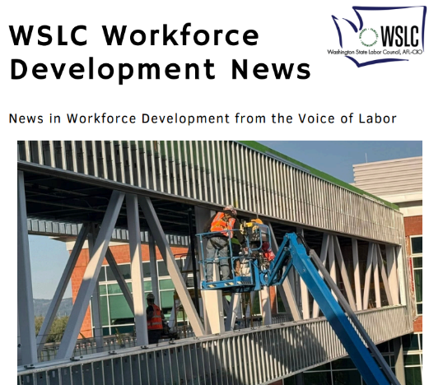

Ways to Connect with the WSLC
Sign up for the STAND
Daily News:
Stay Connected:
Home - Washington State Labor Council, AFL-CIO
Instagram
LinkedIn
Facebook
Bluesky

