Slide 1
Pell for Short term Workforce programs
WEC Presentation: Data, Research & Workforce Subcommittee Feedback
Marie Bruin
May 2026

Slide 2
Statewide Process Development
Governor’s Office leading process with Workforce Pell Cross-Agency Steering Committee
Purpose
To provide multi-stakeholder analysis and recommendation for the implementation of the Workforce Pell Grant program through Federal Title IV Financial Aid funding in Washington State.
Initial membership
Governor’s Policy Office staff
State Board for Community and Technical Colleges (SBCTC)
Workforce Training and Education Coordinating Board (Workforce Board)
Washington Student Achievement Council (WSAC)
Commerce
Labor and Industries
Employment Security Department

Slide 3
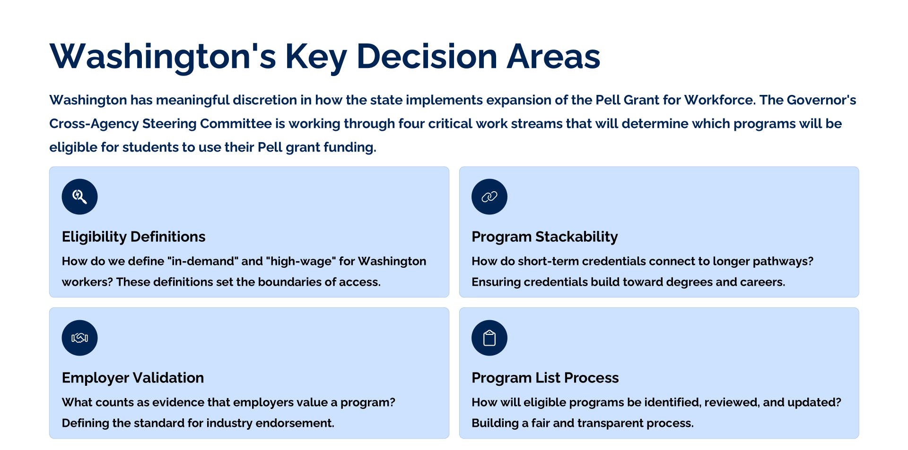
Washington’s Key Decision Areas
Notes:
Marie
These decisions shape:
Which programs qualify
Which students gain access
How institutions implement Pell for Workforce

Slide 4
Systemwide Process Development
System Areas of Focus
Subcommittee for Data, Research, & Workforce
Student Services
Financial Aid
Workforce Education
Non-Credit to Credit pathways
Information Technology -Program coding
Policy Research-Data resources
Julie Parks (Spokane Colleges)
Sheila Dersham (Edmonds AMSC/WATR)
Kelley Sadler (Tacoma CC)
Olga Inglebritson (Tacoma CC)
Rachel Andre (Seattle Colleges)
Renuka Prabhakar (EvCC)
Kari Hammond (Bellevue)
Ryan Masinelli (EvCC)
Cristeen Crouchet (CPTC)
Kristine Barnes (Edmonds)
Annaliese Baker (WWCC)
Lindsey Williams (WWCC)

Slide 5
This Workgroup Is:
An implementation and validation body
Responsible for providing feedback and recommendations of draft policies & definitions from the governor’s office
Focused on feasibility, compliance, and equity
Responsible for actionable statewide guidance
Notes:
Marie

Slide 6
Workforce Pell: Developing the foundation
Subcommittee for Data, Research, & Workforce
Initial Meeting on April 15th
Meeting Tasks: Review and provide input on four preliminary areas;
Minimum wage
Proposed list of careers
Industry approval
Resources

Slide 7
WEC’s Task Today
Review the feedback provided by the Subcommittee for Data, Research, & Workforce on the four items below and identify any fatal flaws.
Minimum wage
Proposed list of careers
Industry approval
Resources

Slide 8
Minimum Wage Threshold
Sub Committee Discussion
Definition of Minimum Wage Threshold
Key Concerns:
Cost of living differences between urban and rural regions.
Disadvantage programs in lower-cost regions.
Risk of excluding high-need programs (e.g., early childhood, nursing assistant, food service).
Risk of programs becoming ineligible or colleges facing financial liability.
Consensus
No support for a single statewide wage rate.
Wage benchmarks tied to local minimum wage plus a percentage.
Proposed: Program eligibility to be determined using the Self-Sufficiency Standard weighted average for the state
Calculated threshold: $20.45 per hour
Household assumption: 2 adults and 1 child
Initial Items for Discussion:
Implications of applying a single statewide rate?
Are there alternative recommendations?
Potential impact- Value added rate computation.

Slide 9
Proposed List of 123 Occupations
Sub Committee Discussion
Potentially Eligible Occupations
Concerns:
Several high-demand fields appeared missing (e.g., construction trades, agriculture-related programs).
List does not yet crosswalk with college program data.
Eligibility may change if wage thresholds are modified regionally.
Consensus
Use a career-based high-demand approach, not a narrow sector-only model.
Update the list once wage threshold recommendations are finalized.
Allow for future additions as labor market needs evolve.
.
Based on statewide high-demand occupation meeting $20.45/hour wage threshold ESD developed a list of a123 occupation.
123 Occupation List
Discussion:
Thoughts on the proposed list of 123 occupations?
What is missing?
Are the anticipated eligible programs represented in the list?
Are these certificates already eligible for financial aid?

Slide 10
Suggested use of a high demand Sector List
Initial Items for Discussion
Sub Committee Discussion
Discuss potential impacts limiting eligibility to predefined high-demand sectors.
Manufacturing
Healthcare
IT
What may be missed with regard to new programs, geography, and regional participation?
Concerns:
Too restrictive for future program development.
Limits responsiveness to emerging industries (e.g., AI).
Could disadvantage continuing education and non-credit-to-credit pathways.
Consensus:
Recommendation: Do not constrain policy to a narrow sector-based list.
Prefer flexibility to adapt to changing labor market needs.
Sector strategies may be used for grants or pilots, but not as a statewide policy limit.

Slide 11
Industry Approval
Validation of hirable graduates
Sub Committee Discussion
Key Considerations:
Avoid creating parallel or duplicative program approval processes.
Align with existing program approval and review cycles.
Workforce Development Councils (WDCs) representing industry.
Address timing issues (approval should occur early enough to support program launch).
Account for labor market shifts that may affect ongoing eligibility.
Consensus
Leverage existing advisory structures
Allow flexibility in how colleges demonstrate industry validation
Existing or Potential Models:
Professional Technical Advisory Board Committees
Worker Retraining Advisory Committees
Other industry- or region-led approval models
Initial Items for Discussion:
Confirming a graduate’s readiness for hiring.
Navigating local eligibility requirements.
Responding to local labor market changes and program sustainability.
Monitoring and review

Slide 12
Gaps and Subcommittee Responses
Implementation Gaps
Subcommittee Responses
Program Development
Sustainability
Data & Research
Industry & Agency Partner Engagement
Other
*Feedback was collected via email response and there was no opportunity to come to consensus.
Lack of baseline data (# of eligible programs, student volume, etc.) limits the ability to forecast staffing needs.
Workforce Pell adds scope without adding capacity.
No system of record tracks the full Workforce Pell lifecycle: Eligibility → Enrollment → Completion → Employment → Wage Outcomes.
New accountability requirements exceed current practice, which create institutional liability.
High-touch program approval and monitoring processes.
Employer validation is decentralized.

Slide 13
QUESTIONS???

