Slide 1
Washington’s Community and technical colleges
SBCTC Spring 2026 WEC Update

Slide 2
SBCTC Winter Update
Thursday, May 7
Agenda Topics:
Program Updates
Funding Highlights
Staff and Resource Information

Slide 3
program & Funding updates

Slide 4
Work-based Learning
Work-based Learning: Assist colleges as they provide experiential learning opportunities.
Team Members:
Genevieve Howard, Policy Associate; ghoward@sbctc.edu
Karin Gitchel, Program Administrator; kgitchel@sbctc.edu
Programs:
Aerospace 1,000 FTE | Career Launch Equipment
Aerospace Contract | Career Launch Endorsement
Apprenticeship | Aerospace Pipeline Committee
Aerospace Legislation | Aviation & Aerospace Advisory Committee

Slide 5
funding & program Updates:
Apprenticeship
Student Supports Program Forum
Inclusion of apprenticeship in this year's forum provides opportunities to:
Educate staff about apprenticeship programs and how colleges partner in the training model.
Share best practices about how to support apprentices with available resources.
Invite apprenticeship staff external to the college to learn about degree pathways and support resources available for apprentices.
External staff are invited to attend the forum on June 3rd.

Slide 6
funding & program Updates:
Apprenticeship (Continued)
Washington College Grant for Apprenticeship (WCG-A)
During winter quarter the remaining 8 apprenticeship colleges were onboarded to the new awarding process.
To date 143 apprentices have been awarded through Financial Aid Offices at CTCs.
Apprenticeship programs that partner with a CTC must request the CTC act as WCG-A servicer on an annual basis.

Slide 7
funding & program Updates
Aerospace Apprenticeship
As part of the new allocation model, the earmark for Aerospace Apprenticeship enrollments (130 FTE @ $8K) is eliminated as of June 30, 2026, and move into the base allocation.
Funding associated with the Aerospace Apprenticeship contract, currently held by AJAC, will move into the base allocation at the end of the current contract, June 30, 2027.

Slide 8
Program support
Program Support: Provide overarching program support to strengthen business, industry and colleges.
Team Members:
William Belden, Policy Associate; wbelden@sbctc.edu
Kimberly Ingram, Program Administrator; kingram@sbctc.edu
Shelby Means, Program Inventory Coordinator; smeans@sbctc.edu
Programs:
Carl D. Perkins | CTE Dual Credit
Comprehensive Local Needs Assessment (CLNA) | High Demand Grant
Program Approval Review & Program Inventory | Workforce Education Council (WEC)
Prof-Tech Certification | Customer Advisory Committee (CAC)

Slide 9
Perkins updates
Direct Assistance Update (FY27)
Perkins can support, in limited circumstances, out of pocket costs for students but not tuition and related fees.
Please see updated Perkins Plan Grant Guidelines.
Email sent on 4/7/26 to Perkins contacts.
Annual Reports Due June 30th
Email with SurveyMonkey links will be sent in early May.

Slide 10
FY27 Perkins workforce Grants
Perkins Plan Grant
College Required Revisions Due | 5/22/2026
SBCTC Approval* | 7/1/2026
Perkins Leadership Grants
SBCTC Application Feedback | 5/18/2026
College Required Revisions Due | 6/3/2026
SBCTC Approval* | 7/1/2026
Availability of Additional Funding for Special Project and Non-Trad Announced | 7/17/2026
*Perkins Approval Process Overview webinar

Slide 11
CTE Dual credit updates
OAAP Admission, Enrollment, and Transcription Pilot
Pilot Sites: Everett Community College and Skagit Valley College
Beginning Fall 2025, a CTE Dual Credit admit type was made available in the Online Admissions Application Portal (OAAP) for pilot colleges. In addition, a dedicated CTE DC Academic Plan has been configured for colleges under the Non-Award Seeking program and is available for students to select in OAAP. Colleges participating in the pilot program are required to use the OAAP for all CTE DC admissions.
System Engagement. Information on this pilot has been presented to the Admissions and Registration Council (ARC) and WEC. Additional webinars to present information on CTE Dual Credit initiatives and the OAAP pilot will be scheduled for winter term.
Draft Business Process documentation has been posted to the WEC page for your information, with the understanding this information has the following limitations:
These processes were developed to guide the 2025-26 Pilot Colleges.
Non-pilot colleges must continue to use Other Credit until a determination has been made about expanding these business processes beyond the existing pilot sites.
This coding may only be applied for Winter 2026 forward and may not be applied retroactively.

Slide 12
Program Approval Updates
New PAR Site
Finalizing updates to the PAR system to allow Apprenticeship requests to be submitted through the site.
Working on getting bachelor’s programs into the PAR system (timeline TBD).
Updating the form to allow colleges to upload documents directly, reducing the need to enter information into limited-character text fields.
Improving form usability and data quality by:
Refining questions,
Enhancing information icons and guidance, and
Adding fields that better support inventory tracking.
Future Enhancements
A PDF summary of each request will be generated and shared with college contacts, providing a clear record of submitted information.

Slide 13
Program Approval Updates
Program Inventory
Reviewing apprenticeship prep programs to determine whether the credential should be identified in inventory as an apprenticeship prep program—or if the label should be removed.
Continue reviewing plan codes to add missing credit CAFs and resolve misalignment between maximum credits and award type.
Will be working with colleges to designate fully online programs in ctcLink inventory, enabling improved Search Stax filtering for interested students.

Slide 14
Baccalaureate Programs
Bachelor's Degree Programs: New program approvals, existing program modifications, support to design, build, and evolve high quality community college baccalaureate programs with an ecosystem of partners.
Team Members:
Ken Hang, Policy Associate; khang@sbctc.edu
Programs and Adjacent Work:
Bachelor's Degree Program Approval | Academic Credit for Prior Learning
Baccalaureate Leadership Council (BLC) | Washington MESA
WACSE & WCERTE: Computer Science and Engineering Related Education (Transfer) | Impacts of AI on CS/IT/Cyber
Course Sharing: CS + Sustainability

Slide 15
Baccalaureate Program Approval
State Board members adopted BLC/IC’s recommendations for a streamlined baccalaureate program approval process at their December 2025 meeting
Statement of Need and Program Proposal combined into one step/document
Details and new templates on website at Bachelor's Degree Program Approval Process

Slide 16
Baccalaureate program approval: 2026-2027
Notifications of Intent of Proposal (“one-pager”) can be sent any time by email to degreeprocess@sbctc.edu
Program Proposals reviewed 3 times per year→
Details and new templates on website at Bachelor's Degree Program Approval Process
Quarter | Program Proposal Submission Deadline for Review | Presentation and Vote at State Board Meeting
Fall | Aug 3, 2026 | Oct 7-8, 2026
Winter | Nov 30, 2026 | Feb 3-4, 2027
Spring | Feb 1, 2027 | Apr 7-8, 2027

Slide 17
Bachelor’s Program Modification
Some modification requests can now be submitted online in the PAR website:
Change of the program title, program CIP code
Change in the maximum number of credits
Change of the program's status (e.g. teach-out)
All other modification requests can continue to be submitted via email, including program subplan/specialization requests

Slide 18
Trends in Tech (CS/IT/CYBER) Education
Nearly one quarter of our baccalaureate programs are in technology
We are working to find the “ground truth” as to what’s happening in landscape so we can evolve programs based on best available evidence
SBCTC partnered with Bragg & Associates to conduct a methodical evaluation of the landscape

Slide 19
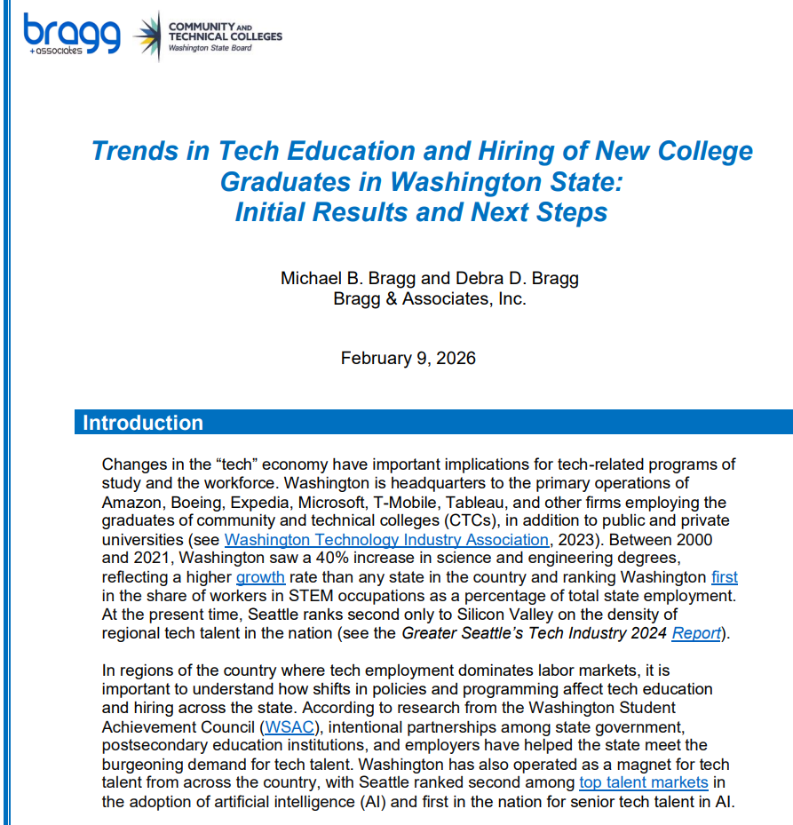
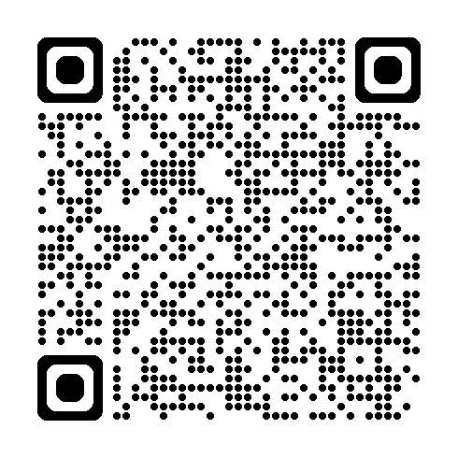
Download the Full (first) Brief

Slide 20
Sector Response
Sector Response: Support colleges as they deliver career and sector-based educational opportunities to students.
Team Members:
Anna Olson, Policy Associate; aolson@sbctc.edu
Megan Harper, Program Administrator; mharper@sbctc.edu
Shanna McBride, Program Administrator; smcbride@sbctc.edu
Programs:
Allied Health | Cybersecurity
Early Achievers Grant (EAG) | Early Learning/Parenting Education
Hospital Employees Education & Training (HEET) | Nursing Expansion
Worker Retraining (WRT)

Slide 21
Funding & Program Updates
Worker Retraining
Quarter to quarter (Winter 2025 to Winter 2026) WRT enrollment is up, but growth has slowed
Headcount up by 1.8%, compared to 4.7% increase Fall to Fall.
FTES up by 2.6%, compared to 4.3%
Growth continues to be uneven college to college; no obvious geographic or institutional patters are present
Detailed layoff notice information is available via the Employment Security Department
WRT will join the 2026 Annual Forum on June 1-3, 2026 at the Hotel Murano in Tacoma, WA.
Early Achievers
Amount of FTES colleges requested is comparable to the previous year.
We anticipate FY27 funding to be at the FY26 level, but no confirmed amount yet as of 4/15.
Deadline for childcare providers to meet employment qualifications was extended to 2030 during the 2025 Legislative Session.

Slide 22
Student support Programs
Core Student Supports Team:
Jennifer Dellinger, Policy Associate, jdellinger@sbctc.edu
Vacant, Program Administrator, (WorkFirst)
Sheila Acosta, Program Administrator, sacosta@sbctc.edu
Dylan Jilek, Integrations Coordinator, djilek@sbctc.edu
Rebecca Kay, Relationship & Compliance Analyst, rkay@sbctc.edu
Integrated Student Supports Team:
Jessica Perez, Interim Policy Associate, jperez@sbctc.edu
Christine McMullen, Policy Associate, cmcmullen@sbctc.edu
Laura Coghlan, Program Administrator, lcoghlan@sbctc.edu

Slide 23
Programs & Grant Updates
Postsecondary Student Basic Needs
Benefits Navigation
2025 Legislative Report
2024-2025 Navigational Services Data
Over 94,000 students served
100,000 in referrals made to college and community
Food support being the highest need
Free/Reduced-Price Meal Pilot Program
2024-2025 Data available end of January 2026
Focus on closing out the pilot program to include:
Communications to colleges, students, and community
Supporting pilot colleges in collecting the final round of data for Y3
Identifying the readiness of current pilot colleges to explore a deeper dive into proactive food approaches
Developing legislative briefs for food advocacy during 2026/27 legislative sessions
Notes:
Benefits Navigators will begin reporting on the navigation data this June in preparation for the legislative report due 12/25
Participating Colleges in the Benefits promotion pilot are starting to launch their targeted efforts to conduct outreach to low-income students
Winter learning community is 2/25, where we will have the opportunity for practice exchange
SBCTC research has offered to assist any college that needs support in matching student list data with contact information. You can reach Diana at dknight@sbctc.edu.

Slide 24
Program & Grant Updates
Basic Food Employment & Training (BFET) & WorkFirst Programs
Important Dates
4/30 - BFET Winter Quarter Invoice Due, WorkFirst March Invoice Due
5/31 - WorkFirst April Invoice Due
Fiscal & Program Monitoring (BFET ONLY)
February – July
Reviewing Fall Quarter Invoices and Backup Documentation
Program Updates
BFET Referrals – request for DSHS to develop and provide desk aids, training, support to DSHS staff.
Update: DSHS has provided 2 state-wide training to eligibility workers and is now focusing in on region 3 (Pierce County) for added training needs.
BAS an Eligible WorkFirst Activity
Effective March 20, 2026, BAS programs are now eligible as a part-time (JT) activity for WorkFirst students. This is intended to support student who become WorkFirst eligible after beginning their BAS program.
Notes:
Survey release is going to be delayed. Fiscal is working through quarterly invoice approvals – if you have had your invoice returned, we has that you pretty please get that turned back in asap.
Our team will follow up with colleges early next week with an updated survey time line. We are sorry for this inconvenience.
First quarter billing - SSP team brought together a few colleges to discuss queries in use, better understand how colleges are developing their invoices, and make recommendations. Our next steps are working with our ctcLink colleagues on BFET specific queries for colleges to utilize.

Slide 25
Program & Grant updates
Opportunity Grant Program
Spring funding survey
2/19/26 - 3/16/26
OG Student Group
OG student group definition finalized and added to Coding Manual
Student group coding will go into effect FY2027
SBCTC will use the student group coding to track OG students
Standardize queries and reporting
OG Engagement and Coordination
First OG quarterly meeting will be held in Feb 2026
Focused on bringing together OG administrators across the system to support coordination, information sharing, and consistent implementation
Notes:
Survey is in development and we are working on readying for release. You can expect mid-feb.
Thank you to colleges for working with SSP team to cleanup the approved inventory. Once our team has made all the updates provided by the colleges, we will be working on cleaning up the health care inventory and readying that to be merged with general OG inventory. The goal is to have 1 inventory that is up-to-date, and tracks approvals.
We know that years ago, OG providers used to receive data on their OG program. We are working with research staff to understand what data is being collected on OG and how we can build processes to access, analyze, and share the data with Colleges again. Our goal is to begin the next program year with college data.

Slide 26
Program & Grant Updates
Student Emergency Assistance Grants and Supporting Students Experiencing Homelessness Program
SSEH & SEAG Important Dates
3/20 - SSEH & SEAG Funding Application Opens
4/30 - Quarter 3 SSEH & SEAG Report and Funding Survey Due
5/4 - SSEH & SEAG Funding Applications Due
Enrollments
SEAG: Summer 2025 – 876 students (up 37% from prior summer)
SEAG: Fall 2025 – 1929 students (down 3% from prior fall)
SSEH: Summer 2025 - 1121 students (up 11% from prior summer)
SSEH: Fall 2025 - 2524 students (up 5% from prior fall)
SSEH 2025 Legislative Report
Notes:
Notice of important dates
Welcome to our last two colleges to come onto SSEH! Bates and South Seattle are running planning grants this year and will beginning FY26 with full SSEH programs.
Welcome to Shoreline, Spokane Falls, and Wentachee Valley to SEAG. These three colleges are running planning grants this year and will beginning FY26 with full SEAG programs.

Slide 27
Industry Demand
Industry Demand: Meets the needs of industries, employers, and incumbent workers.
Team Members:
Carolyn McKinnon, Policy Associate: cmckinnon@sbctc.edu
Vicky Chungtuyco, Interim Program Admin.: vchungtuyco@sbctc.edu
Programs:
Job Skills Program (JSP) | Centers of Excellence
Customized Training (CTP) | Continuing Education Council (CEC)
Workforce Development Funds (WDF) | Economic Development
Invest in Washington | Business (AWBI) & Labor (WSLC) Liaisons
System Noncredit Task Force

Slide 28
Program & funding Updates
Job Skills Program: $1 for $1 matching grant for customized contract training.
FY27
Application opened in OGMS on March 26, 2026.
Application closes on April 30, 2026.
Expecting annual funding of $7.5 million, with quarterly application rounds until fully awarded.
Check program website for resources (guidelines, application webinar recording, Q&A) https://www.sbctc.edu/colleges-staff/grants/job-skills-grant

Slide 29
Program & funding Updates
Customized Training Program: Interest-free loan and B&O tax credit for contract training.
Seven (7) projects in repayment status
Four (4) projects with training ongoing.
Check the program website for the current fund balance, number of projects on the waitlist, and the next fund replenishment schedule: https://www.sbctc.edu/colleges-staff/programs-services/customized-training/
Workforce Development Funds, Hight Demand Enroll & Invest in Washington
15 Applications received; $1.9M
Balance remaining will be made equally available to all colleges that didn’t submit applications. Updates coming soon.
Funding levels: $1.5M for WDF, $82,000 for Invest in Washington, and $1M for High Demand Enrollment Funds.

Slide 30
Updates
Continuing Education Council (CEC)
CEC website – updated & more robust
Business (AWBI) & Labor (WSLC) Liaisons
New liaisons:
Shondae Chapman, Washington State Labor Council, AFL-CIO
Britney Martin, Association of Washington Business Institute
Advisory committee member recruitment.
Helping you gain insights from employers and workers.

Slide 31
Updates
Centers of Excellence
Centers of Excellence provided over 20 years of expert liaison services for colleges and industry.
The supplemental budget eliminates all Centers of Excellence (COE) funding, effective July 1, 2026.
This was an action of the Legislature in a historically difficult budget year.
Their decision is not a reflection of the decades of quality partnerships and opportunities COEs have provided.

Slide 32
Noncredit task force
Learn more here: https://www.sbctc.edu/colleges-staff/programs-services/noncredit/default.aspx
Co-chaired by presidents Jenni Martin (Spokane) and Jim Lemerond (Bellingham Tech).
Representation:
WEC: Wendy Fox (Olympic) and Skye Field (Yakima).
Councils: Workforce Education, Continuing Education, Financial Aid, Admissions and Registration.
Commissions: Diversity and Equity Officers, Instruction.
Centers of Excellence (Brent Lundstrom, Cybersecurity).
Strengthen data.
Improve pathways to credit.
More intentionally align noncredit education with system mission, vision and strategic priorities.

Slide 33
Noncredit task force
What do we mean by “bridging noncredit to degree pathways”?
Bridges to credit pathways are specific, applied strategies and practices that allow students to convert learning from noncredit into credit-bearing programs. Key types of bridges include:
Academic credit for prior learning.
Articulation agreements.
Course equivalencies.
Noncredit competency-based training.
Noncredit Certificates (C00) as defined in SBCTC’s PAR guidelines.
Transcription of noncredit courses.

Slide 34
Noncredit task force
Request from the task force to WEC:
In the interest of leveraging rather than duplicating efforts, please share reports from the Noncredit-to-Credit WEC Work Group.

