Slide 1

WEC May 2026
Labor Liaison
Shondea Chapman
Workforce Development Team

Slide 2

Our Goal
Our goal is to foster and facilitate partnerships between organized labor (unions), state’s community and technical colleges and the SBCTC to facilitate for the following:
1. Increase labor representation on advisory committees and boards.
2. Conduct “Roles and Responsibility” trainings with labor representative.
3. 1x1 visits with college reps, campuses and program tours.
4. Provide workshops and trainings on policy, agenda updates, union, workforce development and other public policy agendas to enhance the workforce.

Slide 3

WSLC Workforce Development Department works to maximize the benefit of workforce development programs and systems for Washington workers, families and communities.
We do this work by:
Directly helping workers
Promoting registered apprenticeships and other labor-supported education pathways
Helping unions engage and serve in advisory and leadership roles
Partnering with the state, local workforce development areas, industry associations and others
Advocating for workers, union pathways and quality jobs in workforce and economic development

Slide 4
WSLC Liaison Activities
Toured of Lake Washington Institute of Technology
Toured Sheetmetal Apprenticeship Local 66
Toured Machinist Institute
Presented at the AFL-CIO Workforce Development Standing Committee’s meeting
Created Advisory Roles and Responsibilities Training
Attended and joined the Workforce Central Construction Roundtable
Attended Enlighten Women's Forum and RPAC (Regional Pre-Apprenticeship Collaboration) Training Standards Conference
Facilitated multiple Labor Roundtables meetings regarding Pell for the Workforce. Collaborative effort with WA Roundtable
Identified and placed Labor Representative on Renton Tech Advisory Committee
Attended Washington State Apprenticeship and Training Council meeting and Workforce Board meetings
Attended Bates Technical College Advisory Appreciation Dinner
Presented at multiple Union Workforce Development Board meetings to promote serving on Advisory Committees
Attended Deans Academy Advisory Training to promote partnership and labor support
Facilitate the Union Apprenticeship Coordinator meetings
Hosted New Data, New Possibilities Forum: Reimagining Workforce Insights with WA New Occupation Data
WSLC Spring 2026 Newsletter

Slide 5
Got Members?
Need new labor representatives for your advisory committee? We can help!
Please sign-up Labor Representative Request Form
contact Shondea Chapman schapman@wslc.org
Notes:
Thank you To:
More info, the better. Broad outreach, more local outreach. Maintain the relationship and maintain he relationship Shout out to SCC staff, best practices for recruitment and retention

Slide 6
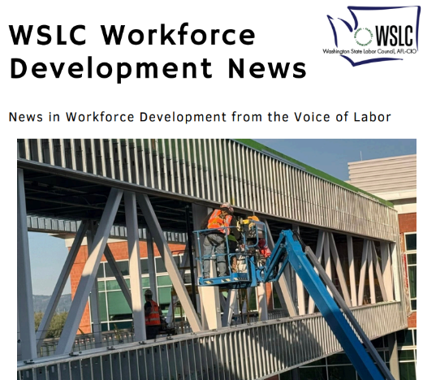

Ways to Connect with the WSLC
Sign up for the Workforce Development Newsletter email list kmunson@wslc.org.
Daily News:
Stay Connected:
Home - Washington State Labor Council, AFL-CIO
Instagram
LinkedIn
Facebook
Bluesky

