Slide 1

February 2026 WEC
Labor Liaison
Shondea Chapman
WSLC Workforce Development Team

Slide 2

WSLC is here for you…
Washington State Labor Council goal is to foster and facilitate partnerships between organized labor (unions), state’s community and technical colleges and the SBCTC to facilitate for the following:
1. Increase Labor representation on advisory committees and boards.
2. Conduct roles and responsibility trainings with labor representative.
3. 1x1 visits with college reps, campuses and program tours.
4. Provide workshops and trainings on policy, agenda updates, union, workforce development and other public policy agendas to enhance workforce.

Slide 3
The Washington State Labor Council, AFL-CIO Workforce Development Department works to maximize the benefit of workforce development programs and systems for Washington workers, families and communities.
We do this work by:
Directly helping workers
Promoting registered apprenticeships and other labor-supported education pathways
Helping unions engage and serve in advisory and leadership roles
Partnering with the state, local workforce development areas, industry associations and others
Advocating for workers, union pathways and quality jobs in workforce and economic development

Slide 4
Why are Advisory Committees important?
RCW 28B.50.252. Districts offering vocational educational programs—Local advisory committees— Advice on current job needs.
Each college offering professional-technical education programs must establish local program advisory committees to provide advice on Industry alignment, program curriculum and training, equipment and technology, and employment of program completers.
Participate in the determination of program goals
Review and evaluate program curricula, equipment, and effectiveness;
Include representatives of business and labor who reflect the local industry, and the community;
Actively consult with other representatives of business, industry, labor, and agriculture.

Slide 5
Got Members?
Need new labor representatives for your advisory committee? We can help!
Please sign-up Labor Representative Request Form
Inquiries contact Shondea Chapman at schapman@wslc.org
Notes:
Thank you To:
More info, the better. Broad outreach, more local outreach. Maintain the relationship and maintain he relationship Shout out to SCC staff, best practices for recruitment and retention

Slide 6

State-Registered Apprenticeship
An apprenticeship combines on-the-job training with related classroom instruction, all under the supervision of a journey-level professional. Apprentices get paid while they learn and develop knowledge, skills, and abilities in a new career field.
After completing a registered apprenticeship program, apprentices receive a professional credential that is recognized nationwide WSATC Policy 2012-03
Apprenticeship Research Brief - 2025
Washington State Apprenticeship & Training Council
Meets quarterly (Jan/April/July/Oct)
Washington Apprenticeship Coordinators Association
Next meeting will be April 15, 2026 @ 2575 Williams Place, Dupont, WA

Slide 7
WSLC Labor Liaison updates
WSAC-Washington Student Achievement Council
  WJI-Washington Jobs initiative (formerly know as the Good Jobs Challenge)
  Washington Stem- Collaboration with Career Connect Washington
Washington Apprenticeship Coordinators Association
Workforce Training and Education Coordinating Board
WA Labor Roundtable
CCI Apprenticeship Navigator Roundtable
SEIU-Service Employees International Union

Slide 8
Workforce Development Regional Events
Empower Women Conference
March 11, 2026
Clover Park Technical College

Slide 9
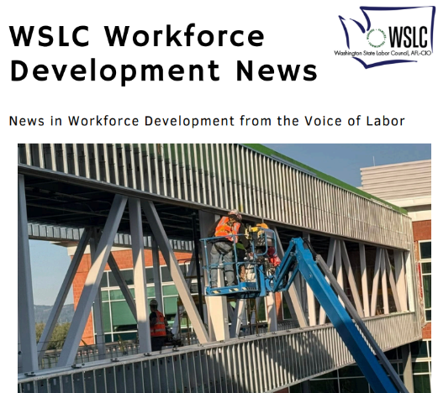

Ways to Connect with the WSLC
Sign up for the Workforce Development Newsletter email list kmunson@wslc.org.
Daily News:
Stay Connected:
Home - Washington State Labor Council, AFL-CIO
Instagram
LinkedIn
Facebook
Bluesky

