Slide 1


Guided Pathways 3.0

Slide 2


Our Mission
"As an open-access learning institution, Seattle Colleges prepares each student for success in life and work, fostering a diverse, engaged, and dynamic community."

Slide 3
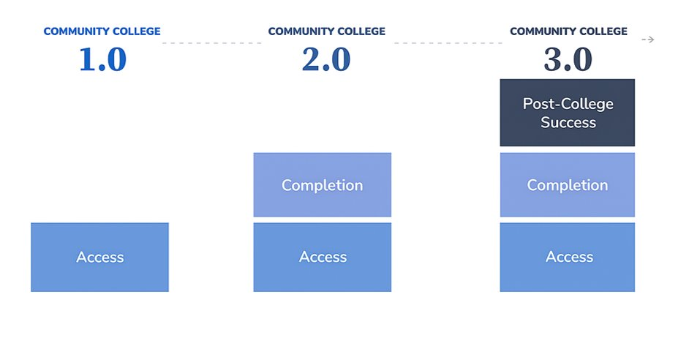
GUIDED PATHWAYS
FERDINAND ORBINO
SKILLED TRADES DEAN, COLLEGE OF EDUCATION
WHAT ARE THE STORIES DO WE REALLY TELL?
INTENTIONAL... BY DESIGN
COLLABORATION... DOESN'T ONLY MEAN WORKING TOGETHER
EVERY STUDENT. EVERY TIME
WHAT DOES "DATA-DRIVEN" REALLY MEAN?
QUALITATIVE AND QUANTITATIVE INTEGRATION
"Shifting Gears"

Slide 4
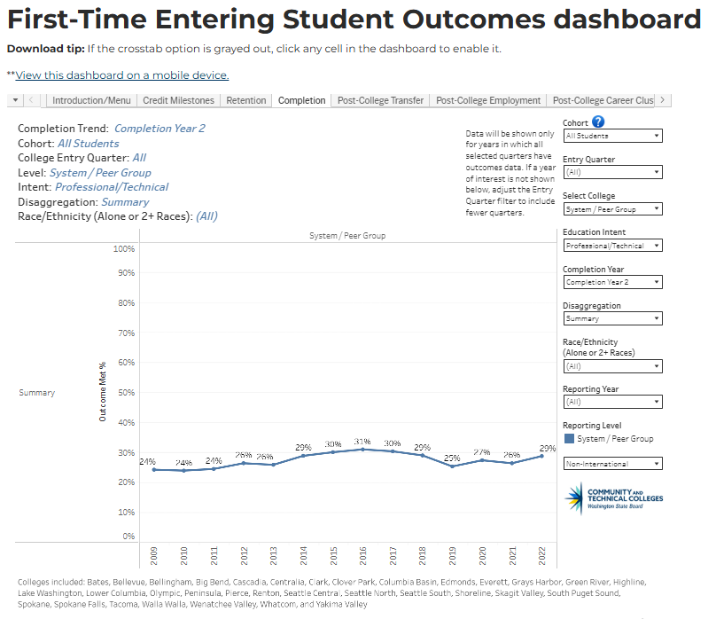
ACT 2025
OUR REPORT CARD

Slide 5

REFERENCES
Community College 3.0
​
National Models of Community College Excellence
​
The Future of American Higher Education
​
The next frontier of Pathways
Decolonizing Methodologies
Leadership Lessons from the Cherokee Nation
​

