Slide 1

AWB Institute
Workforce Education Council
October 24, 2025

Slide 2

AWB Manufacturing Week 2025
AWB Institute led regional outreach, school engagement, and employer coordination for Manufacturing Week 2025.
Goal: Align K–12, higher ed, and industry to deliver hands-on, student-centered experiences in manufacturing.
Key Results:
125+ schools and partners contacted
350 students participated in real-world tours and activities
15 employer partners hosted experiences across six sectors
25+ new schools committed for 2026
“Manufacturing Week 2025 didn’t just show students where they could work — it helped them imagine who they could become.”

Slide 3
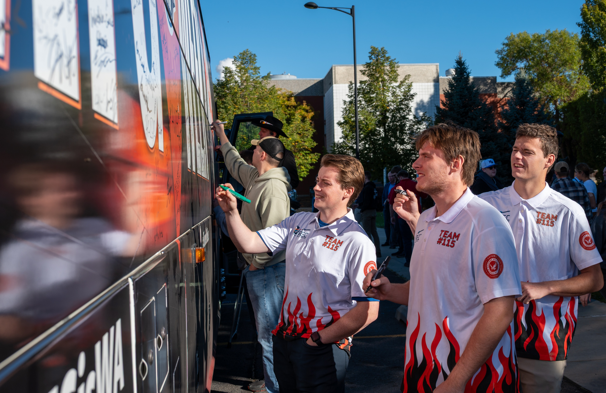


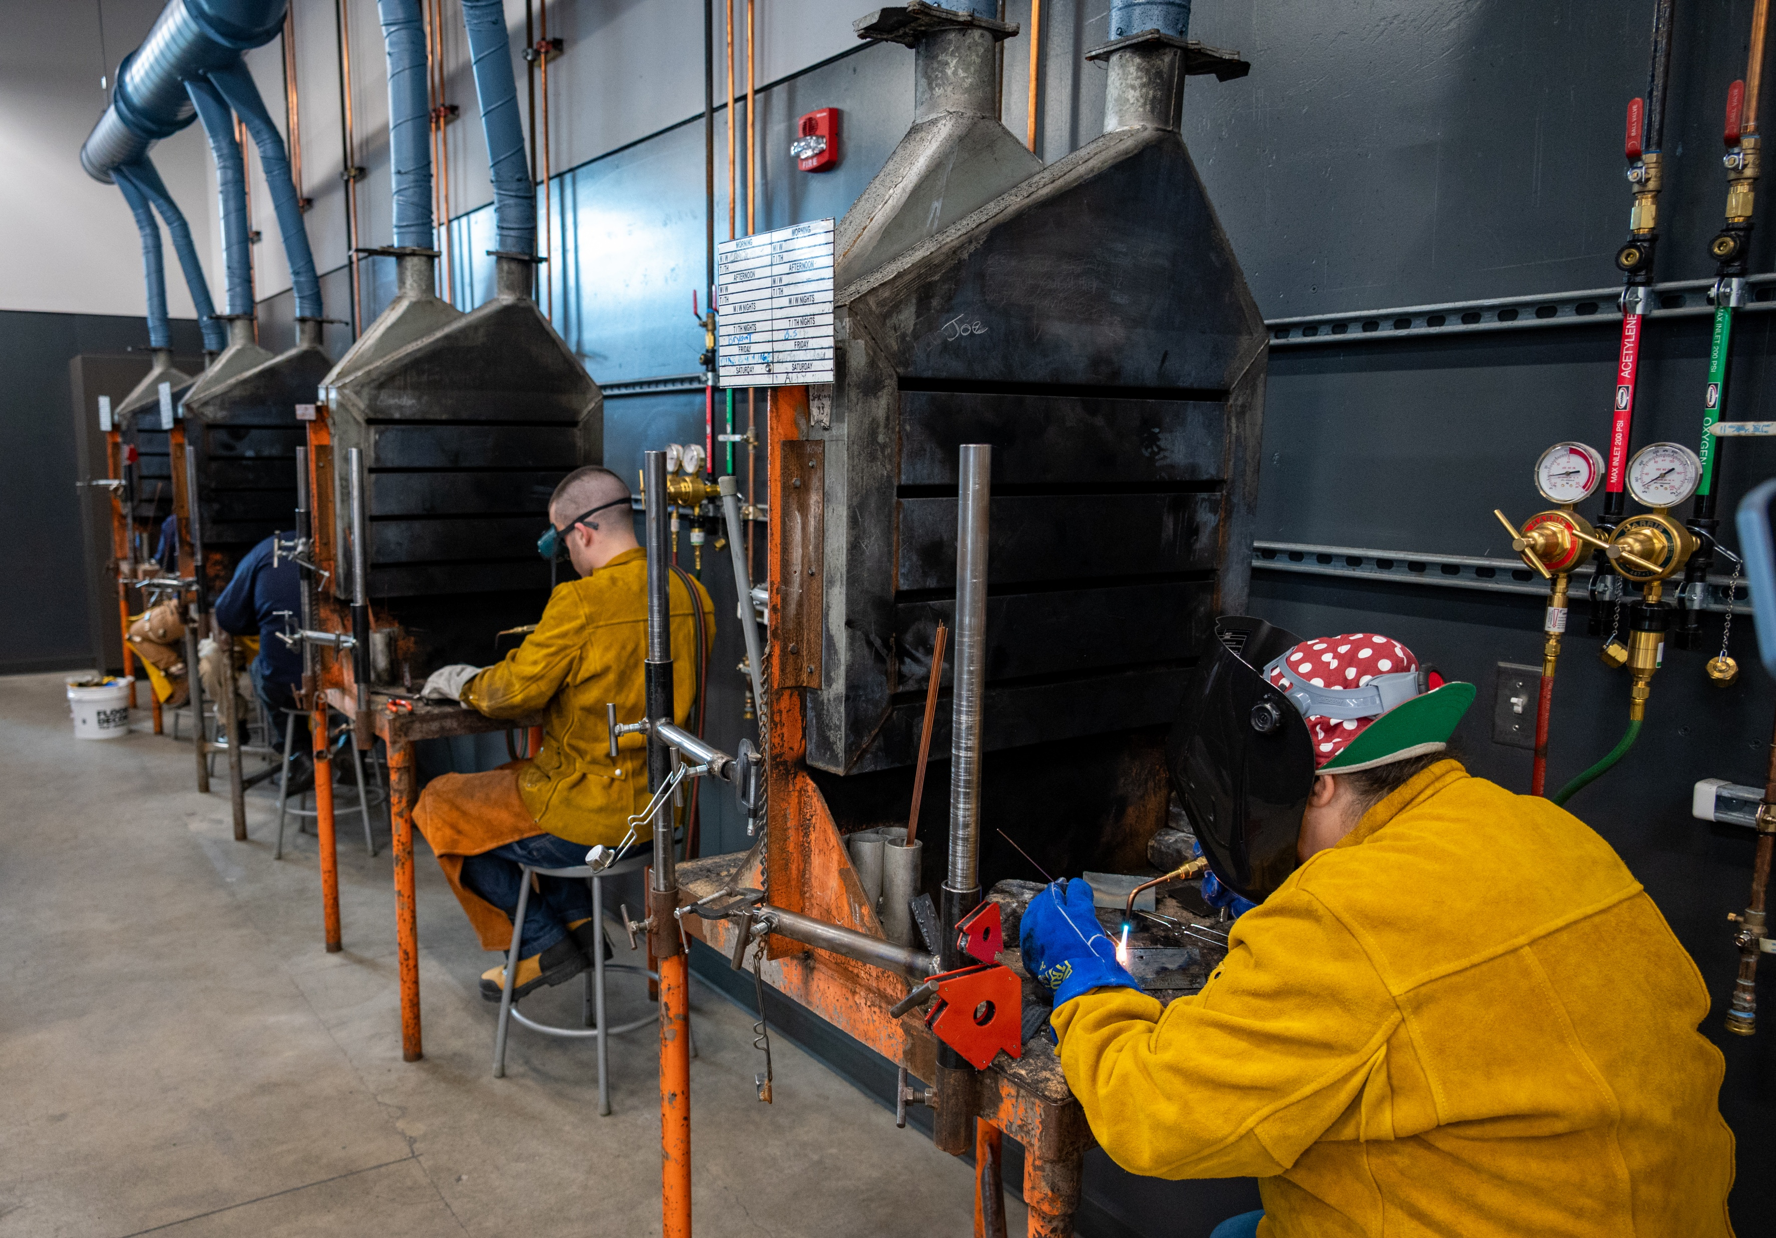
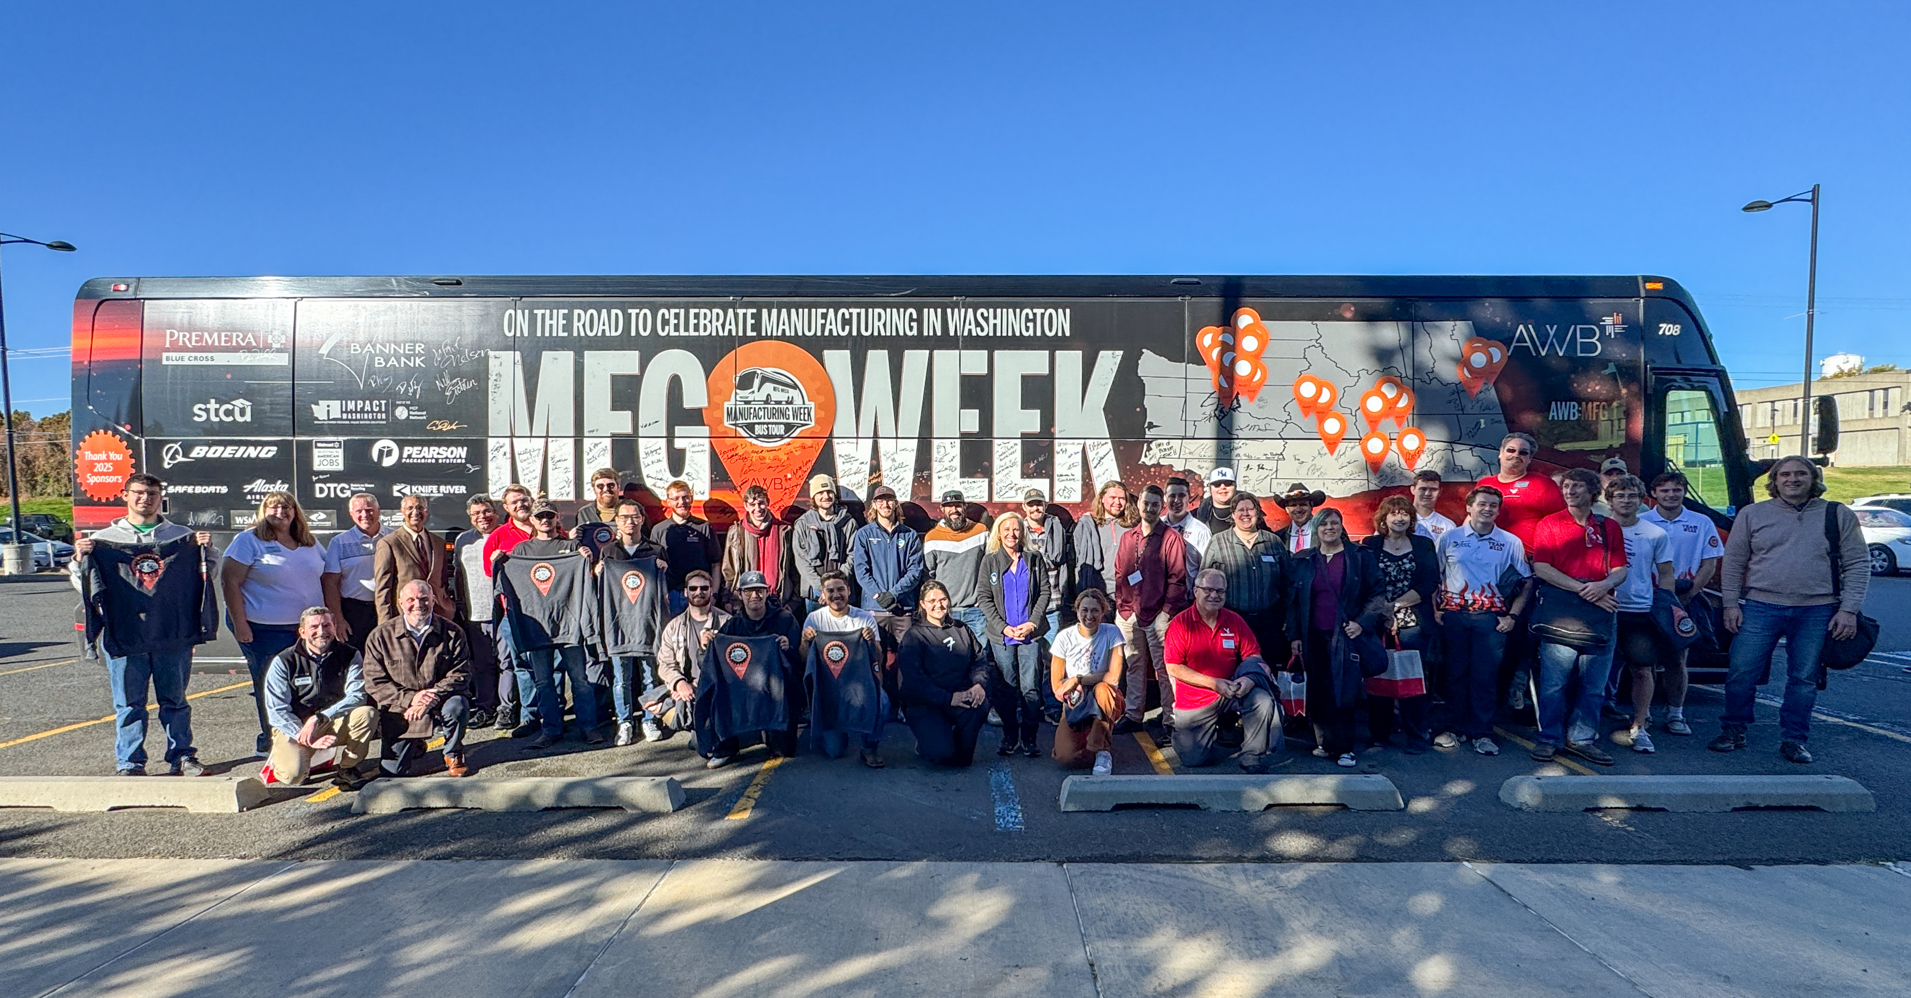

AWB Manufacturing Week 2025
Participating Education Partners
Olympic College
Sno-Isle Skills Center
Envision Career Academy
Franklin Pierce High School
Pasco High School
Kennewick High School
Southridge High School
Tri-Tech Skills Center
CB Tech (Career and Technical Education Center)
YV-Tech Skills Center
Spokane Community College
SEATech Skills Center
Walla Walla Community College
ESD 123 Migrant Education Program
Eastern Washington Universtiy

Slide 4
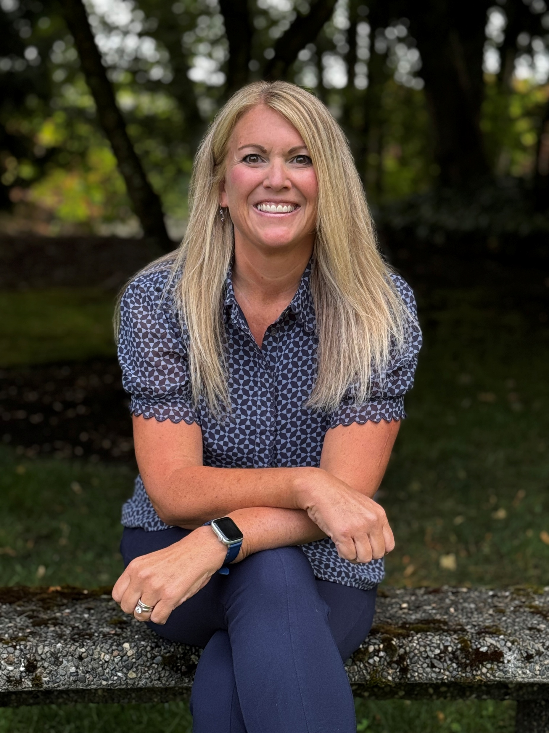
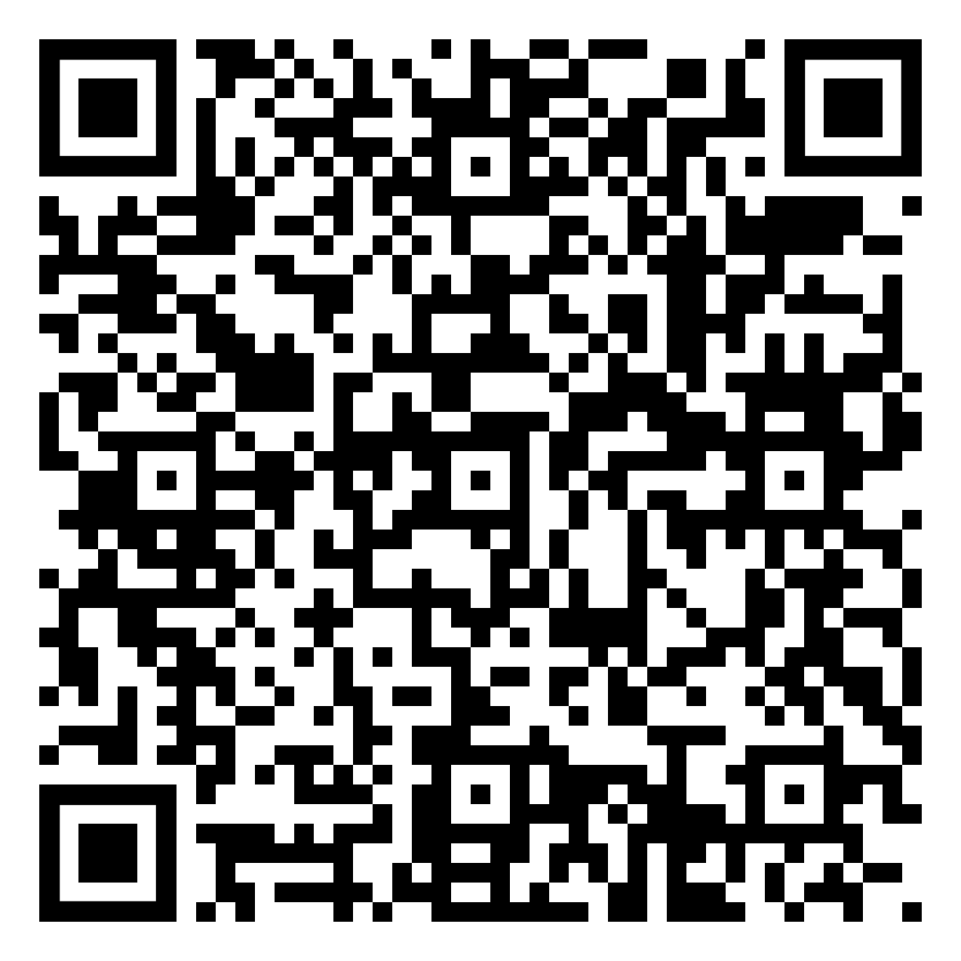
Britney Martin – AWB Institute
Britney Martin is an experienced program and operations professional with a strong background in event planning, grant management, and stakeholder engagement. At the AWB Institute, she oversees grant deliverables, manages budgets, and drives strategic programs in collaboration with partner organizations. She has successfully executed major events including the Toronto-Ottawa Childcare Study Tour, DC Fly-In, National Civics Bee, and LEAP Childcare Bus Tour, consistently demonstrating excellence in event logistics, stakeholder coordination, and cross-sector collaboration.
Britney Martin / AWB Institute Manager
AWB Institute / PO Box 7933, Olympia / WA 98507-0658
Office: 360.943.1600 / Cell: 360.870.7487

