Slide 1
Scaling Innovation Statewide: Consortia & Federal Funding
WEC Update
Dr. Irene Shaver, Program Administrator for WACURE & Tribal Stewards
October 18, 2024

Slide 3
Here is the report on a strategy to maximize federal funding for the workforce in WA State.
Also here is the WA Federal Funding priorities roadmap.
Notes:
Check out the reports linked here.

Slide 4
Tribal Stewards: Cultivating Tribal Leadership & Equity in Natural Resource Stewardship and Climate Resilience
Goal: Redesign our natural resource programs to serve Tribal students & Tribal workforce needs.
Led by: Glenda Breiler @ SBCTC Tribal Gov. Affairs
Project Period: 2024—2028
Funded by: the Inflation Reduction Act Climate Ready Workforce for Coastal States, Tribes, and Territories Competition (NOAA-OAR-SG-2024-2007783). ($9. 3 Million)
Read more about it here.
Tribe | College
Makah Tribe | Peninsula College (Port Angeles)
Quinault Indian Nation | Grays Harbor College (Aberdeen)
Muckleshoot Indian Tribe | Green River College (Auburn)
Squaxin Island Tribe | South Puget Sound Community College (Olympia)
Colville Confederated Tribes | Spokane Community College Wenatchee Valley College

Slide 5
Tribes are the 7th largest employer in Washington State
72% of Tribal jobs are held by non-Tribal people

Slide 6
"Due to the urgency of the current climate situation, many land management agencies are experiencing a lack of qualified natural resource personnel. The Colville Tribes currently need about 535 employees across 12 different natural resource disciplines. However, the natural resource division currently has 146 vacancies, ~50% of which are in the senior level natural resource technician classification. Through this project, the CCT will secure a skilled workforce necessary to accomplish our goals."
(Cody Desautel, February 2024)

Slide 7
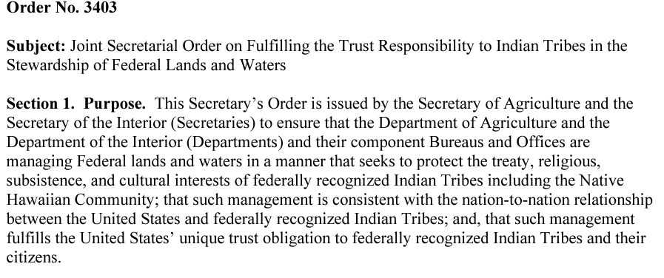
Co-stewardship, Integration of TEK and Gov-to-Gov consultation and relationships are required to fulfill the federal trust responsibility to Indian Tribes
Natural Resource Professionals need new skills in climate adaptation, Tribal collaboration/co-management, and integration of TEK---Tribal Stewards is a model for updating our training and supporting Tribal student success.

Slide 8
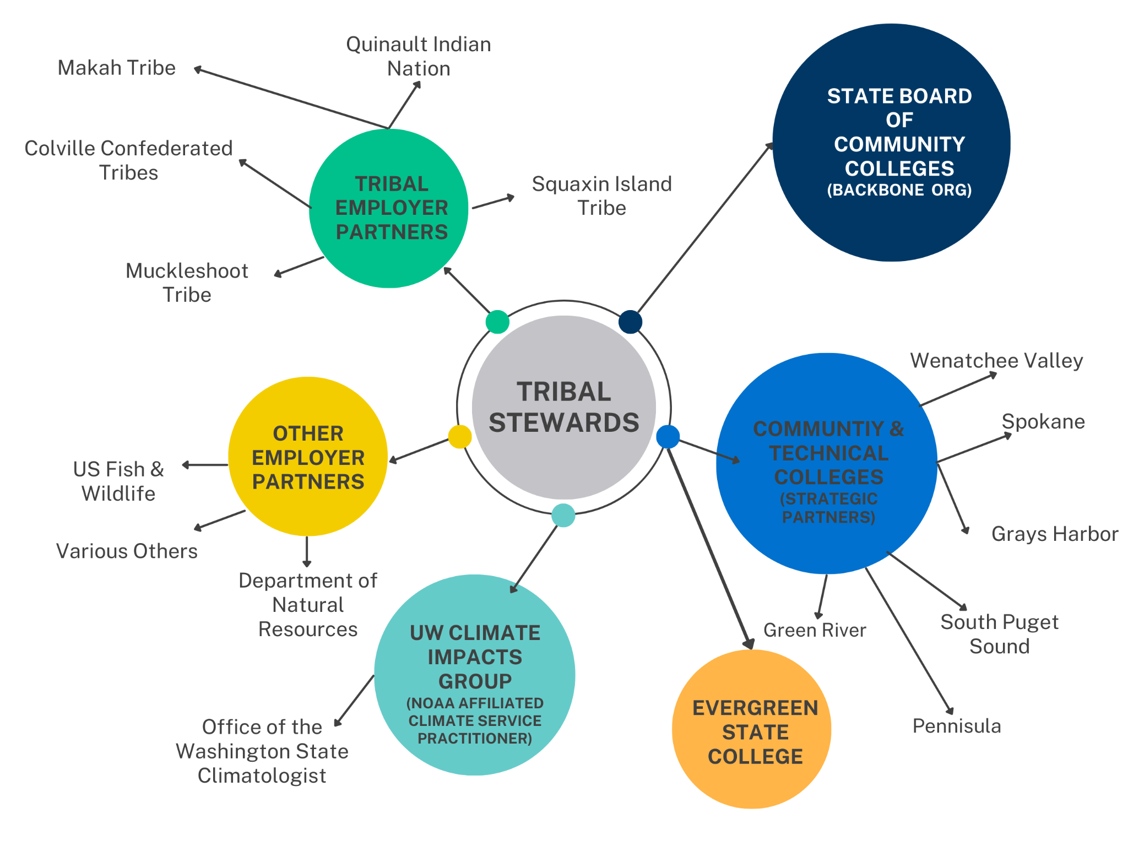
Tribal Steward Network

Slide 9
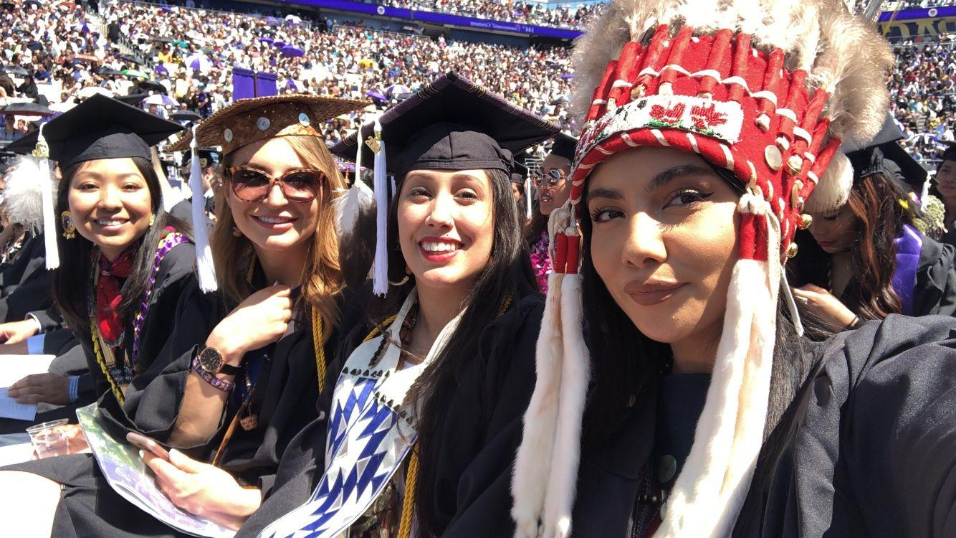

Slide 10
Anticipated Outcomes
145 Tribal students served
553 graduates from ‘Tribal Steward’ programs
11 employers committed to hiring Tribal and non-Tribal students for up to 465 positions
10 new Tribal student success professionals at participating colleges
G2G summits to develop MOAs with all Tribes in service areas ~ 18 total Tribal communities involved over the life of the grant
62 faculty trained
10 programs redesigned
K-12 Alignment & collaborative recruitment

Slide 11
How can you collaborate with Tribal Stewards?
The partnership model, best practices, and new curriculum will be disseminated across Washington’s 34-college system to strengthen workforce partnerships with all 29 federally recognized Tribes of Washington.
Annual government-to-government summits; ongoing support from the Tribal Government Affairs Office @ SBCTC.
Community of Practice Sessions for interested colleges to replicate the model.
Self-fund (Perkins etc.) the model & learn from our work.
Hire a Tribal navigator, replicate our partnership model, etc.
Replicate the model in other industries–i.e. energy sovereignty
OER Curriculum repository– get updated curriculum/modify to your region/Tribal partnerships.
E.g. Climate adaptation case studies; culturally relevant curriculum, place-based field project ideas, video curriculum on TEK from Tribal elder interviews etc.

Slide 12
Washington Consortium for Undergraduate Research and Equity (WA CURE)
Goal: Support colleges in expanding course-based undergraduate research experiences so all students can do hands-on research; benefit from improved outcomes and be more competitive in transfer and job opportunities.
Project period: 2024-2029
Led by: Val Sundby @ SBCTC, Yakima, Edmonds & Green River
Funded by: National Science Foundation, Improving Undergraduate Education (IUSE) Program—Institutional & Community Change track. ($2 million)
This is high-impact career-connected learning and skills training for fields that do research. (e.g. Natural Resources, Agriculture, Business, Data Analytics, Para Legal, Design, BAS degrees (Capstone projects), etc.

Slide 13
How can you get involved with WA CURE?
Our design strategy integrates undergraduate research within a regular course format called course-based undergraduate research experiences (CUREs) across all disciplines.
Each year we offer: (starting recruitment in Spring 2025!)
A Faculty Learning Community (FLC) to learn how to create inclusive CUREs.
A drop-in Community of Practice (COP) to informally explore best instructional practices, share curriculum, connect to research project opportunities, build community, and connect across colleges.
An academy for college teams of faculty and administrators to cultivate leadership, establish strategic action plans, and initiate the expansion and institutionalization of undergraduate research at their colleges as a core student success strategy. Each team will work together for two years with a coach and will be in a learning exchange cohort with other college teams.
Student and faculty-facing workshops and events related to human subjects research, research career skills and preparation, and connections to paid research opportunities and networks.
See Link: https://www.sbctc.edu/blogs/news-releases/2024/nsf-cures-grant

Slide 14
WA CURE Resources
We create resources to support the implementation of undergraduate research as a powerful teaching, learning, and student success strategy.
An open-source CURE curriculum archive and teacher-to-teacher webinars.
Assessment tools to document student learning and the impact of using this teaching practice.
Toolkits to make CUREs more inclusive, culturally responsive, and inquiry-driven.
Toolkits for scaling undergraduate research and leading institutional change.

Slide 15
Questions & Thank You:
Please reach out if you are interested in learning more about any of these initiatives or want to think through consortia and federal grants.
Irene Shaver: ishaver@sbctc.edu
Thank you to the many colleges that have said yes to these bids to collaborate and innovate!
Thank you centers of excellence for being such great collaborators!
Thank you to all the Deans and faculty who shared their perspectives on work-based learning.

