Slide 1

Fall WEC Meeting
October 17-18, 2024

Slide 2
Centers of Excellence Overview
  Key industry sectors in WA
  13 Centers of Excellence housed at community and technical colleges
  Statewide supporting role
  College-industry relations
  Building a diverse and highly skilled workforce
  Economic Development Industry Sector Strategy
  Education, Innovation & Efficiency
  Workforce Supply/Demand Equity and Access

Slide 3
Aerospace & Advanced Manufacturing​
Everett Community College​
​
Agriculture & Natural Resources​
Walla Walla Community College​
​
Allied Health​
Yakima Valley College​
​
Careers in Education​
Green River College​
​
Clean Energy​
Centralia College​
​
Construction​
Renton Technical College​
​
Cybersecurity​
Whatcom College​
Global Trade & Supply Chain Management​
Highline College​
​
Homeland Security – Emergency Management​
Pierce College​
​
Hospitality​
Columbia Basin College​
​
Marine Manufacturing & Technology​
Skagit Valley College​
​
Information & Computing Technology​
Bellevue College​
​
Semiconductor & Electronics Manufacturing​
Clark College​
​

Slide 4


Slide 5
Real-time industry and economic impact data​
Connection point for multiple colleges and partners​
Cross-sector industry collaboration; cross-college collaboration​
Access to emergent technologies, processes, and best practices​
Program development​
Curriculum workshops​
Conduit for equipment sharing and donations from industry​
Implicit Bias training​
Faculty professional development​
Engagement with under-served communities statewide​
Connection to K-12 system​
​
Connect employers to custom training and upskilling​
Connecting industry and education to ensure student success​
Support for registered apprenticeship development and expansion​
Access to evolving industry standards​
Provide employers coordinated access to diverse talent pipeline​
Advocate broadly for community and technical colleges in Washington State​
​

Slide 6

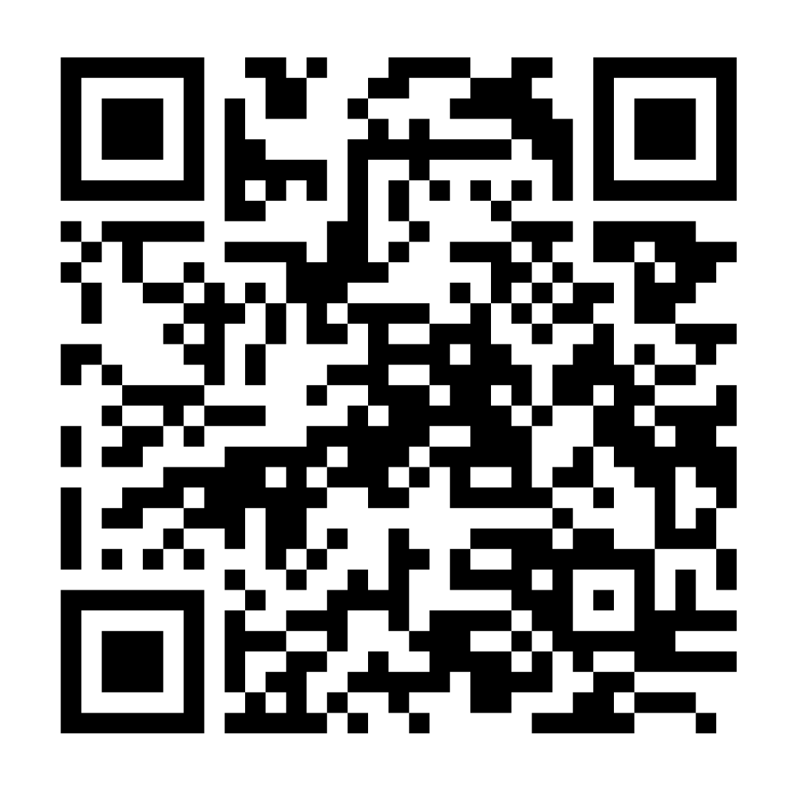
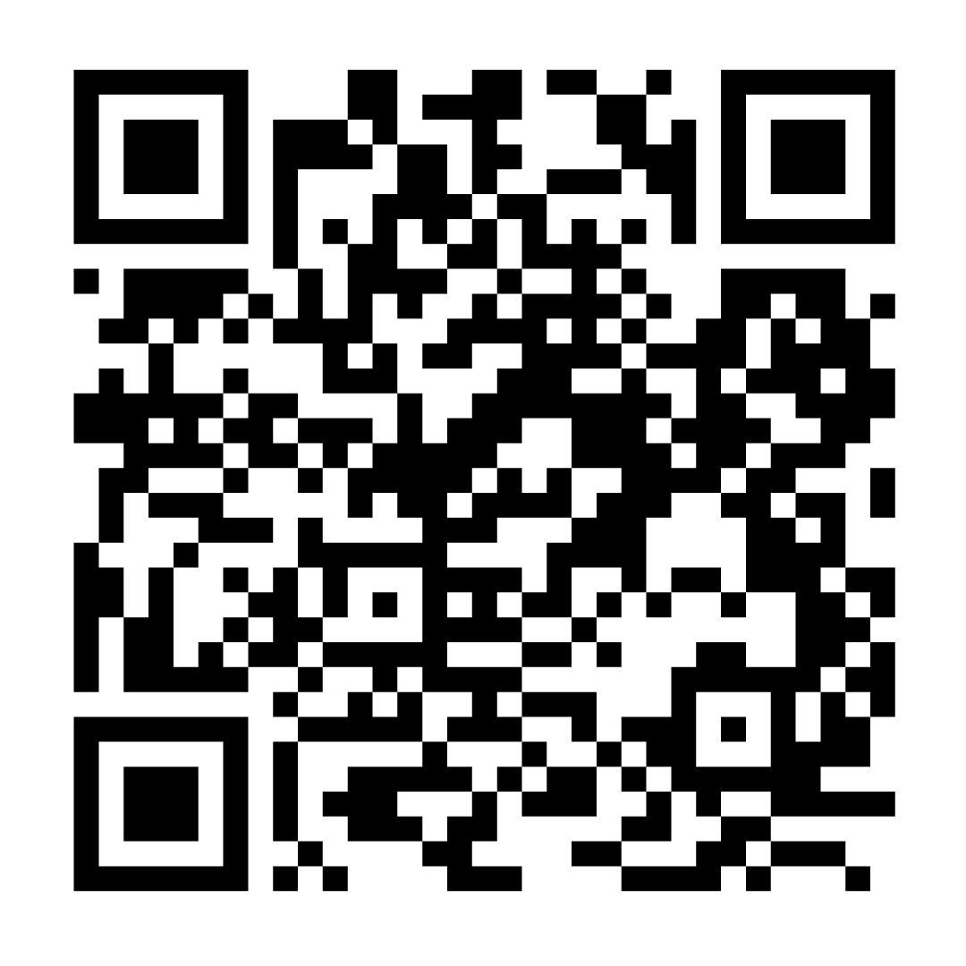
Current Opportunities
  Coursera Generative Artificial Intelligence Academy – free for college faculty & staff through Dec. 31
  www.coeforict.org/coursera
  Faculty Professional Development Funds – IT (www.coeforict.org) and Cybersecurity (www.coecyber.io)
Coursera
IT Prof Dev
Cyber Prof Dev

Slide 7
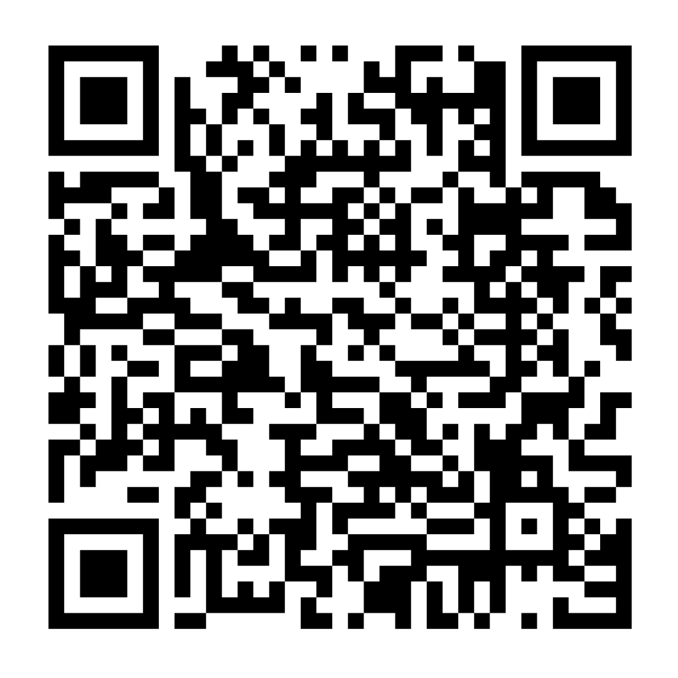
Current Opportunities
  Prof /Tech Faculty Basic Boot Camp – Nov. 8, 15, and 22
  DACUM Facilitator Training – Jan. 27-31; April TBD
  Email Jamie Wells: jrwells@greenriver.edu
Boot Camp

Slide 8
Upcoming Events
  October 21 | Criminal Justice Leadership Workgroup
  Bellevue College
  November 8 | Cybersecurity Townhall – Cyber Range
  Virtual
  November 15 | Latinx Health Workforce Development Symposium
  Big Bend Community College
  November 21 | Diversity & Inclusion Summit
  Renton Tech

Slide 9


Contact Us

