Slide 1

Labor Liaison
October WEC Report

Slide 2

WSLC AFL-CIO Convention
Wenatchee, July 2024
Set Priorities for the Upcoming Year
Workshop on Advisory Committees
Thank You to Construction COE and Renton Tech for being panelists

Slide 3


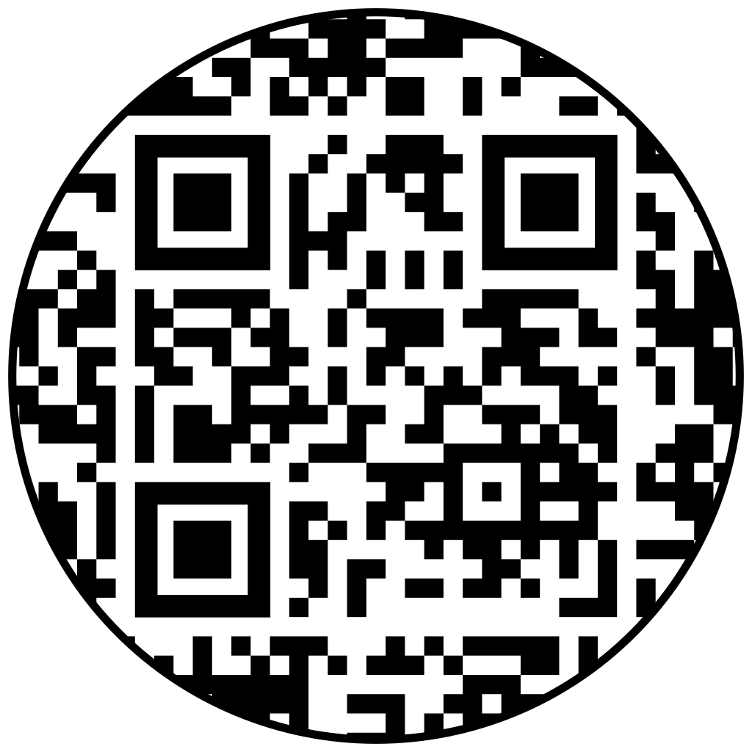



Advisory Committees
  https://docs.google.com/forms/d/e/1FAIpQLSeatiasXiicYVanP6b3dea__ASyQk7Y3eXs3Yj15H2uoq4JYQ/viewform
Notes:
Thank you To:
More info, the betterl. Broad outreach, more local outreach. Maintain the relationship and maintain he relationship Shout out to SCC staff, best practices for recruitment and retention

Slide 4
Statewide training or workshop for college participants pertaining to how
unions function, recent changes in national organizations, and key workforce
issues from a labor perspective
Through the professional/technical programs dean, faculty, or Center of Excellence (COE) Director arrange presentations for classrooms, COE, or employment events provided by local union members, labor liaisons, advisory committee members, or others concerning their career planning, training, and work experience.
Coordinate and convene regional roundtable discussions to include SBCTC
colleges, apprenticeship coordinators, workforce development council labor
members to discuss upcoming Washington workforce needs

Slide 5
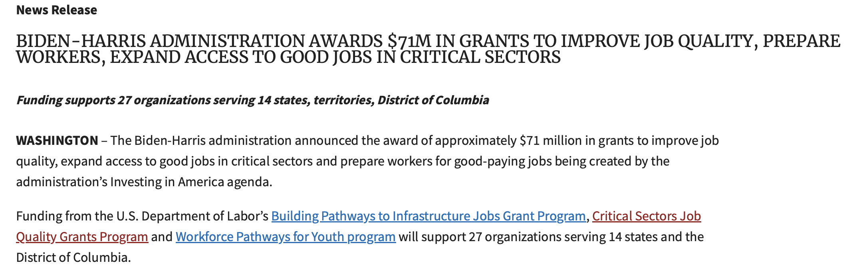
DOL Critical Sectors Job
Quality Grant
  UNITEHERE Local 8
  Hospitality Association
  Tri-Cities WDC
  WSLC
  Awarded Round 2, Tier 1
  Focus Groups by occupation, in the Tri-Cities
  Mapping out Hospitality Pathways
Notes:
All hopeful to partner with new Hospitality COE
SEAKing WDC also awarded Tier 2, with participants

Slide 6
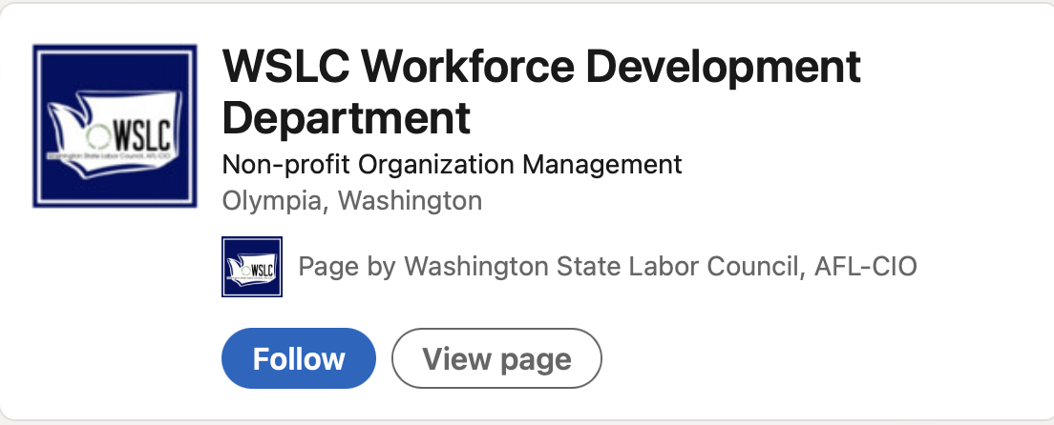


Ways to Connect with the WSLC
Social Media (LinkedIn & Facebook):
Quarterly Newsletter:
Send an email to Lpoplack@wslc.org to sign up!
Notes:
Distribution list has grown. Show of hands if you receive, mostly labor workforce news, events, updates.

Slide 7
Rachel McAloon
Rmcaloon @wslc.org
360-515-1335

