Slide 1
Funding fundamentals
Workforce Education
Genevieve Howard, Associate Director
Fall WEC 2026

Slide 2
Budget Terminology
Allocation – Part of a larger budget that is reserved for specific agencies or uses
Budget Proviso – Language in a budget that provide funds for a specific purpose, “provided solely for…”
State Board Earmark – Funding intent that is continued after the system is not obligated to adhere to the proviso language.

Slide 3
Workforce Grants and Allocations
Aerospace High Demand 1,000 FTES
Basic Food Employment and Training (BFET) Grant
CTE Dual Credit
Early Achievers Grant (EAG)
Job Skills Program (JSP) Grant
Perkins Plan Grant
Perkins Corrections Grant
Perkins Leadership Block Grant
Perkins Non-Traditional Gender Employment and Training Grant
Perkins Special Project Grant
Worker Retraining Program
Worker Retraining Program for Private Career Schools and Colleges
WorkFirst Delivery Agreement
Workforce Development Fund (combined with High Demand Enrollment Fund and Invest in WA)

Slide 4
Critical Components of funding
Source of Funding – Who provides the funding; state, federal, or other source?
Funding Intent – Is there a specific legislative intent?
Eligibility – What programs or services are eligible for funding?
Allowable Costs – What can funding be used to purchase?
Allocation/Billing – Is funding received in an allocation or are expense invoiced?
Reporting – What are the reporting requirements?
Where do you find all this information?
Program and Fiscal Guidelines

Slide 5
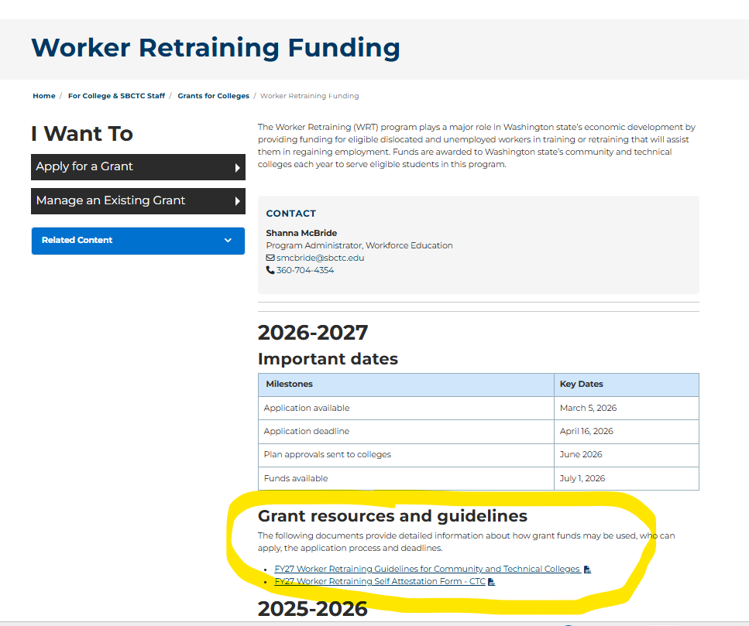
Worker Retraining Funding

Slide 6
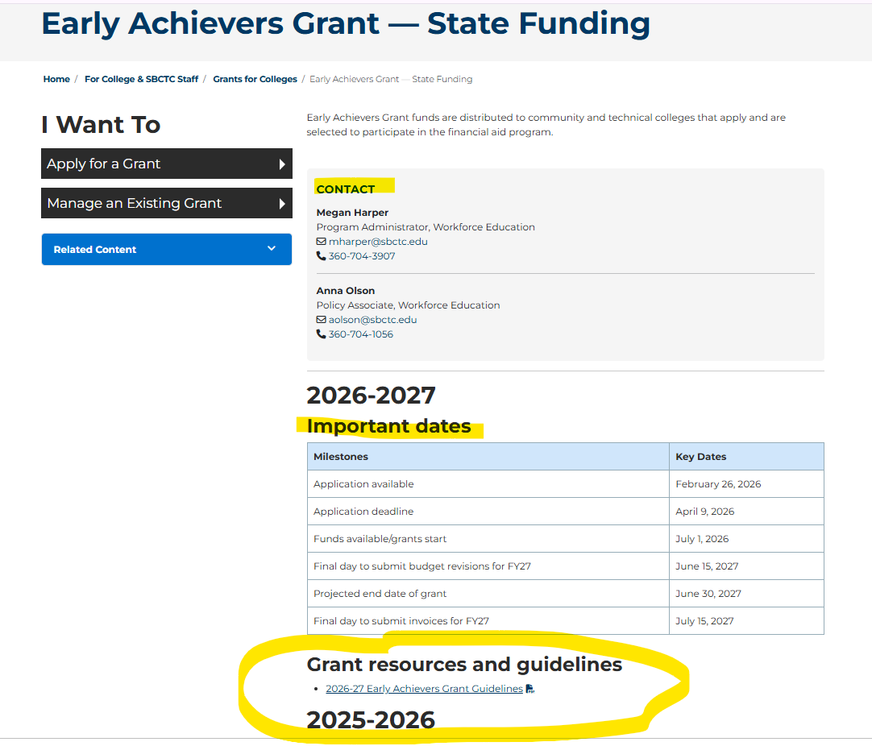

Slide 7
Current Landscape
College leaders have expressed concerns to legislators that provisos are overly restrictive and limit colleges' ability to use funding to address local needs.
Due to these concerns the following item has been added to Instruction Commission’s work plan and assigned to WEC.
  “Support the development of efficiency models for grants, provisos, and earmarks”

Slide 8
Request for Input
What is hard or problematic about current grant processes?
What could be the impact if we change (positive, negative, neutral)?
What is the opportunity?
Do you have suggestions on how the processes could be streamlined?

