Slide 1
Community College Baccalaureate Association BLC/WEC May 8, 2025
Maximizing Industry Partnerships in the Development of Baccalaureate Programs

Slide 2
Presenters
Michaela Jackson
Director; Education Programs
New Program Development
Lower Columbia College
Jason Boatwright
Dean of Healthcare Programs
Clover Park Technical College
Dan Ferguson
Director of AHCOE
Yakima Valley College
Kris Lau,Ph.D.
Program Director
Lead Faculty BAS-Behavioral Health
Big Bend and Wenatchee Valley College

Slide 3
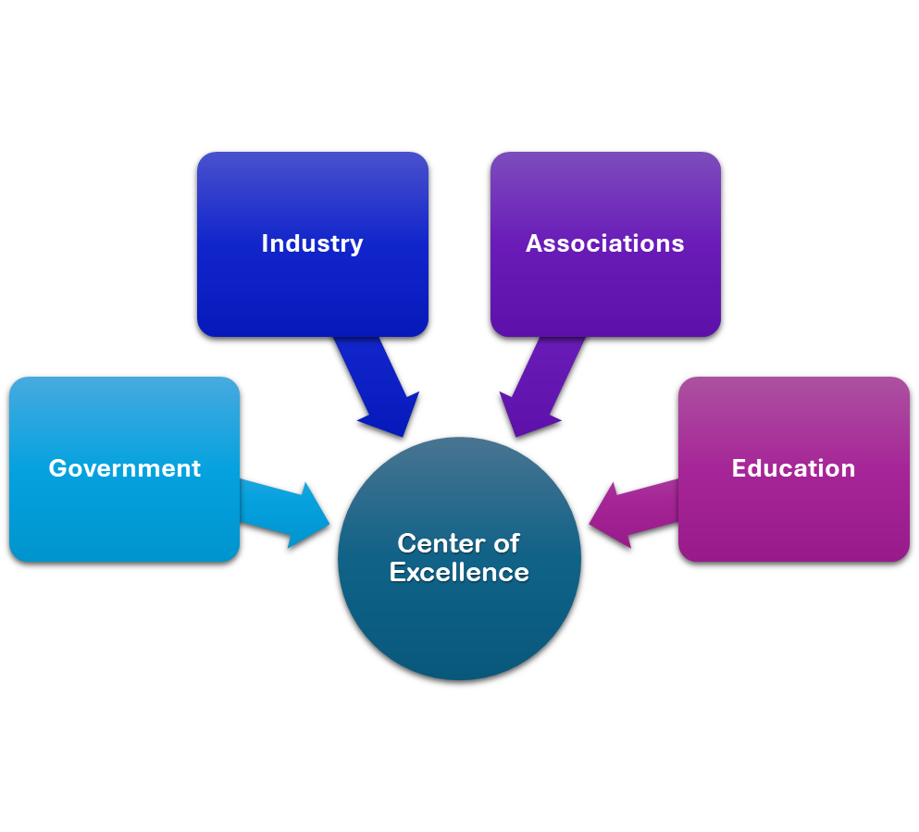
Allied Health COE- Primary Role
Statewide leadership in workforce education and training within the health care sector.
Point of Contact/Resource HUB for industry trends, best practices, innovative curriculum and professional development activities.
Maximize resources by bringing together workforce education and industry partners in order to develop highly skilled employee.

Slide 4
WA Centers of Excellence’s Core Expectations
COE Focus Areas
Economic Development
Industry Sector Strategy
Education, Innovation, and Efficiency
Workforce Supply and Demand
Notes:
Collaboratively build, expand, and leverage industry, labor, and community and technical college partnerships to support and promote responsive, rigorous, and relevant workforce education and training.
Economic Development Focus:
Serve as partners with various state, local, regional, national, and global agencies and organizations to support economic vitality and competitiveness in Washington State’s driver industries.
Industry Sector Strategy Focus:
Collaboratively build, expand, and leverage industry, labor, and community and technical college partnerships to support and promote responsive, rigorous, and relevant workforce education and training.
Education, Innovation, and Efficiency:
Leverage resources and educational partnerships to create efficiencies and support development of curriculum and innovative delivery of educational strategies to build a diverse and competitive workforce.
Workforce Supply and Demand Focus:
Research, analyze, and disseminate information related to training capacity, skill gaps, trends, and best practices within each industry sector to support a viable new and incumbent workforce.

Slide 5
Collaboration / Collective Impact
“Effectively, change is almost impossible without industry-wide collaboration, cooperation, and consensus.”
– Simon Mainwaring
Notes:
Thoughts:
Who is responsible/has the power to make change?
Moves from thinking from current crises to planning to pre-empt future crises.

Slide 6
Shared Responsibility
Mutual Benefit
Collective Impact
Mutually Reinforcing Activities
Shared Impact
Notes:
Images from iStock, royalty free
https://www.istockphoto.com/legal/license-agreement?utm_medium=organic&utm_source=google&utm_campaign=iptcurl
Image with gears

Slide 7
A Mindset Shift.
Four counterintuitive principles:
1. Mission, not Organization.
2. Node, not Hub.
3. Humility, not Brand.
4. Trust, not Control.
“The Networked Nonprofit” by Jane Wei-Skillern and Sonia Marciano (2008)
https://ssir.org/articles/entry/the_networked_nonprofit

Slide 8
Key Tensions in Collaboration
1. Quick Wins & Systemic Change
2. Building Relationships & Advancing the Work
3. Differentiating & Aligning
4. Personal & Community Responsibility
5. Learning & Action
Examples:
Hospital Employee Education Training
WA State Patient Navigation Certificate
Supporting innovation in primary care

Slide 9
Reference
Karam, Rita T., Charles A. Goldman, and Monica Rico, Career Services and College-Employer Partnership Practices in Community Colleges: Colleges in California, Ohio, and Texas, RAND Corporation (RR-A1873-1), 2022
https://www.rand.org/pubs/research_reports/RRA1873-1.html
Rita Karam is a senior policy researcher at the RAND Corporation. She investigates post-secondary education and K–12 reforms. She researches postsecondary interventions and restructuring, college-industry partnerships, workforce development, career pathways and alignment between K–12 and postsecondary institutions, adult education, and career services and advising interventions.
For more information on RAND research contact:
Dr. Rita Karam
karam@rand.org

Slide 10
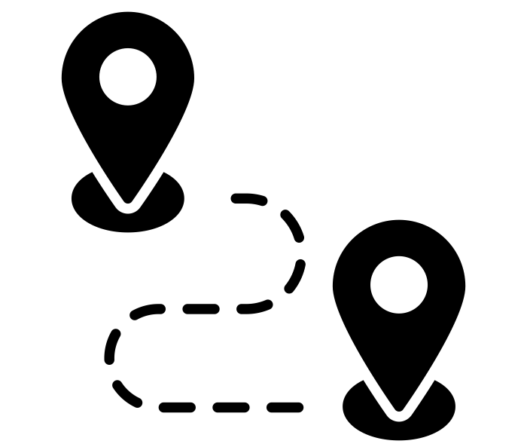
Collaborating partnerships are the strongest for meeting the needs of colleges, its students, and industries
Creation of shared goals
Planning on identifying partnership goals and participants
Leadership encouragement among partners
Mechanisms of accountability
Coordinated action among partners
Strong monetary incentive structure to pursue shared goals
Planning to institutionalize systemic changes and sustaining collaboration
Challenges

Slide 11
RAND work indicates many partnerships lack incorporating collaborative components
In general, limited strategic approaches to building partnerships (lack of shared goals)
Partnership communication efforts tended to lack coordination
Partnerships between colleges and employers tended to be opportunistic
Lack of clear vision or explanations how the partners would collaborate
Partnerships were led by staff with limited capacity and influence (lack of planning)
Colleges and employers did not have adequate resources to build and sustain partnership
Building partnerships often relied on grant funds
Colleges and employers tended to engage in coordinated activities addressing short term goals

Slide 12
New innovative ways for developing and leveraging industry partnerships
Creating new offices/leadership positions that focus on marketing and employer relationship development
Reports directly to Provost and President
Develops strategic vision for development and establishment of industry partners
Allocates resources to most meaningful relationships with an eye on mutual benefit and return on investment
Restructuring advisory boards
Develops two-tiered boards
Includes diverse board members to provide a variety of perspectives

Slide 13
New innovative ways for developing and leveraging industry partnerships
Establishing regional consortium that brings together colleges and industries serving a specific region within state or across states
Develops network of connections and communication with employers and associations
Addresses common needs and pools resources
Provides continuous structure for collaboration
Building research capacity to collect employment data to inform programs
Analyzes Unemployment Insurance (UI) reports
Develops new methods for surveying students/graduates and employers

Slide 14
Recommendations: Initial Steps for Strengthening Partnerships
Develop a strategic vision
Include all partners in strategic planning
Inventory current and potential partners
Develop a rubric for managing partnerships
Develop procedures for documenting partnership activities
Pay attention to staffing needs and partners’ capacity
10

Slide 16
Partnership Levels of Engagement
Community Colleges
Businesses
Level 1
Networking
Level 2
Cooperation
Level 3
Collaboration

Slide 17
Defining Employer Engagement
According to Jobs for the Future’s “A Resource Guide to Engaging Employers” there are identifiable qualities of successful engagement
https://bit.ly/2JAvydh

Slide 18
These include:
Continuous
Strategic
Mutually valuable
Wide-ranging
Comprehensive
Intensive
Empowering
Institutionally Varied
Defining Employer Engagement

Slide 19
Level of Engagement Activity
Take survey
Reflect on your responses
Share thoughts

Slide 20
New Relationship | Working Relationship | Strategic Partnership
 | Level I | Level II | Level III | Level IV | Level V
Key Employer Role | Advising | Capacity-building | Co-designing | Convening | Leading
Stage of Relationship | Initial contact / new relationship | Establishing trust and credibility | Working relationship | Trusted provider and collaborator | Full strategic partner
Activity Examples | Discuss hiring needs, skills, competences, advise on curriculum, contract training, hire graduates. | Job site tours; speakers; mock interviews, internships, needs assessment, loan/donate equipment, recruiting | Curriculum/pathway development, adjunct faculty and preceptors | College-employer, sectorial, partnerships | Multi-employer/ multi-college partnerships
Ladder of Employer Engagement

Slide 21
Facilitated Work
What are some of your best existing partnerships?
What works well?
What may be the blind spots?
Next steps

Slide 22
For more information on the
WA State Center of Excellence
contact:
Dan Ferguson
dferguson@yvcc.edu

