Slide 1
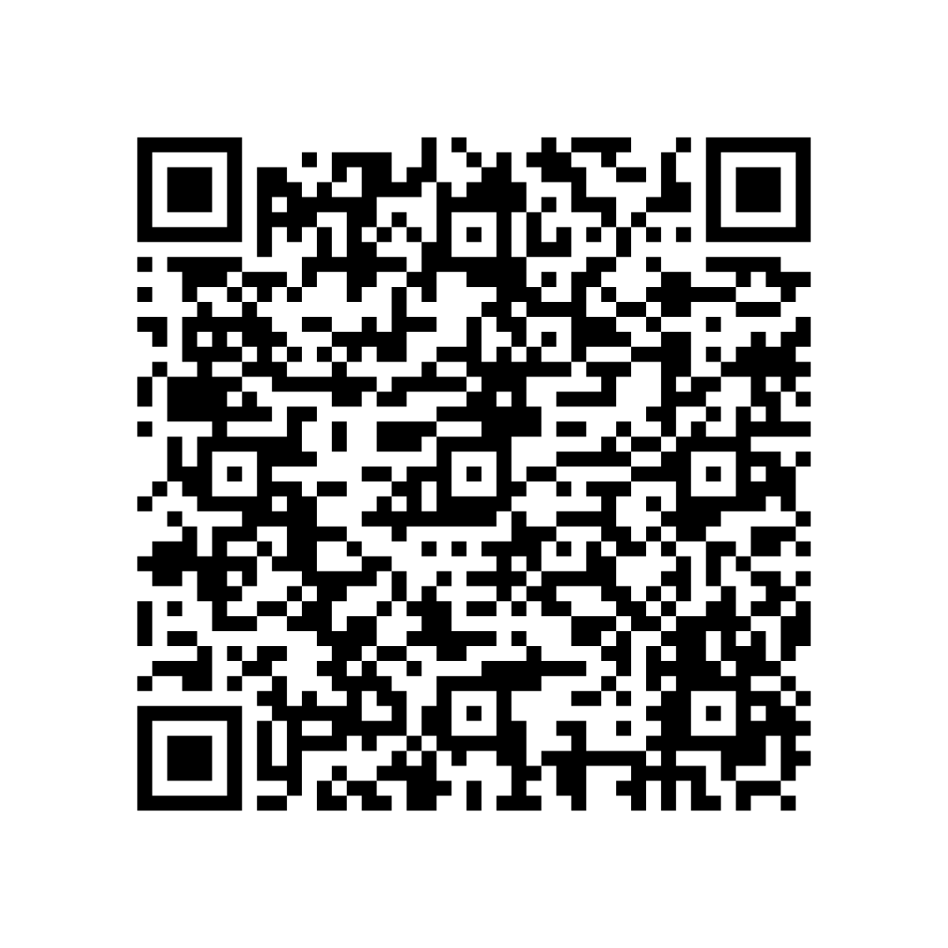
Washington Workforce Portal
AWB Institute partnered with SBCTC to co-host the first-ever Washington Workforce Portal Webinar on April 16th titled Connecting Students to Careers: Leveraging the AWB Institute Washington Workforce Portal
The webinar featured:
A live demo of the Washington Workforce Portal
A panel discussion on the portal and work-based learning with partners from Tacoma Community College, Greater Vancouver Chamber, and Thurston County Chamber
Employer insights on expanding relationship with education partners
Q&A session to explore collaboration opportunities
Blog post now available on AWB Institute’s webpage with webinar recording and slide deck

Slide 2
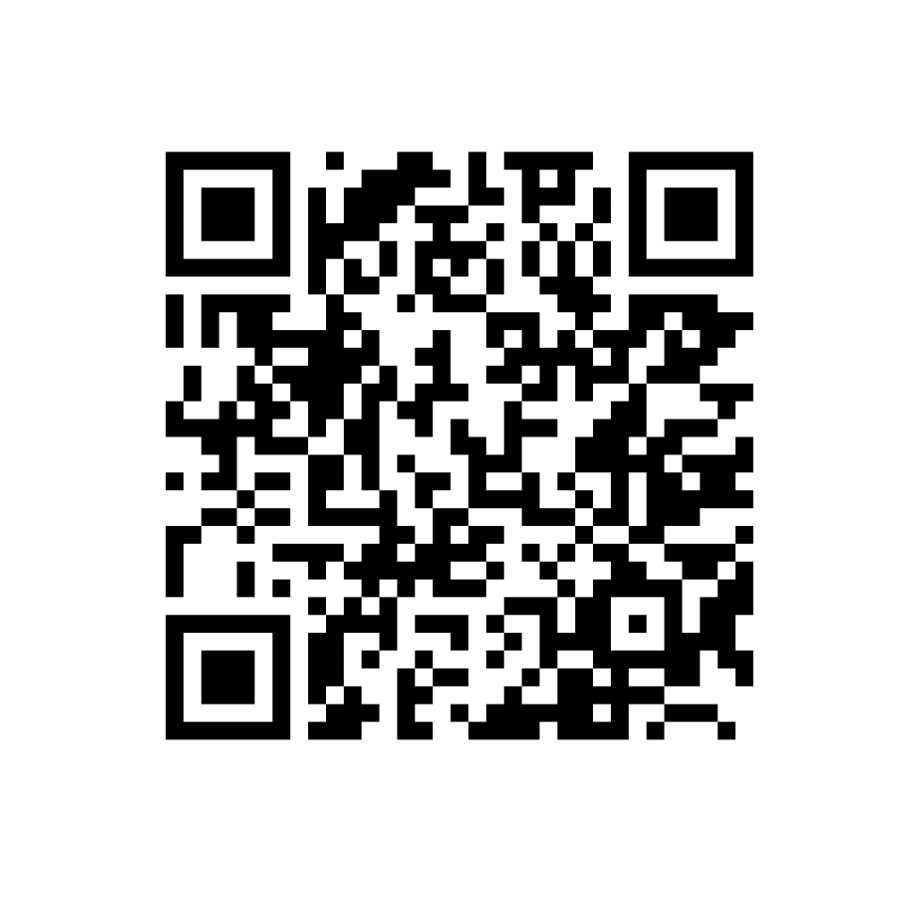
2025 Spring Meeting
Join us May 14 in Vancouver as AWB’s Government Affairs team helps unpack the 2025 legislative session, look ahead to the interim, and strengthen your connections with fellow business leaders throughout Washington.
Workforce Session: Creating Community Partnerships to Build a Stronger Workforce
Moderator: Erika Borg, Strategic Advisor, AWB Institute
Speakers: Mark Wilson, Executive Director, Port of Kalama
Cory Torppa, CTE Director, Kalama High School
Luke Schmeusser, CTE Student, Kalama High School
Scan for details & to register!

