Slide 1
Spring WEC Meeting May 8-9, 2025

Slide 2
Centers of Excellence Overview
Key industry sectors in WA
13 Centers of Excellence housed at community and technical colleges
Statewide supporting role
College-industry relations
Building a diverse and highly skilled workforce
Economic Development Industry Sector Strategy Education, Innovation & Efficiency Workforce Supply/Demand Equity and Access

Slide 3
Aerospace & Advanced Manufacturing​ Everett Community College​
​
Agriculture & Natural Resources​ Walla Walla Community College​
​
Allied Health​ Yakima Valley College​
​
Careers in Education​ Green River College​
​
Clean Energy​ Centralia College​
​
Construction​ Renton Technical College​
​
Cybersecurity​ Whatcom College​
Global Trade & Supply Chain Management​ Highline College​
​
Homeland Security – Emergency Management​ Pierce College​
​
Hospitality​ Columbia Basin College​
​
Marine Manufacturing & Technology​ Skagit Valley College​
​
Information & Computing Technology​ Bellevue College​
​
Semiconductor & Electronics Manufacturing​ Clark College​
​

Slide 4
New COE Directors
David Schweiger Hospitality Center of Excellence Columbia Basin College
Jill Thornton Aerospace & Advanced Manufacturing Center of Excellence Everett Community College

Slide 5
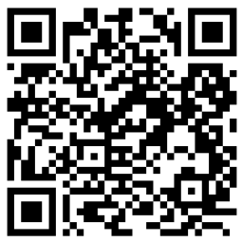
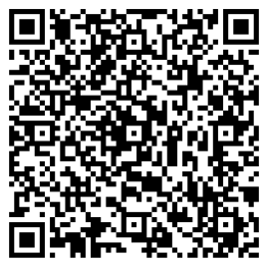
Current Opportunities
Free money! $2,500 stipends available for cybersecurity-related professional development – apply by May 23rd at https://coecyber.io/professional-development-funds-for-faculty
Green Transportation Summit – June 10th in Tacoma. Tickets available! Contact monica.brummer@centralia.edu
Coming this fall! Construction Education Community of Practice (Virtual) Kickoff Event October 9th, 9:00am – Register

Slide 6
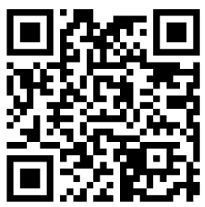
Current Opportunities
Artificial Intelligence Workshop Series Targeted to students by open to all – Fridays at 1pm, Zoom May 9th – How Top Companies Use AI May 16th – Building AI-Powered Products May 23rd – Industry, Ethics, and Human Identity May 30th – Microsoft Copilot Details/registration: www.aiworkshopswa.com
Free ebook access for faculty/staff – The Opposite of Cheating: Teaching for Integrity in the Age of AI Contact brianna.rockenstire@bellevuecollege.edu for access code

Slide 7
Upcoming Events
May 15-16 | Women in Leadership Symposium Lower Columbia College
May 21 | Health Workforce Roundtable Elma, WA
June 12 | DACUM Occupational Analysis: Construction Managers Online

Slide 8
Thank you WEC for 20 years of partnership!

Slide 9
Contact Us

