Slide 1
Implementation of the Universal Online Platform for High School & Beyond Plans (HSBP)
Workforce Education Council
May 9, 2025

Slide 2
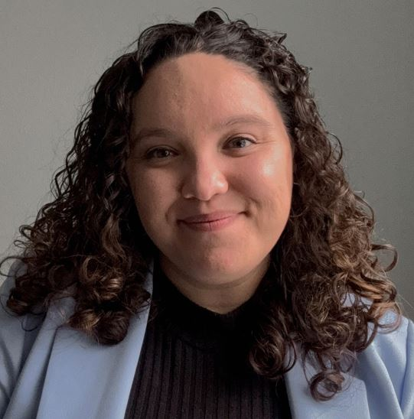
HSBP Implementation Support Team
Kim Reykdal
Director of Graduation
& Pathway Preparation
Eric Thornburgh
Director of IT Project Management
Lindsey Maehlum
Associate Director of Secondary Initiatives
Jeff Parks
Business Analyst and IT Project Management
Abby Anaya Bedell
NEW! High School & Beyond Planning Program Supervisor
Reach the OSPI team at
HSBP@k12.wa.us

Slide 3
Today’s Objectives
The Possible Future of High School & Beyond Planning
High School & Beyond Planning in SchooLinks
Q&A
What is the HSBP?

Slide 4
Graduation Requirement Policy
+
+
=
HSBP
INSTRUCTION (24-CREDITS)
GRADUATION PATHWAYS
MEANINGFUL DIPLOMA & POSTSECONDARY PREPARATION
RCW 28A.230.212
RCW 28A.230.215 (New)

Slide 5
What is Actually Required for the HSBP?
Career Goals (based on ‘assessments’)
Educational Goals
(MS/HS/PS)
Resumé or Activity Log
Course Taking Plan & Grad Pathway
Financial Aid Information
Students Should be Updating Their Plan Annually & in Alignment with IEP Transition Plan

Slide 6
What’s Possible? The Legislature’s Vision: Universal Platform & Student Experience
NEW SECTION Sec.1.(1) The legislature recognizes that the HSBP is both a graduation requirement and a critical component in our education system. However, the practices and technologies that school districts employ for facilitating HSBPs vary significantly. These variances can create inequities for students and families, and do not reflect the legislature's vision for the role of the high school and beyond plan in promoting student success in secondary and postsecondary endeavors.

Slide 7
New Platform Expectations Related to CTE
Inclusion of in-state labor market, apprenticeship, and postsecondary education performance data, including employment and earning outcomes, certificate and degree completion outcomes, and demographics of enrolled students or employees.
A dedicated space in which to build a direct connection to potential employers, including industry associations, trade associations, labor unions, service branches of the military, nonprofit organizations, and other state and local community organizations so students can learn from experts in different occupational fields about career opportunities and any necessary education and training requirements.
Access to data reporting broken down by demographic, socioeconomic, & other characteristics, to analyze student use of the platform, improve student access to the information, guidance, and opportunities that can help them maximize their secondary education experience and postsecondary preparation.
Include a catalog containing meaningful, high quality career exploration opportunities and resources… that are submitted by approved entities (community organizations, institutions of higher education and employers) and vetted by state-selected approvers that allow students to register for or apply to participate in the opportunities (programs, classes, internships, pre-apprenticeships, online courses, etc.) or access the resources.

Slide 8
Building Opportunities for Students; Supporting Transformative Change for Leaders
Saved Careers and Resumé
Saved Colleges
Post-High School Plan/Goal
Course Plan
New electives
Career speakers
Activities/Clubs
Worksite visits
WBL or DVR
CTE courses/CTSOs
Offer more IRCs
Job app support & mock interviews
Connect to jobs, employers, trades
More dual credit & CTE courses
College rep visits
College app support
College visitations
FAFSA/WASFA completion
Scholarship app connect/support
Family support nights
New CTE program & IRC options
New dual credit courses
Offer new/more Grad Pathways & provide support
Offer ASVAB
Offer ACT, SAT
Job app support & mock interviews
Military reps
Future program and course dvmt.
Master schedule and calendar
Teacher training
New equipment grant applications
Inform bonds and levies
Develop new acad. interventions
Inform SIP goals

Slide 9
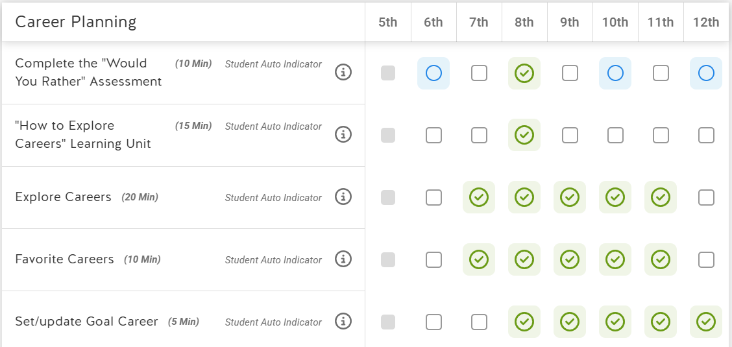
NEW! Setting Minimum Expectations

Slide 10
Data System Alignment
What data would you want to see/use?
Statewide HSBP data dashboard with reporting options for “real time” data sets to support to districts & partners
OSPI and SchooLinks are mapping some data sets to CEDARS, ensuring alignment of HSBP & OSPI data
Event Scheduler feature allows colleges to request visitations
Future Opportunities:
Electronic transfer of HS transcript data to colleges
Supported data analysis of & visuals for NSC data
Some Possible Data Sets:
Saved Careers/Colleges
Graduation Pathway(s)
Dual Credit & IRCs
Postsecondary Plans
Planned Courses
Platform usage analytics and data reporting to support student/family and staff use and inform state-level support for districts and partners

Slide 11
High School & Beyond Planning in SchooLinks

Slide 12
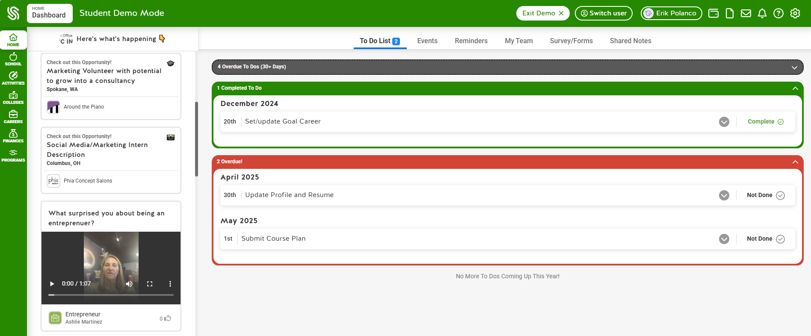
Student Dashboard

Slide 13
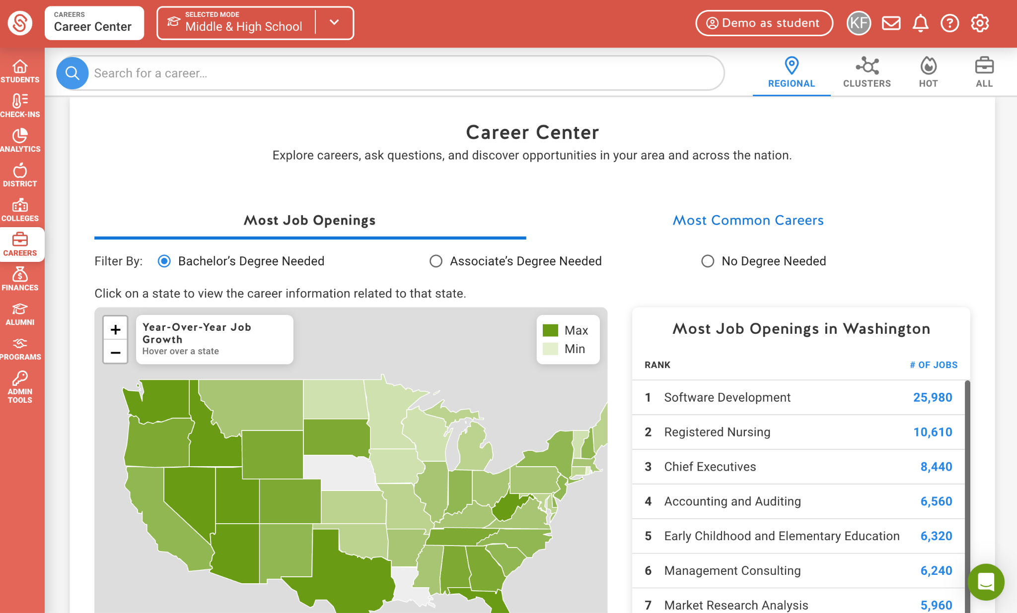
Career Search
Local job posts and volunteer opportunities that industry partners post directly on SchooLinks
Direct linkage from career profiles to local opportunities

Slide 14
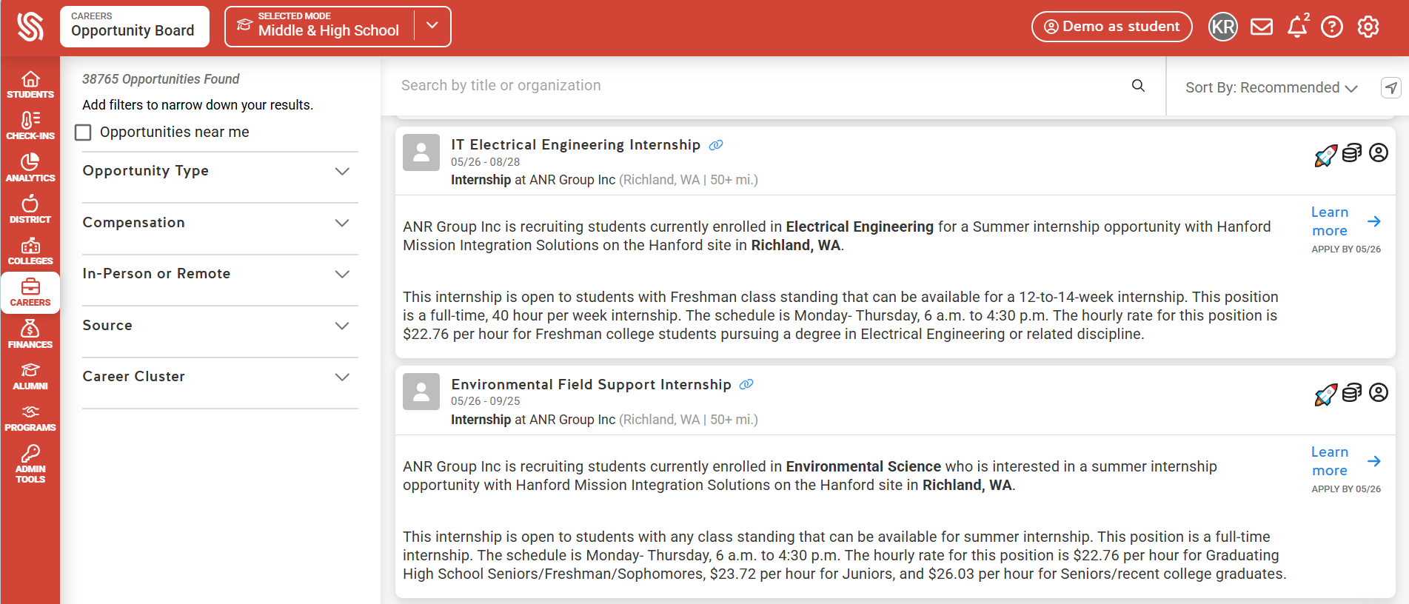
Expanding Partnerships: Opportunity Board

Slide 15
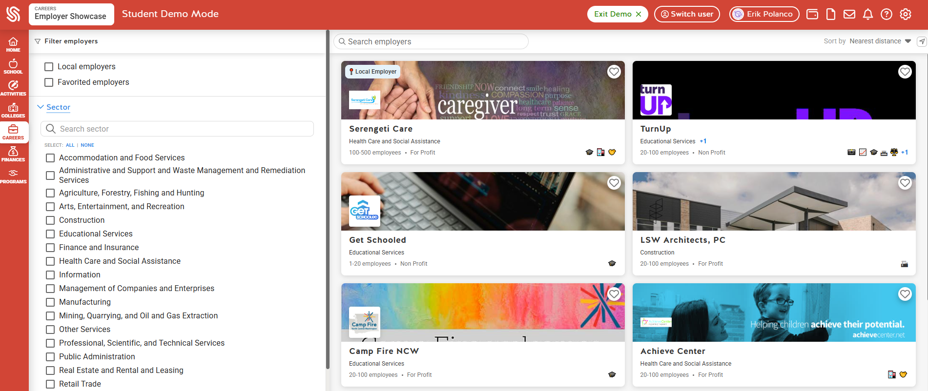
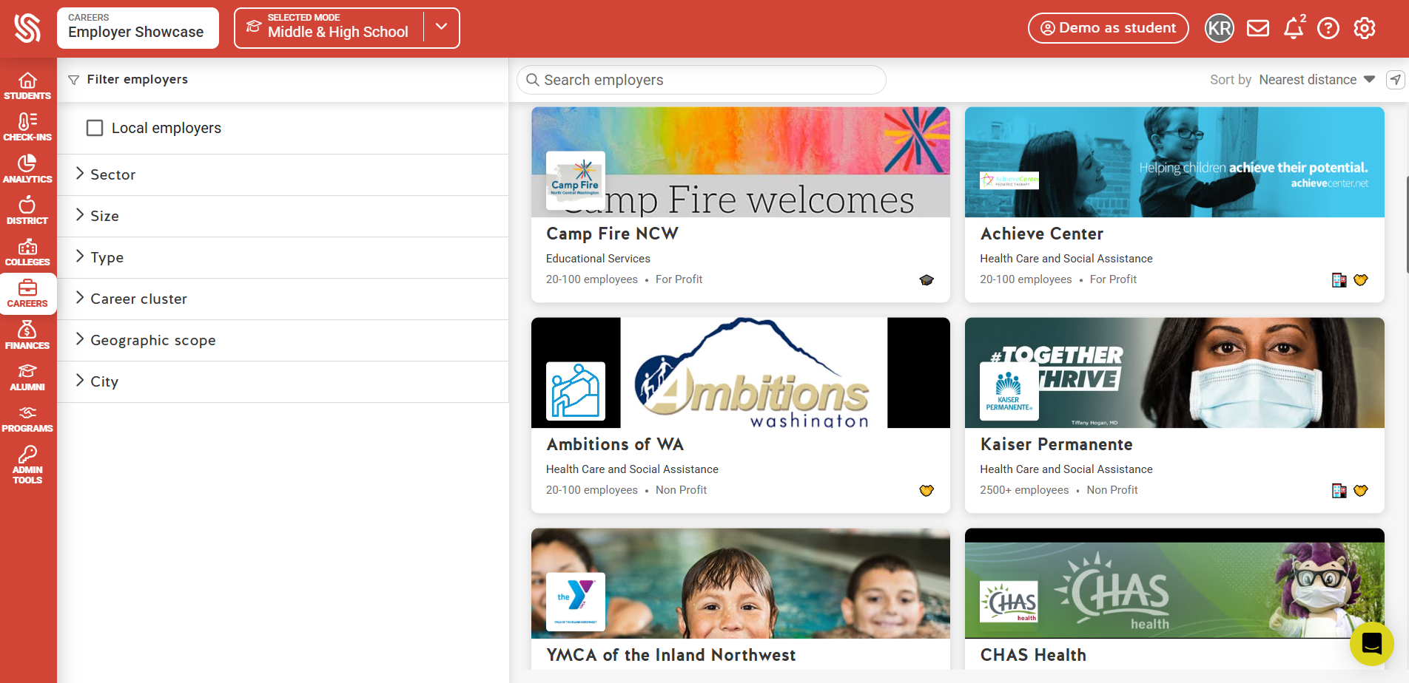
Expanding Partnerships: Employer Showcase

Slide 16
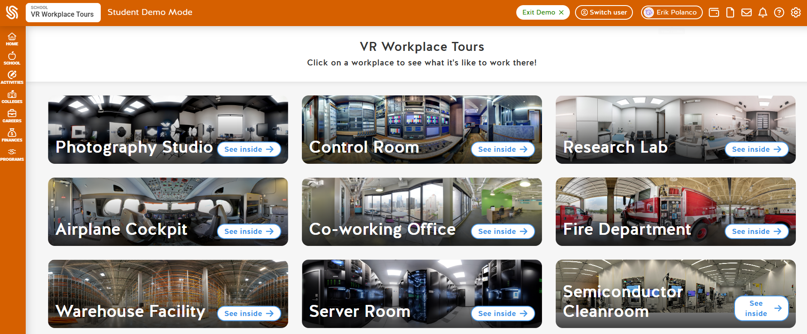
Expanding Partnerships: VR Tours

Slide 17
Thank You!
What Questions, Ideas or Feedback do you have?

Slide 19
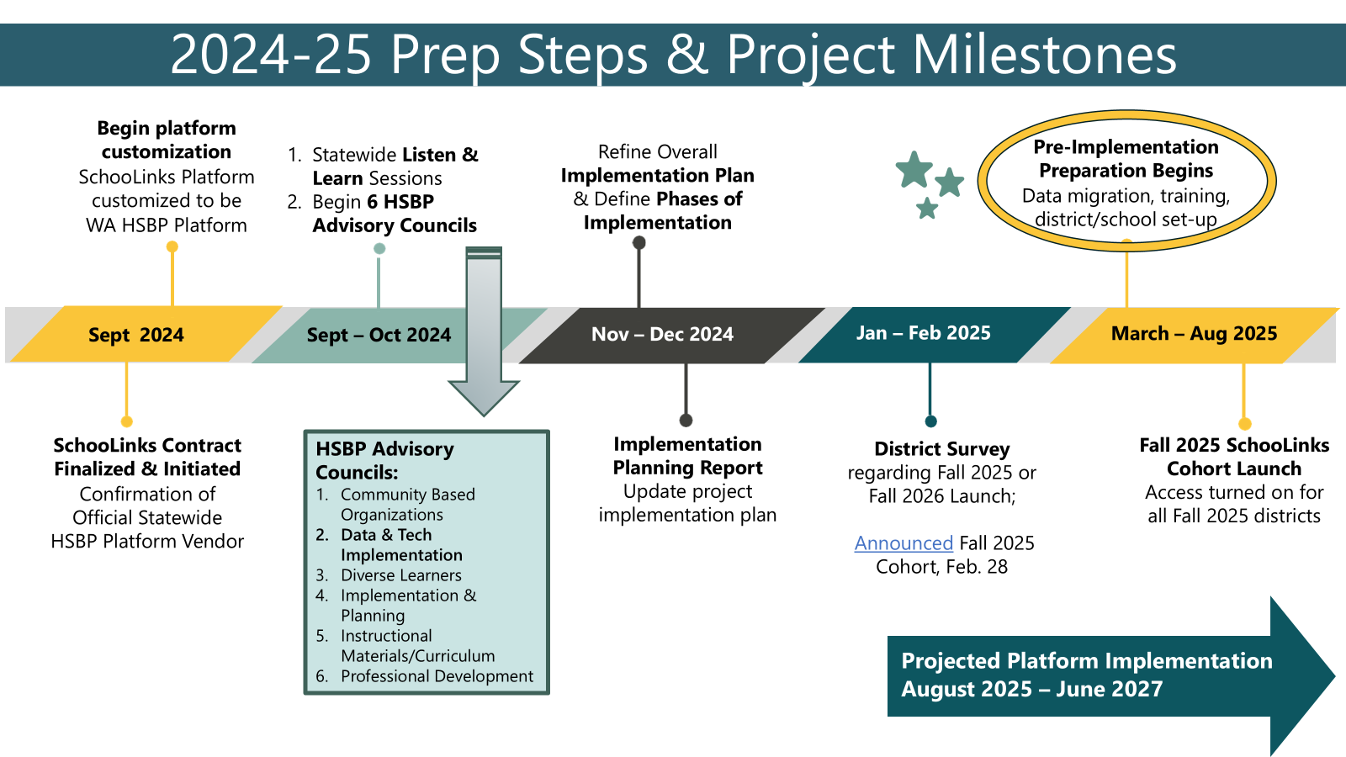
From Grad Req to Guiding/Advising Process
Present HSBP State Support & Major Prep Steps
Past Practice |  | Future Plan
District determines delivery model |  | District determines delivery model; minimum reqs set for WA
District provides online platform At least 12 ‘platforms’ in WA that don’t connect |  | State provides online platform Connects to CEDARS and other systems for data sharing that supports students’ post-HS plans
Focus on completing required HSBP tasks (check box) |  | Focus on providing annual guidance and advising to support students’ learning and decision making
(OSPI)
150+

Slide 20
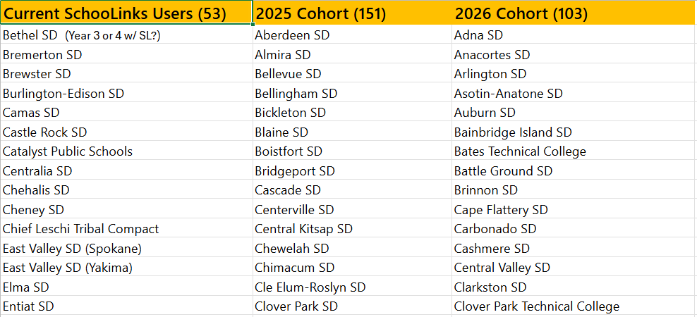
Making the Statewide Transition
2024-25 - Fall 25 - Fall 26 Cohorts
20

