Slide 1
SBCTC Spring update
Thursday, May 8, 2025
Agenda:
System Highlights
Legislative & Program Updates
Funding Updates

Slide 2
System Highlights
Marie Bruin, Director of Workforce Education

Slide 3
2025-27 Operating Budget, as passed
Current Budget Status
SBCTC leadership advocated, as appropriate, with key legislative members. The WACTC Legislative Committee was informed of budget status throughout the legislative session.
SBCTC Workforce Education staff closely monitored and informed leadership of collective impacts, operational considerations, and implications of budget cuts. Capital and Operating budget information was shared with WEC, CEC, and VTC on April 28.
SBCTC leadership provided the operating and capital budgets, along with an analysis for the system, to the Presidents and PRES public listserv ASAP after passage.
SBCTC is awaiting action by the governor (has 20 days to act, including veto of sections). Leadership will regroup with college administrators and relevant staff to further inform and assess the situation as we know more.

Slide 4
2025-27 Operating Budget, as passed
Workforce Education & System Implications
Student Services Impacts
Healthcare Opportunity Grants cut ($2 M)
Benefits Navigator positions maintained
Food Program pilot maintained (FY26 only)
Compensation
FY23-25 I-732 Fund Correction
FY25 no required payback $28.8 M
FY26 payback $19.9 M
FY27 payback $28.5 M
No furloughs
Other
0.5% across-the-board reduction
Capital funding for expansion of Career-Connected Learning ($1.5 M)

Slide 5
2025-27 Operating Budget, as passed
Centers of Excellence
Eliminates the $631,000 annual maintenance adjustment made in 2023-25.
Cybersecurity and Hospitality COE budgets reduced to $204,000 per year.
The effect of the proposed House budget is a 21% across the board cut to COEs, to approximately $204,000 per Center per year.
CDL & Related Supply Chain Industries
Funding for the WA CDL Fund and WA CDL Grant is eliminated ($2.5 M)
The effect is elimination of the grant program for both CTCs and licensed private career schools, eliminating both enrollment capacity resources and student financial assistance that had been sponsored by the program.

Slide 6
2025-27 Operating Budget, as passed
Cybersecurity Enrollment Expansion Funding
50% reduction to the cybersecurity enrollment expansion funding first allocated in FY23 ($2.3 M)
100% of funding is currently allocated to increasing Cybersecurity enrollments by 500 FTES by Spring of 2025.
FY26 allocation to colleges will reflect the 50% reduction.
Career Launch Enrollments
Eliminates all funding for Career Launch expansion enrollments ($3.0 M)
The effect is elimination of funding for all Career Launch expansion enrollments, to include FTEs that have been “permanently” allocated and those that are still currently monitored against FTE targets by SBCTC.

Slide 7
Legislative, program & Funding updates

Slide 8
Work-based Learning
Work-based Learning: Assist colleges as they provide experiential learning opportunities.
Team Members:
Genevieve Howard, Policy Associate; ghoward@sbctc.edu
Karin Gitchel, Program Administrator; kgitchel@sbctc.edu
Programs:
Aerospace 1,000 FTE | Career Connect WA
Aerospace Apprenticeship FTE | Apprenticeship
Aerospace Contract | Aerospace Pipeline Committee
Career Launch Equipment & FTE | Aerospace Legislation
Career Launch Endorsement | Aviation & Aerospace Advisory Committee

Slide 9
funding & program Updates
Aerospace Pipeline Committee
Purpose: align the CTC and apprenticeship training with industry demand within the aerospace sector.
Reviews Aero 1,000 applications and makes funding recommendations.
Committee members represent industry, education, labor, and government entities.
Do you have an aerospace or aerospace related program? If so, I need your input!
What are your questions for industry?
What are your programs struggling with?
How can we maximize the knowledge in the room for the benefit of the system?

Slide 10
funding & program Updates
Apprenticeship
Does your college offer the Multi-Occupational Trades (MOT) AAS?
Developing an apprenticeship degree pathway landing page at each college to identify AAS options and BA/BAS pathway options.
Washington College Grant for Apprentices (WCG-A)
Six pilot colleges (Bates, Everett, Columbia Basin, Renton, Spokane, and South) working with SBCTC and WSAC to provide WCG-A through their FA offices.
Once the pilot process is complete all apprenticeship colleges will be required to provide WCG-A through their FA offices in the 2025-26 academic year.

Slide 11
Program support
Program Support: Provide overarching program support to strengthen business, industry and colleges.
Team Members:
William Belden, Policy Associate; wbelden@sbctc.edu
Kimberly Ingram, Program Administrator; kingram@sbctc.edu
Shelby Means, Program Inventory Coordinator; smeans@sbctc.edu
Programs:
Carl D. Perkins | CTE Dual Credit
Comprehensive Local Needs Assessment (CLNA) | High Demand Grant
Program Approval Review & Program Inventory | Workforce Education Council (WEC)
Prof-Tech Certification | Customer Advisory Committee (CAC)

Slide 12
Legislative Updates
HB 1167 Careers in Maritime Professions (Core Plus).
Work-integrated learning opportunities in Maritime.
Articulate to postsecondary education approved by US Coast Guard.
Delivered to Governor
2SHB 1273 Improving Access to Dual Credit and CTE Dual Credit.
Alignment with regional credential pathways and apprenticeships leading to in-demand career fields
Signed by Governor
ESHB 1414 Improving Access to Career Opportunities for Students.
Specific to 16- and 17-year-old students
OSPI to expand career and technical education taskforce to review laws, rules, and policies specific to employment.
Signed by Governor
HB 1722 Review Age Restrictions to Participation in CTE Career Pathways.
Specific to 16- and 17-year-old students
Emergency medical services, fire services, and health professions
Requires training until student graduates HS or turns 18.
Signed by Governor

Slide 13
FY26 Perkins workforce Grants
Perkins Plan Grant
College Required Revisions Due | 5/22/2025
SBCTC Approval* | 7/1/2025
Perkins Leadership Grants
SBCTC Application Feedback | 5/23/2025
College Required Revisions Due | 6/11/2025
SBCTC Approval* | 7/1/2025
Availability of Additional Funding for Special Project and Non-Trad Announced | 7/18/2025
*Perkins Approval Process Overview webinar

Slide 14
Perkins updates
Perkins Annual Reports
FY25 Annual Reports—Due July 31, 2025
Link for FY25—Emailed early May
FY26 Annual Reports—Due June 30, 2026
Resources
Perkins Canvas Class
Website Improvements
Email kingram@sbctc.edu
2026 Initial CLNA—Due January 15, 2026
Degree Awarding—Due September (TBA)

Slide 15
Program Approval Updates
Updates to Plan Request Process and Plan Inventory
New SOC Code Field
SOC (Standard Occupational Classification) code used by employment security department to connect programs to workforce outcomes.
Added to new plan request form and will be used for new submissions.
If colleges submit a modification request and the CIP code changes, we will also collect the updated SOC code.
For credentials already in inventory, we will add the SOC code, and this will be another phase of the project.
Identifying fully online programs
Request to identify credentials in our inventory that can be completed through only online coursework.
Already in the new plan request form and currently collecting for new programs.
This identifier will soon show in our inventory and the program search tool.
If you’re already tracking this information at your college, please send a list of plan codes to programapproval@sbctc.edu
Updates to PAR Guidelines
PDF posted on the WEC resource page and listed on the Professional/Technical Program Approval page.

Slide 16
Program Updates
PAR Changes
Removed all references to Related Instruction
Colleges have begun implementing changes to associates degrees, aligning them with the updated language in 1.C.6 of the NWCCU guidelines.
Colleges identified language in the SBCTC PAR Guidelines (2024) referencing WAC 250-61-100 – providing guidance related to associate degree requirements. This WAC section outlines general education requirements for associate degrees, including communications, computation, and human relations.
Clarified exemption for public higher education institutions from WAC Chapter 250-61.
CTE Dual Credit
Pilot Sites: OAAP, Direct Enrollment, Course Coding
ProCert Reminder Messaging
Any account not responding will be removed from notifications after 12 months.
Reminders will be sent once per month (first Tuesday) for all outstanding activities.
Bloodborne Pathogens, First Aid, and CPR will be combined into one notification.

Slide 17
Sector Response
Sector Response: Support colleges as they deliver career and sector-based educational opportunities to students.
Team Members:
Anna Olson, Policy Associate; aolson@sbctc.edu
Megan Harper, Program Administrator; mharper@sbctc.edu
Shanna McBride, Program Administrator; smcbride@sbctc.edu
Programs:
Allied Health | Cybersecurity
Early Achievers Grant (EAG) | Early Learning/Parenting Education
Hospital Employees Education & Training (HEET) | Nursing Expansion
Worker Retraining (WRT)

Slide 18
Legislative, Funding & Program Updates
HB 1648:
Extending the deadline for early learning professionals to meet staff qualifications from August 1, 2026 to August 1, 2030
Allows childcare providers until August 1, 2030 to meet staff qualifications through an experience-based competency
HEET: TBD
Worker Retraining:
Enrollments up 12% Winter 2024 to Winter 2025
No changes to funding in the state budget

Slide 19
Student support Programs
Core Student Supports Team:
Jennifer Dellinger, Policy Associate, jdellinger@sbctc.edu
Vacant, Program Administrator, (WorkFirst)
Sheila Acosta, Program Administrator, sacosta@sbctc.edu
Dylan Jilek, Integrations Coordinator, djilek@sbctc.edu
Rebecca Kay, Relationship & Compliance Analyst, rkay@sbctc.edu
Integrated Student Supports Team:
Jessica Perez, Interim Policy Associate, jperez@sbctc.edu
Christine McMullen, Policy Associate, cmcmullen@sbctc.edu
Laura Coghlan, Program Administrator, lcoghlan@sbctc.edu

Slide 20
Program & Grant Updates
Program Applications
WorkFirst Delivery Agreement
Fiscal and program approvals under way
Final approvals will be granted once the SBCTC Board approves the budget (typically by June 30)
BFET
Expecting DSHS Budget Workbooks by mid-May
SBCTC Program Application Releases – June 12th

Slide 21
Program & Grant Updates
Funding & Allocations
July 1st –
WorkFirst Delivery Agreement Grant
SSEH Allocation
SEAG Allocation
OG & OG Health
Student Basic Needs/Navigators/Meal Pilot Allocation
SSP Summer Funding Survey Timelines
WF and BFET – July 14th – 28th
Opportunity Grant – no summer survey
SSEH & SEAG – no summer survey
Notes:
The WF grant goes live July 1 with the new fiscal year. The SSEH, SEAG, OG, and Basic Needs allocations are anticipated to go out in the first allocation schedule. Make sure to connect with your business office folks. A friendly reminder that for allocations colleges receive associated fund codes for each allocation, please use these codes when setting up your allocation in ctcLink.
Of the SSP programs only WF and BFET will run a summer funding survey. WF will help college with revisions needed from their planning numbers that support actual program needs. Summer survey for BFET will be the last survey of the FFY and will follow the previous years scaled survey.

Slide 22
Program & Grant Updates
SBCTC Webpage Updates
New lay out –
SSP has a landing page in Workforce and Student Services.
SSP programs are nestled within
Working on process for updating college contacts
Canvas Community Updates
Announcements
Now colleges can respond to announcements to engage and interact with each other
Discussion Boards
Encouraging use for the system to connect, ask questions, and share – SSEH and Navigators currently use, and they work well.

Slide 23
Industry Demand
Industry Demand: Meets the needs of industries, employers, and incumbent workers.
Team Members:
Carolyn McKinnon, Policy Associate: cmckinnon@sbctc.edu
Vicky Chungtuyco, Interim Program Administrator: vchungtuyco@sbctc.edu
Programs:
Job Skills Program (JSP) Customized Training (CTP) | Commercial Drivers Licensing Fund and Grant
Workforce Development Funds | Invest in Washington
Centers of Excellence (COEs) | Continuing Education Council (CEC)
Business (AWBI) & Labor (WSLC) Liaisons | Economic Development

Slide 24
Legislative updates
SB 5682 Extends the tax credit associated with the Customized Training Program by 5 years PASSED!
EHB 1874 Requires that cosmetologists, barbers, estheticians, and hair designers be trained on care, styling and treatment of textured hair. PASSED!
SJM 8006 Calls on the WA Supreme Court to re-open the Limited License Legal Technician to new licensees. Did NOT make cutoff, but if you had LLLT courses, worth monitoring WA Supreme Court and WSBA for potential updates.

Slide 25
funding Updates
Job Skills Program
FY26 Application closes in OGMS on May 8, 2025, for projects starting July 1, 2025.
This year’s funding totals $7,542,207 and is provisional until the 2025-27 Washington State Operating Budget is signed into law.
Quarterly application rounds until fully awarded. Check State Board webpage for status.
Final day of grant period is June 30, 2026; all activities must be concluded – no extensions
Customized Training Program
Helps offset costs of contract training for employers through an interest-free revolving loan fund and Business & Occupation Tax credit.
Apply anytime using a short application. A waitlist is maintained until loan funds are available.
Don't use the old application. Get a new one on the State Board website.

Slide 26
funding Updates (con't)
Workforce Development Funds
22 proposals amounting to almost twice the available funding were submitted by colleges by the March 27 deadline. Recommended awards were posted in OGMS on April 30. Funding to begin on July 1, 2025.
WA CDL Fund (CTCs)
WA CDL Grant (Private Schools)
Eliminated: As covered earlier in the State Board report, the operating budget eliminated all funding for this grant program.
We appreciate that nearly 1/3 of colleges were awaiting word about their FY26 applications for this program. We are sorry it turned out this way.

Slide 27
Industry demand initiatives
Retail Industry Work Group, Senate Bill 6296.
The group meets monthly and reports to the Legislature on Oct. 1.
Contact us if you want more information or to participate.

Slide 28
Micro-pathways Fellowship with Education Design Lab
Currently looking for philanthropic funding, in partnership with Education Design Lab, to sponsor new micro-pathway development in our system.
Centers of Excellence (COEs) are logical hubs for deploying this model in a supportive way to colleges.
Today, let's take a quick look at the Micro-pathways model.

Slide 29
Micro-pathway Template

Slide 30
Design Criteria for Micro-pathways

Slide 31
Baccalaureate Programs
Kendrick Hang, Policy Associate

Slide 32
Highlights
The State Board has approved over 170 bachelor’s degree programs.
Located at all 34 community and technical colleges.
Includes 14 approved Bachelor of Science in Computer Science programs.
There were 5,121 FTES in baccalaureate-level courses in Winter 2025.
Up 11% (+488 FTES) from Winter 2024

Slide 33
Baccalaureate Programs By Classification
Programs | Classification
38 | Health Professions and Related Clinical Services
38 | Computer and Information Sciences and Support Services
34 | Business, Management, Marketing, and Related Support Services
16 | Education
9 | Engineering Technologies/Technicians
5 | Natural Resources and Conservation
5 | Visual and Performing Arts
4 | Public Administration and Social Service Professions

Slide 34
Baccalaureate Programs By Classification
Programs | Classification
3 | Agriculture, Agriculture Operations, and Related Sciences
3 | Security and Protective Services
2 | Communication Technologies/Technicians and Support Services
1 | Transportation and Materials Moving
1 | Mechanic and Repair Technologies/Technicians
1 | Legal Professions and Studies
1 | Biological and Biomedical Sciences

Slide 35
BS Computer Science
We are planning a BSCS convening with WACSE for May 15-16, 2025 in Bellevue to coordinate efforts on BSCS to likely include:
Course sharing, curriculum sharing
Common course numbering
Shared voice in connecting with industry
Please contact Ken Hang, khang@sbctc.edu for registration details.

Slide 36
National Presentations
Community College Baccalaureate Association 2025 Conference
Toward Equitable Outcomes: Bridging the Gap Between College and Career for CCB Students
Apprenticeship to Baccalaureate and Beyond
Maximizing Industry Partnerships in the Development and Sustaining of Baccalaureate Degrees
PLA-ce Your Skills: Building a Strong Foundation for Prior Learning Assessment
Principles of a High Quality CCB: Three Concrete Approaches to Work-based Learning

Slide 37
Research Publications
Meza, E., & Bragg, D. D. (2025). Washington’s community college baccalaureate degrees: Growth and outcomes, 2024 update. Seattle, WA: University of Washington.
Full-text available online.

Slide 38
Baccalaureate Program Proposals for Fall 2025
BLC’s work currently includes reviewing a revision of the new baccalaureate program approval process for eventual consideration by the State Board.
Until a new process is approved, the existing approval process continues:
Statements of Need and Program Proposals for new baccalaureate programs are due August 1, 2025 for review and presentation at the October 15, 2025 State Board meeting.

Slide 39
Clean energy workforce
Irene Shaver, Program Manager Climate Solutions
Monica Brummer, Director Pacific Northwest Center of Excellence for Clean Energy
Agnes Balassa, Contractor

Slide 40
Preparing Students for A Clean energy CAREER

Slide 41
Clean Energy Sector
Generation, Transmission, Distribution and Storage
Hydropower Largest system in the US
Renewables Intermittent non-reliable resources: wind, solar and hydropower
H2: PnwH2, REVIT, Renewable H2 Alliance, Center for H2 Safety, H2Skills
Fusion: Largest concentration of independent fusion companies in the world
Advanced Nuclear: EnergyNW / Institute for NW Energy Futures (INEF) / CBC
Storage: Pumped storage and battery technologies
Security: Cyber Operations Technology (OT)’ Industrial Cybersecurity at EvCC
Green Transportation: GT Summit & Expo, WSU Green Transportation Webinars, Ken Mays at LWTech
Building Science - South Seattle Building Science, Climate Corps Fellow

Slide 42
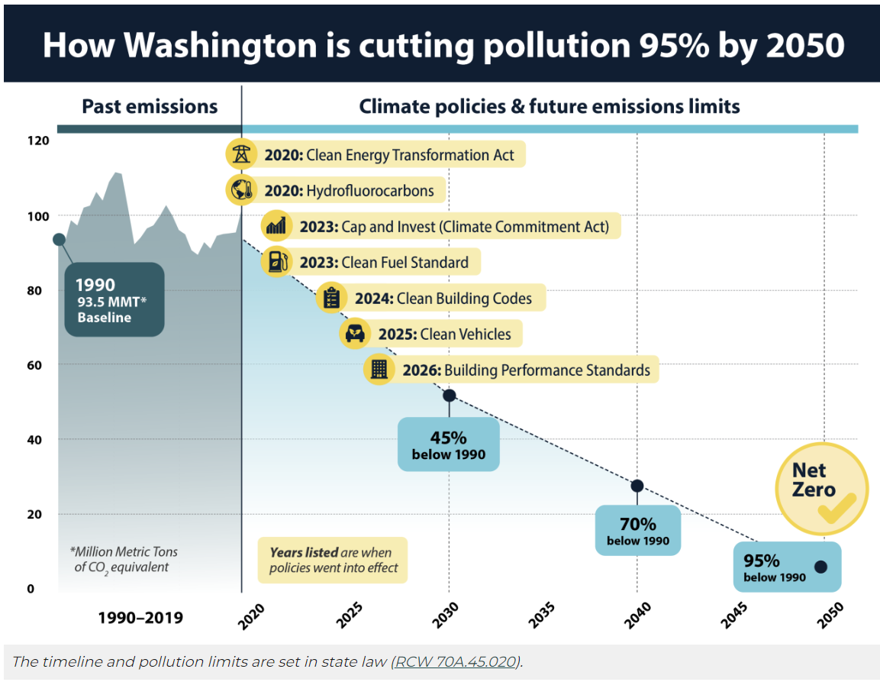
Timeline: WA’s state law commits to reducing greenhouse gas emissions to net zero by 2050.
These benchmarks will require an upskilled workforce who support electrification of the grid, increased energy efficiency, fuel switching, new technologies, etc.
Notes:
Notice of important dates
Welcome to our last two colleges to come onto SSEH! Bates and South Seattle are running planning grants this year and will beginning FY26 with full SSEH programs.
Welcome to Shoreline, Spokane Falls, and Wentachee Valley to SEAG. These three colleges are running planning grants this year and will beginning FY26 with full SEAG programs.
Clean Energy Workforce Trends: [MONICA INSERT HIGHLIGHT] 44,000 new jobs
Define Sector and relevant programs.

Slide 48
What does our system need to be Responsive?
State Level Workforce Planning: CETWAC & CCAP* will be making recommendations/requests to the legislature this year for increasing workforce system responsiveness (improving existing programs, recommending new programs, requesting resources) to serve these sectors.
We are the largest workforce provider in the state; we have the most programs that serve these combined sectors.
They need to hear from us what we need!
CETWAC= Clean Energy Technology Workforce Advisory Committee
CCAP= Comprehensive Climate Action Plan

Slide 49
The Ask: Please Complete this Survey by May 15!
Share what your programs need to be responsive to these changes and prepare students for these sectors!
[INSERT SURVEY QR CODE]

