Slide 1
Labor Liaison May 2025 WEC Rachel McAloon

Slide 2
Labor Openings
Partnership between Labor and the CTC system
WSLC provides broad outreach
Balanced committee of Labor and Management (50/50)
Worker sits on Labor side
Management side has ability to hire and fire
Union density is NOT equal by industry or by region of the state
Strong union presence: EX: healthcare, building and construction trades, education, state and city employees, transportation, aerospace, advanced manufacturing, utilities, etc.
Low union presence: cosmetology, automotive, information technology,

Slide 3
Best Practices
Email introduction from WSLC to college
Follow up with: Introduce yourself, Advisory Committee, and schedule
Build a relationship with the worker voice
Advertise to past students
Outreach to regional unions
CLC’s regional meeting schedule: https://www.wslc.org/afl-cio-central-labor-councils/
WSLC AFL-CIO Directory: https://www.wslc.org/wp-content/uploads/2024/04/2024-WSLC-Directory-web2.pdf
WSLC can provide letter of no/low union presence for certain committees for Perkins audits
College must still work to fill worker voice and have a balanced committee
Myths:
Does not need to be a union representative (i.e. someone who works for unions)
Do not need to replace worker voice member if they are not in a union. Quality of partnership matters.

Slide 4
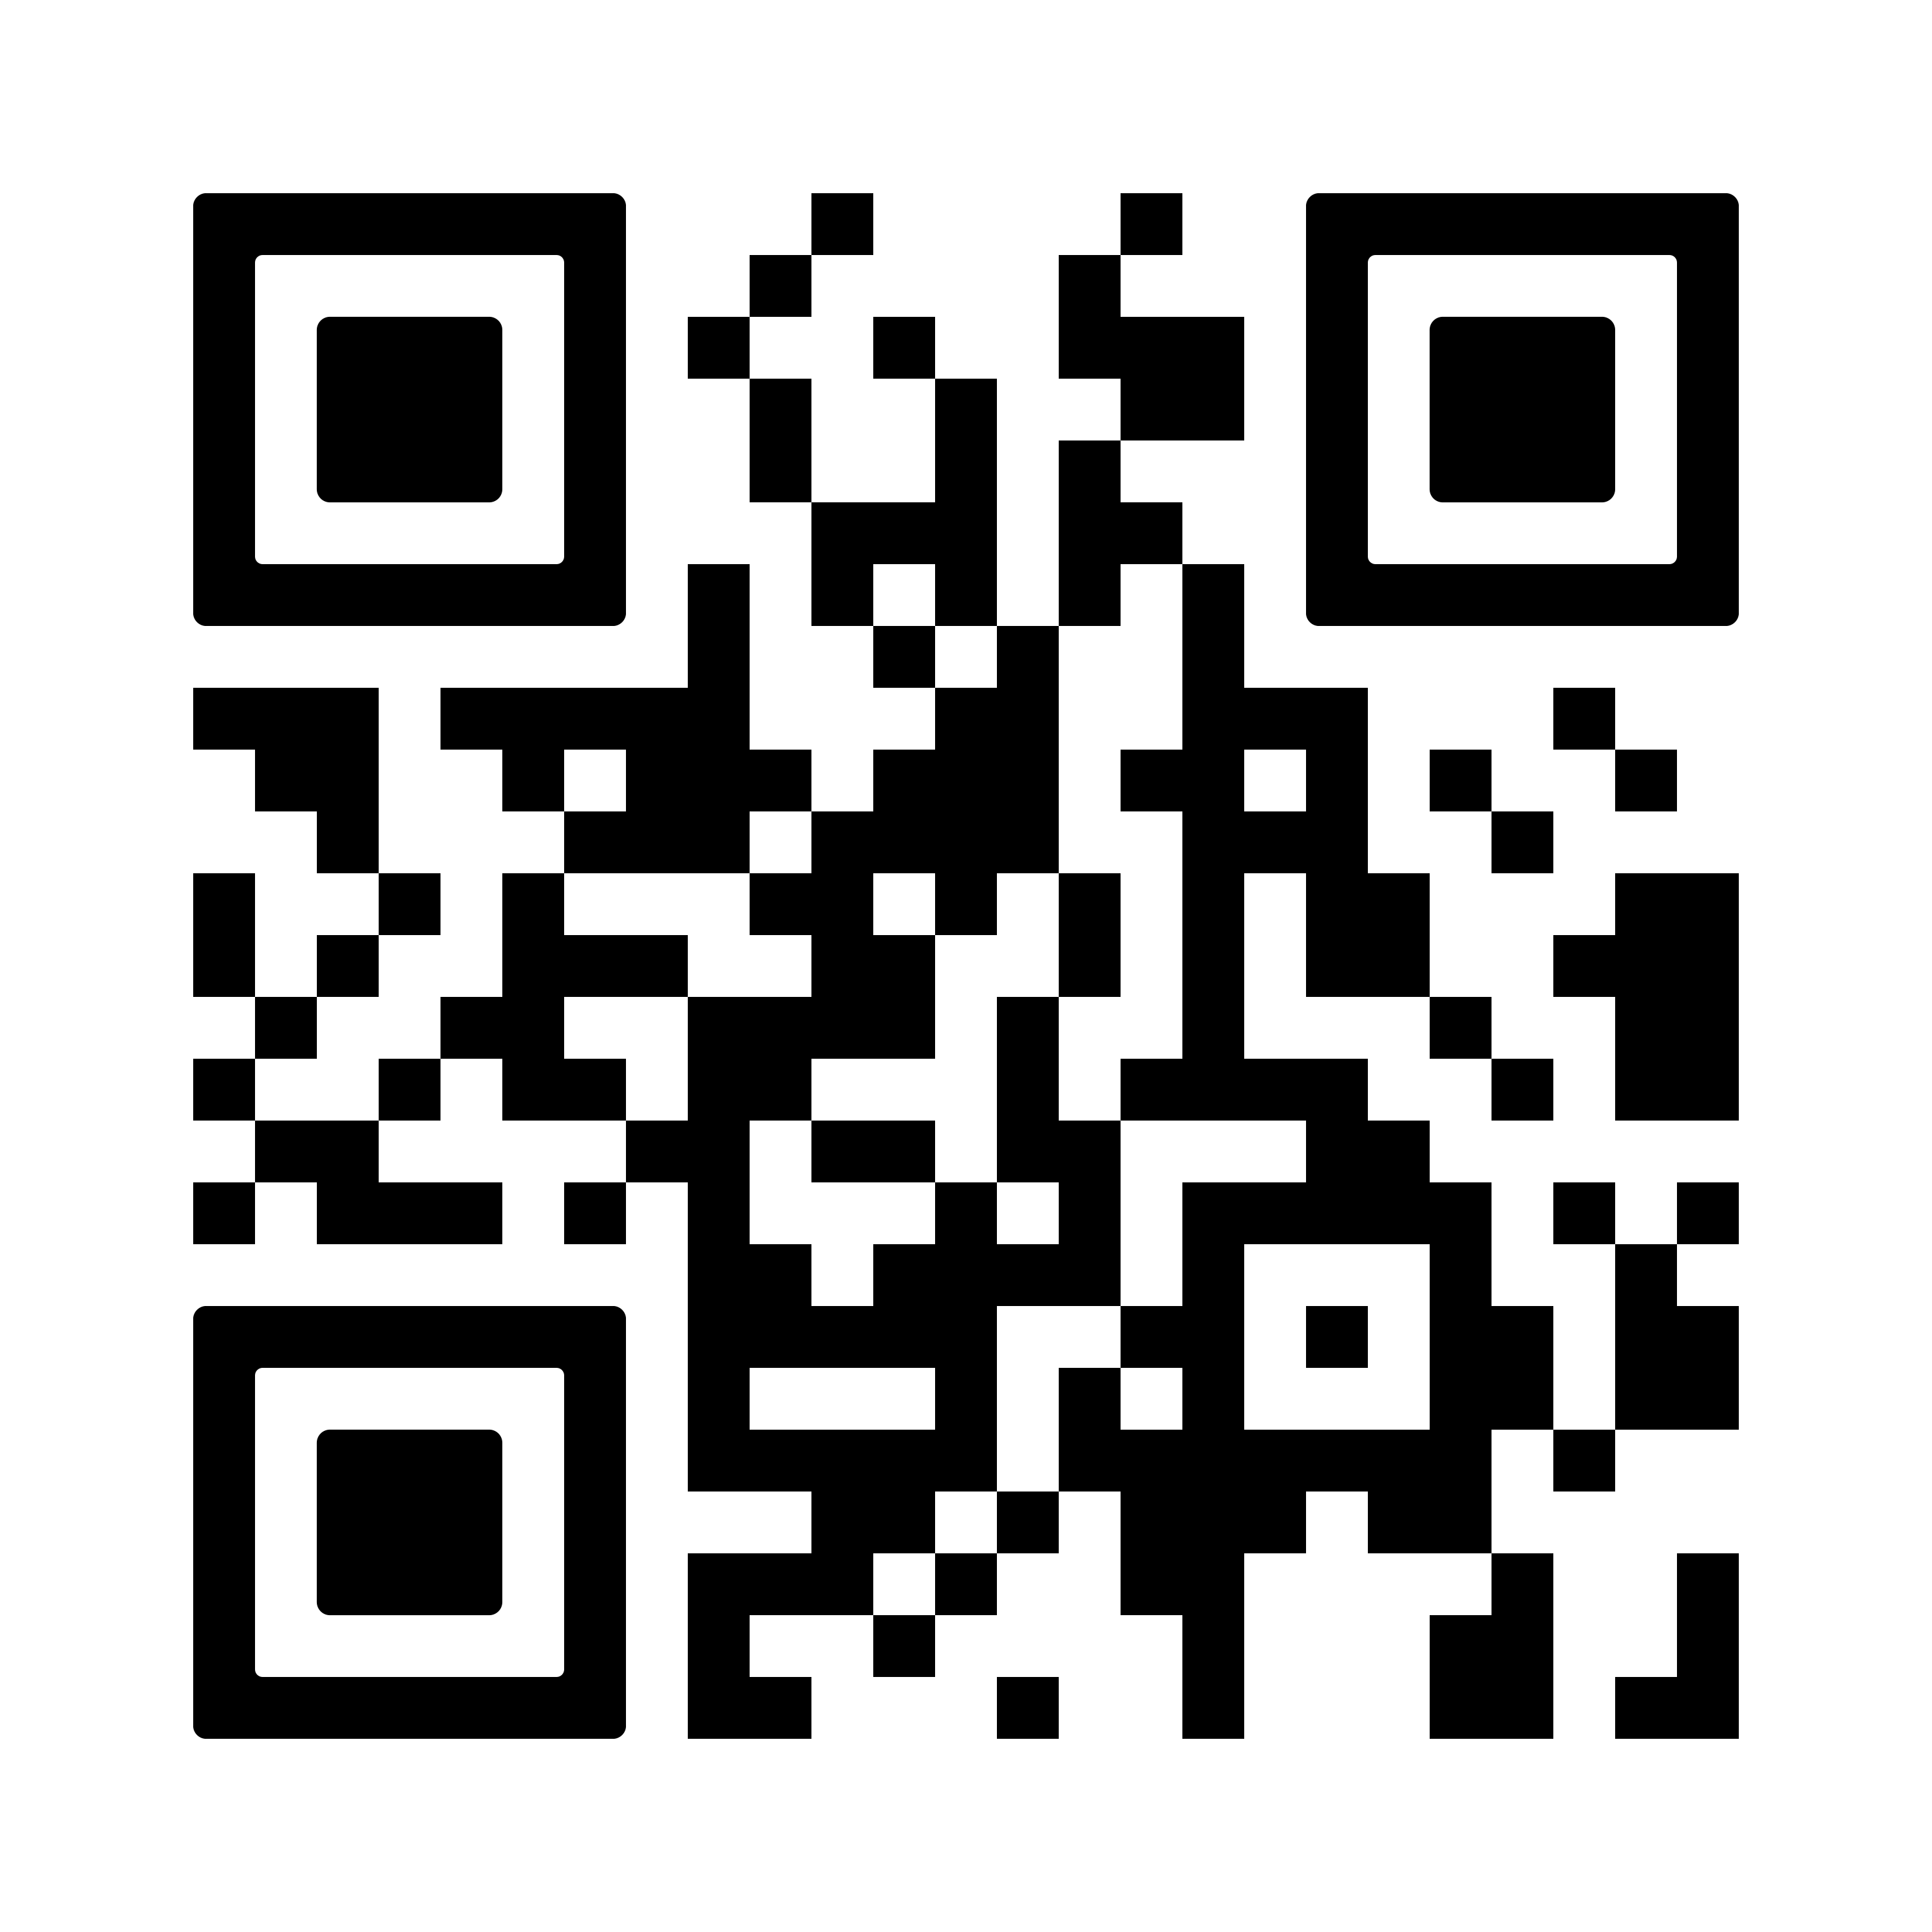
Advisory Committees- Labor Member(s) needed
https://docs.google.com/forms/d/e/1FAIpQLSeatiasXiicYVanP6b3dea__ASyQk7Y3eXs3Yj15H2uoq4JYQ/viewform
Notes:
Thank you To:
More info, the betterl. Broad outreach, more local outreach. Maintain the relationship and maintain he relationship Shout out to SCC staff, best practices for recruitment and retention

Slide 5
Hospitality Pathways DOL grant
Dept. of Labor grant to map out hospitality pathways- specifically in the Tri-Cities
On-going worker focus groups in Tri-Cities (Feb/April/TBD)
Employer survey completed April 28, 2025
Partnership between: WSLC, Kinetic West Consulting, Benton-Franklin WDC, UniteHere! Local 8, Hospitality Association Education Foundation
Thank you to David Schweiger at the new Hospitality Center of Excellence for your partnership!
Interested in learning more? Reach out to Rachel @ rmcaloon@wslc.org

Slide 6
Seeking Volunteers
WSLC Annual Convention July 22nd/23rd in Vancouver, WA
Breakout session to affiliates on SBCTC, Advisory Committees, AC openings,
Seeking 2 CTC or COE representatives to talk about Advisory Committees and importance of including workers' voice
Talk about your department and the role the Advisory Committee play
BIG Thank You to Christina Rupp, Construction Center of Excellence, and Shannon Matson, Renton Tech, for sharing your expertise at 2024 convention

Slide 7
Registered Apprenticeship FYI
WSATC
Meets quarterly (Jan/April/July/Oct)
Wednesday Meetings
Day before Thursday Council meeting
Childcare Taskforce (11am) , Apprenticeship Coordinators (1pm), Joint Retention & Recruitment Committee (2pm)
Great way to network and connect with Registered Apprenticeship Community
Upcoming dates:
July 16th/17th 2025, L&I Headquarters
Registered Apprenticeship 101 Presentation available, reach out to schedule

Slide 8
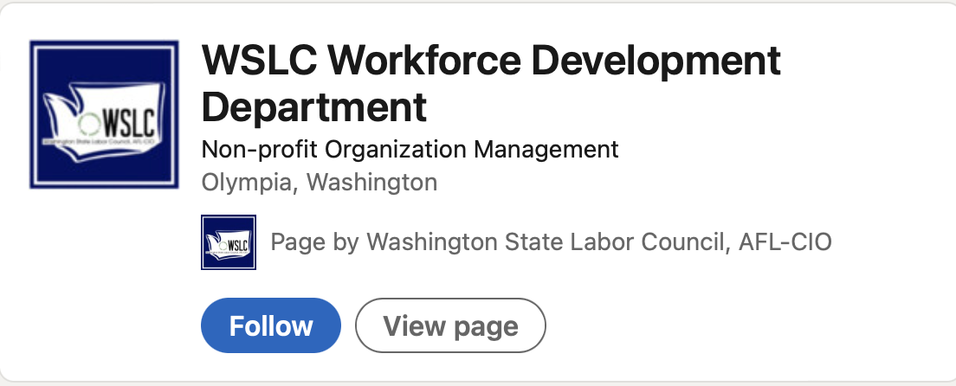
Ways to Connect with the WSLC
Social Media (LinkedIn & Facebook):
Quarterly Newsletter:
Send an email to Lpoplack@wslc.org to sign up!

