Slide 1



Slide 2

Course Introduction
Welcome to PeopleSoft Query! PeopleSoft Query is a data extraction tool that all ctcLink PeopleSoft users are able to access and use. A Query is simply a set of instructions on what data to pull from the system.
Notes:
Page 1 15 minutes
Welcome to PeopleSoft Query! PeopleSoft Query is a data extraction tool that all ctcLink PeopleSoft users are able to access and use. A Query is simply a set of instructions on what data to pull from the system. For example, all students who were enrolled in Math for term 2167. Sometimes, these instructions can be modified by the end user in the form of a Prompt. Perhaps, instead of always pulling data for term 2167, the Query is written so that the end user would be prompted for which term they would like to see the data. There are many Queries which have already been written and are available for use by end users. These Queries will extract data from the system that end users can use to create reports.

Slide 3
Course Goal
The goal of this course is to teach end users of ctcLink PeopleSoft to find and retrieve Queries and Reports in the most effective manner.
Course Learning Objectives
At the end of this course users will:
Understand Query Development Requests and Query Migration
Access PeopleSoft Query Viewer and Schedule Query
Search for existing Queries using Wildcards.
Run Queries to multiple outputs.
Effectively use MetaLink to search Query metadata.
Have knowledge of how to run reports created with BI Publisher.
Notes:
Page 1 15 minutes
Welcome to ctcLink PeopleSoft Reporting
Thank you for taking the time to come here to learn about PS Query
Hope to make this a very valuable experience for you!
There’s no need to logon yet. We’ll get into the system a bit later.
Class Goal: The goal of this course is to teach end users of ctcLink PeopleSoft to find and retrieve Queries and Reports in the most effective manner.
Course Learning Objectives:
Understand the Query Development Lifecycle and properly create a Query Development Request.
Access PeopleSoft Query Viewer and Schedule Query
Search for existing Queries using Wildcards.
Run Queries to multiple outputs.
Effectively use MetaLink to search Query metadata.
Have knowledge of how to run reports created with BI Publisher.
Introduce myself
My name is Paula McDaniel was an ERP software trainer for about 15 years working with different programs like SAP and Ecometry. Wanting less travel I moved into a Business Analyst role for about 5 years where I spent most of my time pulling, analyzing, eating, sleeping data. Super excited to be here at the State Board and be a part of your PeopleSoft journey!
Introductions: Tell me a little about you, your position and Pillar/s and what your goals are for this class?
Student goals on Board/Paper
Fill out Seating Chart for reference

Slide 4
Course Plan
In this class we are going to learn how to request the development of a new Query as well as how to find and run existing Queries. We are also going to learn how to use MetaLink to search Query metadata and how to find and run BI Publisher reports.
Notes:
Page 1 4 minutes
In this class we are going to learn how to request the development of a new Query as well as how to find and run existing Queries. We are also going to learn how to use MetaLink to search Query metadata and how to find and run BI Publisher reports.
Housekeeping/Timing/etc
Well have breaks as needed and as time permits. Volunteers for door duty?
The nearest restrooms are down the hall to the right from back exit. Don’t get locked out! ☺
Water fountains there as well.
Getting the most out of class.
You will be given opportunity to “follow along” in the simplified instructions part of class as well as during the hands on exercises at the end of each section.

Slide 5
Requesting Query Development
Before requesting a new query be created it is important to always search existing queries first. Sometimes, there may not already be an existing query to meet your needs. In this case you will need to follow your institutions guidelines for getting your request to one of your college’s query developers.
Each college has multiple query developers to handle requests for query development and/or modifications. Additionally, the State Board has staff that can assist the college query developers with development and modification requests.
If you don’t know your college’s process for development requests, please contact Paula McDaniel at: pmcdaniel@sbctc.edu
Notes:
Page 2 1 minute
Sometimes, there may not already be an existing query to meet your needs. In this case you will need to follow your institutions guidelines for getting your request to one of your college’s query developers.
Each college has multiple query developers to handle requests for query development and/or modifications. Additionally, the State Board has staff that can assist the college query developers with development and modification requests.
If you don’t know your college’s process for development requests, please contact Paula McDaniel at: pmcdaniel@sbctc.edu
.

Slide 6



Query Protocol
Query Migration
Query Migration is the process by which queries are moved from PCD (Production College Development) to PRD (Production).
Query Developer
Writes Query in PCD
Data Services Team
Checks out Query
Query Moved to Production
Query Migrations occur twice a week on Tuesdays and Thursdays. Migration requests are submitted only by Designated College Query Developers to the State Board Reporting Team.
Tuesday migrations must be submitted by Monday at 12pm.
Thursday migrations must be submitted by Wednesday at 12pm.
If the ticket is not submitted before 12pm on the correct day, the query will be reviewed for migration during the next migration window.
Query requests sent for migration by Monday at 12pm should be available in Production on Wednesday morning, while those sent in by 12pm on Wednesday should be available in Production by Friday morning.
Notes:
Page 3 3 minutes
Queries are developed in the PCD (Production College Development) environment.
Once they have been reviewed and tested by the SBCTC Data Services team, they are migrated to production.
There is generally a less than 24 hour turn-around time for this so the process is quick and efficient.

Slide 7
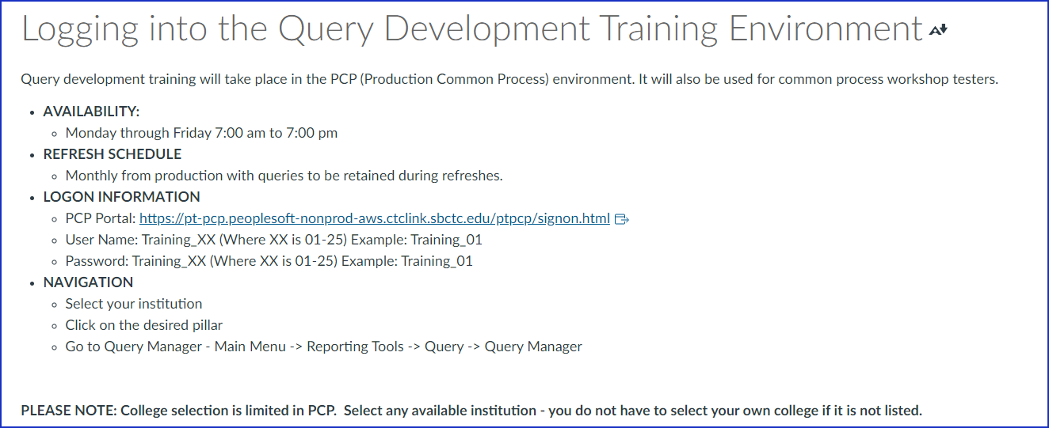
Log in to PS Query
Notes:
No Page 10 minutes
Give everyone a number.
MAKE SURE TO ALLOW POPUPS IF ASKED.
Check in the upper right hand side of your screen for a small red X. Click on it to allow pop ups.

Slide 8
Using PS Query
Once you have logged into PeopleSoft there are two main areas in PS Query you will be able to access:
Query Viewer
Schedule Query
Query Viewer: Main Menu → Reporting Tools → Query → Query Viewer
Schedule Query: Main Menu → Reporting Tools → Query → Schedule Query
Log in to PeopleSoft and follow the path to go to Query Viewer.
Notes:
Page 4 5 minutes
Query Manager is used to create and modify Queries and is only available to Query Developers.
Query Viewer is accessible by everyone with a PeopleSoft License and can be used to view Query output in HTML, Excel or XML. Users are also able to schedule a Query to run through Query Viewer.
Schedule Query is used exclusively for scheduling a Query to run at a future time or to run Queries with large results.
Log into PeopleSoft and follow the path that is bolded on screen to reach Query Viewer.

Slide 9
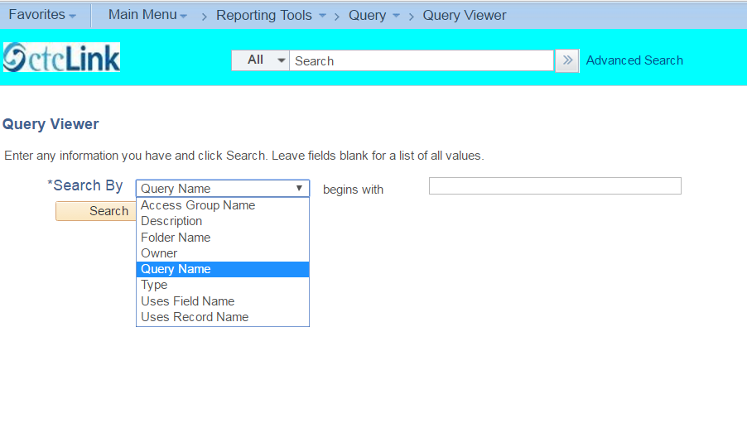
Searching Using Query Viewer
Basic Search Detailed Instructions
Notes:
Page 5 3 minutes
From this screen users are able to search using the Operator “Begins With” by multiple criteria including:
Access Group Name – name of the query tree access group
Description – query description
Folder Name
Owner – private or public
Query Name
Type - default is a User Query. Talk about rest on next page.
Uses Field Name – name of a field that is being used in the query.
Uses Record Name – name of a record that is being used in the query.
Boolean searches are not supported.

Slide 10
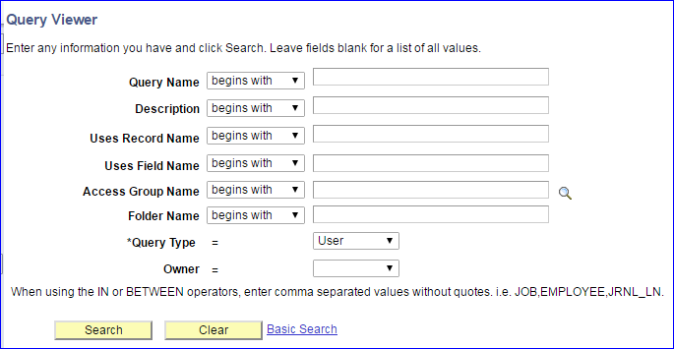
Searching Using Query Viewer
Advanced Search
Notes:
Page 5 5 minutes
Advanced Search offers even more operators
< Begins With
<= Contains
= Not =
> In - The name is in the specified list. Separate with commas. No
quotes. For example, ACCT1, ACCT2, ACCT3.
>= Between – Search between 2 values. Separate the values by a comma. Do not use quotes. Eg: ACCT1,ACCT9.
Access Group Name – name of the query tree access group
Query Type: 4 types of queries:
• User queries. Create and run queries to retrieve data from the database
• Archive queries. Define selection criteria to archive data from transactional tables to history tables
• Process queries. Write queries that are intended to be run periodically by batch processes
• Role queries. Write queries that PeopleSoft Workflow uses to determine to whom to send emails, forms, or worklist entries.
Combine criteria here. We are next going to look at wildcards and then we’ll input our search criteria in a combination to see how it works.

Slide 11
Searching Using Query Viewer
Wildcards
_
Using Wildcards to Search
_ replaces a single character.
% replaces a string of characters. It can be used in front of or in back of the search term.
Use the wildcard character as the literal character.
Use the wildcard character as the literal character.
%
\−
\%
Notes:
Page 6 5 minutes
_ matches any single character. For example, _ones matches any five-character string ending with “ones”, such as "Jones" or "Cones".
% matches any string of zero or more characters. For example, C% matches any string starting with C, including C alone.
To use one of the wild-card characters as a literal character (for example, to include a % in your string), precede the character with a \ (for example, 100\%).
Go ahead and try the combination search using wildcards.
For example,
CS
Description begins with %ACAD%
Uses field name contains %Term%
HCM
Description begins with %full%
Uses field name contains %business%
FS
Description begins with %budget%
Uses field name contains %ledger%

Slide 12
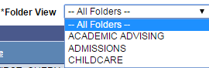
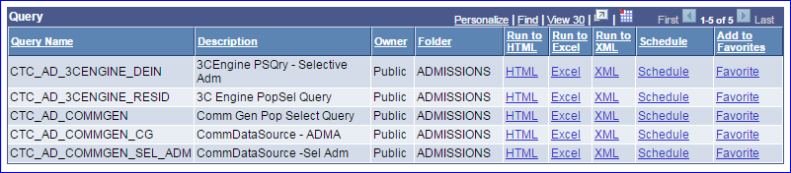
Searching Using Query Viewer
Query Viewer Options
Refine search results by selecting folders to search in.
Run results to: • HTML • Excel • XML
Schedule the Query
Add the Query to Favorites
Notes:
Page 6-7 5 minutes
The Query results can be ran to:
HTML Excel XML Schedule
Note that this is also where regularly accessed Queries can be added to Favorites by simply clicking on the "Favorite" hyperlink.
Let’s go ahead and search for the query on screen for your pillar and run it to Excel.
Pop up will appear with any Prompts. MAKE SURE TO ALLOW POP UPS!
Click View Results once prompts filled in.
File appears in lower left side of the screen in Chrome or prompt at the bottom of the screen for IE.
Click on the box in Chrome or select “open” in IE to open excel and see the query results. Same process for XML.
Now lets see the same Query in HTML. Go back and search for the same query. A new window will open with the prompts and results.
TIP! When viewing the results in HTML you are able to, in essence, “re-run” the Query without the need to retype in all the prompt information. Instead, you are able to make whatever changes you want directly from the new tab. Able to download to excel from here too.

Slide 13

Schedule Query
Schedule Query is used exclusively for scheduling a Query to run at a future time or to run Queries with large results.
Schedule Query can be accessed through:
Query Viewer
PeopleSoft menu path
Notes:
Page 8 1 minute
Schedule Query can be accessed through:
Query Viewer
PeopleSoft menu path
We are going to discuss all three ways of accessing Schedule Query.

Slide 14
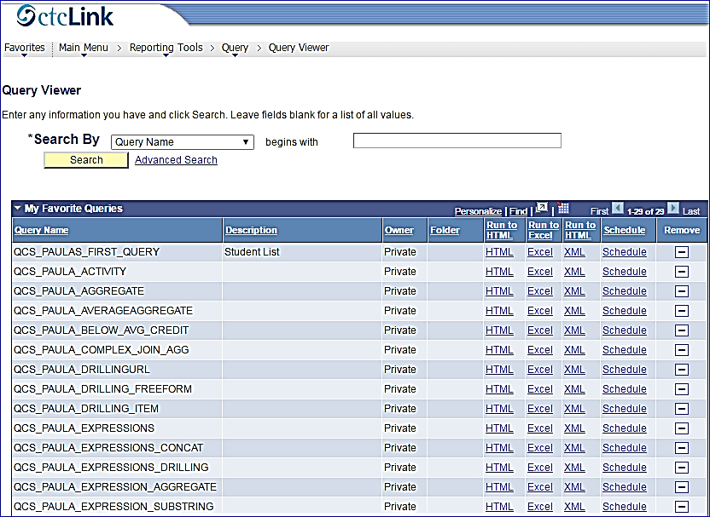
Schedule Query
From Query Viewer – Detailed Instructions
Query Viewer
Notes:
Page 8 3 minutes
Still working with the search criteria you were searching based on your pillar in query manager search pull up your search results.
Click on Schedule.
CS – Search for QCS_TRAIN_STDNT_ENRL
HC – Search for QHC_TRAIN_ACCT_LINE
FS – Search for QFS_TRAIN_CUSTOMER

Slide 15
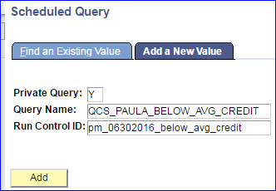
Schedule Query
From Query Viewer – Detailed Instructions
A Run Control ID is a database record that provides values for Query parameters.
Instead of entering the same values each time you run a Query, you can create and save a Run Control ID with those settings.
Run Control ID’s are “private” and are only visible to you. Careful though! It is very hard to delete them!
Notes:
Page 8 4 minutes
The “Scheduled Query” page will come up with the Query name previously selected already filled in along with designating whether the Query is Private or Public.
Enter a Run Control ID in the Field.
A Run Control ID is used to tell the system when and where and how you want the report to run.
For example, you might tell the system to run the report on the database server at 2 am or you might tell it to run the report immediately.
For most reports, you must also set parameters that determine the content of the report, such as the business unit or time period on which to report.
These parameters are based on the Prompts used in the query and are saved by the run control ID so they don’t have to be re-entered each time you use the run control ID to run the query.
There is no specific naming convention for the Run Control ID but it is recommended to use the date and description (making sure to use underscore in place of spaces).
Run Control ID’s have a 30 character limit and cannot be deleted.
Run Control ID’s can be used for a single Query to save the parameters or the user can change the Query associated with the ID.
Once the Run Control ID has been entered click on the “Add” button if it is new. If there is an existing run control id for the Query selected it will display so you don’t have to worry about creating a duplicate run control id.

Slide 16
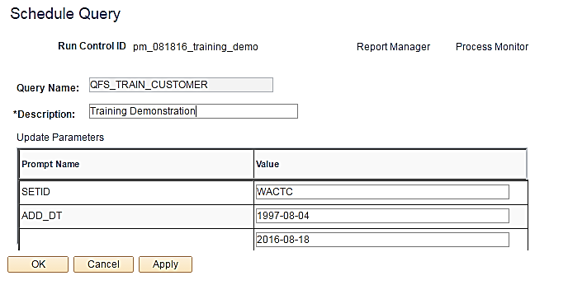
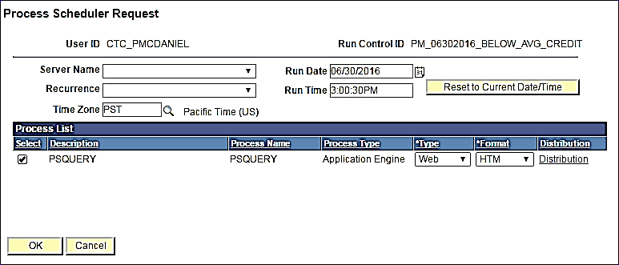
Schedule Query
From Query Viewer – Detailed Instructions
Schedule Query
Enter a description for the Query Run Control ID in the Description Field. Update any Prompts.
Process Scheduler Request
Select the Time Zone, Date and Time to run the Query.
Notes:
Page 9 3 minutes
The Schedule Query page will display. Enter a description for the Query Run Control ID in the Description Field. This will be the Report Name.
The Query Name will automatically populate based on the Query selected from Query Viewer or Query Manager
Note: if there are prompts (parameters) for the Run control ID they can be updated here by clicking Update Parameters. (Click on “Save” to save the changes to the run control ID.
To schedule the Query click on “Apply” Apply is only for when the run control id is used when going through Query Manager or Viewer. It has a different process in the menu path.
The Process Scheduler Request page will display.
Select the Time Zone, Date and Time to run the Query.
The Output Type and Format can also be selected here.
Server Name and Recurrence are turned off for regular staff to maintain better performance standards.
Click OK to return to the Schedule Query Page.

Slide 17
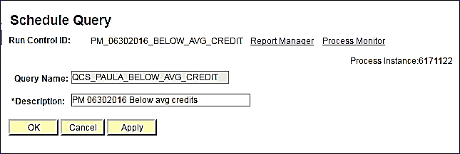
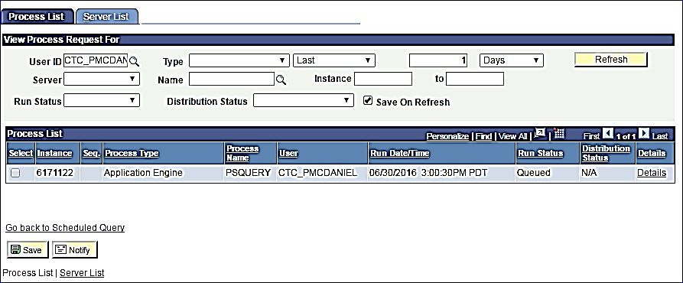
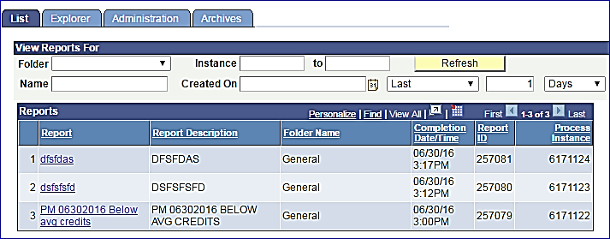
Schedule Query
From Query Viewer – Detailed Instructions
Process Monitor
Report Manager
Notes:
Page 9 1 minutes
There is now a process instance number.
Click on the Process Monitor to view the Status of the Query run (you can also access the final Report here)
Click on Report Manager to View the Query Output.

Slide 18
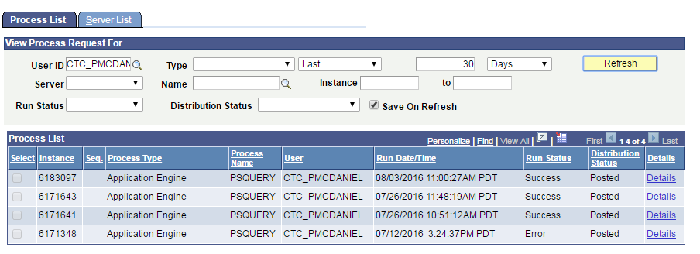
Schedule Query
From Query Viewer – Detailed Instructions
Can also be accessed through the Menu Path:
Main Menu>PeopleTools>Process Scheduler>Process Monitor
Process Monitor
You are able to see the status of Scheduled Query runs by:
User ID
Type
Number of days past
Server
Name
Instance from and to
Run Status
Distribution Status
Notes:
Page 10 2 minutes
The Process Monitor will display the status of the Scheduled Query.
You are able to see the status of Scheduled Query runs by:
User ID
Type
Number of days past
Server
Name
Instance from and to
Run Status
Distribution Status
Menu Path: Main Menu>PeopleTools>Process Scheduler>Process Monitor
Once the Query has ran you see a status of “Success” click on “Go back to Scheduled Query” ”. This will return you to the first Scheduled Query search page. Note that your Run Control ID is filled in so to get to the Scheduled Query page to view the report via Report Manager click on "Enter". Click on the Report Manager hyperlink to view the Report.

Slide 19
Schedule Query
From Query Viewer – Detailed Instructions
Can also be accessed through the Menu Path:
Main Menu > Reporting Tools > Report Manager
Report Manager
You are able to filter the displayed reports by:
Folder
Instance from and to
Name
Created on Date
Number of Days past
Date Range
Notes:
Page 10-11 3 minutes
You are able to filter the displayed reports by:
Folder
Instance from and to
Name
Created on Date
Number of Days past
Date Range
Click on the Run Control ID Description found in the Report column to view the output.
This take you to the report file. The file logs are viewable from here as well as the Query results.
The Query results can be viewed in the selected format by clicking on the Query Name in the Name column.

Slide 20

Schedule Query
From Query Viewer – Detailed Instructions
Schedule Your Own Query
Schedule a Query to Run via Query Viewer or Query Manager.
CS – Search for and schedule QCS_TRAIN_STDNT_ENRL
HC – Search for and schedule QHC_TRAIN_BENEFIT
FS – Search for and schedule QFS_TRAIN_CUSTOMER
Run Control ID Description Type Format
NAME_TRAIN_RUNID Schedule Exercise Web HTM
Notes:
Page 11 5 minutes
Follow the instructions on page 11 to schedule your Query.

Slide 21
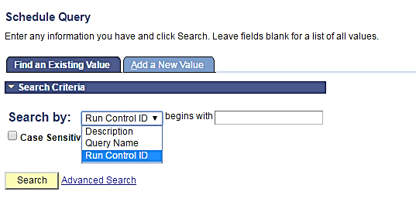
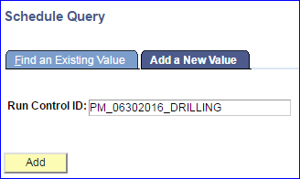
Schedule Query
From the Menu Path – Detailed Instructions
Main Menu → Reporting Tools → Query → Schedule Query
Search for an existing Scheduled Query via:
Description
Query Name
Run Control ID
Click on the “Add a New Value” tab to create a new Run Control ID.
Notes:
Page 12 3 minutes
Main Menu → Reporting Tools → Query → Schedule Query
You will be brought to the page to search for an existing Scheduled Query or Run Control ID via:
Description
Query Name
Run Control ID
Click on the Add a New Value tab to create a new Scheduled Query Run.
Enter a Run Control ID in the Field. There is no specific naming convention for the Run Control ID but it is recommended to use the date and description (making sure to use underscore in place of spaces).
Once the Run Control ID has been entered click on the “Add” button.

Slide 22
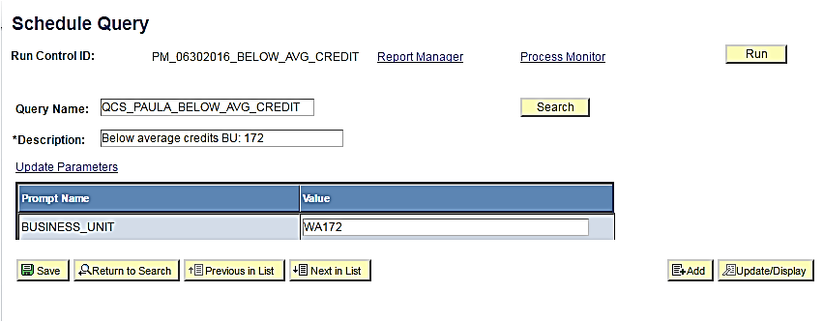
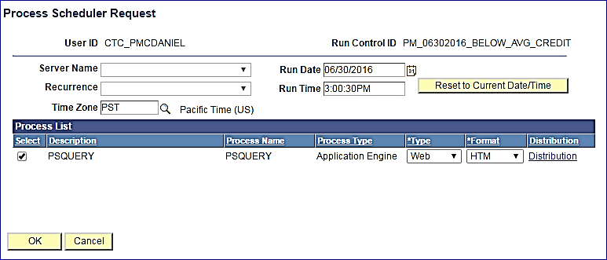
Schedule Query
From the Menu Path – Detailed Instructions
Schedule Query
Enter a description for the Query Run Control ID in the Description Field. Update any Prompts.
Process Scheduler Request
Select the Time Zone, Date and Time to run the Query.
Notes:
Page 13 3 minutes
The Schedule Query page will display. Enter a description for the Query Run Control ID in the Description Field.
The Query Name will automatically populate based on the prior selection.
Note: if there are prompts (parameters) for the Run control ID they can be updated here by clicking Update Parameters. (Click “Save” to save these changes to the Run Control ID.
To schedule the Query click on “Run”.
The Process Scheduler Request page will display.
Select the Time Zone, Date and Time to run the Query.
The Output Type and Format can also be selected here.
Server Name and Recurrence are turned off for regular staff to maintain better performance standards.
Click OK to return to the Schedule Query Page.

Slide 23
Schedule Query
From the Menu Path – Detailed Instructions
Process Monitor
Report Manager
Notes:
Page 13 1 minute
There is now a process instance number.
Click on the Process Monitor to view the Status of the Query run (you can also access the final Report here)
Click on Report Manager to View the Query Output.

Slide 24
Schedule Query
From the Menu Path – Detailed Instructions
Can also be accessed through the Menu Path:
Main Menu>PeopleTools>Process Scheduler>Process Monitor
Process Monitor
You are able to see the status of Scheduled Query runs by:
User ID
Type
Number of days past
Server
Name
Instance from and to
Run Status
Distribution Status
Notes:
Page 14 2 minutes
The Process Monitor will display the status of the Scheduled Query.
You are able to see the status of Scheduled Query runs by:
User ID
Type
Number of days past
Server
Name
Instance from and to
Run Status
Distribution Status

Slide 25
Schedule Query
From the Menu Path – Detailed Instructions
Can also be accessed through the Menu Path:
Main Menu > Reporting Tools > Report Manager
Report Manager
You are able to filter the displayed reports by:
Folder
Instance from and to
Name
Created on Date
Number of Days past
Date Range
Notes:
Page 14-15 3 minutes
Once the Query has ran you see a status of “Success” click on “Go back to Scheduled Query. Click on the Report Manager hyperlink to view the output.
You are able to filter the displayed reports by:
Folder
Instance from and to
Name
Created on Date
Number of Days past
Date Range
Click on the Run Control ID Description found in the Report column to view the output.
This take you to the report file. The file logs are viewable from here as well as the Query results.
The Query results can be viewed in the selected format by clicking on the Query Name in the Name column.

Slide 26
Schedule Query
From Schedule Query Menu Path – Simplified Instructions
Schedule Your Own Query
Schedule a Query to Run via Schedule Query.
CS – Search for and schedule QCS_TRAIN_STDNT_ENRL
HC – Search for and schedule QHC_TRAIN_BENEFIT
FS – Search for and schedule QFS_TRAIN_CUSTOMER
Run Control ID Description Type Format
NAME_TRAIN_RUNID2 Schedule Exercise Web XLS
Notes:
Page 15 5 minutes
Follow the instructions on page 15 to schedule your Query.

Slide 27

The metaLink data dictionary

Slide 28
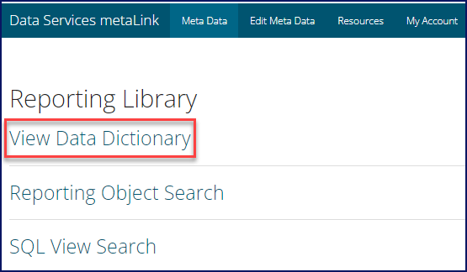
metalink
View Data Dictionary
To view table and column information, click on View Current Data Dictionary.

Slide 29
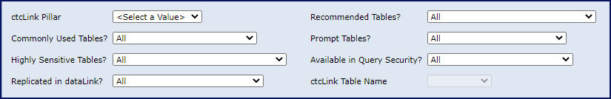
metalink
Data Dictionary
Filtering Data Dictionary Tables
Select a pillar then filter by:
ctcLink Pillar
  ctcLink Pillar must be selected as a filter.
Commonly Used Tables
  The table has been selected as commonly used and is used in many queries and reports.
Highly Sensitive Tables
  The table contains a highly sensitive field.
Replicated in dataLink
  The table has been replicated in dataLink.
Recommended Tables
  The table has been designated by the Data Services Reporting Team as a recommended table.
Prompt Tables
  The table is appropriate for use as a prompt table in query development.
Available in Query Security
  The table is included in an access group in a Data Services Query Tree.
Notes:
Users are able to filter the list available records by the options listed here. For example say that you are looking for a query that is highly sensitive because you want to see what roles are needed in order to run the query you could filter and show only highly sensitive tables.
ctcLink Pillar
Required
Commonly Used Tables
The table has been selected as commonly used and is used in many queries and reports.
Highly Sensitive Tables
The table contains a highly sensitive field.
Replicated in dataLink
The table has been replicated in dataLink.
Recommended Tables
The table has been designated by the Data Services Reporting Team as a recommended table.
Prompt Tables
The table is appropriate for use as a prompt table in query development.
Available in Query Security
The table is included in an access group in a Data Services Query Tree.

Slide 30
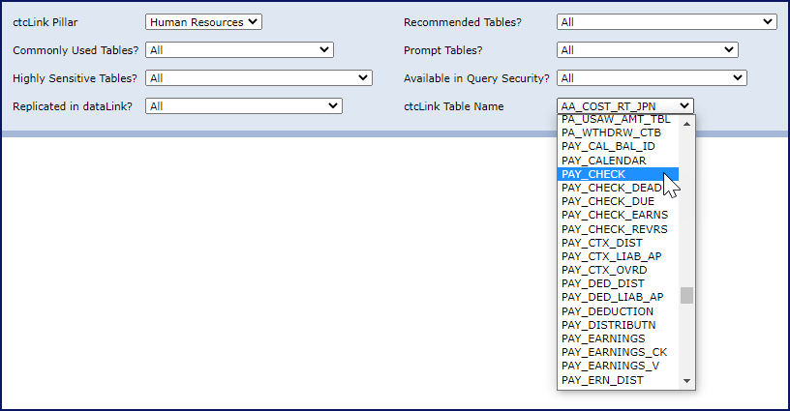
metalink
Data Dictionary
Once filters have been selected, the ctcLink Table Name field will become selectable.
Notes:
Select the table. The table name will be in the ctcLink format for searching, however, if the table has been replicated to dataLink both table names will appear in the Table Information section of the data dictionary.
Click on View Report in the upper right corner of the screen.
The Data Dictionary Report contains two main sections: Table Information and Column Information. Table Information holds details about the record while column Information holds details about the fields in the table.
Search for:
HR
High Sens
Prompt
Pay_check
Once it pulls up go back to the presentation and go over the table and column fields.

Slide 31
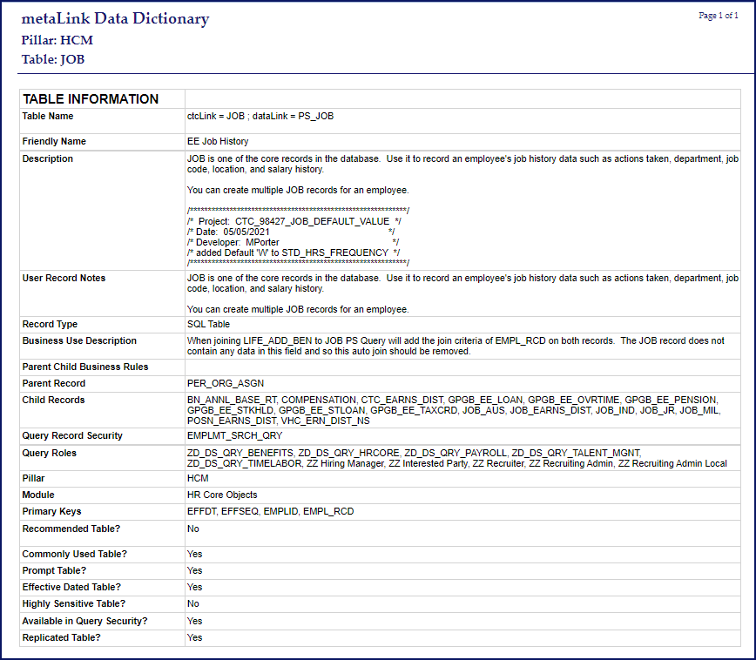
metalink
Data Dictionary Table MetaData
Notes:
Pay_check
Sourced Systematically
Table Name – Name of the record. If the table has been replicated both the ctcLink and dataLink naming schema will display. If the table has not been replicated, only the ctcLink name will display.
Friendly Name – The laymen name for the record. For example, the record STDNT_ENRL is commonly referred to as the Student Enrollment table.
Description – System description of the record.
Record Type – The type of record.
Parent Records – Name of the parent records, if applicable.
Child Records – Names of child records, if applicable.
Query Record Security – Secure view entered in the Query Security Record field in the record properties that will enforce row level security.
Query Roles – Roles that grant access to the record.
Pillar – The record’s pillar.
Module – The record’s module.
Primary Keys – Fields designated as Primary Keys in the record.
Recommended Table? – indicates if the record has been flagged as recommended.
Commonly Used Table? – indicates if the record has been flagged as commonly used.
Prompt Table? – indicates if the record is used as a prompt table.
Effective Dated Table? – indicates if the record contains the EFFDT field.
Highly Sensitive Table? – indicates if the record contains a highly sensitive field.
Available in Query Security? – indicates if the record has been added to an access group in a Data Services Query Tree.
Replicated Table? – indicates if the record has been replicated to dataLink.
Sourced from metaLink Users
Record Notes – Notes regarding the record
Business Use Description – Description of the business use of the record.
Parent Child Business Rules – A parent-child hierarchy is a hierarchy in a standard dimension that contains a parent attribute. A parent attribute describes a self-referencing relationship, or self-join, within a dimension main table. Parent-child hierarchies are constructed from a single parent attribute.

Slide 32
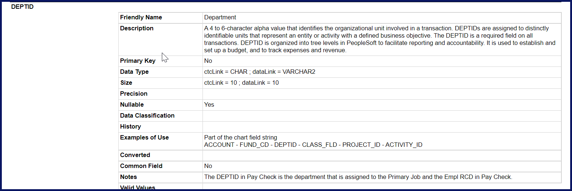
metalink
Data Dictionary Column MetaData
Notes:
Field Information
Field details are found under the header COLUMN INFORMATION. Field information is either sourced from system tables or it is crowd sourced from metaLink users.
Sourced Systematically
Friendly Name – The laymen name for the column. For example, the column name STRM is commonly referred to as Term.
Primary Key – Indicates if this field is part of the primary key for the record.
Data Type – shows the data type for both ctcLink and datalink if applicable as they are sometimes different.
Size – The length or scale of the field value. Size is related to the Data Type. Again, these may not always be the same for ctcLink and datalink.
Precision – Indicates the decimal places for numeric fields.
Nullable – Indicates of the field can contain null or blank values.
Data Classification – The field is considered highly-sensitive if this field is populated with “Category 4.”
Valid Values – Field values and their meanings. Valid values can be sourced both systematically and from end users. When sources systematically the values come from the PSXLATITEM table.
Sourced from metaLink Users
Description – The description of the field and what it is used for. Any pertinent information regarding the field should be included.
History – Includes any historical changes to the field such as inclusions or exclusions of values.
Examples of Use – Provides examples of how/when to use the field. Information about auto-joins and how they might affect the query, etc.
Converted – The table and field name of the legacy source record if converted during implementation.
Notes – Any other notes, pertinent information regarding the field.
Valid Values – Field values and their meanings. Valid values can be sourced both systematically and from end users.
Go back into the system and then cntrl+F _DT to show various dates

Slide 33
Edit Meta Data

Slide 34
metalink
Edit Meta Data
While many meta data values are updated systematically in metaLink 2.0., the metaLink app remains a wiki utilizing crowdsourcing as a main source of information. We leverage our communities of practice, end users, functional analysts, query developers… anyone who knows (or finds out something interesting) about the data can share their knowledge. It is quick and easy to add information.

Slide 35
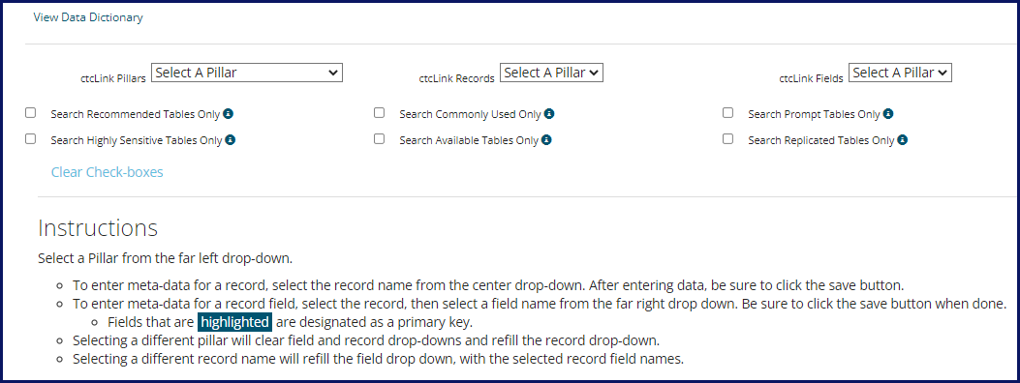
metalink
Edit Meta Data
To update the record – select only the Pillar and Record. To update a field within a record – select the Pillar, Record, and Field to modify. Click on the corresponding checkbox to narrow the list of available records by:
• Recommended
• Highly Sensitive
• Commonly Used
• Available (assigned to a Data Services Query Tree)
• Prompt Tables
• Replicated in dataLink

Slide 36
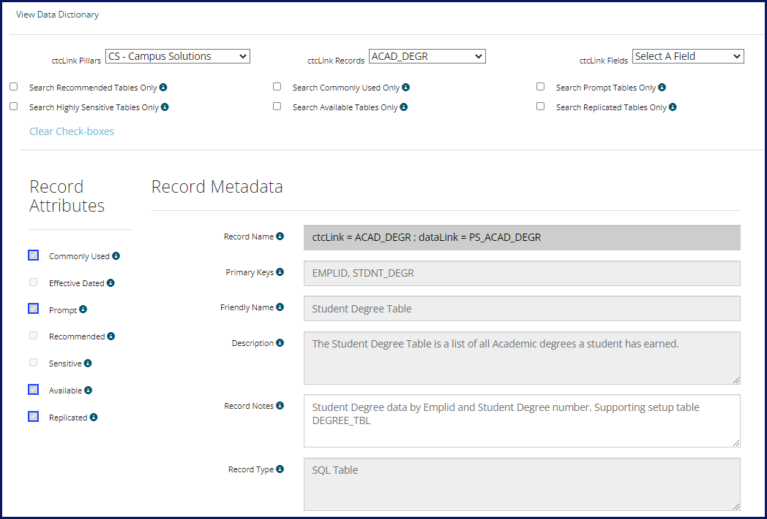
metalink
Edit Meta Data
Type in the information. Fields which are greyed out are updated systematically and may not be changed by users. Checkboxes that are bordered in blue indicate the
checkbox applies to the record or field. If the checkbox remains unchecked with no blue border, it does not apply to the selected record.
Notes:
Show stdnt_enrl
Valid values for acad_prog can be added by users but stdnt_enrl_status come from xlat and can’t be modified.

Slide 37
The metaLink reporting object search

Slide 38
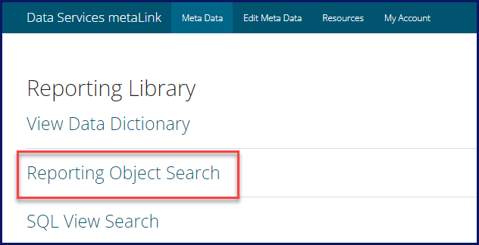
metalink
Reporting Object Search
One of the wonderful things about metaLink is that it allows users to search for reporting objects such as Queries, Pivot Grids, and BI Publisher reports across a variety of fields from a single input source.
Notes:
Users can search across all pillars, by field name, record name, description, definition, and folder. The plethora of available options and the ease of searching is one of the best features of MetaLink. In PeopleSoft query for example, the only way to search by query definition is by creating a query to do so, while metaLink allows definition searching with no additional effort required.

Slide 39
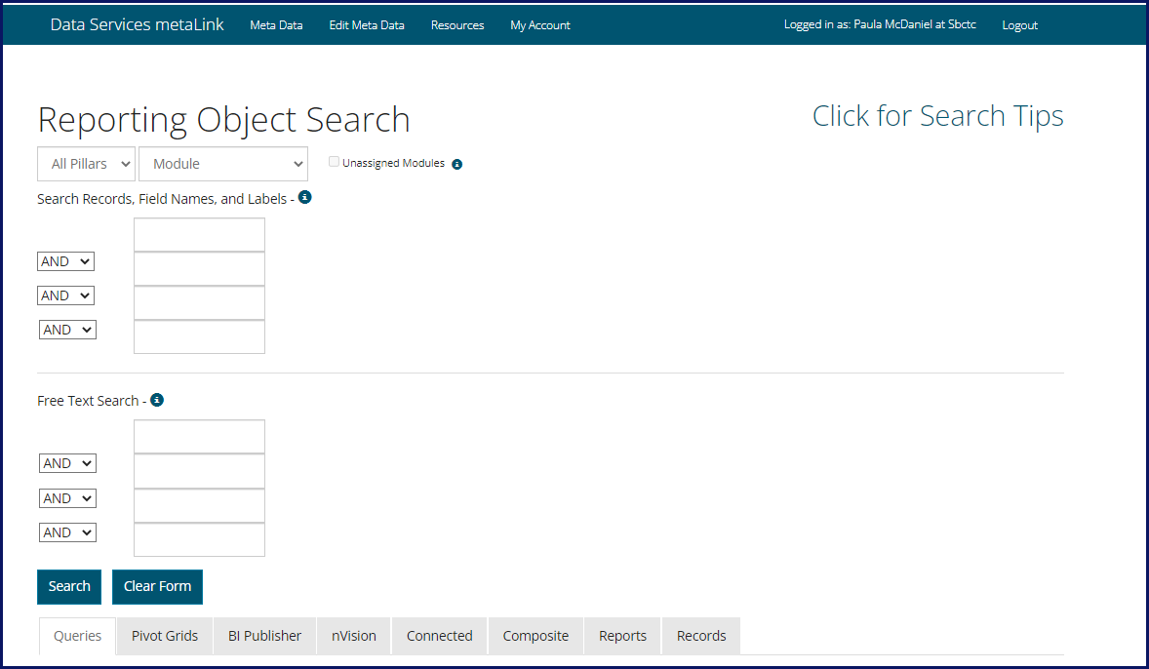
metalink
Reporting Object Search
Search reporting objects by record names and labels, field names and labels, free text, description, long description, label, and folder.
Notes:
All Pillars
Select CS (Campus Solutions), FS (Financials), HCM (Human Capital Management) or All Pillars to search by one or all pillars.
Module
Module is assigned to most records and reports. The list of available modules will filter based on pillar selection.
Unassigned Modules Checkbox
While most records and reports have an assigned module, not all of them do. To include reporting objects that may not have an assigned module, check the Unassigned Modules checkbox. The Unassigned Module checkbox will only be able to be selected if a module has been selected.
Search Records, Field Names and Labels
Search Record and Field Names and Labels will search:
Database Field Name
Short Field Name
Long Field Name
Query Field Name Label
Field Label
Record Name
Use a single word in each search box. Do not leave search boxes in between search terms and use the Clear Form between searches. All searches allow for partial search terms to be entered with no need for a wildcard. Separate search terms by:
AND: include each search term in the results.
OR: include any search term in the results.
An AND attribute used after an OR attribute will be part of the OR statement.
NOT: disallow search term in the results. If using NOT, always use it as the last search option with no blank search box in between.
(Start with HCM-Benefits Administration-Unassigned)
(Narrow down results – field EMPLID cause we all know it and birth for birthdate to show partial search) Just show queries tab.
Free Text Search
Free Text will search:
Object Name
Any Reporting Object Description
Any Reporting Object Long Description
Query Folder
Use a single word in each search box. Do not leave search boxes in between search terms and use the Clear Form between searches. All searches allow for partial search terms to be entered with no need for a wildcard. Separate search terms by:
AND: include each search term in the results.
OR: include any search term in the results.
An AND attribute used after an OR attribute will be part of the OR statement.
NOT: disallow search term in the results. If using NOT, always use it as the last search option with no blank search box in between.
(Narrow down results – retire and age.
Clear form
CS Pillar
Class
AND Roster
NOT Grade)

Slide 40
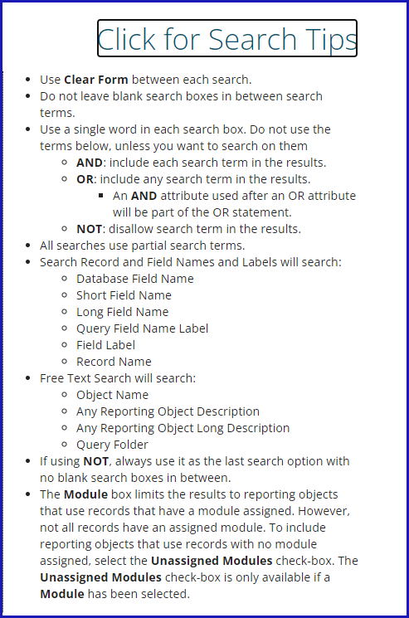
metalink
Reporting Object Search
Don’t have a photographic memory? No worries – we have some handy search tips for you to use as well! Click on the “Click for Search Tips” hyperlink to open the box.

Slide 41
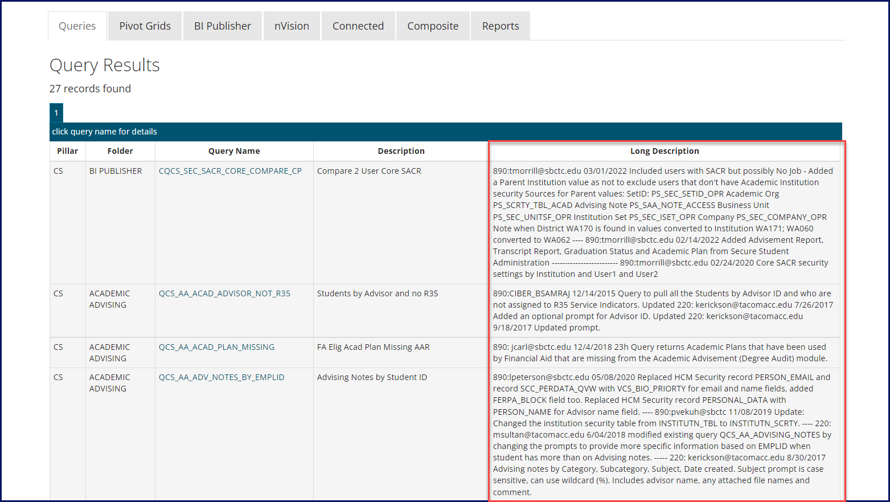
metalink
Reporting Object Search Results
Each tab will display either results or a message saying no results found.
Notes:
(Clear form FIN – Payroll module – unassigned
Free text – expense
Show all tabs and long description in query tab)
And here we have an example of the long description. As you can see it will tell you the purpose of the query, if any updates have been made to the query, who made the updates, when the query was written... just all sorts of good stuff. Having access to this information should really help you decide if this is the query that you're looking for.
One thing to be aware of is that you might find a query in metaLink and then go into PeopleSoft to run the query and not be able to see that query. This doesn't mean that something is broken, instead it means that you don't have the proper security access in order to view and use that query. In that case contact your local security team so they can determine whether you should have the role to be able to see the query.

Slide 42
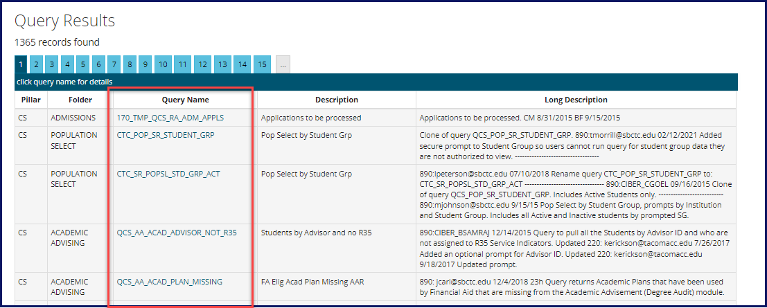
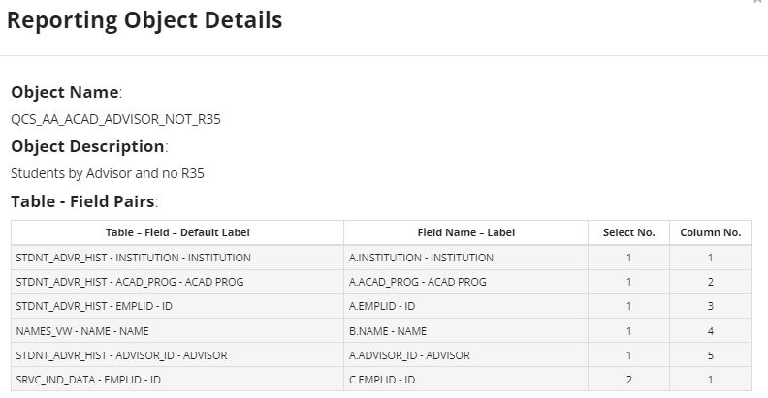
metalink
Queries Tab Search Results
The Queries Tab will show queries that match the search criteria. The query name will be in the form of a hyperlink, which can be clicked to bring up additional details about the query.
Notes:
The additional details available via the hyperlink are the table/field pairs that show which records and fields were used in the creation of the query. The Select No. Column lists the SELECT statement number that the record and field is included in. In the example below, we see that SRVC_IND_DATA – EMPLID belongs to Select No. 2. This means that the query includes a subquery or a union because the query has two SELECT statements in the SQL code. The field Column No. indicates the column order.

Slide 43
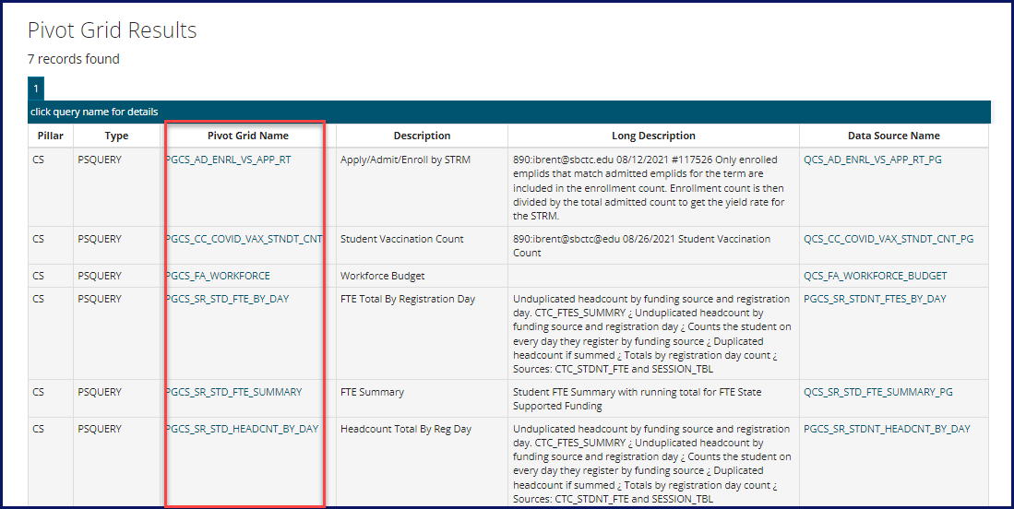
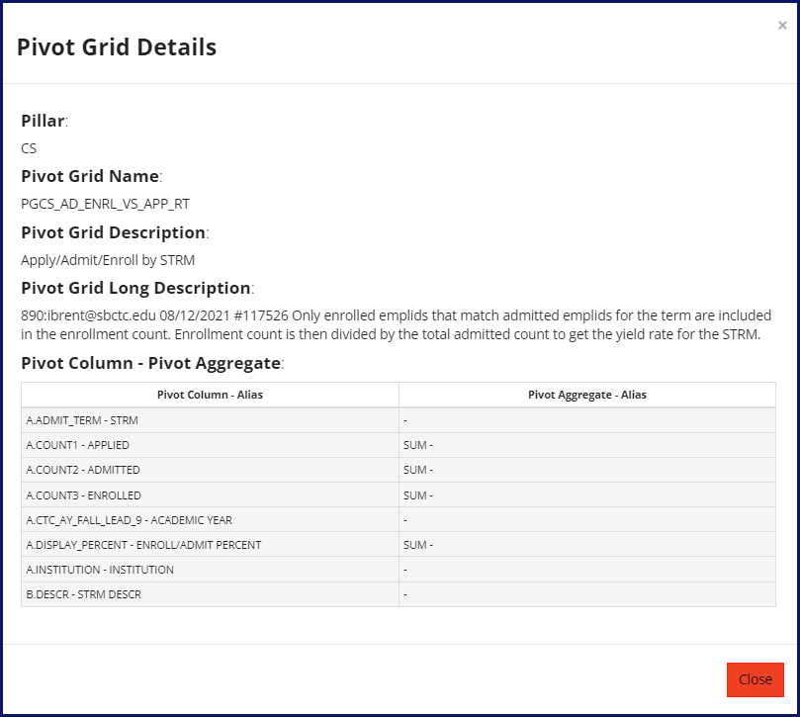
metalink
Pivot Grid Tab Search Results
The Pivot Grids Tab will show pivot grids that match the search criteria. The pivot grid name will be in the form of a hyperlink, which can be clicked to bring up additional details about the pivot grid.
Notes:
The additional details available via the hyperlink are the table/field pairs that show which records and fields were used in the query data source of the pivot grid. The Pivot Grid Aggregate – Alias column shows the aggregate function applied to each field.

Slide 44
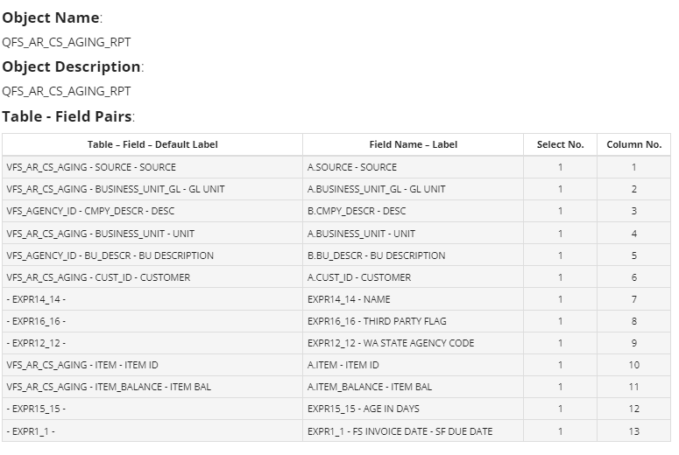
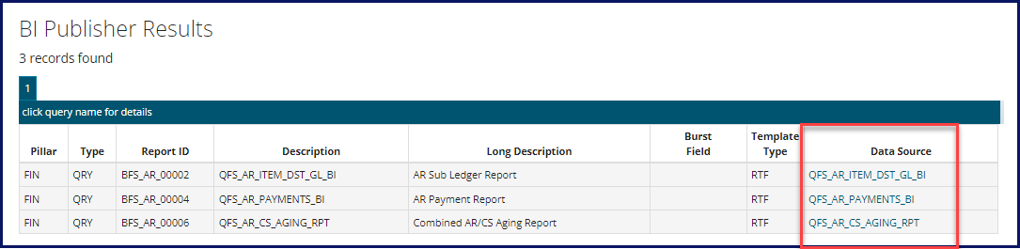
metalink
BI Publisher Tab Search Results
The BI Publisher Tab will show BI Publisher reports that match the search criteria. The BI Publisher Data Source name will be in the form of a hyperlink, if it is not a Connected Query, which can be clicked to bring up additional details about the query data source.
Notes:
The additional details available via the hyperlink are the table/field pairs that show which records and fields were used in the query data source of the BI Publisher report. The Select No. Column lists the SELECT statement number that the record and field is included in. The Column No. field indicates the column order.
If the data source is a connected query you can look it up in the connected query tab to view the parent and child queries.

Slide 45
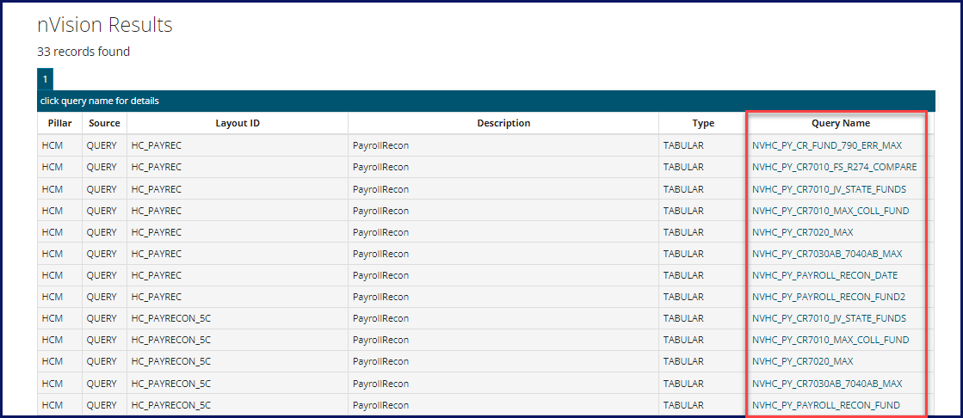
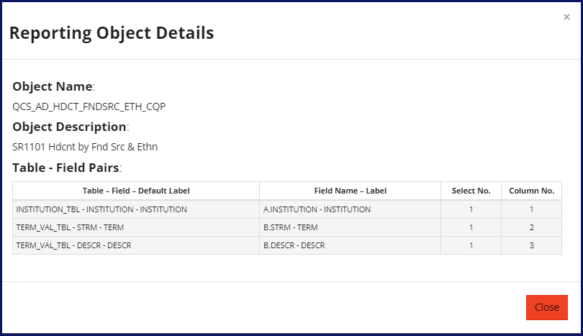
metalink
NVision Tab Search Results
The NVision Tab will show queries that match the search criteria. The query name will be in the form of a hyperlink, which can be clicked to bring up additional details about the nVision query data source.
Notes:
The additional details available via the hyperlink are the table/field pairs that show which records and fields were used in the creation of the query data source. The Select No. Column lists the SELECT statement number that the record and field is included in. The Column No. field indicates the column order.

Slide 46
metalink
Composite Queries Tab Search Results
The Composite Queries Tab will show composite queries that match the search criteria. The base queries names will be in the form of a hyperlink, which can be clicked to bring up additional details about the parent or child query.
There are currently no composite queries in ctcLink.
Notes:
The additional details available via the hyperlink are the table/field pairs that show which records and fields were used in the creation of the parent or child query data source. The Select No. Column lists the SELECT statement number that the record and field is included in. The Column No. field indicates the column order.

Slide 47
metalink
Reports Tab Search Results
The Reports tab links to a manually maintained database that is not currently connected to metaLink. When the connection is made this document will be updated.

Slide 48
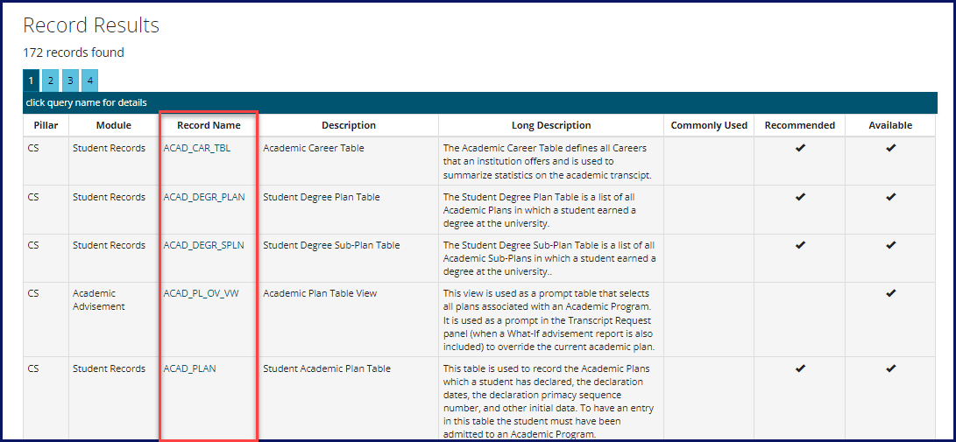
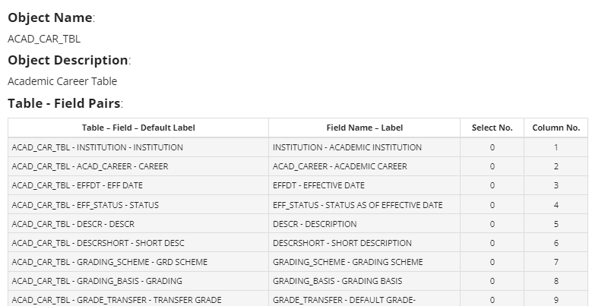
metalink
Records Tab Search Results
The Records Tab will only display if the user is logged into metaLink. The Records Tab will show records that match the search criteria. There are checkboxes used to indicate if the record is commonly used, recommended, or available in the Data Services Query Tree. The record name will be in the form of a hyperlink, which can be clicked to bring up additional details about the record.
Notes:
The additional details available via the hyperlink are the table/field pairs that show the record and all the fields available in the record. The field Select No. Contains a 0 for records. The same template is used for records and queries and since there is no SELECT statement for records, the select number will always be 0.

Slide 49
The metaLink SQL view search

Slide 50
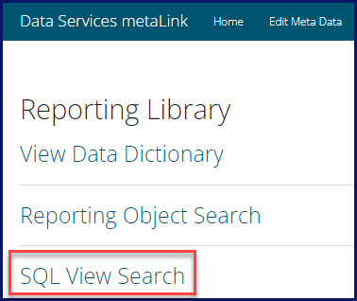
metalink
SQL View Search
The MetaLink Script Search allows for searching for the underlying SQL script used in the creation of Views and the SBMD (State Board Master Data) views used for the Data Warehouse. Users can search by View Name and/or by Pillar.

Slide 51
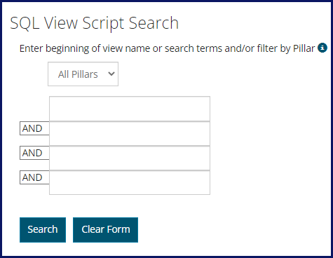
metalink
SQL View Search
To search the SQL View Script, use a single word in each search box. Do not leave search boxes in between search terms and use the Clear Form between searches. All searches allow for partial search terms to be entered with no need for a wildcard. Separate search terms by:
AND: include each search term in the results.
OR: include any search term in the results.
  An AND attribute used after an OR attribute will be part of the OR statement.
NOT: disallow search term in the results. If using NOT, always use it as the last search option with no blank search box in between.

Slide 52
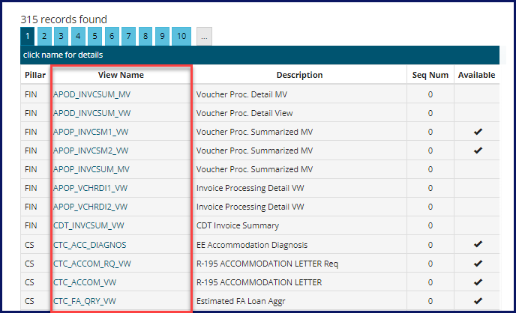
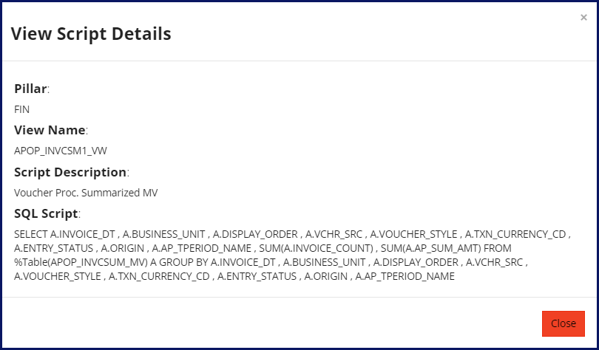
metalink
SQL View Search Results
The View Name will be a hyperlink that will show the SQL script used in the view creation. The field Seq. Num indicates if additional space is needed to see the complete view and the ordering sequence of the script. The field Available indicates if the view is assigned to an access group within a Data Services Query Tree.
Notes:
Click on the hyperlink of the View Name to see the underlying SQL code.

Slide 53
BI Publisher
Oracle Business Intelligence Publisher (BI Publisher, formerly XML Publisher) is an enterprise reporting solution that streamlines report and form generation. In essence BI Publisher allows the State Board to create actual formatted reports using Queries, Connected Queries or other data sources and then allow the end users the option of how the report should be rendered. Users are able to select to view a report on the Web, in Excel, Word or Adobe.
The BI Publisher report naming convention prefixes will be:
BCS - Campus Solutions
BFS - Finance
BHC - Human Capital Management
The rest of the BIP report name will follow the standard query naming convention.
For the purpose of this class we are going to be looking at how to view Query based BI Publisher reports through Query Report Viewer, how to run a BI Publisher report using Query Report Scheduler and using BI Publisher Report search.
.
Notes:
Page 29 5 minutes
Oracle Business Intelligence Publisher (BI Publisher) is an enterprise reporting solution that streamlines report and form generation. BI Publisher enables you to design and create report layout templates with the more common desktop applications of Microsoft Word and Adobe Acrobat, and renders XML data based on those templates. With a single template, it can generate reports in many formats (PDF, RTF, Excel, HTML, and so on). This approach to reporting can dramatically reduce report maintenance, enabling power business users to adjust report templates without involvement of IT resources.
In essence BI Publisher allows the State Board to create actual formatted reports using Queries, Connected Queries or other data sources and then allow the end users the option of how the report should be rendered. Users are able to select to view a report on the Web, in Excel, Word or Adobe. BI Publisher is basically a translator of data. It takes the raw format of Query results and translates those results into a nicely formatted report.
The BI Publisher report naming convention prefixes will be:
BCS - Campus Solutions
BFS - Finance
BHC - Human Capital Management
The rest of the BIP report name will follow the standard query naming convention.
For the purpose of this class we are going to be looking at how to view Query based BI Publisher reports through Query Report Viewer, how to run a BI Publisher report using Query Report Scheduler and using BI Publisher Report search.
.

Slide 54
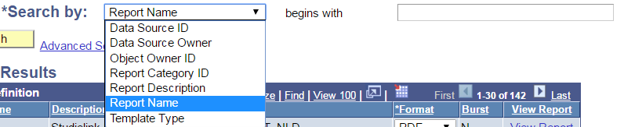
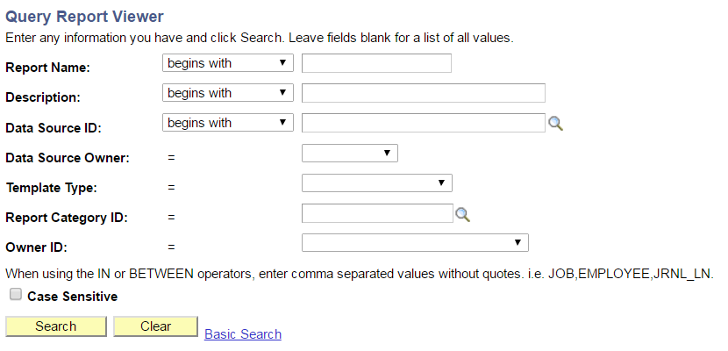
BI Publisher
Query Report Viewer
The BI Publisher Query Report Viewer allows end users to run Query based BI Publisher reports. Note: BI Publisher reports with data sources other than Query do not appear in search results and will need to be scheduled to run.
Navigate to Query Report Viewer: Main Menu → Reporting Tools → BI Publisher →Query Report Viewer
There are two search methods: Basic Search and Advanced Search.
Basic Search
Advanced Search
Notes:
Page 29-30 5 minutes
The BI Publisher Query Report Viewer allows end users to run Query based BI Publisher reports. Note: BI Publisher reports with data sources other than Query do not appear in search results and will need to be scheduled to run.
Navigate to Query Report Viewer: Main Menu → Reporting Tools → BI Publisher →Query Report Viewer
There are two search methods: Basic Search and Advanced Search.
Basic Search allows users to search by:
Data Source ID
Data Source Owner
Object Owner ID
Report Category ID
Report Description
Report Name
Template Type
Wildcards % and_ are also available to use in your searches here.
“Begins With” is the only available operator in Basic Search.
The Advanced Search allows for the same searching options but with different operators available. Users can combine search Criteria in the Advanced Search to narrow the results returned.
Wildcards % and _ are also available to use in your searches here.

Slide 55
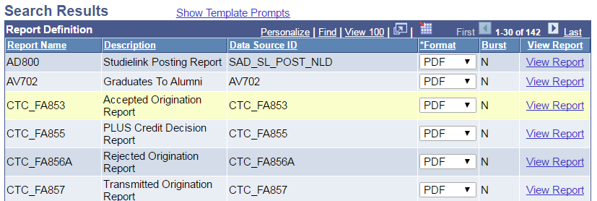
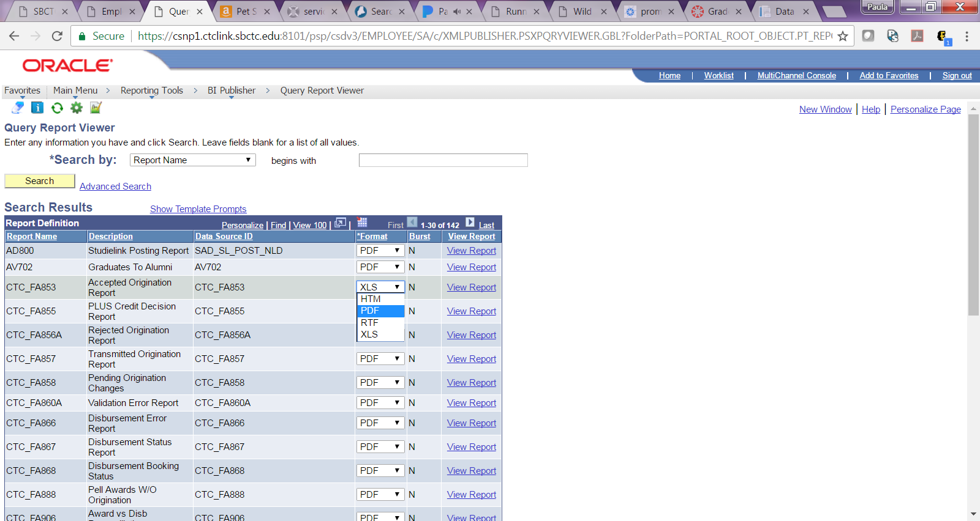
BI Publisher
Query Report Viewer
Enter your search Criteria or simply hit enter for a list of all available reports
Users are able to select how the report should be displayed in the Format column. Available options are:
PDF
HTM
RTF
XLS
Notes:
Page 30-31 2 minutes
Enter your search Criteria or simply hit enter for a list of all available reports.
Users are able to select how the report should be displayed in the Format column. Available options are:
PDF
HTM
RTF
XLS

Slide 56
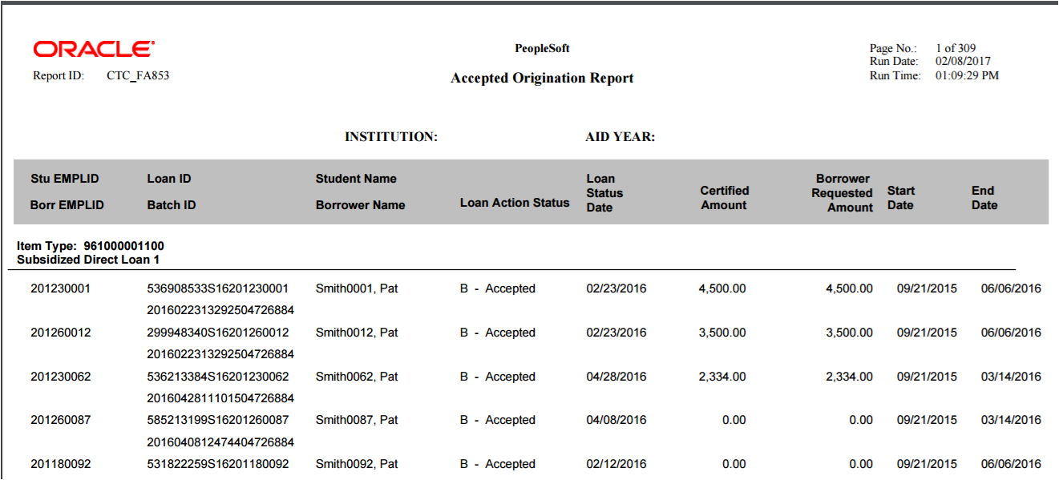
BI Publisher
Query Report Viewer
Once the Format selection is made, click on “View Report” to see the report results.
Notes:
Page 31 2 minutes
Once the Format selection is made, click on “View Report” to see the report results.

Slide 57
BI Publisher
Query Report Scheduler
The Query Report Scheduler is similar to Schedule Query in that users are able to schedule reports to run at a specific time/date or immediately. All BI Publisher reports with data sources of Query or Connected Query are available to be run through this tool.
Note: Do not schedule any Queries or Reports to run between the hours of 1 am and 3 am as this time is reserved for IT.
The BI Publisher Query Report Scheduler is very similar in use and appearance to Schedule Query. Each report is assigned a Run Control ID which will tell the system when, where and how to run the report saving the report parameters (prompts) to the Run Control ID. Run Control ID’s are personal and are not shared across the system.
Notes:
Page 31 2 minutes
The Query Report Scheduler is similar to Schedule Query in that users are able to schedule reports to run at a specific time/date or immediately. All BI Publisher reports with data sources of Query or Connected Query are available to be run through this tool.
Note: Do not schedule any Queries or Reports to run between the hours of 1 am and 3 am as this time is reserved for IT.
The BI Publisher Query Report Scheduler is very similar in use and appearance to Schedule Query. Each report is assigned a Run Control ID which will tell the system when, where and how to run the report saving the report parameters (prompts) to the Run Control ID. Run Control ID’s are personal and are not shared across the system.

Slide 58
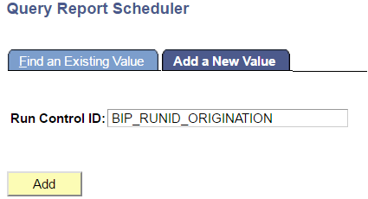
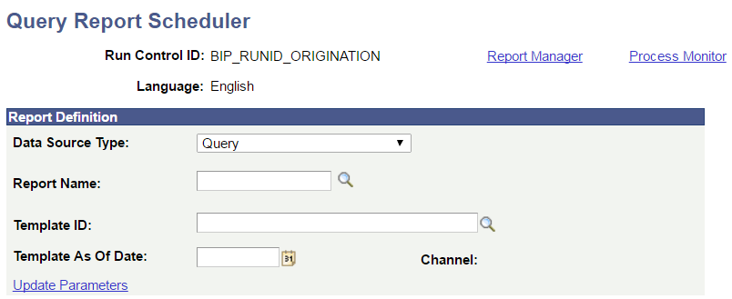
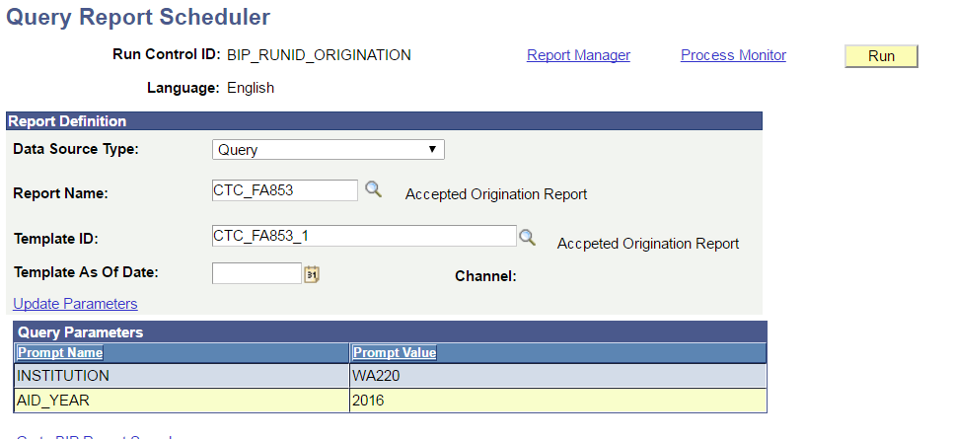
BI Publisher
Query Report Scheduler – Adding a New Run Control ID
If adding a new Run Control ID, select the Add a New Value tab. Enter the Run Control ID and click on “Add”.
Select the Report Name
Once the Report Name is entered the most of the remaining fields will fill in automatically
Notes:
Page 32-33 3 minutes
If adding a new Run Control ID, select the Add a New Value tab. Enter the Run Control ID and click on “Add”.
This will take you to the Query Report Scheduler Page.
On this page select the Report Name. Either type it in or click on the magnifying glass next to the Report Name Field to search for your report. Once you have made the selection if there are prompts in the report you will be asked to enter in the values.
Note that once the Report Name is entered the remainder of the fields will fill in automatically with the exception of Template as of Date where users can select a particular version of the template they want the report to be based on. Click on Run in the upper right corner to run the report.

Slide 59


BI Publisher
Query Report Scheduler – Adding a New Run Control ID
The Process Scheduler Request page is where final selections are made including the Date and Time to run the report as well as Type and Format. Once done with the selections click OK to schedule the report.
You will be directed back to the Query Report Scheduler page where you will be able to check the Process Monitor and the Report Manager for your report.
Notes:
Page 33 2 minutes
This will take you to the Process Scheduler Request page where final selections are made including the Date and Time to run the report as well as Type and Format. Once done with the selections click OK to schedule the report.
You will be directed back to the Query Report Scheduler page where you will be able to check the Process Monitor and the Report Manager for your report.

Slide 60


BI Publisher
Query Report Scheduler – Using an Existing Run Control ID
From the main Query Report Scheduler page you are also able to search for an existing Run Control ID. There are two search options:
Basic Search
Advanced Search
Basic Search
Advanced Search
Wildcards are available to use in both search types. Enter your search criteria or simply hit enter for a list of all BI Publisher reports. Remember they are personal to you so only Run Control ID’s you have created will display here.
Notes:
Page 34-35 2 minutes
From the main Query Report Scheduler page you are also able to search for an existing Run Control ID.
There are two search methods: Basic Search and Advanced Search.
Basic Search allows users to search by:
Data Source ID
Data Source Type
Description
Language Code
Report Name
Run Control ID
Wildcards % and_ are also available to use in your searches here.
“Begins With” is the only available operator in Basic Search.
The Advanced Search allows for the same searching options but with different operators available. Users can combine search Criteria in the Advanced Search to narrow the results returned.
Wildcards % and _ are also available to use in your searches here.
Enter your search Criteria or simply hit enter for a list of all Run Control ID’s. Remember they are personal to you so only Run Control ID’s you have created will display here.

Slide 61




BI Publisher
Query Report Scheduler – Using an Existing Run Control ID
The list of Run Control ID’s will display as a hyperlink. Click the one to run.
On the Query Report Scheduler page make any adjustments needed to the Parameters, if any.
On the Process Scheduler page choose the type and Format
View the Report Manager and Process Monitor on the Query Report Scheduler page
Notes:
Page 35-36 3 minutes
Click on the hyperlink of the Report you wish you run. This will take you to the Query Report Scheduler page where the report name will be filled in already. The parameters will also be saved though they can be changed by clicking on the Update Parameters hyperlink. Click on Run in the upper right corner to run the report.
This will take you to the Process Scheduler Request page where final selections are made including the Date and Time to run the report as well as Type and Format. Once done with the selections click OK to schedule the report.
You will be directed back to the Query Report Scheduler page where you will be able to check the BI Publisher Process Monitor and the Report Manager for your report.

Slide 62


BI Publisher
Report Search
The BI Publisher Report Search will allow users to search specifically for the results of their scheduled BI Publisher reports. It is similar to Report Manager. Enter your search criteria then click the hyperlink of the report you would like to view.
To download and/or view the report click on the Report Name in the File List box.
Notes:
Page 37 3 minutes
The BI Publisher Report Search will allow users to search specifically for the results of their scheduled BI Publisher reports. It is similar to Report Manager. In the example to the right the search was made for all BI Publisher Reports ran within the last 30 days.
Also note that users are able to access the BI Publisher Process Monitor and BI Publisher Report Manager from this page.
Click on the hyperlink in the Report column to go the Report Index page to view the report.
To download and/or view the report click on the Report Name in the File List box.
It is interesting to note that while there appears to be separate Process Monitors and Report Viewers for BI Publisher with different menu paths they are actually the same Query Process Monitor and Report Viewer as found when scheduling standard Queries. You will be able to view both BI Publisher reports and standard scheduled Queries from either navigation. At the same time, only BI Publisher run Control ID’s will display when finding an existing value in BI Publisher Query Report Scheduler and only Run Control ID’s for standard Queries will display in Schedule Query.

Slide 63


Course Exercises
Notes:
Page 38-43 10 minutes
Time after exercises should be 11:15
Take 10 minutes to complete the Course Exercises
CS – Page 38-39
HCM – Page 40-41
FS – Page 42-43
If class started at 8:30 then time now should be approximately 11:15 am at the end of the time for exercises.

Slide 64

Course Review
The goal of this course was to teach end users of ctcLink PeopleSoft to find and retrieve Queries and Reports in the most effective manner.
The Objectives for this course were to give attendees the tools and necessary information to:
Properly Request Query Development from your college and Understand Query Migration
Access PeopleSoft Query Viewer and Schedule Query
Search for existing Queries using Wildcards.
Run Queries to multiple outputs.
Effectively use MetaLink to search Query metadata.
Have knowledge of how to run reports created with BI Publisher.
To meet the Goal and Objectives we learned how to correctly create a development request and the steps for Query migration. We saw how to search for and run Queries in Query Viewer and how to schedule Queries to run. We learned how to run Queries to
multiple outputs and use Wildcards in searches.
We also became knowledgeable about MetaLink and how it can be a very useful tool for finding information and how to run and schedule reports created through BI Publisher.
Notes:
Page 44 3 minutes
The goal of this course was to teach end users of ctcLink PeopleSoft to find and retrieve Queries and Reports in the most effective manner.
The Objectives for this course were to give attendees the tools and necessary information to:
Properly create a Query Development Request and Understand Query Migration
Access PeopleSoft Query Viewer and Schedule Query
Search for existing Queries using Wildcards.
Run Queries to multiple outputs.
Effectively use MetaLink to search Query metadata.
Have knowledge of how to run reports created with BI Publisher.
To meet the Goal and Objectives we learned how to correctly create a development request and the steps for Query migration. We saw how to search for and run Queries in Query Viewer and how to schedule Queries to run. We learned how to run Queries to multiple outputs and use Wildcards in searches. We also became knowledgeable about MetaLink and how it can be a very useful tool for finding information and how to run and schedule reports created through BI Publisher.

Slide 65









Notes:
Hand out review forms.

Slide 66




Break
Time!!!!
Notes:
Class Time from end of last section: 45 minutes. Approximate time if class starts at 8:30 is 10:05 am.
Class Resumes at 10:20

