Slide 1
2022-27 BEDA Master and IELCE Grant
Bidder’s Conference
Troy Goracke, Policy Associate
January 26, 2022
Notes:
Good morning/afternoon. And welcome to the Request for Application Bidders’ Conference for all agencies applying to become providers of Adult Education in Washington State under the federal Workforce Innovation and Opportunity Act or WIOA-- Title II.
I’m Will Durden, Washington State Director for Basic Education for Adults with the Washington State Board for Community and Technical Colleges, and I am joined by the State Board Team who will be participating in today’s conference. We would like to start off by taking a few moments to have our team introduce themselves:
Hi, my name is Troy Goracke, Policy Associate and lead on the RFA process for State Board for Community and Technical Colleges
Hi, my name is Christy Lowder, Administrative Assistant to the Director and official questions and answers record keeper for the RFA
Hi, I’m Kari Kaufman and I’m the Program Assistant for the Education Fiscal Department and the OGMS Administrator
The State Board for Community and Technical Colleges (SBCTC) is the agency authorized by state law to administer the federal and state funded adult basic education programming in Washington State under the Federal Workforce Innovation and Opportunity Act (WIOA) Title II (Sec. 231.e.1-13 and the WIOA Final Rules and regulations.
Our office must assure rigorous, quality basic skills services are delivered by providers who have demonstrated effectiveness in providing adult education and literacy activities as outlined in the act.
The purpose of Adult Education and Literacy, Title II of WIOA, is to:
Assist adults to become literate and obtain the knowledge and skills necessary for employment and economic self-sufficiency through a living-wage employment;
To assist adults who are parents or family members to obtain the education and skills that are necessary to becoming full partners in the educational development of their children and lead to sustainable improvement in the economic opportunities for their family;
Programs are required to assist adults in attaining a secondary school diploma and in the transition to postsecondary education and training through the implementation of clearly defined career pathways;
And they must also assist immigrants and other individuals who are English language learners in improving their reading, writing, speaking and comprehension skills in English and their mathematics, employability, and technology skills along with acquiring an understanding of the American System of government, individual freedom, and the responsibilities of citizenship.
Perhaps the most significant change to basic education under WIOA is the new definition-where in the past basic education was defined as providing life skills. It is now defined as Academic instruction and education services below the postsecondary level that increases an individual’s:
Reading, writing, speaking, listening, mathematics, English acquisition, technology and employability skills for attainment of a secondary school diploma or its equivalent
Transition to postsecondary education and training
Obtain of living-wage employment
It is every provider’s responsibility to assist adults in obtaining the knowledge and skills necessary for work, further education that leads them to college certificates and degrees with meaning in the workforce, family self-sufficiency, and community involvement.
The goal is for every individual we serve to get to the tipping point (1 year of college plus a credential) and beyond to ensure they have the skills to secure family sustaining careers.
The systematic implementation of the Title II of our WIOA State plan and the alignment of your program’s activities with the local Workforce Development Plan are critical to the success of our basic skills population and to Washington’s future economic well being, and we appreciate your interest in being a part of this great work. Washington needs your agency and staff’s expertise.
My hopes is as you write your RFA application that you will be guided by the six Title II goals of the plan and describe the action you will take and the evidence-based strategies you have implemented or will implement over the next 5 years to ensure success for our students. Thank you for your interest.

Slide 2
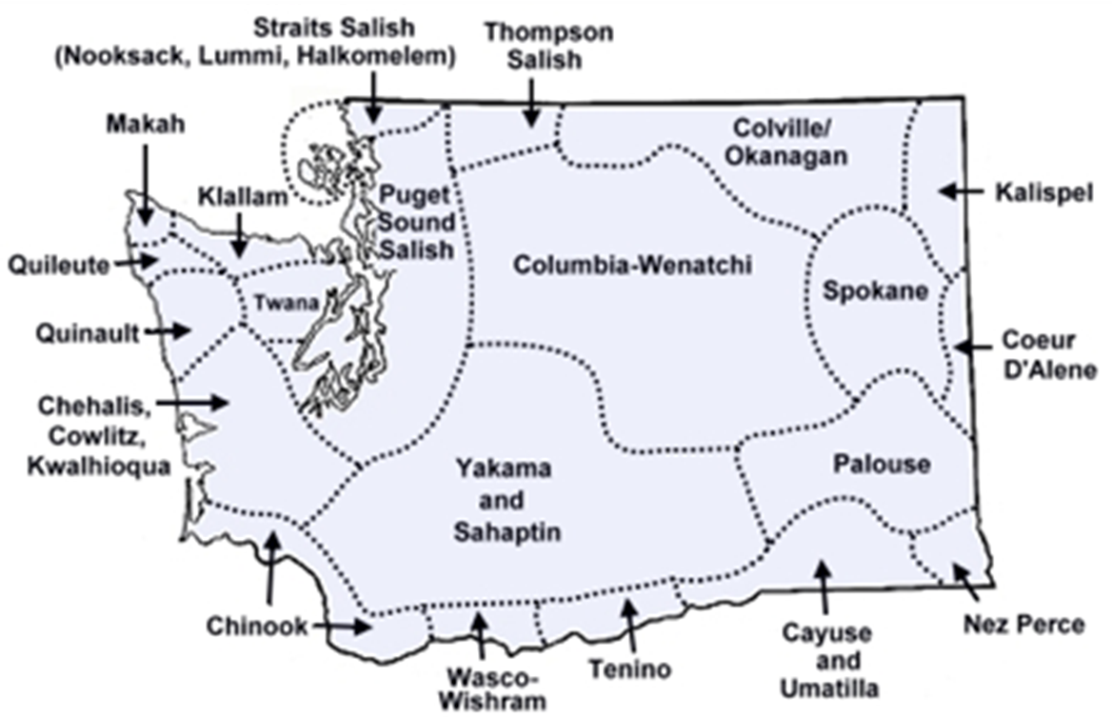
Land Acknowledgement
Notes:
Will Durden is doing the Land Acknowledgement

Slide 3
Review of Agenda
Review of Critical Dates
Review of the elements of the grant process
Kari will present the elements of OGMS
Review of the Q and A website
Notes:
Thanks, Will and now I would like to go over the agenda for today:
We’ll spend some time reviewing critical dates and reviewing the elements of the grant process. Kari will present on the various sections of OGMS and then we’ll end by showing the Q & A website where all questions and answers will be posted within 2 business days.

Slide 4
Review of Dates
Jan 24th 2022-27 BEdA Master and IELCE Grant opened
Jan 26th Bidders conference
Feb 22nd Q & A Closes
Mar 3rd Applications DUE
Mar 29th SBCTC Feedback on grant returned in OGMS
April 6th BEdA Budget Application Conference 2-4 p.m.
April 6th Preliminarily approved organizations enter budget application
April 14th All modifications to Master and IELCE grant applications DUE
May 5th Budget applications are DUE
June 2nd All budget revisions are DUE
June 29/30th SBCTC Board meeting
June 30th Notifications sent to providers
Notes:
Let’s start by reviewing the critical dates:
Jan 24: As you know, applications opened in OGMS. If you have not gotten into OGMS yet I encourage you to do so ASAP and confirm who at your organization has “contribute & submit” rights to the application, if you do not have them, contact your Security Administrator, as we are not able to help you.
Jan 26th: Here you are today at the Bidders Conference Jan 26th
Feb 22nd: Q & A Closes so be sure to get your questions in to Christy Lowder prior to that. Final answers will be posted by the Feb. 24th
Mar 3rd: Master & IELCE Applications are DUE
SO, there are two opportunities for funding, ABE funding for Adult Basic Education and a smaller grant funded for Integrated English Language and Civic Education (IELCE). And as you may be aware, the only way to apply for this funding is through the WA State Online Grant Management System (OGMS). We strongly recommend that you get your applications in EARLY. We cannot reopen the system for any reason.
March 29th: SBCTC Feedback is returned in OGMS. You will receive an email notification of feedback from OGMS@sbctc.edu in the following categories:
Your application has Preliminary approval;
Your application has Preliminary approval but needs clarification/edits/modifications; or
Your application has been denied.
If you don’t receive feedback on March 29th check your spam, or with your IT department
Now on to the Budget application process:
April 6th: The Budget applications will open in OGMS for those who have preliminary approval, with a Zoom conference to answer questions the same day
April 14th: All narrative modifications to Master & IELCE applications are DUE
May 5th: Budget applications are DUE and then on
June 2nd: All budget revisions are DUE
All applications will be in “preliminary” status until we receive final Board approval. Which occurs at their meeting June 29/30, with notifications going out to providers June 30.

Slide 5
Overview of Grant Components
  Information under grant resources tab
    2022-27 BEdA Master and IELCE Guidelines
    Definitions
    Attachment A
    Assurances
    Scoring rubric
    Supporting Guidance for OGMS application questions
    Fiscal Guidelines
  Content Section 1-6
  Attachment(s)
    Attachment A
    Assurances
  Budget
Notes:
Overview of Grant Components
The Information under grant resources tab is critical. Please make sure that you read over these resources carefully.
The Guidelines Please read through prior to submitting questions, as there may be a chance, your question is answered in the guidelines.
Definitions are terms that are used throughout the grant process and will help to ensure consistency as you respond to various items in the grant.
You will also find two attachments (Attachment A and the Assurances) that are required. If these attachments are not attached your application will not be considered as a complete application.
The scoring rubric will be used by the scoring teams for evaluation of all applications.
Supporting Guidance for OGMS application will assist you in using the OGMS system and finally are the fiscal guidelines that outline the requirements of this federal funding.
Under the content tab there will be 6 sections
All applicable Narrative questions are required to be addressed in order for the application to be complete and reviewed by the team.
Attachments
Attachment A is the data collection mechanism that demonstrates past effectiveness and is required; along with the Signed Assurances attachment which addresses both state and federal requirements to receive funding
Budget - The budget is not required at this time, but will be needed after applications have been preliminary approved.
Now, I would like to turn it over to Kari for a closer look at the actual OGMS system.

Slide 6
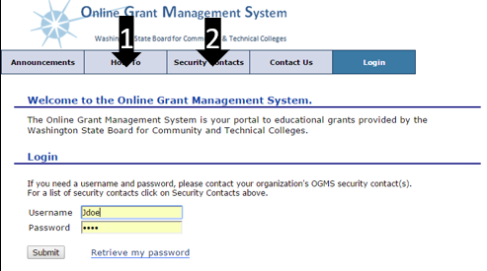
Online Grant Management System (OGMS)
Notes:
OGMS Access
As mentioned earlier, the grant application is now live in OGMS. The How To tab shown here by the #1 Arrow contains a very helpful OGMS user manual. I highly recommend reading through that if you have questions about how to use OGMS or why something might not be working right.
In order to access OGMS, you must have a user account. Organization OGMS security contacts create OGMS accounts. SBCTC cannot create accounts for organization users. If you don’t know who that is, there’s a tab in OGMS that lists each organization’s security contact. The #2 arrow on the screen points to that.
It is entirely possible that your organization has a process where only certain staff has access to OGMS. If that’s the case, those staff will work with you to write and submit the application. Regardless of the process at your organization, it is extremely important to work closely with your grants staff.
Even if you already have an OGMS user account you must still contact your OGMS security administrator to get access to the application. Access to last year’s application does not carry over to this year’s application. Or, if your organization selects to have your grants staff submit the application for you, you’ll still need go to them and let them know about this year’s application.
Login Screen
If you have forgotten your OGMS username and password, you can contact your security administrator for your username. They probably don’t have access to your password though, but you can use the “Retrieve my password” feature on the log in screen, and OGMS will email your password to you. It emails your password within about 30 seconds.
If you don’t receive the email in about 2 minutes, check your spam or junk email folder. If it’s not there either, double check with your security administrator to make sure the email address associated with your OGMS user account is correct. As schools update email address, OGMS security contacts don’t always remember to go update user accounts at their college.

Slide 7
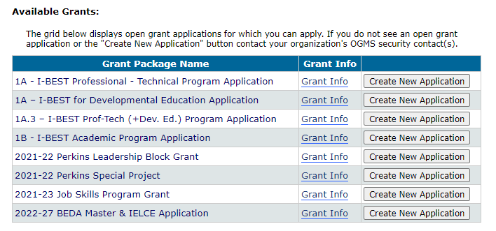
Available Grants
Select “Create New Application”
Notes:
Creating an Application
After you log in, you’ll see the Status of Grant Applications that you have access to near the top of your screen. A little farther down, you’ll see Available Grants that you can create a new application for. Locate the grant (it may be the only one you see), and click the Create New Application button.

Slide 8
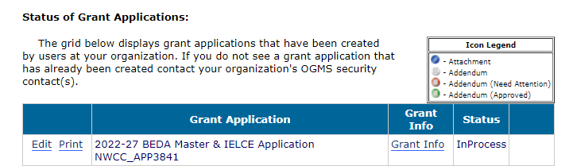
Application Access
Once you have “created new application”, you’ll open the application under the “Status of Grant Applications” – Never go back and use the “create new application”
ALWAYS - Make sure to select FY23, or you will not find the application you started
Notes:
Application Access
Only go through creating an application once! After you create the application the first time, the grant application will be in the fiscal year 23 (or FY23) screen of your existing grant applications. Because we’re currently in FY22, OGMS will show you FY22 grants by default. So the next time you log into OGMS, click into the FY23 screen, and locate your in-process application.
If you don’t see the application anywhere, contact your organization’s OGMS security administrator.
OGMS has a security feature where the system will time out after 20 minutes of inactivity, OGMS will log you out. OGMS only counts clicking the save button and clicking from one screen to another as activity. Typing doesn’t count as activity. Neither does clicking check boxes nor radio buttons. The good news is that at the 15 minute mark, OGMS has a popup window that comes up and lets you know you need to save or you’ll be logged out and lose all the work you’ve done since you last saved.
We recommend that you craft your responses in a Word Document and copy and paste your answers into OGMS, please see the “User Manual” under the “How To” tab in OGMS.

Slide 9
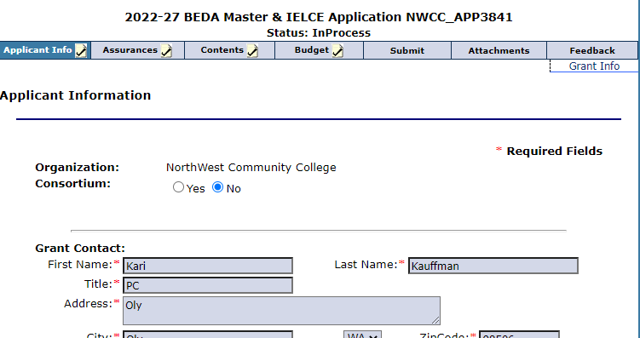
Grant Info Tab
All the resources to complete the application are located under the “Grant Info” tab
Notes:
Grant Info Tab
In your application, you’ll see a link off to the right side of your screen shown here by the arrow. This is the Grant Info section of the application and is where you’ll find all the resources you need to complete this application. Please read through the resources to find out what’s allowed in this grant, who to contact, timeline, deadlines, etc.

Slide 10
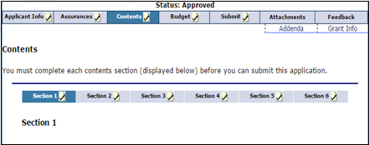

Contents Section
Notes:
Contents Section
There are 6 sections of content in this application.
You can click through each section on the contents tab, You must complete each section and mark the “check to mark as complete” box at the bottom of each section before you can submit an application.
Be sure to also click the Save button on every screen…and no less often than every 20 minutes to prevent you from getting timed out and losing any content.
Once you check a section as complete, the little icon on the Contents Section row turns into a check mark. This lets you easily see which sections you still need to complete.
You don’t have to complete the sections in order. And even if you mark a section as complete, you can still go back and change it (as long as you haven’t already submitted your application). Just be sure click the save button after you make any changes.

Slide 11
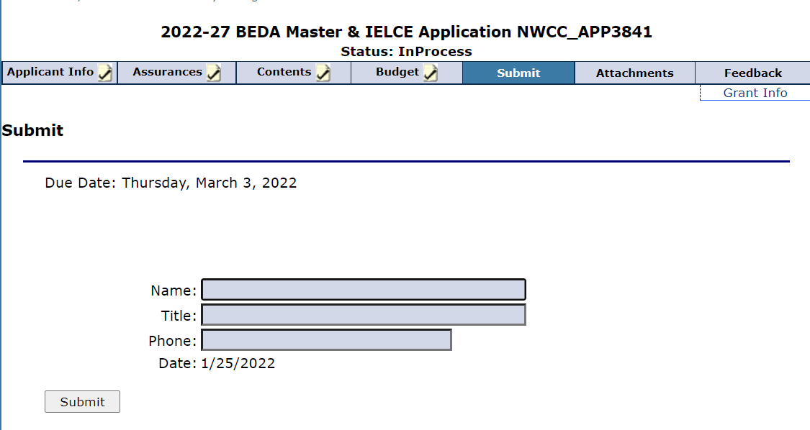
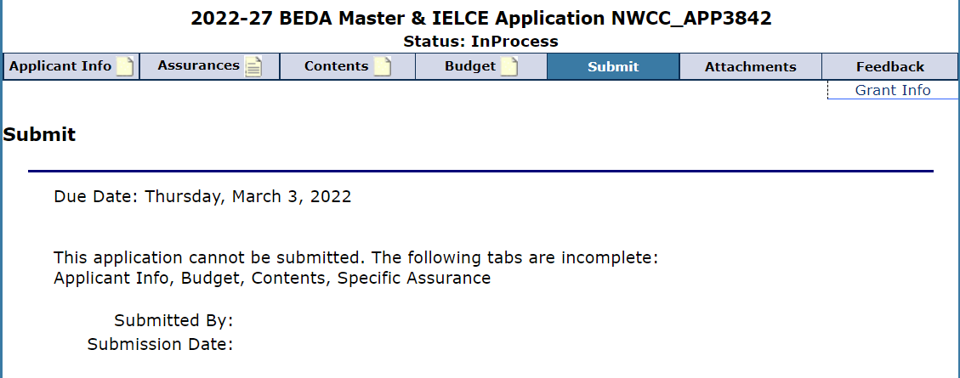
Submitting a grant Application
Notes:
Submitting a Grant Application
Once you’ve completed every part of the grant application, you can go to the submit tab of the application in OGMS, and submit the application to the SBCTC.
Type in your name, title, and phone number. Click the Submit button, and the application has been submitted to SBCTC. We get a notification from OGMS, so you do not need to call or email us. Additionally, if you refresh your screen, the status on your end should change from “In Process” to “Submitted.” The OGMS user manual will show you where you can find the status as well.
If your submit screen looks like the example on the bottom, and there aren’t any boxes on this screen for you to type your name, title, and phone number, and the submit button is missing, first check to make sure every section of your application is completed, you’ve checked to mark each section complete at the bottom of every screen, and each tab has a checkmark on it. You can see in this example that the Contents boxed is not checked.
If every tab has a checkmark and you still don’t have content boxes and a submit button on the submit screen, check with your OGMS security administrator. It is very likely that person did not set your OGMS permissions adequately for you to be able to submit the grant. This may be an oversight or by design as different organizations have different protocol on who can actually submit grant applications.
After you submit your grant application, SBCTC reviews them and you will receive notification based on the timeline Troy mentioned earlier. That’s it for OGMS.

Slide 12
Review of Q and A Website
All questions are to be emailed to Christy Lowder at clowder@sbctc.edu
Answers will be posted to our website within 48 working hours.
When submitting questions, please reference the section and question # you are asking about.

Slide 13
Contact Information
All Questions:
Christy Lowder, clowder@sbctc.edu
SBCTC considers answers in the forthcoming Q & A document to be the only official source for answers related to this RFA. The Q & A document is on the website and answers will be posted within 2 business days.
  Last date for submitting Questions is February 22nd
  The last posting of Answers is February 24th
Notes:
Will any concluding comments?
I want to thank you all again for your interest in applying to become providers of Adult Education in Washington State under the federal Workforce Innovation and Opportunity Act.
Under WIOA’s new vision for basic skills (please remember that programs funded) must provide evidence of demonstrated effectiveness that clearly shows a track record of improving the skills of eligible individuals particularly those who have low levels of literacy in reading, writing, mathematics, English language acquisition, employability skills, and digital literacy.
It is critical that programs funded are of high quality and have programming in place that holds students to college-level expectations and academic rigor. Successful programs must provide active and applied learning experiences for all students that provide them with the skills and credentials to secure living-wage jobs.
We here at the State Board for Community and Technical Colleges look forward to your applications. Please don’t hesitate to send us any questions that you have that will be helpful to your preparation of a high-quality application. Thank you.

