Slide 1
Washington commercial drivers license Grant
(WA CDL Grant)
FY25 (July 1, 2024 – June 30, 2025)
Carolyn McKinnon, Policy Associate, Workforce Education
Danny Marshall, Program Administrator, Workforce Education
Denise Costello, Associate Director of Fiscal Management, Education Division
March 28, 2024

Slide 2
About the webinar
This webinar is being recorded and will be made available on the program webpage for future reference.
This webinar is to discuss the application process and is not a forum to vet proposal ideas.
Applications are due April 25, 2024. We will gather your questions today. Answers will be posted in a Q&A document on the program webpage and updated regularly through April 25, 2024.
SBCTC Program webpage, find Commercial Drivers License (CDL) for Private Career Schools and Colleges page. https://www.sbctc.edu/colleges-staff/grants/cdl-pcsc

Slide 3
What we Will cover
Overview of the WA CDL Grant FY25 guidelines, including:
    the purpose of the funds
    allowable uses of funds
    who may apply
    funding and budget details
Applying through OGMS
Attachments that must be submitted for consideration
Review criteria

Slide 4
Purpose of funds
Through the WA CDL Grant, SBCTC makes CDL expansion funding available via contracts with eligible Private Career Schools and Colleges (PCSC) and Public K-12 School Districts (SDs) that are selected through a competitive application process.
The CDL Grant Fund may be used to fund financial assistance for enrolled students and other expansion resources. School districts may access funds exclusively to offset out-of-pocket costs that are otherwise incurred by school bus driver trainees.

Slide 5
Purpose of funds, continued
The allocated resources will support the development and continued alignment of education and training programs with current industry practice and employee recruitment needs.
Commercial drivers licensing programs are a priority; instructional programs that support trucking-related supply chain and school bus driving industries are also eligible. Please contact us if you have questions about any specific programs.
Overall, what we’re looking for is enrollment capacity increases and more completions in CDL and related programs.

Slide 6
Allowable uses
A total of $1,000,000 is being made available for WA CDL grant contracts. Funding will be divided between student financial assistance and enrollment expansion resources.
WA CDL Grant funds may be used for student financial assistance to:
Support published tuition and expenses for a students’ training and other reasonable and necessary student support services, including childcare costs.
Funding for financial assistance is provided at a rate of $2,000 per student per program per grant fiscal year.
WA CDL Grants should be combined with other student aid and must not exceed the maximum per student rate, or the actual total student charges.
Given the limited funding available, schools are encouraged to make requests at levels that reflect their planned support needs, and to leverage coordination with other training resources.

Slide 7
Allowable uses
WA CDL Grant funds may also be used for:
Equipment upgrades or new equipment purchases for expanded training, at a maximum of $25,000 per contract;
New training spaces and locations to support capacity needs and expansion of training to veterans and veteran spouses, and underserved populations to include foster care and homeless transition populations and previously incarcerated persons, at a maximum of $25,000 per contract; and
Faculty curriculum development and instructor training for driving, repair, and service of technological advancements facing the industries, at a maximum of $6,000 per contract.

Slide 8
Allowable uses
Student financial assistance policies:
  The applicant must not require a student to fill out the Free Application for Federal Student Aid (FAFSA) in order to receive WA CDL Fund student financial assistance.
  The school must require students seeking CDL Fund student financial assistance to make their requests for assistance in writing. These requests must be retained on file by the school.
  WA CDL Grant student financial assistance is offered in recognition that CDL programs are not typically eligible for federal or state financial aid and there is a high out-of-pocket cost to students for these programs. Given the limited amount of funding available, colleges should focus proposals for financial assistance on instructional programs that are not otherwise eligible for financial aid. Aid should be leveraged as much as possible with other workforce student support funding programs.

Slide 9
Allowable uses
Student financial assistance policies:
  Student financial assistance must not exceed the per-student published cost of attendance for the program.
  The school must maintain a record of students who received WA CDL Fund financial assistance.
  There are no eligibility requirements for students to receive WA CDL Fund financial assistance beyond meeting the admissions requirements for the instructional program that is being supported by the CDL Fund.
  Schools will be able to bill the grant one time for the total financial assistance provided to a student, including tuition, or other direct expenditures made on the student's behalf.

Slide 10
Who may apply
Private career schools and colleges (PCSCs) that:
have a license in good standing.
are operating in the state of Washington.
are on the state Eligible Training Provider list.
have a physical presence in the state to apply for these funds.
School Districts (SDs) in the State of Washington K-12 system that:
have a school bus driver training program, where trainees incur out-of-pocket costs, may apply for these funds.

Slide 11
Funding
Amount available: $1,000,000 for the year, General Fund-State
July 1, 2024 to June 30, 2025
NO EXTENSIONS or “CARRY FORWARDS” on annual money
Contracts will be awarded to a PCSC or SD to administer financial assistance directly to enrolled students, and to reimburse approved expenditures for CDL expansion resources.
Funding will be allocated with a preference for student financial assistance, with a maximum of $500,000 total to all CDL expansion resources. Note: in the previous year 87% of all funding was allocated too student aid.

Slide 12
Grant and Application guidelines
Master CDL File Requirements
    Course catalog
    Graduation/completion rates for all students
    Signed Grant Assurances
Student File Requirements
    The PCSC or SD must maintain student WA CDL Grant files that are easily distinguishable from other student files.
    Enrollment
    Attendance and Academic Progress
    Program Completion
    Student Financial Ledger
Step-by-step instructions in the Application Guidelines (Appendix A)

Slide 13
Online Grant Management system (OGMS) Questions
Contact Kari Kauffman, 360-704-1021 to create an account for you.
Create a new application for the FY24 WA CDL Grant.
The OGMS User Manual is available under the “How To” tab in OGMS.
Save frequently to ensure you don’t lose your work!

Slide 14
Application Information and Grant Resources
Enter your contact information on the Applicant Information screen
    Be sure to avoid typos when entering your email address.
    Add OGMS as a safe sender.
Find and download Program Guidelines, as well as other important documents in the Grant Info link.

Slide 15
Applying in ogms
All required elements must be completed and uploaded to be considered for funding.
OGMS Sections:
Applicant Information
Assurances
Minimum Eligibility: school districts may skip last portion.
Funding Request – Student Support
Administrative Requirements
Budget: enter the requested amounts for student support, equipment upgrades, repairs, or purchases, training spaces and locations, and curriculum development and instructor training.
Attachments Checklist: check as complete once all files are uploaded.

Slide 16
FUNDING CATEGORIES
Take note of these important terminologies when completing the budget narratives part of your application:
Funding Category | Equivalent in OGMS
Student Financial Assistance | Student Support
Equipment upgrades, repairs, or purchases | Enhancement Funding
Training spaces and locations | Operating
Curriculum Development and Instructor Training | Curriculum Development

Slide 17
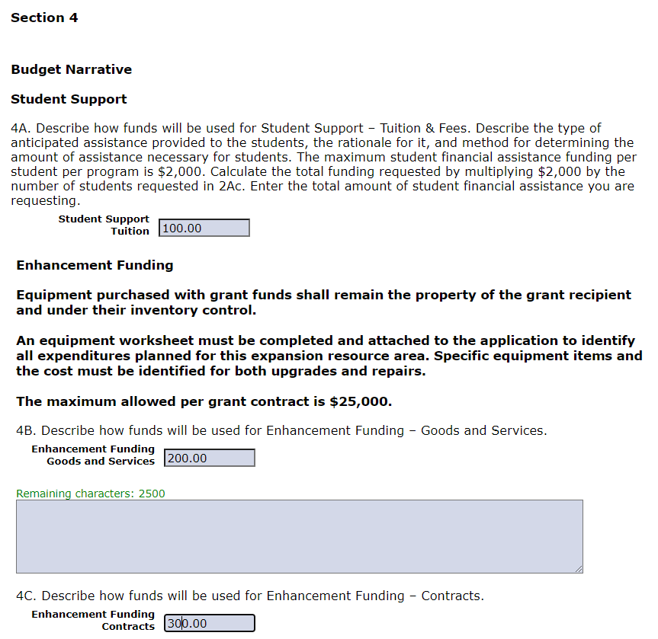
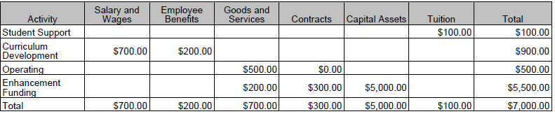
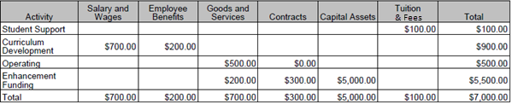
BUDGET
Tuition & Fees

Slide 18
Student support
Section 2 (and part of Section 4) of your OGMS application focuses on Student Support. In completing this section, take note of the following:
Section | What’s Being Asked For
2A | Your estimated enrollment (adjusted by current trends)
2A.a | Number of new for the period of the project in state fiscal year 2025
2A.b | Only for applicants that hold a contract for state fiscal year 2024; the number of students that will be crossovers from FY24
2A.c | The total number of students (looking at 2A.a and 2A.b) you are planning to budget $2,000 each for
2A.d | Explanation of how the funding requested will expand enrollment
4A | $2,000 x the number in 2A.c

Slide 19
Required Attachments
Assurances:
  Signed form
Program Information Registration:
  Enrollment and registration information for all programs included
Program Mix:
  The Program Mix and Equipment Worksheet have been developed to support applicants in fully and accurately calculating each invoice. Use of these worksheets is required and is incorporated into the applicants’ WA CDL contract.

Slide 20
evaluation criteria
Be thorough yet succinct. Make your case. Show your timeline and milestones. Leverage resources wherever possible.
Proposals that do not meet the minimum requirements listed for eligibility will not be reviewed.
An eligible application will be evaluated based on:
  A clear understanding of CDL program requirements and the goal of increasing the supply chain workforce, as evidenced in the application responses.
  Submission of all required documents.
  For applications that include equipment, instructional space, and/or faculty curriculum development/instructor training, funding requested clearly justifies that the expenses are necessary to expand enrollment capacity.

Slide 21
evaluation criteria
  Applicants’ previous performance in the program, if the PCSC or SD has been under contract previously. This includes but is not limited to:
  compliance with program requirements,
  responsiveness to administrative requests and deadlines,
  past funding levels,
  and the ability to meet the contracted target.
  ETPL records of performance obtained from the Workforce Training and Education Coordinating Board.
Criteria | Points
Expansion CDL capacity through the award of financial assistance to students | 50
Description of outreach and inclusion of underserved populations | 10
Level of previous performance in student completion and placement | 10
Description and justification for budgeted expansion resources | 25
Previous WA CDL contract experience | 5
Total | 100

Slide 22
timeline
Proposals due: April 25, 2024, 11:55pm
    Staff available for assistance until 4pm
May 20 – 27, 2024
    Clarification or revisions, if needed / project scaling if required
    Revisions are time-sensitive; please monitor inboxes for OGMS messages
Notification and award of funding: in June and prior to July 1, 2024
Contracted activities begin July 1, or as soon as possible thereafter.

Slide 23

Frequently asked questions
Q: Can a school save an incomplete application and then return and pick up where they left off?
A: Yes, you can save an incomplete application, and return to it later. When you log back in, and your application was saved, it will show up as “in process”. There will be an option to “edit” on the left-hand side of the grant name/application.
Q: I understand that the WA CDL Grant may be used to help students with their childcare and some other types of needs so the student can go to school. Can we reimburse the student for those costs?
A: The WA CDL Grant can only be used to reimburse the PCSC/SD for direct expenditures that they make on behalf of students. Schools must pay directly for childcare or other fees and may not reimburse students for these expenses.
We regularly update the Q&A document in the WA CDL web page. Read or download from:
https://www.sbctc.edu/colleges-staff/grants/cdl-pcsc

Slide 24
Questions?
Danny Marshall
360-704-4332
dmarshall@sbctc.edu
Give us your feedback. A screen will pop up in your browser when the webinar ends.
Questions are welcome. Answers will be posted in a
Q&A document on the program webpage and updated regularly.

