Slide 1
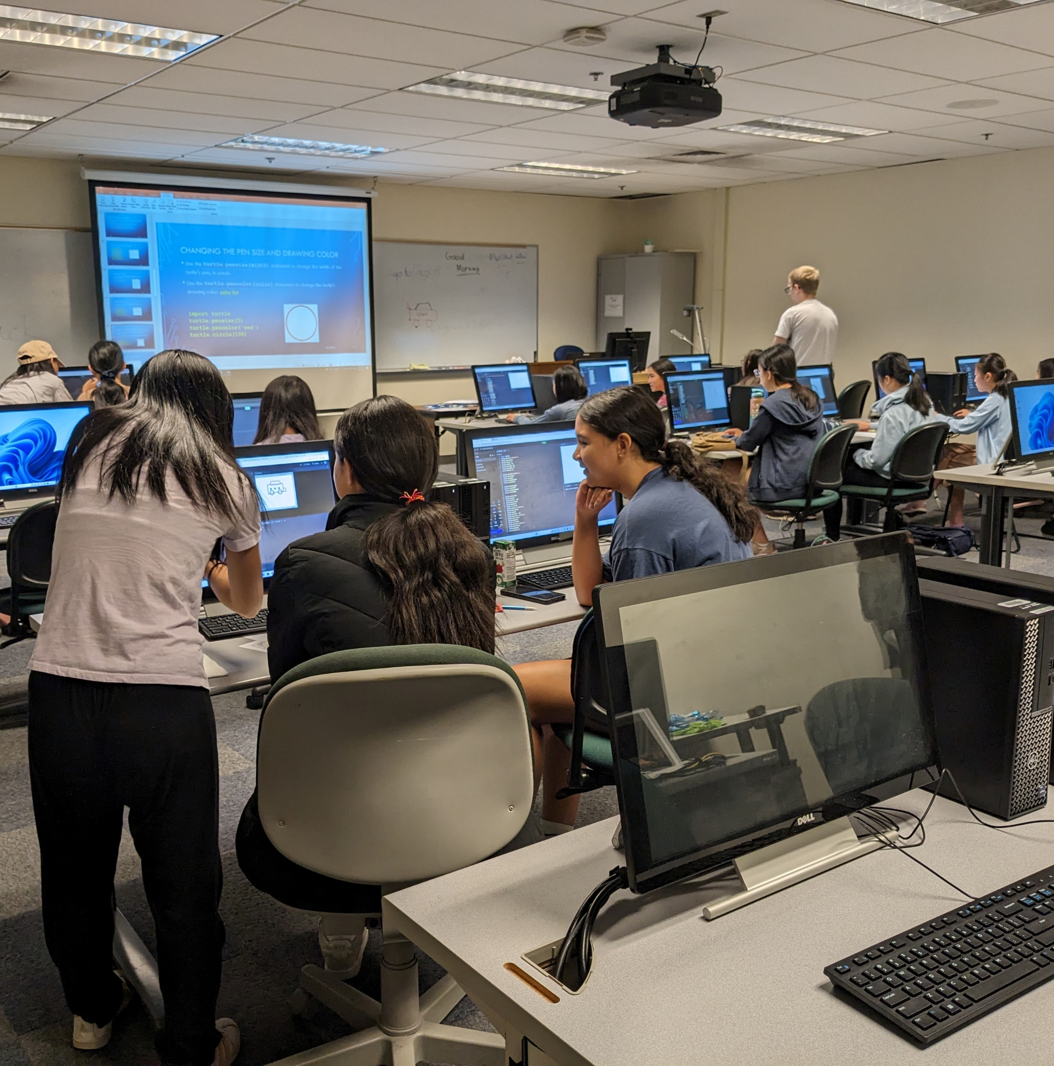




Recruiting Non-Traditional Students
Representative faculty and staff: LGBTQ+ and gender diversity (36% M, 36% F, 27 % Non-binary)
Community outreach: Digital Media & Arts Global Game Jam, Coding Camp, Test Fest, Hackathon
High School District Partnerships
1-on-1 Prospective Student Advising Sessions with Program Managers
1
Notes:
Respresentative Faculty and Staff: The makeup of our staff and faculty in the School is reflective of gender diversity writ large- 36% M, 36% F, 27% nonbinary.
Community Outreach: DMA partnered with our BC maker space to co-host students in the Global Game Jam; a majority female team of students worked together to design and submit a game into national competitions:
* BC also organizes an annual coding camp for high-school age students, focused on building a pathway to explore tech career options and gain some vital basic programming skills for female and non-binary students, though enrollment is open to all. Additionally we have historically hosted a Test Fest and Hackathon in partnership with employer partners
High School District Partnerships
IT and Software Development programs currently partner with local HS districts with diverse groups of students on dual credit (articulation that allows students to earn college credit in HS)
Bellevue, SnoValley and Renton School District, Issaquah HS
Also partnered with a few different Skills Centers in the area
Puget Sound, SnoIsle and Wanic
This is usually not a one-time event and it does require a lot of investment on our end to build and maintain these partnerships (Tom estimates 20 hours per year to maintain dual credit). However, we have found the return on investment to be successful in recruiting large diverse groups of students into our IT/Software Development programs
Ways in which we maintain partnership: Invest in class visits, talking to students about college and what the process looks like, oftentimes we sit on their advisory board, paperwork to maintain dual credit agreement, etc.
1-on-1 Prospective Student Advising
Oftentimes prospective students get the same amount of our time as current students, if not sometimes more
Any prospective students can reach out to one of our PM’s and get academic advising including their transcripts reviewed, individualized academic plans and assistance with the admission process, clearing course prerequisites, and whatever else they might need before applying to the college.
In our conversations with prospective students we learn about their barriers if any and help them one-on-one to locate resources to navigate those obstacles
New tools such as TargetX have allowed us to better tracking of prospective students and have helped us be able to better follow-up on leads and check-in on students who have not yet registered for their first class at BC
Info sessions and events such as “Quarterly Advising Day” are geared towards providing advising services to diverse groups of prospective students

Slide 2
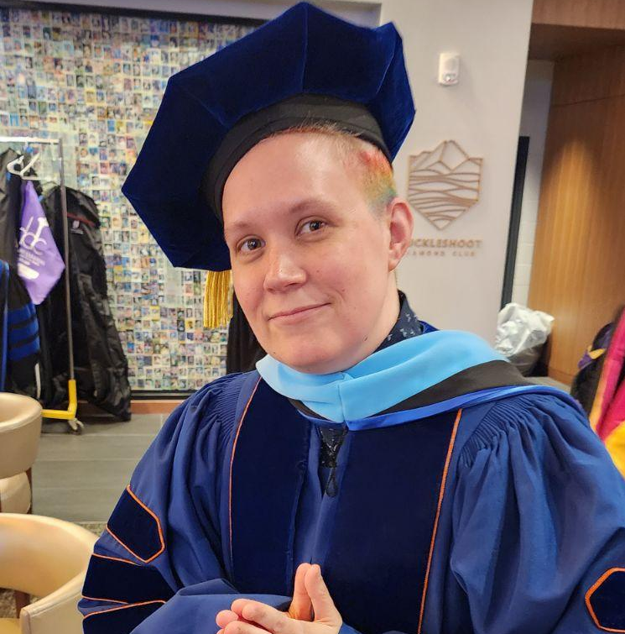
Retaining Non-Traditional Students
Gender diversity and inclusion is embedded in the leadership and principles of the School
We maintain as much flexibility with class modalities as we can
Dedicated student support from program managers, scheduled regular check-ins
Alumni events and connections: Recruiting diverse alumni to share their experiences
1
Notes:
ERIC (Flexibility in Modalities): promoting inclusive and accessible classrooms that fit the needs of our diverse student
population. Our instructors use diverse teaching methods and formats to engage students
with different learning preferences and abilities. Since many of our students are
non-traditional learners who are employed full-time, we have prioritized providing evening
classes that work well for the working student. Additionally, in response to student
feedback showing preference for online learning, particularly in the post-Covid era, we
have increased offerings in hyflex, online, and hybrid modalities while still accommodating
students who prefer to attend classes on-campus.
Dedicated program manager
All Bachelor programs have a dedicated program manager that not only manages the BAS but the related AAS-T degree and Certificates
This allows students to have one contact person/advisor throughout their entire journey at the college (all 4 years)
Allows us to respond to student inquiries within 1-2 days providing high touch quality advising and increasing program retention rates
Some examples: schedule regular check-ins with students to assess progress, address concerns and provide academic support (reports we run: bad grade report, checking registrations, early alert)
PM’s are responsible for a lot of the internal and external marketing of our programs
Include diverse student groups on all marketing materials including flyers, presentations, websites and social media
Feedback and Continuous Improvement: We ask feedback from current students on their experiences and suggestions for improvement
Alumni Connections
When including alumni student testimonials on our websites, flyers, etc. we highlight diverse and/or non-traditional students (Cybersecurity/SD have traditionally less women and Digital Marketing less men)
Example: Maria Luiza Cartaxo who graduated from our BAS Software Development degree and got offered three different internships including ones at Meta and Microsoft
Many of our programs hold events where alumni may be asked to share their experience in the program and what careers they were able to land after college (i.e Bachelor Event)
Select diverse group or non-trad students

Slide 3
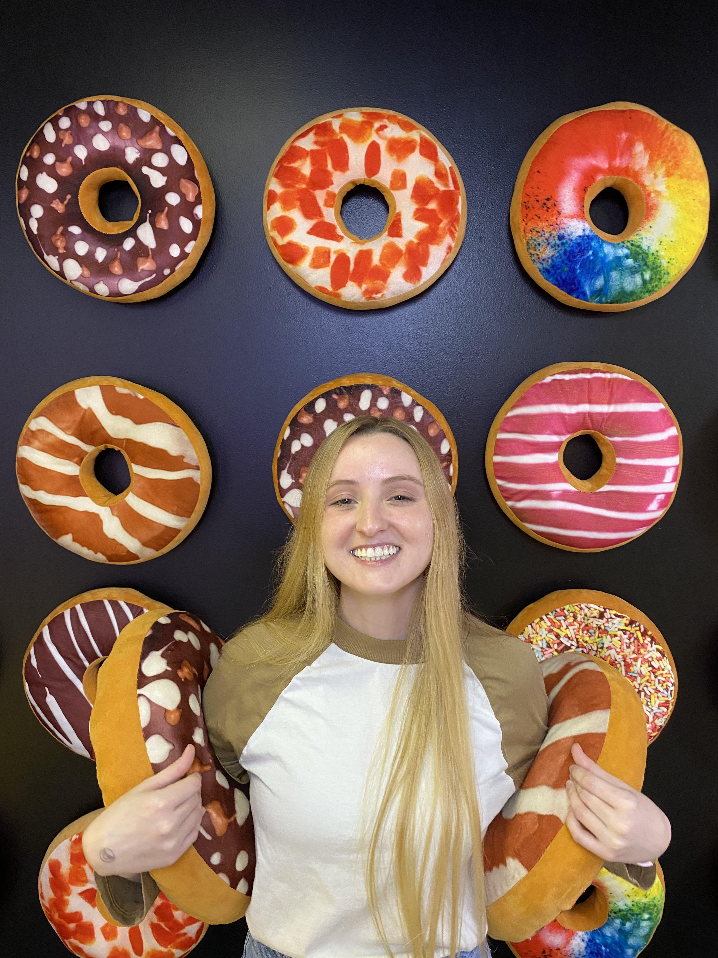
Alumni Connections: Maria’s Story
“Bellevue College has opened doors for me that I never thought possible.
I have had the opportunity to meet people from diverse backgrounds, participate in several clubs including my own, and work with incredible professors who taught me hands-on skills that prepared me for the workforce…Throughout my time in the bachelor’s program I was able to participate in three summer internships including Meta and Microsoft and ended up accepting a permanent position at Microsoft. I am more than happy I was able to attend this amazing college!”
1

Slide 4
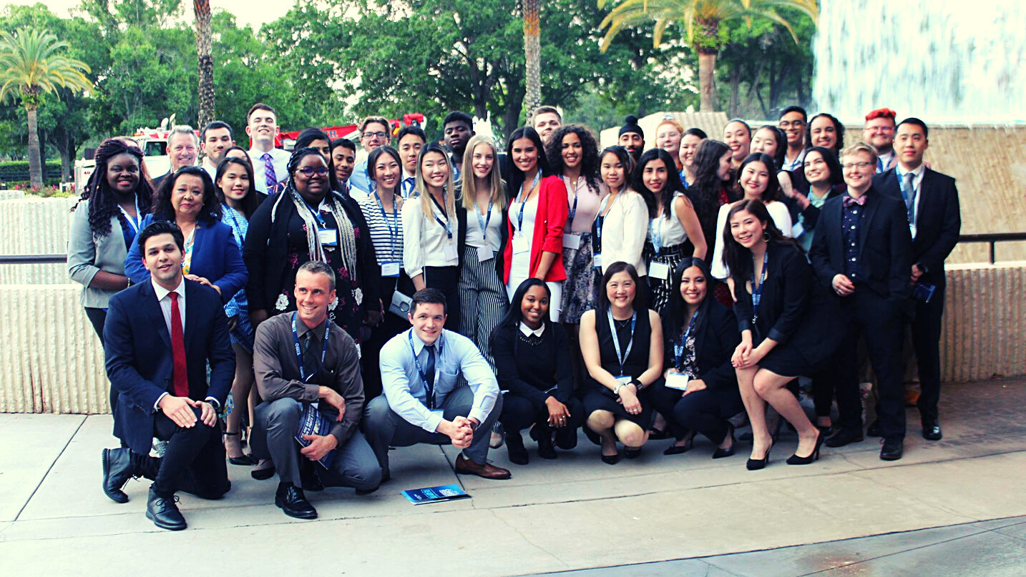
Thank You
Alysa Kelsey Eric Wolf alysa.kelsey@bellevuecollege.edu eric.wolf@bellevuecollege.edu

