Slide 1
Mindshift: Overcoming 5 Barriers to Create The Future of CTE
Notes:
Acknowledge Zoomies and roomies

Slide 2
Today (Element 5 – recruiting, retaining and developing CTE faculty)
Learning objectives:
To identify barriers to success in hiring new CTE faculty
To understand shifting demographics
Six stages of employee life cycle
Co-creating culture intentionally
To consider a mind shift: a “grow your own” formula
Interns from within
Skill bridge programs
EDI in practice partnering with your HR
What does it mean to be inclusive and to create belonging?
Gallup 12
What do Y and Z want at work
Plan a new strategy with your college cohort (break-out rooms) applying these principles

Slide 3
Poll question
Which of these barriers exist for hiring new CTE faculty?
Cumbersome hiring process
Lack of “qualified” applicants
Lack of competitive salaries for people with current industry knowledge
Lack of willingness to try new recruitment strategies
Lack of capacity to pivot quickly to adapt (change fatigue or short-staffed?)
Notes:
Are there any other barriers that I haven’t listed? Please throw them up in the chat for Zoomies and I’ll share them aloud. For the roomies, do we have a roving mic you can raise your hand and share?
These are the top 5 barriers we’re working to overcome and I’ll share my experience of staffing for technical experts in this challenging hiring market.

Slide 4
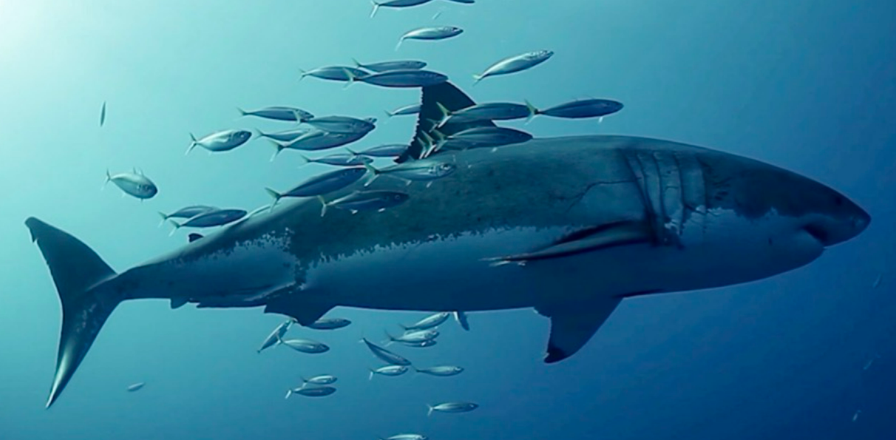
Today’s reality
Labor shortage doesn’t just impact industry; it impacts colleges too
9.8 million job openings in the U.S. but only 5.9 million unemployed workers
The Great Resignation, Great Re-shuffling, and the “War for Talent”
Notes:
https://www.uschamber.com/workforce/understanding-americas-labor-shortage-the-most-impacted-industries
Shallow labor pool
The Health Services, Professional and Business Services, Trade, and Accommodation and Food Services industries have the highest numbers of job openings.
The COVID-19 pandemic caused a major disruption in America’s labor force—something many have referred to as The Great Resignation. In 2022, more than 50 million workers quit their jobs, many of whom were in search of an improved work-life balance and flexibility, increased compensation, and a strong company culture. That follows the 47.8 million who quit jobs in 2021.
Related
The Pandemic Unemployed Survey: Why Americans are Staying Out of the Workforce
Data Deep Dive: The Workforce Impact of Second Chance Hiring
The Future of the Office
But a closer look at what has happened to the labor force can be better described as ‘The Great Reshuffle’ because hiring rates have outpaced quit rates since November of 2020. So, many workers are quitting their jobs—but many are getting re-hired elsewhere.

Slide 5
Problem: Constant Hiring Mode
Notes:
Nearly 47 percent of new employees have left within the first two years
YTC: 320 so far for 2023
My challenges of getting technical industry folks like you of skilled IT workers:
Shallow pool 1 to 3 applicants per recruitment
Failed recruitments
Failure to show up for interviews
Failure to convert from offer to first day (melt)

Slide 6
Posting on LinkedIn Is Not Recruitment
Six stages of the employee life cycle
Do we even talk about the first one?
What is our why for working here?
Are we creating our story well in all stages?
Notes:
Just before I stepped into this role, there were 7 unfilled vacancies, one that is still open, because of the demographics we talked about. Multiply that over
I had to take a hard look to see what we could do differently to attract IT employees, and luckily it coincided with changes happening in district in how we value employees in these stages of the lifecycle.

Slide 7
Mission statement: The Information Technology Division (IT)
deploys strong technical skills and a passion for
improving the lives of students, staff and faculty in a dynamic
teaching, learning, and working environment.
IT puts students first, promotes equity through accessible learning
and information technologies, and provides responsive service with
excellence and integrity.
Notes:
What’s our why?

Slide 8
Barriers | Potential Solutions
Cumbersome hiring process | Eliminate stages in recruitment Partner with HR to change procedure Search Advocate + Hiring Manager Require SA’s to help with “screening in” vs. “screening out” Qualitative screening instrument: 3, yes; 2, reconsider; 1, no
Lack of “qualified applicants” | SA Training: Demonstrable vs. demonstrated competencies Interns from our programs Skill bridge programs with active service Change threshold: “Or equivalent mix of education, training, volunteer and paid experience” Mind the gap, but don’t rule it out
Lack of competitive salaries | Hire and develop for potential and salaries are competitive for beginning career stage professionals where experience is more valuable
Lack of willingness to try new recruitments | Partner with HR for a “pilot” recruitment process; one size does not fit all Talent spotting during internships, last quarters of CTE programs
Lack of capacity to pivot | Think of a future with the same challenges you have if you do nothing. Then start small, gain support, try and fail,
Notes:
Use Head Start as an example of leaning recruitment after search advocate training

Slide 9
What is your culture like to enter?

Slide 10
Gallup 12: Can your team say yes?
I know what is expected of me at work.
I have the materials and equipment I need to do my work right.
At work, I have the opportunity to do what I do best every day.
In the last seven days, I have received recognition or praise for doing good work.
My supervisor, or someone at work, seems to care about me as a person.
There is someone at work who encourages my development.
At work, my opinions seem to count.
The mission or purpose of my company makes me feel my job is important.
My associates or fellow employees are committed to doing quality work.
I have a best friend at work.
In the last six months, someone at work has talked to me about my progress.
This last year, I have had opportunities at work to learn and grow.

Slide 11
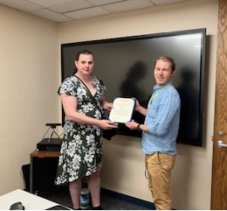
Talent Development
Talent development is the organizational process of positioning employees for career advancement in a way that aligns with the organization’s mission.
This includes identifying workers' aptitude and goals and helping them develop the knowledge and skills they need to achieve those goals and fill the needs of the organization.
Notes:
Core

Slide 12
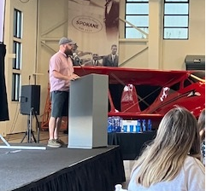
CCS Strategic Priorities 2021-2025
Operational Excellence: Ensuring the continuous improvement of our financial sustainability through on-going academic and student service innovation, consistent data-informed decision-making and the constant pursuit of organizational efficiencies that make us quick to respond to student needs and external opportunities. Employee Success & Excellence: Advancing the engagement and change management capacity of a high-quality faculty and staff through purposeful recruitment, development & retention, consistent standards of performance and accountability, and the relevant, timely and transparent internal communication needed to best serve our students.
Notes:
Core

Slide 13
Show that learning matters
Poll team on what team wants to learn that support strategic plan
Custom trainings with training waivers for HR credit
Partner internally to offer learning for team
Cyberconference 4.28.2023
Tie every learning opportunity to strategic priorities: operational excellence, employee success and development
Notes:
Core

Slide 14
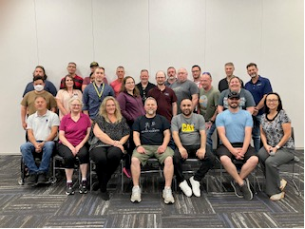
Pilot – IT Talent Development
Individual level –
Strength sort
70/20/10 plan
Baseline interim evaluation
Development plan
Notes:
Core

Slide 15
Pilot – IT Talent Development
Observe baseline year – who does what and how well?
Use the ITPS or contract
Use nonpermanent (classified)
Notes:
Core

Slide 16
“S”
Card sort – 12/14/12
Scrum certification
Lean training
Key screening committees
Mentor informational interviews
Reclass through ITPS
Map out master’s degree
Visibility plan with stretch committee assignments
Notes:
Core

Slide 17
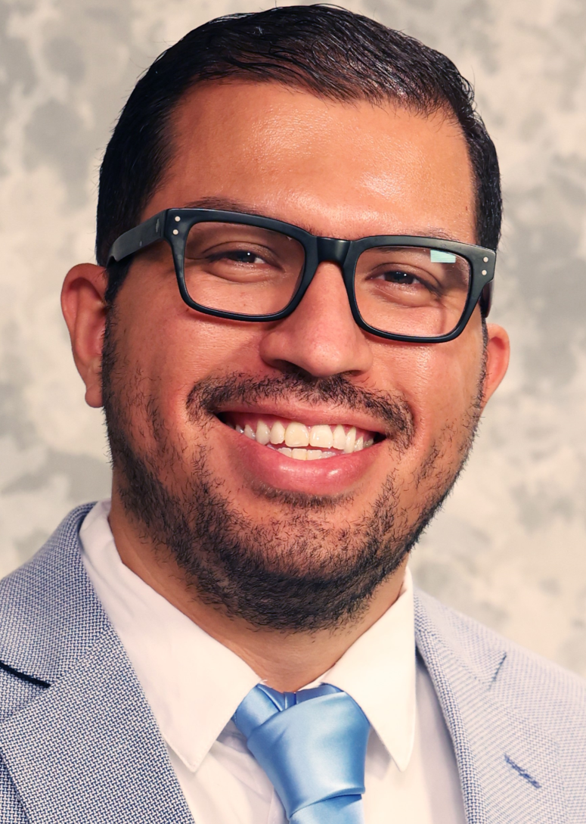
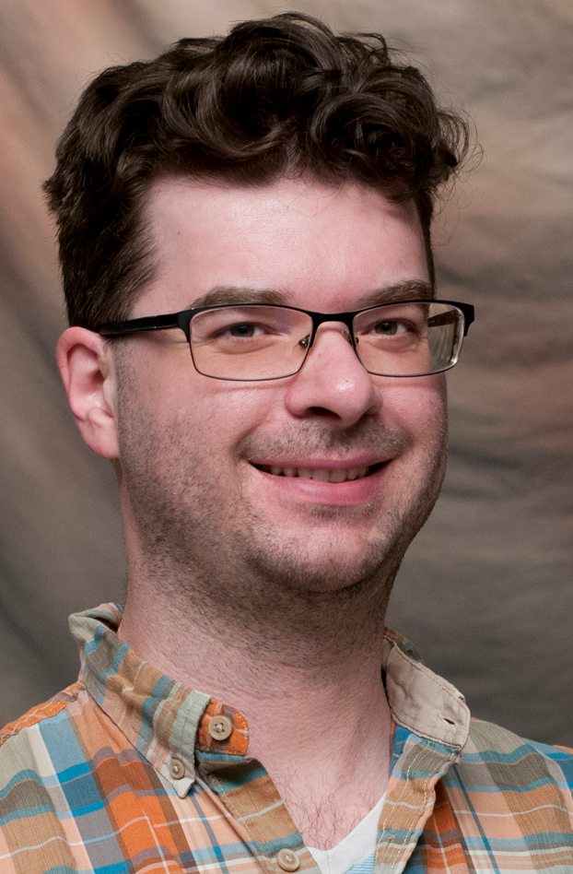
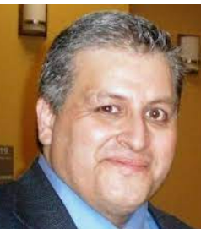
Search Advocate Trainings at CCS
October 27, 8:30 to 4:30 on Zoom
February 2, 8:30 to 4:30 on Zoom
Understand the role of the search advocate in promoting EDI goals for your organization through the recruitment, hiring, and onboarding process
https://www.campusce.net/spokane/course/course.aspx?c=1090
Notes:
Core

Slide 18
Breakout session: Next Steps
Go back to barriers slide and possible solutions
Discussion about what’s possible: Yes, and… (not no, but)
Action items and timeline with assignment
Notes:
Core

