Slide 1
Facilitated by:
Dr. Kevin R Johnson Sr., Senior Advisor
Suela Cela, Senior Policy Associate
August 16, 2023

Slide 2
Meet your group facilitators
Opening remarks
Meeting objectives
Housekeeping items
Review workshop materials
Notes:
Kevin Talking Points:
Introduce facilitator
Introduce host of workshop to provide welcoming remarks and provide context
Provide overview of agenda – general time, lunch, restroom location

Slide 3
Workshop Objectives
Support the CTE community in effectively understanding their data to better identify and close gaps.
Develop and disseminate ready-to-use guides, templates and materials that can be adapted and used by state and local leaders to facilitate a CTE opportunity gap analysis process at the secondary and postsecondary levels.
Build state capacity to use Advance CTE’s opportunity gap analysis tools through a train-the-trainer strategy.
Support state and local CTE leaders to make changes in policy and practice that will improve equity access for under-represented learner populations.

Slide 4
Community Agreements
Should be created collaboratively with all participants
Collaborative ownership encourages vulnerability, engagement and a willingness to learn from each other
Establishes ground rules for creating a collaborative space
Examples:
Commit to being fully present
Assume positive intent
Understand other people’s experiences
Be receptive, not defensive
Notes:
Suela:
Before we engage in Opportunity Gap Analysis, establishing community agreements or a shared understanding of rules and expectations is vitally important to guide the conversation.
Establishing community agreements in a collaborative approach with all participants involved in the process is advisable for your workshops as well. This shared ownership of the space encourages vulnerability, engagement, and a willingness to learn with one another.
We also talk about the opportunity to create safe spaces and also take it to another level to create brave spaces. So what is the difference between each one?

Slide 5
Community Agreements
Assume best intentions - safe space, trust, respect, and all voices are heard
Make connections - build relationships
Act with purpose - action oriented, use time wisely
Communicate challenges
Avoid technology distractions
Virtual: (Mute your sound unless you’re talking) - Virtual
Virtual: (Be present and actively “seen” - cameras on) - Virtual
Notes:
Suela:

Slide 6
Reflective Approach to Equity in CTE
Develop and Implement an Action Plan
Gather Data and Identify Opportunity Gaps
Build Awareness
Select Strategies
Examine Root Causes
Notes:
Kevin Talking Points:
Today’s workshop is grounded in a reflective, data-driven approach to equity in CTE
We start with Building Awareness by discussing why equity is important in CTE and understanding common equity and access challenges in CTE.
Then we Gather Data and Identify Opportunity Gaps, using a proportionality gap analysis with CTE enrollment data to identify opportunity gaps
Once we identify our opportunity gaps, we’ll Examine Root Cause Analysis by leveraging different tools and techniques to investigate opportunity gaps and identify root causes
Then we draw on evidence-based and promising practices to Select Strategies that can help us address root causes
And finally, we Develop and Implement an Action Plan
This approach is represented as a cycle to illustrate that we’re never truly done with the work. As soon as we finish the cycle, we start from the beginning again by gathering and examining our data.

Slide 7
Agenda – Part 1
Agenda item | Time
Welcome and Introductions | 10:30 - 10:45
Community Agreements | 10:45 - 10:55
Program of Study | 10:55 - 11:05
Breakout Session: Strength Based Thinking | 11:05 - 11:20
Percentage-Point Gap Analysis | 11:20 - 11:30
Breakout Session: Identifying Opportunity Gaps | 11:00 - 12:00
LUNCH BREAK | 12:00 - 1:00
Notes:
Suela
Customize this slide to provide an overview of the specific times and flow of the workshop.

Slide 8
Agenda – Part 2
Agenda item | Time
Root Cause Analysis Process | 1:00 - 1:05
Breakout Session: Root Causes Brainstorm and Fishbone Mapping | 1:05 - 1:40
Identifying Practical Strategies | 1:40 - 1:50
Breakout Session: Action Planning for Equal Access | 1:50 - 2:00
Review of Workshop Goals | 2:00 - 2:05
Breakout Session: Action Planning | 2:05 - 2:25
Wrap Up | 2:25 - 2:30
Notes:
Suela
Customize this slide to provide an overview of the specific times and flow of the workshop.

Slide 9
Shoulder Partner Discussion
In breakout groups, discuss the following questions:
Describe your current approach to analyzing data?
What do you wish could be different about how your institution analyzes data with a focus on closing the gaps for special populations and subgroups?
What is a hope you have for this workshop?
Notes:
Suela:
And now, we will break in small random groups, for a quick small group discussion where we will answer the following questions.

Slide 10
Programs of Study - Secondary and Postsecondary Alignment
Introduction:
Collaboration between secondary and postsecondary required in Perkins V
Programs of study alignment is necessary to begin analyzing
Data on enrollment and performance
CLNA
Effective equity analysis
Notes:
Kevin

Slide 11
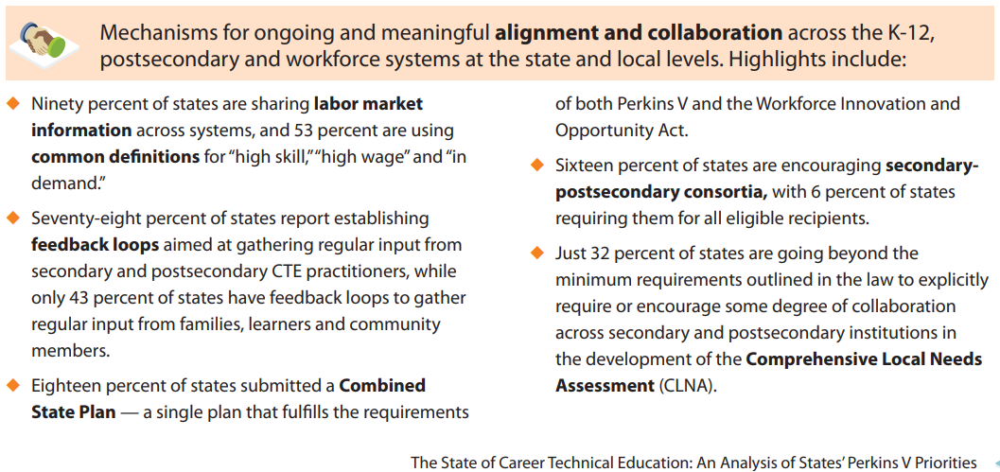
Programs of Study - Secondary and Postsecondary Alignment

Slide 12
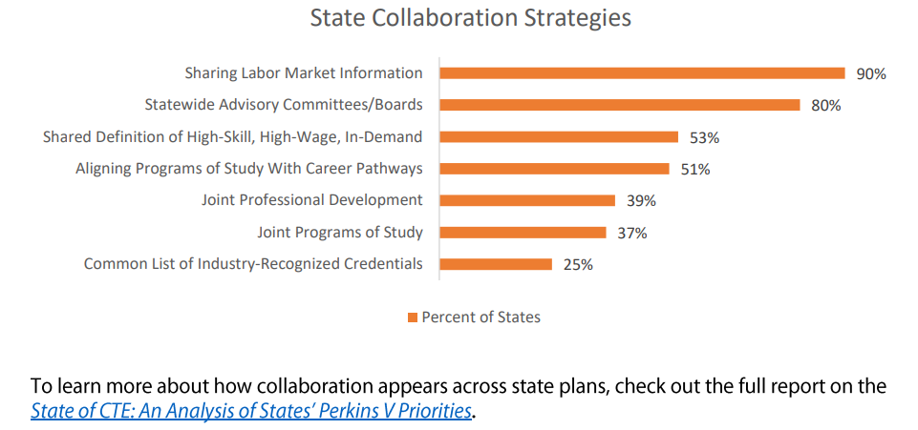
Programs of Study - Secondary and Postsecondary Alignment

Slide 13
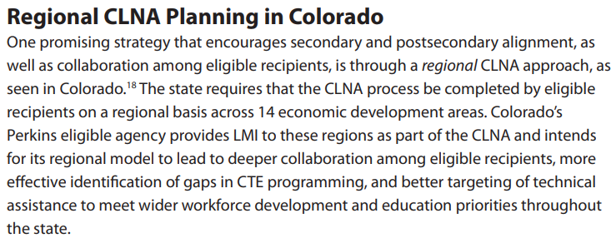
State Examples

Slide 14
State Examples

Slide 15
Putting Equity-Mind Principles into Practice
Deficit-based thinking
Strengths-based thinking
Recognizes and celebrates the diversity and strengths of learners
Identifies systems-level root causes of opportunity gaps
Shifts the blame
Identifies problems with the behaviors/attitudes of learners and families
Reinforces systems of inequity
Notes:
Suela:
Putting equity-minded principles to practice requires a pretty significant mindset shift.
We want to move from a deficit-based thinking, which shifts the blame and points to characteristics of individual learners as the basis of inequities, to strengths-based thinking, which recognizes and celebrates learners’ strengths and acknowledges the role that systems, practices and policies play in reinforcing inequities.
You’ll see an example of this on page 7 of your participant workbook.
Instead of saying “The reason there are only boys in my welding program is because girls just aren’t interested in welding,” we can reframe this statement as ”There are girls in our school who would excel in welding, but they don’t feel welcome in these programs and haven’t been invited in.”

Slide 16
Group Activity
In your breakouts, work together to reframe these statements using a strengths-based lens
Note: Assign a reporter/recorder for a 1-minute per group report out after the breakout session.
Follow along using the handout for this exercise. Record your individual responses.
Notes:
Suela:
In the next activity we’re going to practice this mindset shift.
On page seven you’ll see a list of common statements that you might hear about CTE students and families.
Together with your groups, think about ways to rewrite these statements to focus on the strengths of the learner and reframe barriers as problems of practice.

Slide 17
Percentage-Point Gap Analysis
Looks for parity between learners in the program and the broader population of the community
Reveals whether or not the learners in your CTE programs are proportionally representative of their community
Highlights the programs with the largest disparities
Notes:
Kevin Talking Points:
One way to check for equity and access barriers in CTE is to conduct a percentage-point gap analysis. This means looking at the students who are enrolled in your CTE program to see if they are reflective of the demographics of the broader student community.
To illustrate, imagine that you have a bag of mixed types of candy. If you were to select candies equitably from the bag, you would expect to have an assortment of candies that is in direct proportion to the candies in the bag.
However, if there are other conditions that affect the distribution in the bag – for example, if the candies have shifted around so that all of the kit kats are at the bottom – you might not pull out an equitable representation of candies.
Conducting a percentage-point gap analysis can help you illuminate if there are other conditions affecting access to CTE programs. Looking at the data is the first sign of whether an opportunity gap exists and the size of the gaps.
Of course, this analogy is overly simplistic. Students aren’t candies, and there are a number of other factors that may influence whether or not they enroll in CTE.

Slide 18
Heartland Public School District
10% of learners at Heartland Community College are learners with disabilities
Notes:
Kevin Talking Points:
Doing a proportionality gap analysis requires simple math
You start by calculating the proportion of students in a specific subgroup or special population overall
[Click]
10% of learners in grads 9-12 in Heartland Public Schools are learners with disabilities.

Slide 19
Heartland Public School District
10% of learners at Heartland Community College are learners with disabilities
5% of CTE learners in the Welding program are learners with disabilities
Interpretation: Students with disabilities are under-represented in Welding by 5 percentage points (10% - 5%)
Notes:
Kevin Talking Points:
[Click]
If the CTE programs were recruiting students equitably, we would expect 10% of students in the welding program to be students with disabilities.
However, only 5% of CTE learners in the Welding program are learners with disabilities.
[Click]
We would measure the percentage point gap as the difference in the proportion of all students with disabilities and the proportion of CTE learners in Welding who are learners with disabilities. That value is 5 percentage points. Our interpretation is that learners with disabilities are under-represented in Welding by 5 percentage points.

Slide 20
Heartland Community College
12 high schools
27 CTE programs in 14 Career Clusters®
Geographically, economically and ethnically diverse
Heartland Community College serves a very diverse community
Notes:
Kevin Talking Points:
I am going to walk you through a description of our fictitious school district, Heartland Public Schools, along with an example of data on student enrollment
Heartland Public Schools represents a community that is diverse geographically, economically and ethnically.
It includes 12 high schools and 27 CTE programs across 14 Career Clusters.

Slide 21
Heartland Community College Snapshot
STUDENT GROUP | SEC | % SEC
GENDER IDENTITY
Female | 46,206 | 51%
Male | 44,394 | 49%
RACE/ETHNICITY
Asian | 6,795 | 8%
Hispanic | 28,690 | 32%
Black or African American | 23,405 | 26%
White | 31,710 | 35%
SPECIAL POPULATIONS
Individuals with Disabilities | 12,684 | 14%
Economically Disadvantaged | 34,989 | 39%
English Learners | 4,698 | 5%
Total Enrollment: | 90,600
Notes:
Kevin Talking Points:
This slide represents the demographics of the total grade 9-12 students in the Heartland Public Schools. One would expect that since this represents the demographics of the students in the Heartland Public Schools that the representation of students in CTE programs should be proportionally similar.
While there are other sub-groups and Special Populations used for Perkins disaggregation, for the purposes of this analysis and example, only these the sub-groups and special populations were utilized

Slide 22
CTE Enrollment Compared to Community Demographics by Gender Identity
CTE Enrollment Compared to Community Demographics by Gender
All Learners
51%
49%
CTE Only
49%
51%
0%
25%
50%
75%
100%
FEMALE
MALE
Interpretation: Female learners are under-represented by 2 percentage points in CTE compared to all learners at Heartland Community College.
Notes:
Kevin Talking Points:
This chart compares the proportion of CTE students by gender identity to the proportion of the all high school students at Heartland Public Schools.
Female learners are underrepresented by 2 percentage points compared to all students.

Slide 23
CTE Enrollment Compared to Community Demographics by Race/Ethnicity
CTE Enrollment Compared to Community Demographics by Race / Ethnicity
50%
25%
24%
32%
23%
26%
45%
35%
0%
8%
8%
Asian
Hispanic
Black / African American
White
CTE ONLY
ALL LEARNERS
Interpretation: Hispanic learners are under-represented in CTE by 8 percentage points compared to all learners at Heartland Community College. Black/African American learners are also underrepresented by 3 percentage points, and White learners are over-represented by 10 percentage points.
Notes:
Kevin Talking points:
Looking across racial and ethnic groups, Hispanic learners are underrepresented in CTE by 8 percentage points compared to all 9-12 learners in Heartland Public Schools.
Additionally, Black learners are underrepresented by 3 percentage points, and White learners are overrepresented by 10 percentage points.

Slide 24
CTE Enrollment Compared to Community Demographics by Special Population
CTE Enrollment Compared to Community Demographics by Special Population
50%
25%
51%
39%
20%
14%
1%
5%
0%
Learners with Disabilities
Economically Disadvantaged
English Learners
CTE ONLY
ALL LEARNERS
Interpretation: Students with disabilities are over-represented in CTE by 6 percentage points compared to all learners in Heartland Community College. Economically disadvantaged learners are also over-represented by 12 percentage points, and English learners are under-represented by 4 percentage points.
Notes:
Kevin Talking Points:
We also have data for three special populations at Heartland Public Schools: students with disabilities, learners who are from low-income families (called “economically disadvantaged” under Perkins V), and English learners.
Students with disabilities are overrepresented in CTE by 6 percentage points compared to all 9-12 learners in Heartland Public Schools. This is because 20% of CTE students are learners with disabilities compared to only 14% of the total population.
Economically disadvantaged learners are also overrepresented by 12 percentage points and English learners are underrepresented by 4 percentage points.

Slide 25
Heartland Public School District Program Enrollment Heatmap
Program Name | Popularity | F | M | Asian | Hispanic | Black | White | Dis | ED | EL
Accounting Technology/Technician & Bookkeeping | 4% | -4% | 4% | -8% | -2% | -19% | 29% | -9% | 17% | -5%
Administrative Assistant and Secretarial Science, General | 2% | 49% | -49% | -8% | 4% | 9% | -6% | 57% | 55% | -5%
Applied Horticulture/Horticulture Operations, General | 2% | 10% | -16% | -8% | 7% | 8% | -7% | 61% | 28% | -2%
Architectural Technology/Technician | 3% | -20% | 20% | 8% | -27% | -13% | 47% | -9% | 2% | -5%
Automobile/Automotive Mechanics Technology/Technician | 4% | -38% | 38% | -1% | -18% | 21% | -2% | -2% | -2% | -5%
Business Administration/Management | 4% | 9% | -9% | -1% | -15% | 8% | 8% | -11% | 3% | -5%
Carpentry/Carpenter | 4% | -35% | 35% | -6% | -20% | 7% | 3% | 12% | -1% | -5%
Child Care Provider/Assistant | 4% | 49% | -49% | -6% | 1% | -5% | 10% | 41% | 39% | -4%
Child Development | 3% | 45% | -45% | -5% | 9% | 7% | -11% | 35% | 27% | -5%
Computer Programming/Programmer, General | 5% | -36% | 36% | 10% | -19% | -18% | 27% | -14% | -9% | -5%
Cosmetology/Cosmetologist, General | 5% | 46% | -46% | -8% | -3% | -4% | 15% | 16% | 13% | -4%
Criminal Justice/Police Science | 4% | -38% | 38% | -8% | -16% | 8% | 15% | -11% | 13% | -4%
Culinary Arts/Chef Training | 4% | -5% | 5% | -6% | 9% | -5% | -1% | -7% | 14% | -5%
Digital Communications & Media/Multimedia | 5% | -4% | 4% | -2% | -11% | -16% | 32% | -6% | 6% | -5%
Engineering, General | 5% | -23% | 23% | 20% | -10% | -17% | 22% | -13% | -4% | -5%
Food Preparation/Professional Cooking/Kitchen Assistant | 3% | 9% | -9% | -8% | 3% | 2% | 0% | 70% | 38% | -3%
Health Services/Allied Health/Health Sciences, General | 5% | 25% | -25% | 3% | -18% | -10% | 25% | -11% | 0% | -5%
Landscaping & Groundskeeping | 2% | -43% | 43% | -8% | 14% | -3% | -12% | 51% | 38% | 3%
Logistics, Materials, and Supply Chain Management. | 4% | -14% | 14% | 1% | 2% | -1% | -2% | -2% | 18% | -5%
Manufacturing Engineering Technology/Technician | 5% | -27% | 27% | 24% | -19% | -19% | 14% | -12% | -9% | -5%
Mechatronics, Robotics, and Automation Engineering | 3% | -21% | 21% | 10% | -19% | -1% | 10% | -9% | 31% | -5%
Nursing Assistant/Aide and Patient Care Assistant/Aide | 4% | 43% | -43% | -6% | 17% | 5% | -16% | 36% | 37% | -4%
Radio & TV Broadcasting Technology/Technician | 4% | 5% | -5% | -4% | -16% | 9% | 11% | 2% | -4% | -5%
Restaurant/Food Services Management | 4% | 0% | 0% | -4% | 10% | -8% | -8% | -9% | 21% | -5%
Small Engine Mechanics & Repair Technology/Technician | 1% | -43% | 43% | 1% | -7% | -1% | 7% | 69% | 53% | -5%
Web Page, Digital/Multimedia and Information Resources Design | 6% | 1% | -1% | 4% | -13% | -9% | 18% | -10% | 4% | -5%
Welding Technology/Welder | 2% | -48% | 48% | -8% | -9% | 13% | 4% | -3% | 22% | -5%
 |  | -2% | 2% | 0% | -7% | -3% | 10% | 6% | 13% | -5%
Notes:
Kevin Talking Points:
[Facilitator Note: There are built in animations in this slide.]
Heartland has 27 CTE Programs offered in 14 Career Clusters. The Government and Marketing Career Clusters are not represented.
These range from many traditional programs such as carpentry, business administration, culinary and a ranges of other programs such as Engineering, Mechatronics, computer programming, etc
This slide represents the Heatmap that is generated using the proportionality analysis. There is also a copy of this heatmap in your participant workbook on page 10 if it’s easier to follow along there.
If the cell is light orange, that means students in that subgroup are underrepresented in that program by more than 10 percentage points. If the cell is light blue, that means students in that subgroup are overrepresented by more than 10 percentage points.
[Click]
Example: White students are overrepresented by 47% in Architectural Technology Program while Hispanic students are underrepresented by 27%
[Click]
Hispanic students are underrepresented in the Automotive program by 18% and Black students are overrepresented by 21%
Note: While ELL is not implicated here, remember as a whole this population is underrepresented in the school district and current n size is very small. – That may already be one issue to address for this district
Remember- look at “n” size
Since this chart is also in your workbook, please take a moment and look at it. Are there any other observations that you would like to call out?

Slide 26
Opportunity Gap
An observable disparity in access and/or outcomes for a specific subgroup or special population that results from systemic inequities, implicit biases, stereotypes and outright discrimination based on group identities
Notes:
Kevin Talking Points:
The heatmap illuminates opportunity gaps, or observable disparities in access or outcomes for specific subgroups or special populations.

Slide 27
Understanding Opportunity Gaps
Which is better? To have a program that over-represents or under-represents learners?
It depends!
Opportunity gaps must be examined through the lens of program quality.
Notes:
Kevin

Slide 28
Identify Opportunity Gaps
WHO
Who is most affected?
WHAT
What is the direction of the opportunity gap? What is the degree of the gap?
WHERE
Where does the gap occur?
WHEN
When does the gap occur?
Notes:
Kevin Talking Points:
We want to use the data to identify and describe opportunity gaps. To do this, we want to be sure that we are indicating who is affected by this gap; what is the nature of the gap; and where and when this gap occurs.

Slide 29
Opportunity Gap
Program | F | M | Asian | Hispan | Black | White | Dis | ED | EL
Architectural Technology/Technician | -20% | 20% | 8% | -27% | -13% | 47% | -9% | 2% | -5%
Who | Hispanic learners
What (DIRECTION & DEGREE) | Are under-represented by 27 points
Where | In the Architectural Technology program
When | In the 2018-19 academic year
Notes:
Kevin Talking Points:
For example, if we zoom in on the Architectural Technology/Technician program in the Heartland Public Schools data we can observe a gap in enrollment for Hispanic learners.
These learners are under-represented in this program by 27 percentage points compared to the overall student population.

Slide 30
Observations for Heartland Community College
Hispanic students are under-represented by 15 or more percentage points in 10 of 27 programs
Black students are under-represented by over 15 percentage points in STEM-related programs (Computer Programming, Manufacturing Engineer, General Engineering)
Learners with disabilities are over-represented in five programs by more than 50 percentage points
16 of 27 programs have an over-representation of economically disadvantaged learners’
Notes:
Kevin Talking Points:
Here are some additional observations and opportunity gaps at Heartland Public Schools.

Slide 31
Limitations of Data Analysis
Only looking at one year of enrollment
Not looking at performance — that is another discussion but similar process
N-size differs by program
Different levels of data expertise
Might not have all perspectives present today
Notes:
*** Customize to fit your data. You may want to add notes on data limitations if necessary.***
Kevin Talking points
Enrollment patterns can shift dramatically from one year to the next. On a state scale, these fluctuations won’t change the analysis much, but there can be significant shifts at the local level. If possible, consider using three-year averages for your dashboard to account for these fluctuations.
This dashboard – and the workshop – is focused on CTE program enrollment, which can help evaluate equity of access but not equity of outcomes. Further data analysis is needed to identify if learners are being supported equitably within their programs and whether they are transitioning equitably into further education, employment or other pathways.
Small enrollment counts by population or program could have an outsized impact on the data. As a general rule, be cautious of any cells smaller than 5 and any programs that enroll fewer than 20 students. The dashboard is designed to automatically identify programs with fewer than 50 students.
We also want to acknowledge the different data expertise represented in the room. This exercise shouldn’t require a great deal of expertise, but feel free to ask questions about the data if you have any.
And finally, we realize we might be missing some valuable perspectives that can help add context to what we’re seeing in the data. One of our objectives for today’s workshop is to identify other stakeholders we want to hear from to get a better understanding of what we’re seeing in the data.

Slide 32
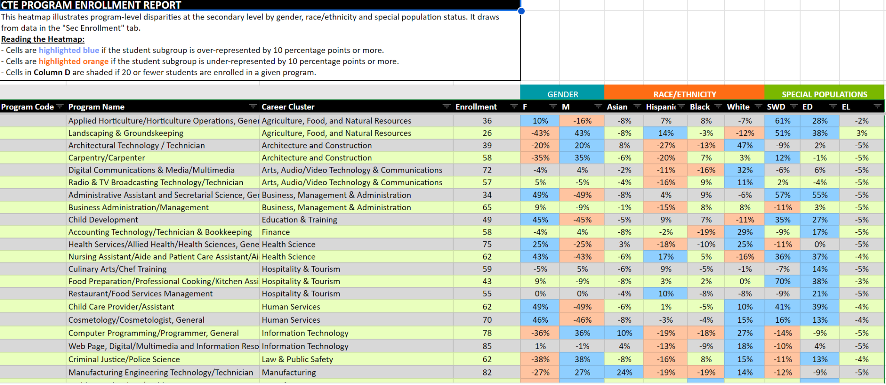
Notes:
Kevin

Slide 33
Group Activity
Considerations for identifying opportunity gaps
Do you see any gaps in the most popular programs (those with the highest enrollment)?
Which programs have the most sizable gaps?
Do any programs have a compromising n-size (20 or fewer)? Do not spend too much time on these.
Are any gaps unexpected and/or not currently being addressed?
Are there programs with opportunity gaps for multiple subgroups?
Do not focus on causes of problems — provide statements supported by data
Notes:
Kevin Talking points
As you go through this process of identifying opportunity gaps you might notice that there are a lot of disparities across programs and subgroups – but don’t panic.
It helps to start by prioritizing the most urgent opportunity gaps that you want to examine. Here are a few considerations to help you focus your examination of the data.

Slide 34
Group Activity
Using the secondary mock data dashboard in in your breakouts
Select a reporter/recorder in your group
In small groups, examine your data dashboard, answer questions and identify three opportunity gaps
Facilitators will keep a record of the “gaps” identified in each breakout group to use for Day 2 (Group will select one gap for Day 2)
Secondary Mock Data Spreadsheet Handout
Notes:
Kevin Instructions
Split participants into groups by table
Ask them to open their workbook to page 12
Take time together as a group to examine the data, answer these questions and identify three opportunity gaps.
Encourage participants to look beyond the gender disparities. We know these still exist and these have been the long-term focus of Perkins. Instead, look at the range of disparities.

Slide 35
BREAK

Slide 36
Revisiting Community Agreements
Spread glitter, not shade
Cultivate a safe space to share without judgment
Make space, take space
There are no bad ideas
Commit to being fully present
Commit to defining acronyms
Assume best intentions - safe space, trust, respect, and all voices are heard
Make connections - build relationships
Act with purpose - action oriented, use time wisely
Communicate challenges
Avoid technology distractions
Virtual: (Mute your sound unless you’re talking) - Virtual

Slide 37
Root Cause Analysis
Industrial Approach to Root Cause Analysis
Notes:
Kevin Talking points
Root cause analysis comes out of an industrial mechanical environment, but it is a valuable process to use when trying to understand causes for opportunity gaps in education.
This diagram shows how the industry applies this problem solving approach. It applies logical and critical thinking along with analytical skills to identify the deepest causes of a problem. By clearly defining the problem and causes or factors that led to the problem in the first place, you can more easily address the roots instead of applying an impermanent “band-aid” solution to the symptoms.
In education, however, there are usually multiple causes of a particular challenge or issue rather than a single root cause. While we still follow the same process outlined in this chart, it is important to consider multiple root causes and how they may compound one another.
It is important to identify the problem with data and more thoroughly define and understand this problem – or in our case- the opportunity gaps in order to further understand and resolve underlying causes.

Slide 38
Root Cause Analysis
What we can observe
The deeper, underlying causes we cannot see
Notes:
Kevin Talking points
A root cause analysis method of problem solving is designed to uncover the deepest root(s) and causes of the opportunity gap.
If you think of the term ”root cause” as an analogy to a weed, consider that you must dig deeper to get to the root in order to eliminate a weed. If you focus only on the symptom of the problem, in this case to keep the weed from growing back, you will not eliminate the problem. You must dig deeper. These deeper roots may not be obvious, but they are often the underlying cause that is creating the “symptom” – in this case the weed. These causes would need to be addressed in order to correct the symptom or result in a reduction of the symptom.
When you are analyzing your data, you have identified an opportunity gap, which is the symptom. The opportunity gap is a signal that something might be happening below the surface that is causing inequities. We must dig deeper to identify the underlying causes.
In complex social systems, such as schools and colleges, you will typically find that there is not one single root cause; rather, you’ll find that the root of any “opportunity gap” is actually a system of causes when you begin to break it down into parts. Often clusters of causal factors contribute to the problem.
It’s important to note that root cause analysis can also be used to understand causes for “positive” symptoms. For example, if there are specific programs that you have in your school or college that are proportionally represented by all sub-groups, you may want to explore the reasons for this. Perhaps these conditions can be replicated to impact other areas in your school/college.

Slide 39
Root Cause Analysis
One of the most challenging aspects of root cause analysis is the ability to be open and honest in a safe, collaborative environment.
This climate will foster true examination of causes which may be uncomfortable, including issues of climate, organization and instructional quality. *
* http://ccsd.net/resources/aarsi-school-improvement/pdf/planning/school-improvement-planning-basics-root-cause-analysis.pdf
Notes:
Kevin Talking points
For the root cause analysis process to work, you must be willing to be open and vulnerable, but this can easily become a stumbling block.
It is important for school and institutional leaders to foster a safe, collaborative environment in which all participants can be open and honest.

Slide 40
Implicit Biases
The unconscious implicit attitudes, reactions and stereotypes that can affect one’s behavior or understanding.
Example: Recommendations for programs of study based on assumptions about a learner’s interest based on special populations and subgroups.
Learning about implicit biases, particularly biases that do not align with your true values, intentions or beliefs, is important to interrupt or prevent them from affecting decisions about policy or practice.
Notes:
Kevin talking points:
But it is important for everyone coming into this conversation, that we have biases, because everyone has biases.
These can be conscious or unconscious biases. The unconscious biases are also known as implicit biases - the unconscious attitudes, reactions, and stereotypes that affect behavior and understanding.
It is important to be aware of our implicit biases, particularly biases that do not align with our true values, intentions or beliefs in order to interrupt or prevent them from impacting decisions about policy or practice.
Examples of implicit biases in education are assumptions instructors can hold about a student’s learning behaviors and their capability for academic success, which are tied to their identity and/or background.
In CTE, these biases may show up in the way school counselors and administrators provide counseling and advising services and recommend programs of study.

Slide 41
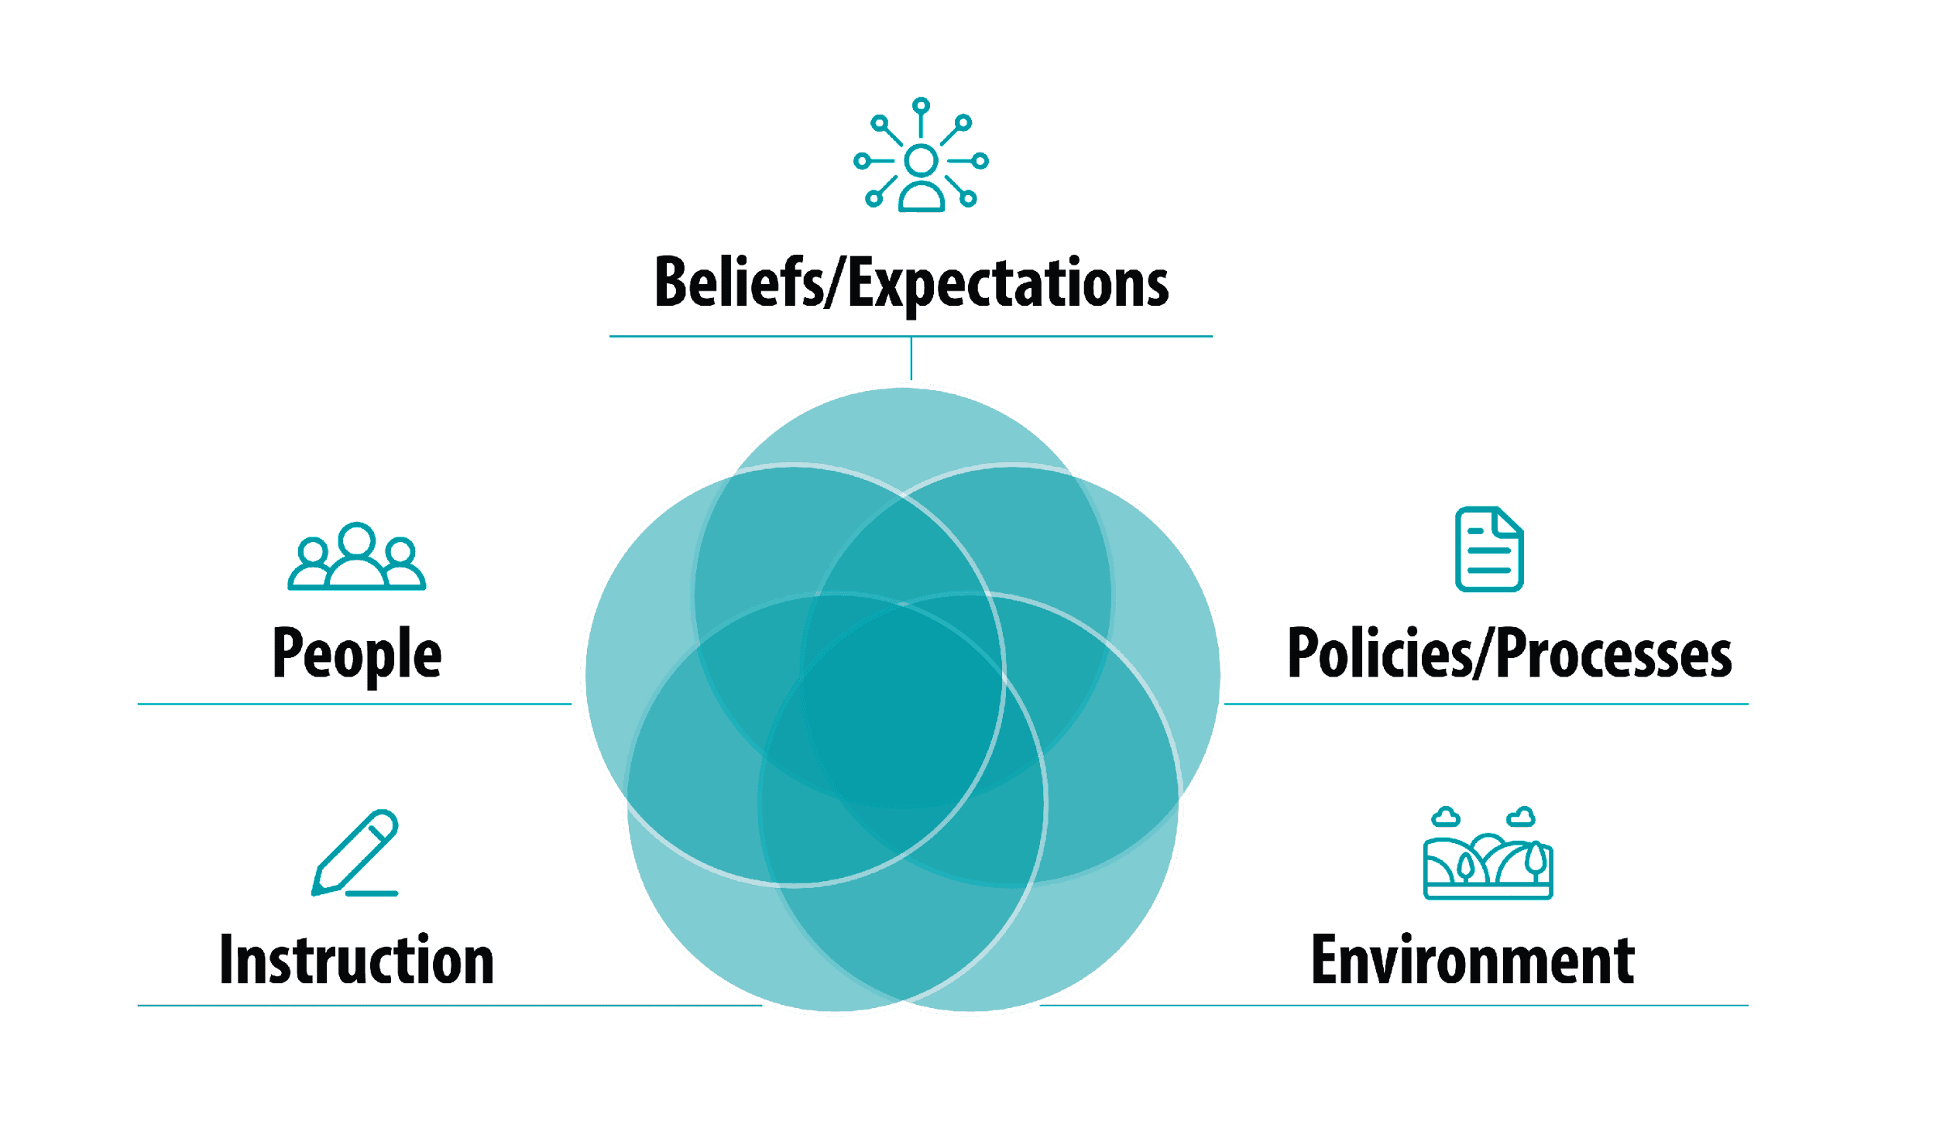
Root Cause Themes in CTE
Think about systems — not blaming people
Notes:
Kevin Talking points
As we consider root causes we want to be sure that we are examining “systems” and not looking to blame people or groups. Systems are composed of an organized array of interdependent and interacting components. Let’s explore how we may be able to organize some root causes. This diagram shows several different categories that can be considered. Note that these categories are overlapping.
Beliefs/expectations include the expectations and values in relation to CTE itself and/or to specific learner groups. This is where we may see implicit bias, CTE stigma or stereotypes about particular groups.
Policies/processes include state, district and/or institutional policies and procedures that create barriers to access or success in CTE programs. This may include admission requirements, scheduling and funding limitations.
Environment includes the geographic and/or socioeconomic factors that impact access and/or prevent learners from realizing their educational and career goals. This may be lack of access to equipment, financial barriers, transportation, etc.
Instruction includes barriers related to teaching and learning in the CTE classroom such as lack of accommodations for students with disabilities, bias in the curriculum or insufficient preparation prior to entering CTE program.
People includes barriers related to staffing such as insufficient school counselors or career advisors; shortage of qualified teachers and faculty and/or lack of diversity in the CTE teacher workforce and among industry partners.
Again, these are not discrete categories. There may be root causes that fit into many of these areas. These are examples to spur brainstorming to ensure that you are considering causes from several angles.

Slide 42
Example: Heartland Community College
Opportunity Gap: Hispanic learners are under-represented by 27 percentage points in the Architectural Technology program in the 2018-19 school year
Possible root causes:
Hispanic families are not aware of this CTE program
This CTE program is not located in the communities where most Hispanic families reside
Recruitment material for this program is provided only in English
The high school where this program is located has only one part-time Hispanic instructor
Notes:
Kevin Talking points
Let’s go back to our example from Heartland Public Schools.
We’ve observed a sizable gap in participation of Hispanic learners in the Architectural Technology Program.
Here are some potential root causes for this opportunity gap.
At this point, we’re just brainstorming ideas. Later we’ll want to validate our potential root causes with additional data or by gathering new information.

Slide 43
Organizing Ideas
The high school where this program is located has only one part-time Hispanic instructor
Recruitment material for this program is provided only in English
This CTE program is not located in the communities where most Hispanic families reside
Hispanic families are not aware of this CTE program
Notes:
Kevin Talking points
You currently have a pile of post-it notes with ideas from a number of different perspectives. We are going to work on a process to begin to organize these in a meaningful way to help explore these root causes.

Slide 44
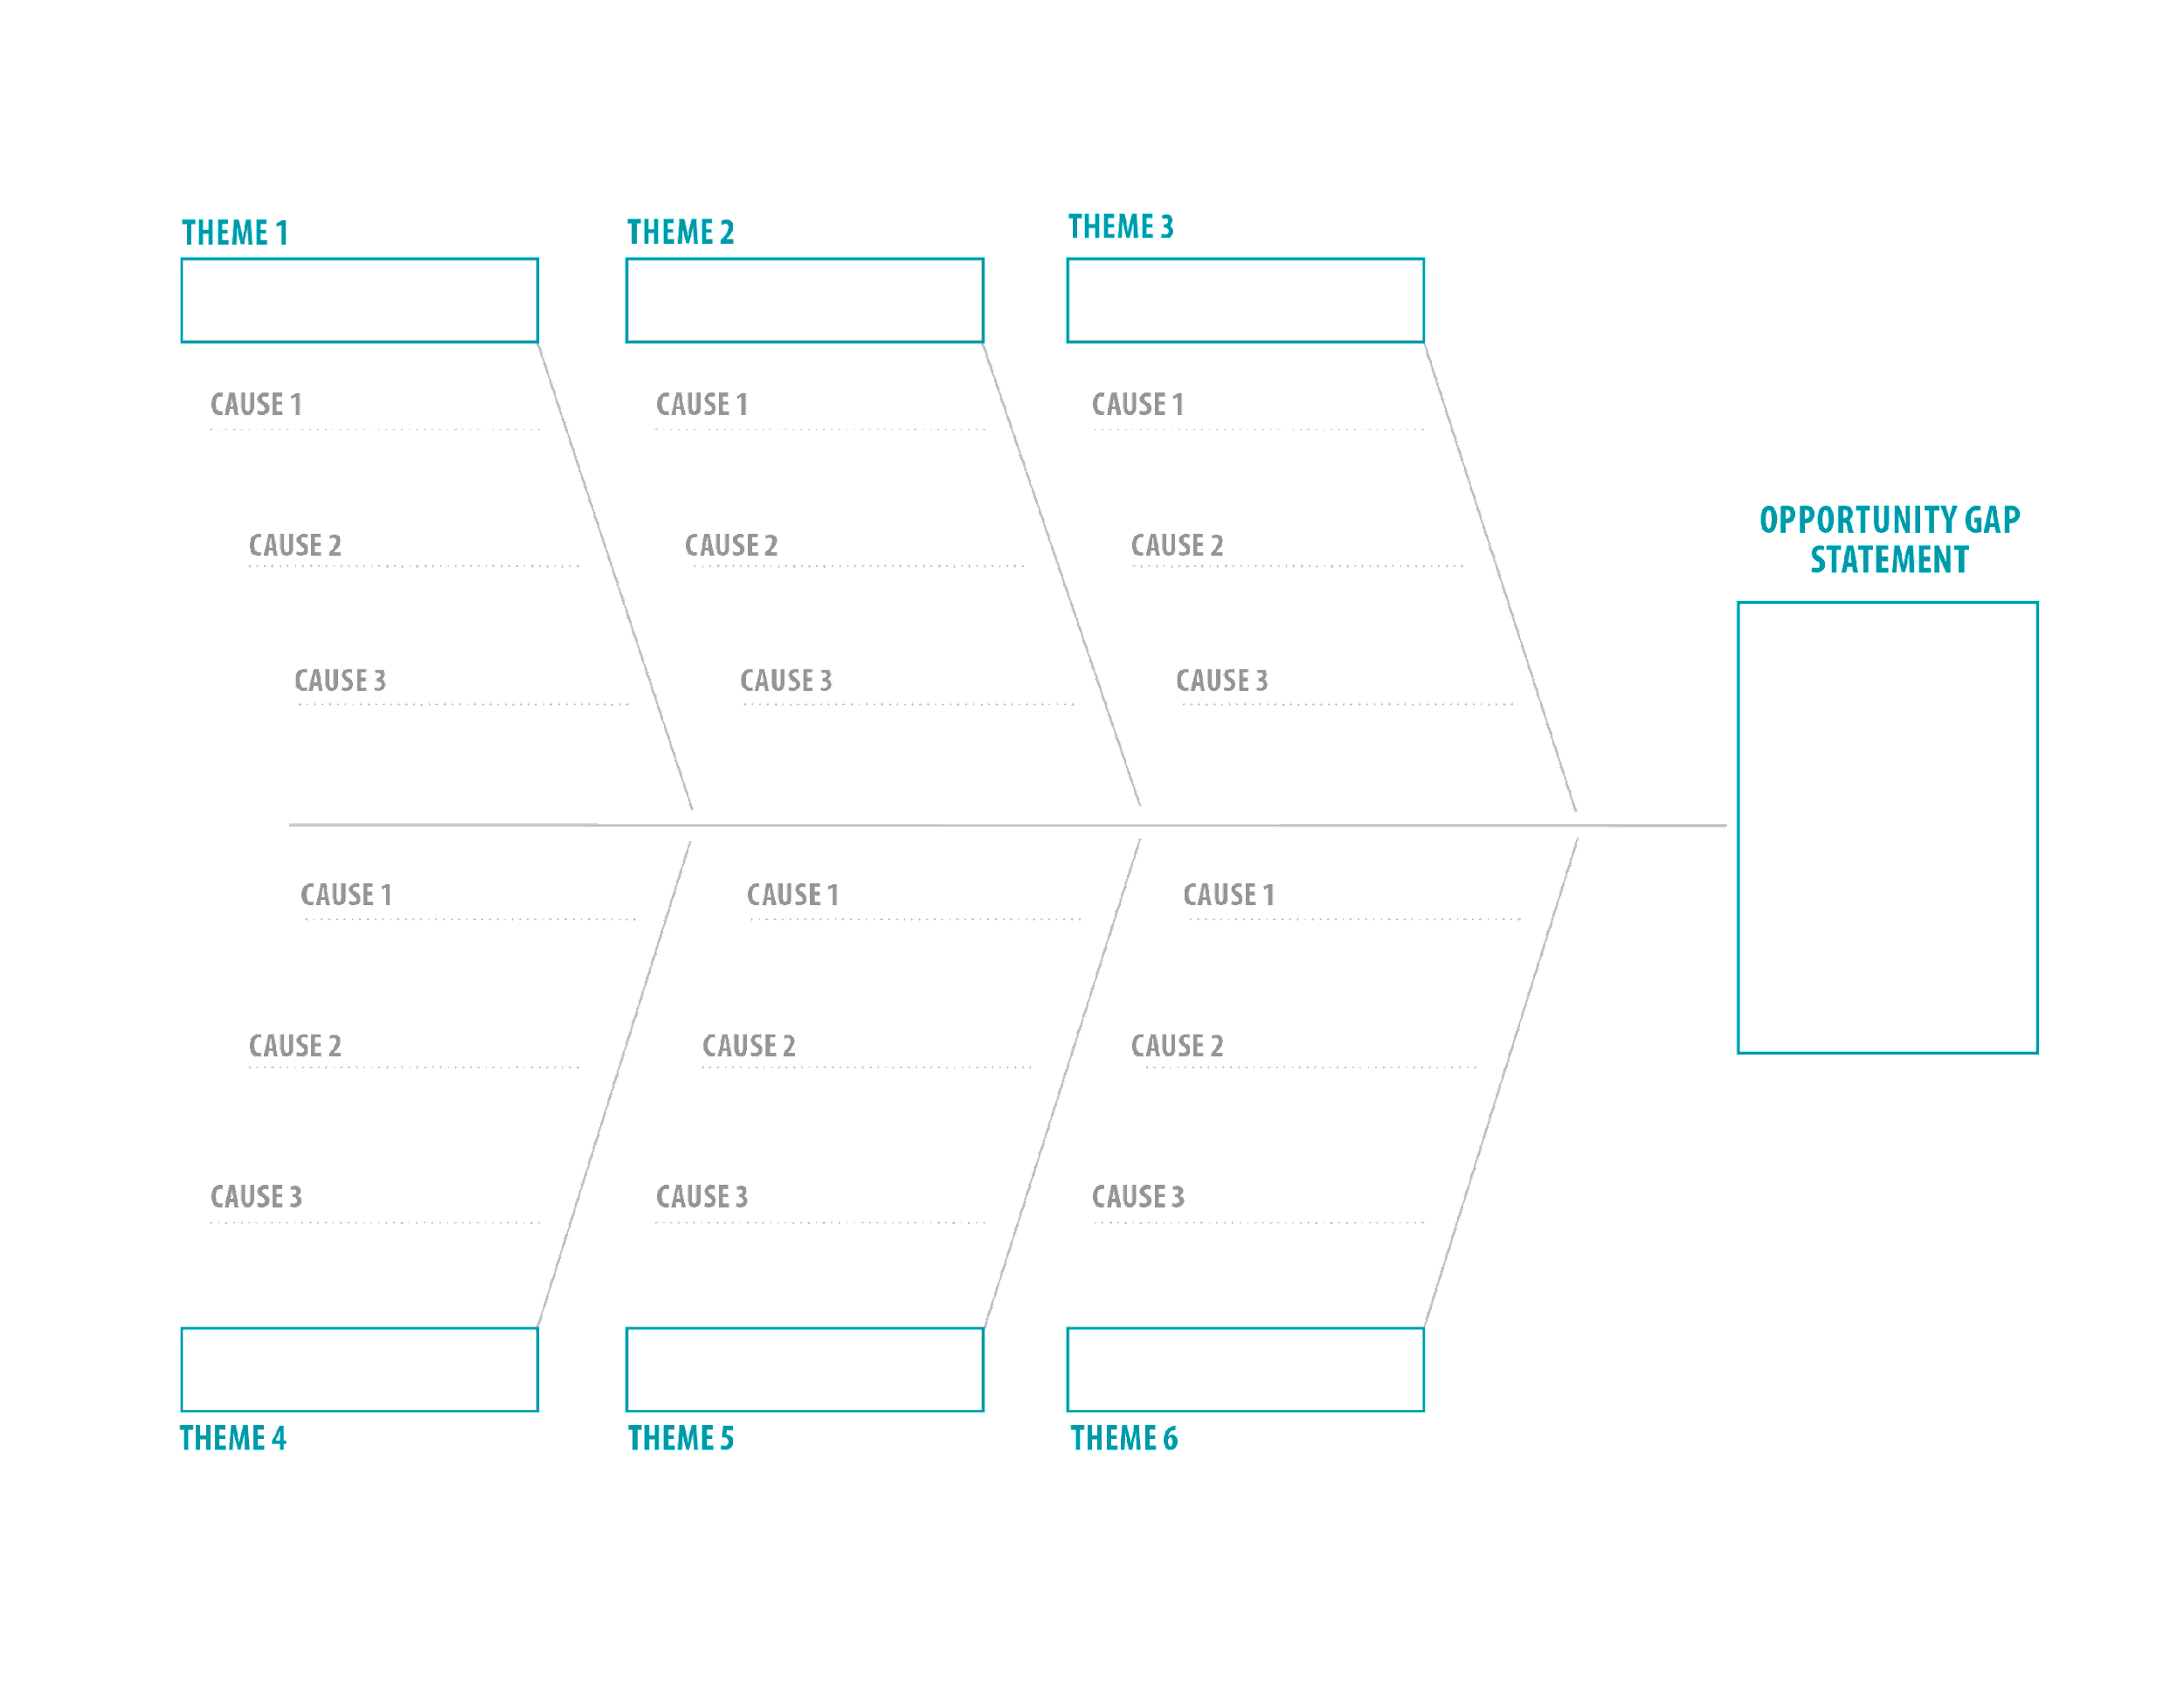
Fishbone Diagram
Notes:
Kevin Talking points
We are now going to use a fishbone diagram to organize these identified possible causes and further understand what other underlying issues need to be examined.
A fishbone diagram is a visual tool used in a collaborative manner to organized and dig deeper.
In this example, there are six different categories where you can organize your ideas from these individual notes. We will look at an example from the Heartland Public Schools data to demonstrate how this can be done.

Slide 45
Heartland Community College Fishbone Diagram
Notes:
Kevin Talking points
When a group from Heartland Public Schools looked at the ideas they had generated, they began to organize them on the fishbone diagram to look for themes.

Slide 46
Dig Deeper — Ask Clarifying Questions
How do you know this?
What does that mean here?
Why is this so?
Notes:
Kevin Talking points
Digging deeper requires you to ask questions of one another to seek understanding about root causes. These are some examples of questions that can help you drill down further in identifying causes that may be below the surface.
There is a protocol called “Five Whys” which is often used to do this. The process is pretty straightforward: Once you identify a challenge, assemble a team of individuals familiar with the challenge and ask a series of “Why” questions to get a deeper understanding of the root causes.
There are other types of open-ended questions that may yield further information to move this to a deeper discussion. As you are posting and organizing your notes, question one another. Seek understanding.

Slide 47
Clarifying Questions — Heartland Community College
Root Cause: Hispanic families are not aware of this CTE program
Digging Deeper:
Informational sessions are limited
Information is not provided in Spanish, and there are no translators available
Limited transportation is available in the evening
The admission requirements for this program are not clear
This program is available only in one school
College counselors do not have information on this program
Notes:
Kevin Talking points
This is an example of some of the information uncovered by the Heartland Public School discussions with their fishbone diagram as they asked questions regarding the statement “lack of awareness of this CTE program among Hispanic families.”
As they asked “Why?” and “Why is that so?” some of these other thoughts bubbled up to explain the root cause.

Slide 48
Validating Assumptions
What data do you have or need (CLNA, surveys, etc.)?
Whom will you need to follow up with?
What policies may need to be explored?
Notes:
Kevin Talking points
As you dig deeper and identify potential root causes, you want to also be sure that you are validating your assumptions.
What data to you have that supports these statements? What data do you need? Is there data available from your Perkins V comprehensive local needs assessment to support these statements? Are there certain individuals or groups that you may need to follow up with to ensure your assumption is correct? And, most importantly, if there are statements made that are due to policies and/or processes, what information do you need? Are you sure you have an understanding of the policy?

Slide 49
Group Activity
Work together to brainstorm on root causes (first 10 -minutes and organize root causes onto the fishbone diagram (final 10-minutes). Facilitator will guide you through each activity:
As you do so:
Ask clarifying questions
Check your assumptions
Consider need for other data, people and policies
Using a large post-it and sticky notes, work in groups of 3 - 5 participants to record responses.
Notes:
Kevin Talking Points
Have participants use the flip chart with this fishbone diagram to organize the post-it notes with root causes into various themes.
Individuals may read their individually-generated ideas and collaboratively discuss possible ways to organize these on the diagram. Try to group these into categories related to systemic barriers.
Participants may also realize that you haven’t gone deep enough with your initial post-it note ideas and may need to add more. This should be an iterative process that generates more ideas with your discussion.
Participants should not look for solutions as this point; rather, they should try to uncover as many possible causes for the gap as possible.
As participants are posting and explaining their ideas, their group should be asking clarifying questions as needed to help them dive deeper into root causes. This is an active and collaborative process. Each group may have their own style of approaching the notes, but everyone is encouraged to participate.
Everyone should also refer to their workbook to record information on other stakeholders needed to consult with, other data to explore and other policies that may need to be reviewed.

Slide 50
Report
State the opportunity gap discussed
Discuss one or two root causes
What did your deeper questioning yield?
What people, data or policies need to be included?
Notes:
Kevin reviews this slide

Slide 51
Practical Strategies
Challenge
Solution
Advising
Timing
Mapping tools
Information flow
Peer communication
Sustained, non-intrusive contact
Stigma
Rebranding
Addressing parents’ concerns
Enrollment criteria
Bridge programs
Set-aside seats
Soft skills
Training in soft skills
Social networks
Adult and alumni mentors
https://www.mdrc.org/sites/default/files/CTE_Equity_Brief_2019.pdf
Peer support and check-ins
Employer preparedness
Training employers to work with young people
Addressing deficit language
Notes:
Suela Talking points
The MDRC report we have shared with you as part of the workshop materials includes a number of different strategies at use locally. The report draws on interviews with local practitioners to identify strategies for addressing common equity challenges in CTE.
Some of these challenges may resonate with some of the discussions you had in the breakout groups.
We’ll have some time in small groups shortly to go through some of these strategies.

Slide 52
Group Activity
Review your group's selected root causes and identify practical strategies from the provided practical strategies list, you plan to use to address the opportunity gaps identified.
Share the strategies your group selected to address opportunity gaps
What was your group’s rationale for at least one of the strategies selected in a one-minute report out to the whole group?
Use the list of practical strategies and the action planning handout in breakout groups of 3 - 5 participants.
Notes:
Suela Talking Points:
Have participants use the flip chart with this fishbone diagram to organize the post-it notes with root causes into various themes.
Individuals may read their individually-generated ideas and collaboratively discuss possible ways to organize these on the diagram. Try to group these into categories related to systemic barriers.
Participants may also realize that you haven’t gone deep enough with your initial post-it note ideas and may need to add more. This should be an iterative process that generates more ideas with your discussion.
Participants should not look for solutions as this point; rather, they should try to uncover as many possible causes for the gap as possible.
As participants are posting and explaining their ideas, their group should be asking clarifying questions as needed to help them dive deeper into root causes. This is an active and collaborative process. Each group may have their own style of approaching the notes, but everyone is encouraged to participate.
Everyone should also refer to their workbook to record information on other stakeholders needed to consult with, other data to explore and other policies that may need to be reviewed.

Slide 53
Accomplishments
Identified opportunity gaps
Completed root cause analysis
Documented need for additional information
Identified evidence-based practices
What’s Next?
Notes:
Kevin Talking points
This group has accomplished so much today.
We’ve taken a deep dive into exploring opportunity gaps, in completing a root cause analysis process and identifying other information that can contribute to this work.
This may seem like a daunting task and indeed this work is a process that takes dedication and commitment. But where do you begin? What’s next?

Slide 54
Action Planning for Equity
Nobody builds a house overnight — you have to start with the first brick
Notes:
Kevin Talking points
It’s easy to identify challenges. What takes real hard work is identifying practical solutions and implementing an action plan that results in systems-level change.
Yet every building starts with laying the first brick. For the action planning process, we want to create a blueprint, gather our bricks, and start with the first steps.

Slide 55
Group Activity
Reflect on the opportunity gaps, root causes and practical strategies we have discussed today
In your breakout groups, discuss: (15 min)
Individual actions you can take to address opportunity gaps
Discuss next steps for applying the workshop materials in your region
Complete the workshop planning document for your group.
Share Out - Full Group: (5 min)
Share how you plan to apply the workshop materials in your region
20 min
Using the workshop planning handout, begin the process of identifying who you will offer this training to, a pilot with staff or an LEA/stakeholders.
Notes:
Suela
Facilitator Note: Update the red text in the slide with your school, district, college, agency or state name. To prepare for this activity, post flipcharts around the room. Write a reflection question at the top of each flipchart.
Half of the charts should say: “What actions can I take individually to address the opportunity gaps identified in this workshop?”
The other half should say: “What actions can [my school/district/college/agency/state] take to address the opportunity gaps identified in this workshop?”
Talking points
As you begin to think about planning next steps and implementing some of the strategies you identified, you may want to revisit your workbook and consider some of the things you have discussed and uncovered. There may be some easy first steps that require a minimal effort and there may be larger issues that are going to require significant input from others who have not been involved here.
Regardless, there are probably some actions that you can take as an individual based on your current role. Let’s take a few minutes and reflect on some of these actions that you or your institution can take.
As you reflect, document some individual and collective action steps on the flipcharts around the room. Make sure you leave time at the end to review your colleagues’ responses and add questions, responses or agreements.
We will use this information to prioritize action opportunities and create the building blocks for an equity action plan.

Slide 56
Closing Thoughts
“This work happens in your heart, in your head and in your hands. The work is never done. Mistakes will be made. That is okay. We are all learning and endeavoring to do better.”

Slide 57
Wrap Up
Congrats to our participants for completing the Opportunity Gap Workshop training!
Any lingering questions?
Evaluation
Notes:
Kevin Talking Points
Acknowledge efforts and reflect on progress
Acknowledge the effort of all participants during this workshop and encourage them to continue with these efforts.
Thank the host and/or organizer of the day’s workshop.
Identify specific next steps (may vary depending on organizer)
Provide opportunity for the organizer of the workshop to provide closing comments and/or explain specific next steps for the group.
Inform the participants of any specific follow up materials they may receive (example: copies of PowerPoint Slides; copies of fishbone diagrams).
Ask if there are any final comments.
If applicable, provide contact information for facilitator(s) or organizer.

Slide 58
Contact:
Dr. Kevin Johnson
kjohnson@careertech.org
Suela Cela
scela@careertech.org
careertech.org
@CTEWorks
301-588-9630
Notes:
Speakers contact information

