Slide 1
3P1
Multi-pronged approach to increasing
non-traditional enrollments
For incremental, compounding successes
over time

Slide 2
Partner with community Create a sense of belonging Create peer community and support Invest in and build their professional development and networks
Continuous multi-faceted, multi-year strategies

Slide 3
Don't do it alone! Collaborate with community
Partner with organizations committed to increasing diversity in traditional careers
Results: Airport Career Pathways Project launched in Fall 2019 and by Fall 2022, a faculty shared that out of 24 students in his class alone, seven were females and 21 of the 24 were students of color!
Highlight: Port Jobs (excerpt from mission) Port Jobs works as an equity-focused partner with community members and employers to build diverse, equitable and inclusive aviation career pathways to living wage jobs. We foster an environment where all jobseekers and workers are welcome and supported. Port Jobs provides high quality career development resources and works with community-based organizations to address structural inequities that limit community members' efforts to prosper.
Marketing videos
Supporting Equitable Access to Aviation Careers: https://www.youtube.com/watch?v=8VKj2wL_CB4​ Introduction to Aviation Maintenance Technology AMT Program: https://www.youtube.com/watch?v=cF3P8XJQOVU​

Slide 4
Create a sense of belonging in structure and design
I-BEST programs: While designed for ELL and basic skills support, the model supports a range of nontraditional learners in a specific program or field; also creates a more cohesive sense of belonging for students when blending them with "traditional" students
Female hires/ representation in key positions: including program faculty, I-BEST faculty, navigator, advisors
PROGRAM SNAPSHOT ​​ | Non-traditional Faculty | I-BEST program
​ | ​ | ​
AUTOMOTIVE ​* | ✓​ (Tenure track) | ✓
AVIATION | ✓ (Tenure track) | ✓
BUSINESS OPS​ | ✓
CULINARY ​ | ✓ | ✓
DIESEL & HEAVY EQ​ | ​​ | ✓​ (1st qtr shared with Auto)
LANDSCAPE HORT​ | ✓ (Tenured) | ✓
WELDING​ | ✓ (Newly Tenured) | ✓
* Another female PT faculty works in K-12 feeder so provides additional awareness and continuity for prospective students

Slide 5
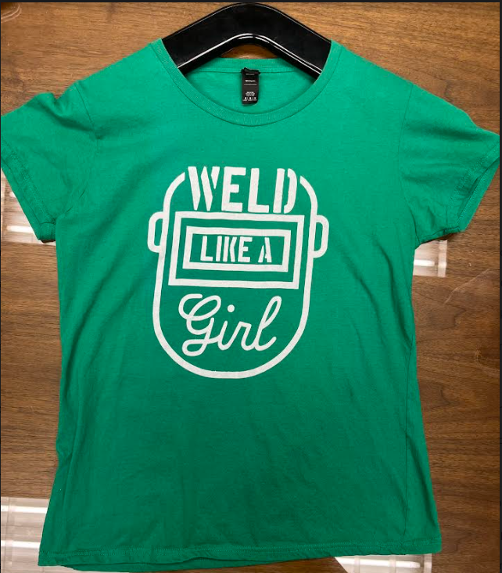
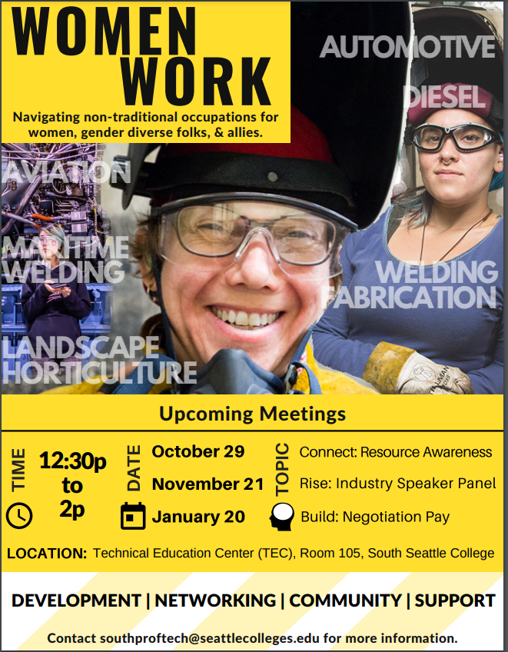
Create peer community and support
inside and outside the classroom
Empower their classroom experience: Female student designed these shirts for classmates when they completed Maritime Shipyard Welding program
Affinity Groups: Launched a Women & Allies in Trades Student Group
Build Scholarships: Partner with Foundation for specific supports and requests = Creation of a Women in Workforce fund

Slide 6
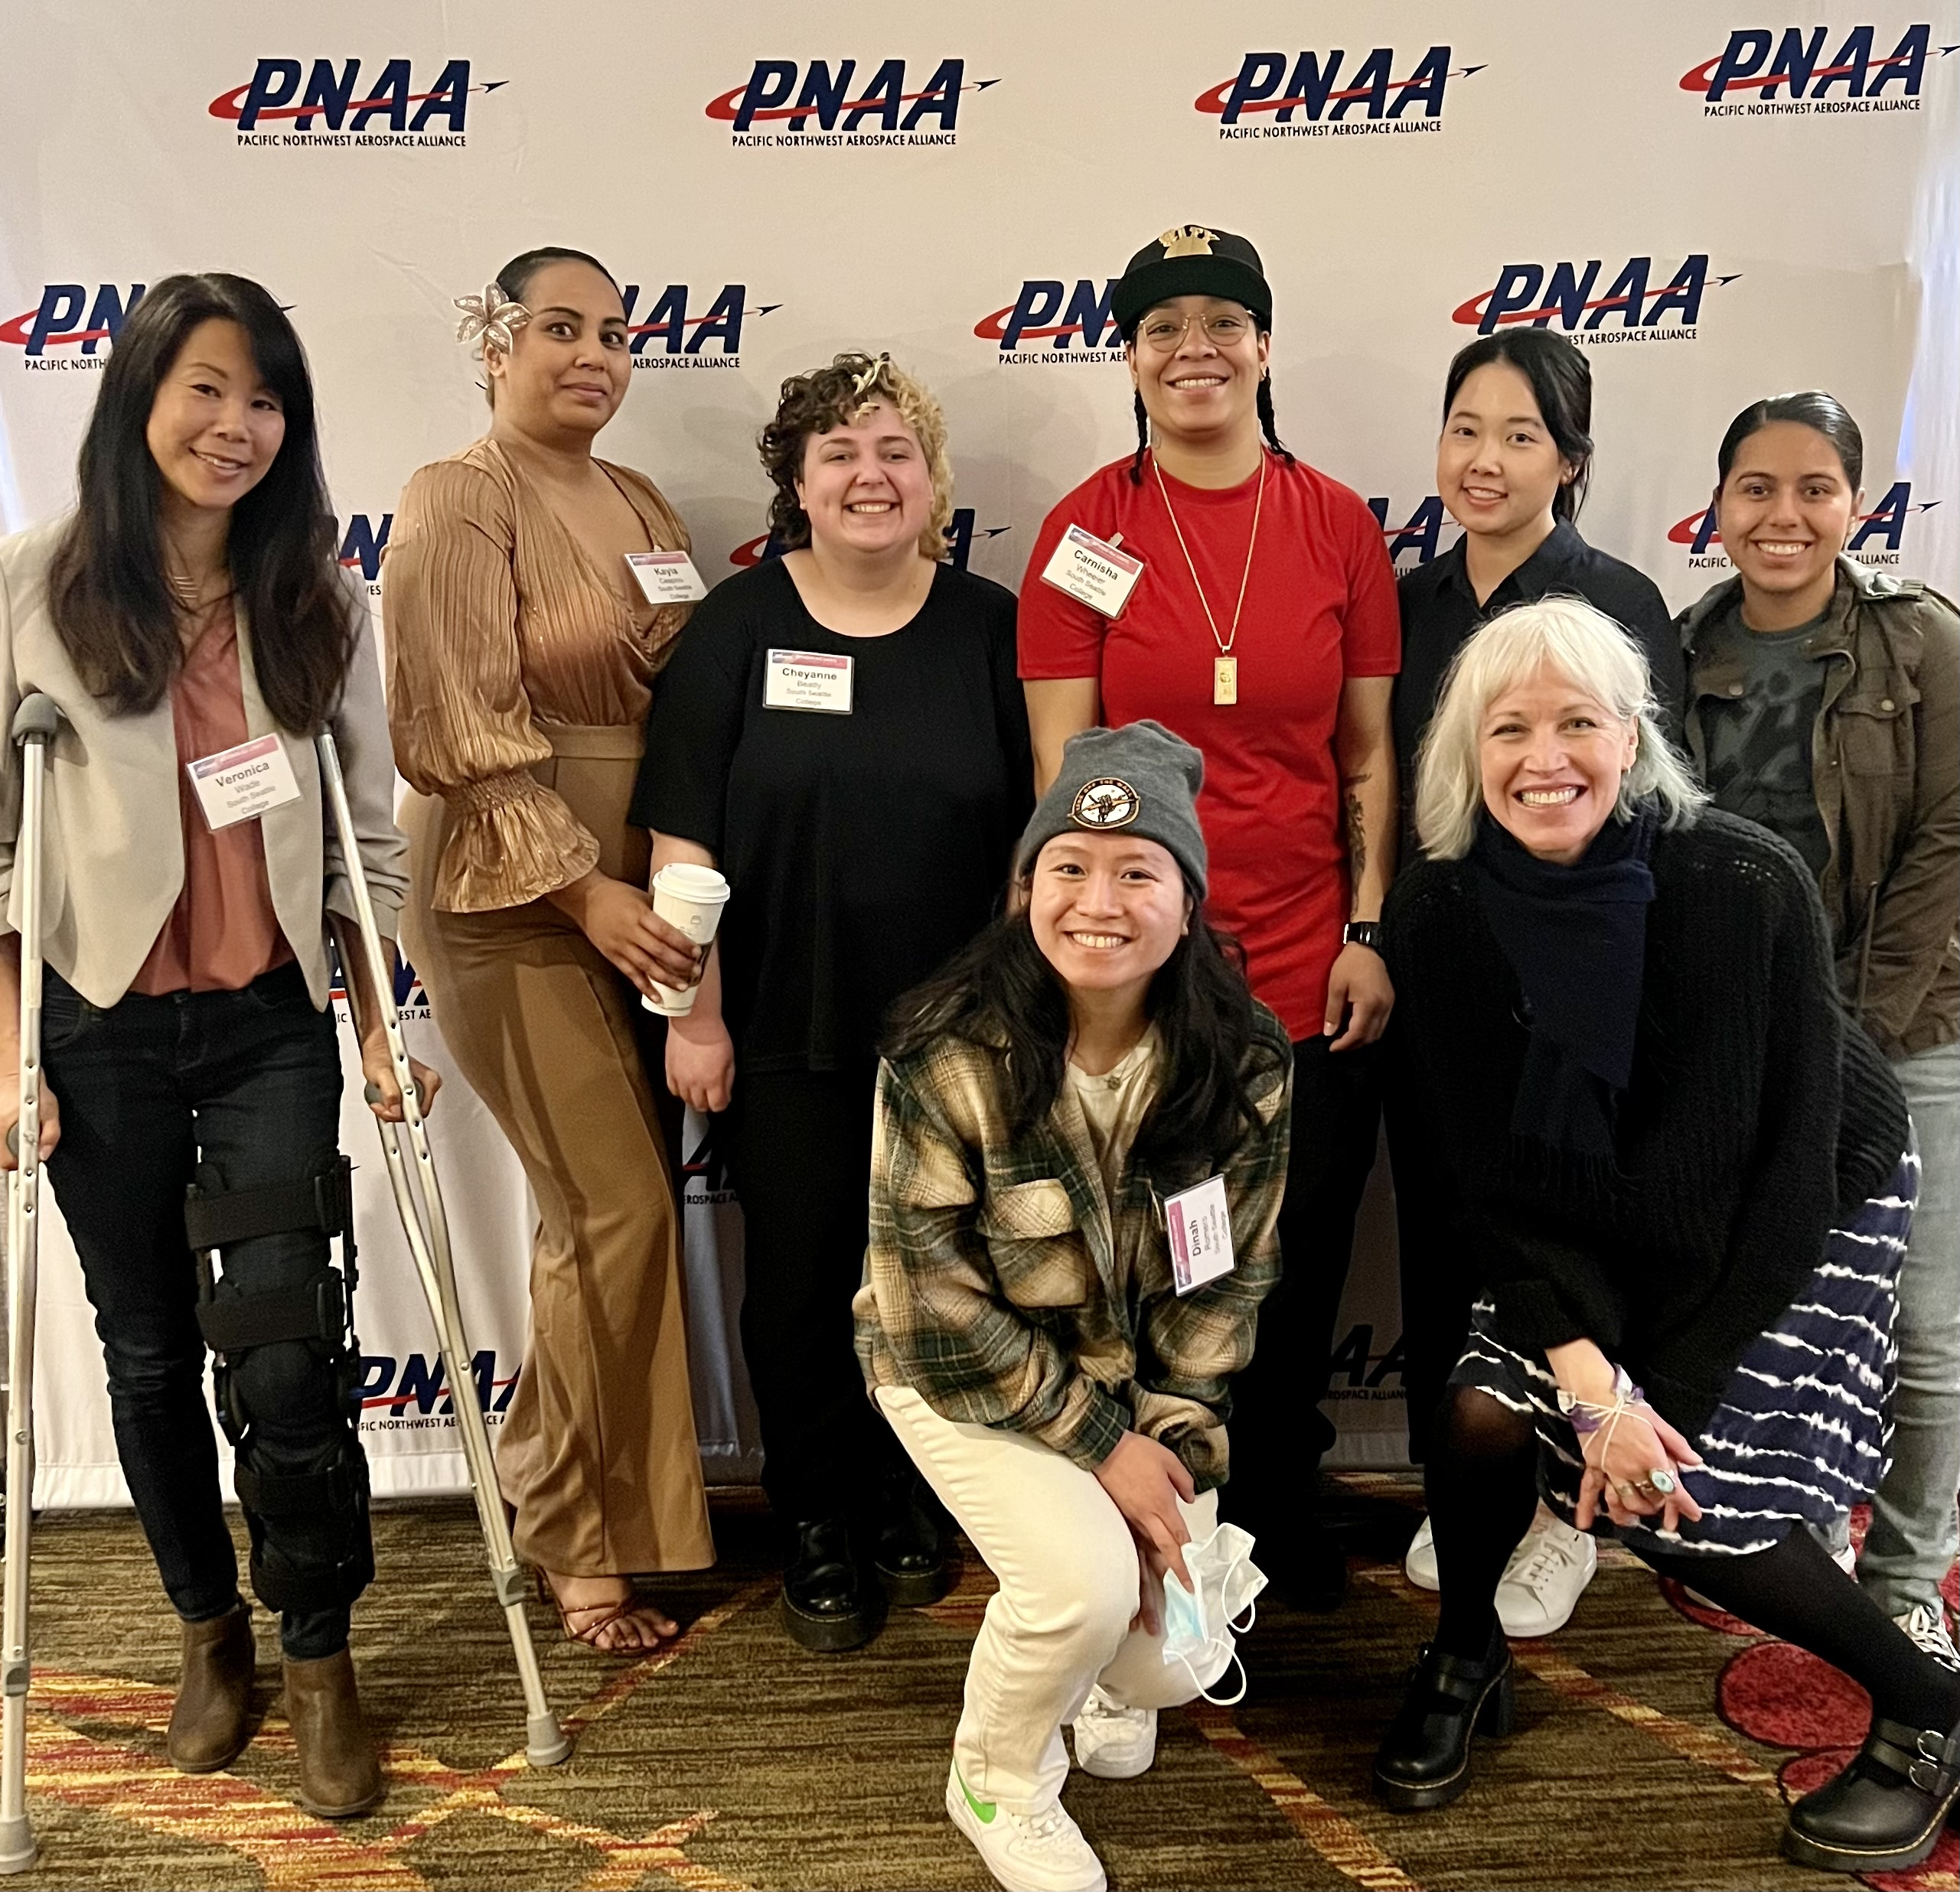
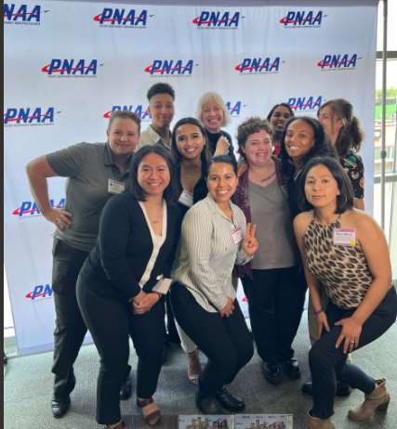
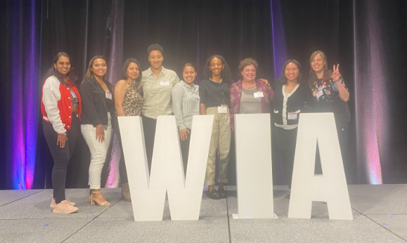
Invest in their professional connections and development
Annual attendees of events such as Washington Women in Trades and
Pacific Northwest Women in Aerospace Alliance Conference (featured here) –focused on empowerment, leadership, and education for women in aerospace. ​
2022
2023
“ I want to thank you all for the part that you played in getting our students to the 2023 Women in Aerospace Conference by PNAA. It was such a great experience for them, and they were able to network and meet a lot of new contacts. A huge thank you to PNAA for sponsoring our students to go!”
- Haley Barnes, Tenure Track Faculty, AMT (Previous South Grad)

Slide 7
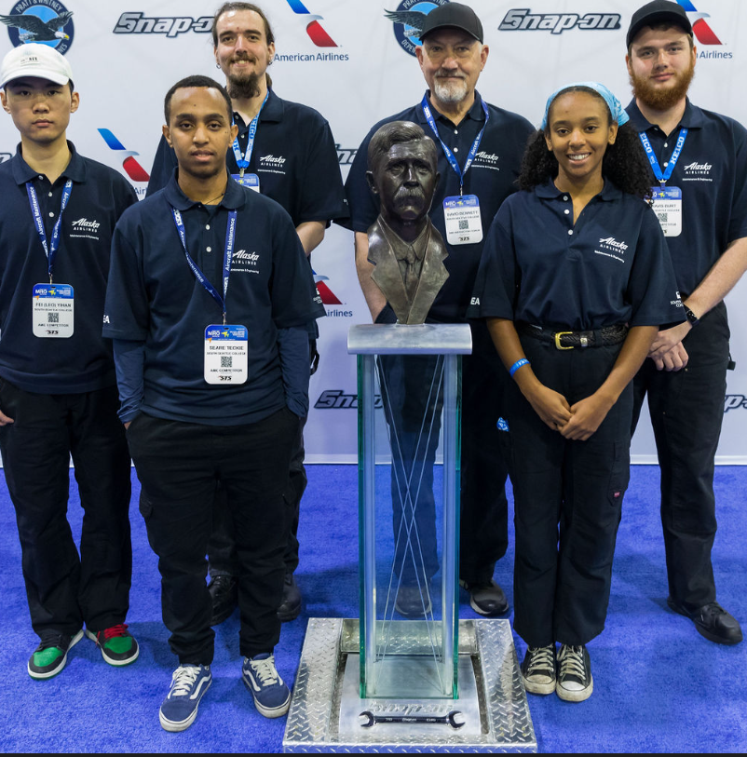
Invest in their professional connections and development
Atlanta 2023
Our Aviation TAC Chair from Alaska Airlines sponsored a team (1 faculty & 5 students) to compete in the
Aviation Maintenance Council's national Aviation Maintenance Competition

Slide 8
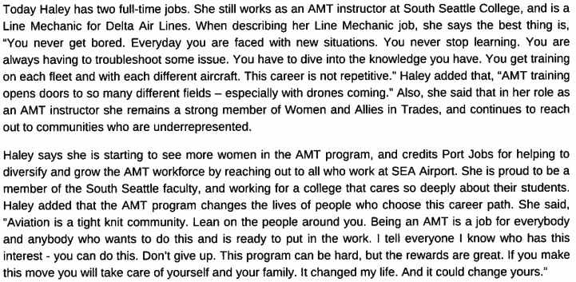
Case Study: Strategies in action

Slide 9
The Numbers.....

Slide 10
Female and Female Identified Enrollments 2020-2023
​ | 2020-21 ​ | 2021-22 ​ | 2022-23 ​
AUTOMOTIVE | 4/58 | 9/70 <1> | 11/89 ​
AVIATION * | 6/151 ​(3) | 14/188 ​ | 23/209 ​<1> (2)
BUSINESS OPS | 23/38 ​(2) | 21/44​ (2) | 56/110 (7)​
CULINARY | 13/28 ​ | 11/26 (2) | 13/35 (1)
DIESEL & HEAVY EQ | 1/25 ​ | 2/25 | 2/27
LANDSCAPE HORT | 8/18​ (1) | 20/31 (2) | 24/42 ​<1> (4)
WELDING | 16/69 ​ | 20/77 (1) | 13/77 ​(1)
< > - Non-binary
( ) – Not Reported
* - Includes International

Slide 11
DEMOGRAPHICS

Slide 12
Parting Thoughts
It's not just one thing, it's a collection of little things for the greatest collective impact
It takes time
Ensure budget resource allocation supports impactful strategies
Lean into the champions that emerge in the process and support them!

Slide 13
In closing, a tribute to the words my youngest son learned in elementary school.....
lea
Questions.....or compliments? 😊

