Slide 1
FY26 workforce pell application webinar
February 17, 2026
Notes:
Introductions

Slide 2
About the webinar
Introduction
    Marie Bruin, Director, SBCTC
    Jamie Traugott, Director, SBCTC
Workforce Development Council Partnership
    Teresa Rich, President, YVC
    John Traugott, Executive Director, WWA
    Amy Martinez, CEO, South Central WDC
Overview of the Workforce Pell/Perkins Special Projects FY26 guidelines and OGMS
    Denise Costello, Associate Director, SBCTC
    William Belden, Policy Associate, SBCTC

Slide 3
Workforce pell Initiative
The federal Workforce Pell Grant Program expands Pell Grant eligibility to short-term workforce training programs that demonstrate strong labor market value, alignment with in-demand jobs, and high-quality student outcomes.
These requirements emphasize employer validation, regional workforce alignment, outcomes reporting, and stackable, transparent pathways.
Washington’s CTC system offers extensive CE and noncredit training, but these offerings often operate outside traditional program approval structures and may not fully align with federal Workforce Pell requirements.
Ensuring equitable access to high opportunity careers requires modernizing program approval processes and integrating CE and PLA pathways into credit-bearing professional technical programs.

Slide 4
Pilot program overview
This application process is being expedited to help frame system recommendations, with a project end date of September 30, 2026.
Applications must focus on a system approach and must include participation by a partnership of up to five colleges (lead college and up to four partner CTCs).
Project resources will be awarded to the lead college.
The application must identify the lead college and the additional partners, including statements of support.
Project funding for partner activities and engagement is managed by the lead college through interagency agreements or contracts, as appropriate.
Project is being funded by Perkins Leadership funding (Special Projects Grant) and follows existing grant guidelines, with exceptions as noted in the appendix, and program assurances.

Slide 5
Purpose of Project
Selected colleges will collaboratively develop actionable recommendations in the following areas:
Feasibility analysis of aligning short-term programs with Workforce Pell requirements.
Development of updated short-term program approval processes reflecting federal expectations.
Creation of models for embedding CE, noncredit, and PLA pathways into professional technical credentials.
Cross functional collaboration across financial aid, IR, instruction, student services, and workforce divisions.
Engagement with regional WDCs, secondary education partners, and other partner colleges.
Integration of equity and inclusion principles to ensure improved access, reduced barriers, and equitable outcomes for marginalized learners.

Slide 6
Eligibility – Perkins leadership grants
Perkins Special Projects Grant
Eligibility
    Washington State Community and Technical Colleges
Funding Available
    Up to $180,000 (up to $60,000 for the lead college, up to $30,000 per partner college)
    Funding is divided between two fiscal years: up to $100,000 in FY26 and up to $80,000 in FY27.
Process
    Competitive application, Apply in OGMS, WEC Executive Committee Review (March 2), SBCTC Review and Approval

Slide 7
Proposal Content
To be eligible for Perkins Special Projects funding, the Workforce Pell applications must address the following elements:
How the project will support the state's ability to improve student outcomes and achieve the state targets for 1P1, 2P1, and/or 3P1 performance indicators.
Identify the statewide impact of the project.
Identify intended outcomes.
How the project will help close equity gaps and improve retention, completion, and employment rates for special populations/subgroups.

Slide 8
Online Grant Management system Questions
Contact your OGMS Security Contact for access to the 2025-26 Perkins Special Project application.
The OGMS User Manual is available under the “How To” tab in OGMS.
Contact your OGMS Security Contact if your question is not answered in the Manual.
Contact Kari Kauffman, 360-704-1021, if your Security Contact cannot resolve your question.
Notes:
(Denise)

Slide 9
OGMS Login and Application Access
If you’ve forgotten your OGMS username, contact your OGMS Security Contact.
If you’ve forgotten your OGMS password, use the “Retrieve my password” feature located here.
Create a new application for the FY26 Perkins Special Project grant.
Save frequently to ensure you don’t lose your work!
Notes:
(Denise)

Slide 10
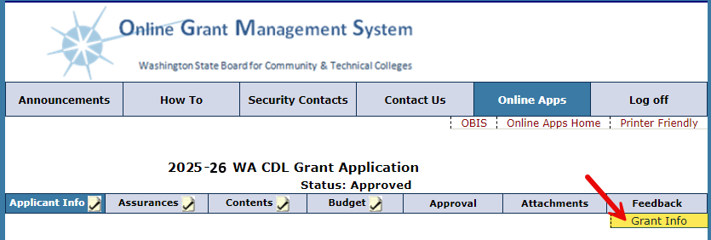
Application Information and Grant Resources
Enter your contact information on the Applicant Information screen
    Be sure to avoid typos when entering your email address.
    Add OGMS as a safe sender.
    If possible, add a secondary contact.
Find and download Program Guidelines, as well as other important documents in the Grant Info link.
Notes:
(Denise)
When you open the application in OGMS, the first section you will see is the “Applicant Information” section. Enter the main grant contact’s information on this screen. We highly encourage adding in a secondary contact to serve as a back-up.
Be sure to avoid typos when entering your email address as this is where communications regarding your application will be sent. You may want to add OGMS as a safe sender or contact in your email.
Find and download the Grant Guidelines, as well as other important documents in the Grant Info link, located at the top right-hand corner of the Applicant Information section.

Slide 11
Applying in ogms
All required elements must be completed to be considered for funding.
OGMS narrative
    Applicant Information
    Contents
      Section 1: Program Detail
      Section 2: Grant and Fiscal Accountability
      Section 3: Budget
Notes:
Denise

Slide 12
Budget Details
Allowable Costs
Salaries, Wages, and Benefits
Goods and Services
Travel
Contracts
Unallowable Costs
Administration
Capital Assets
Notes:
(Denise)
Administrative expenses are not allowable under Perkins Special Projects.
While OGMS has a field for Capital Assets, they are not allowable expenses for Workforce Pell Projects. Please leave that section of the budget narrative blank.
Funding for approved applications will be awarded to colleges for each fiscal year. Note that, funds do not extend beyond the end of the fiscal year (June 30, 2026). Funds for FY27 become available July 1, 2026, and will require a separate application in OGMS.

Slide 13
Reporting and accountability
An FY26 Status Report is due by June 30, 2026.
An FY27 Final Report is due by October 31, 2026.
Reports must be submitted via OGMS.
Notes:
Program Staff

Slide 14
timeline
Milestone | Dates (subject to change)
Applications available in OGMS | February 19, 2026
Application webinar | February 17, 2026
Applications due in OGMS | February 26, 2026
Grant Start Date | March 2026
Final Budget Revision Deadline | June 15, 2026
Final Invoicing Date | July 15, 2026
Notes:
Program Staff
Funding for approved applications will be awarded to colleges for each fiscal year. Note that, funds do not extend beyond the end of the fiscal year (June 30, 2026). Funds for FY27 become available July 1, 2026, and will require a separate application in OGMS.

Slide 15
Questions?
Please Contact:
William Belden
Workforce Policy Associate
wbelden@sbctc.edu
Notes:
Program Staff

