Slide 1
CampusCE Integration
ctcLink PeopleSoft & CampusCE
Susan Maxwell, CampusCE Integration PM
October 19, 2021

Slide 2
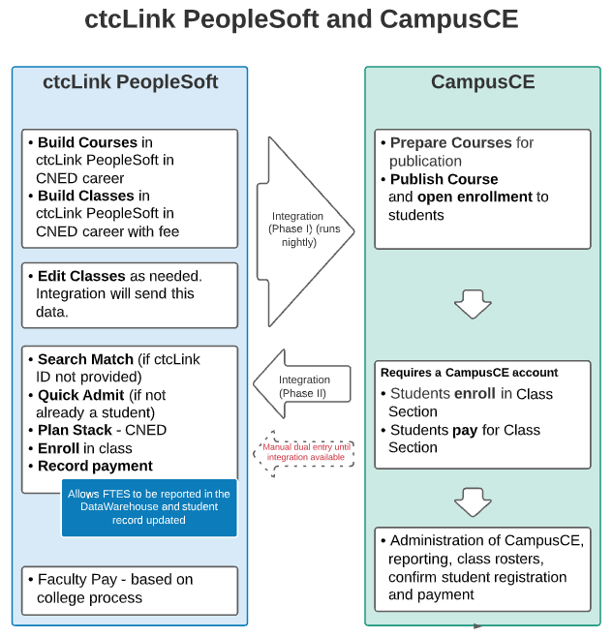
Overview of integration
Phase I
Build courses and classes in ctcLink PeopleSoft
Add fees (recommend in class)
CampusCE pulls data each morning
Phase II
Student enrolls and pays in CampusCE (or manual by staff)
Real time integration sends data to PeopleSoft and a response is returned to CampusCE
Student profile thru to payment is processed in PeopleSoft
Phase III
Additional automation & enhancements

Slide 3
Phase I pages created
Admin Unit Set Up
15 character Admin Unit Code
Description and Short Description – what you see in CampusCE as Description (Short Des)
MANDATORY for classes to move to CampusCE

Slide 4
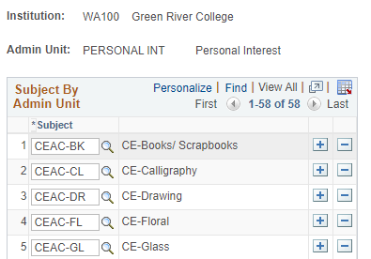
Phase I pages created
Subject By Admin Unit Set Up
For each Admin Unit list the subjects which belong
Only one Admin Unit per subject

Slide 5
87 days
27 days
10 days
12 days
97 days
5 days
5 days
6 days
6 days
1 day
CampusCE Phase I Integration Milestones – as of October 8, 2021
College / DG | Phase I Integration | Integration Set-up
Centralia DG4 | Complete
Clark DG2 | Complete
Edmonds DG4 | Complete
Highline DG4 | Complete
Lower Columbia DG3 | Complete
Olympic DG3 |  | Waiting for Phase II
Peninsula DG3 | Complete
North Seattle DG4 | Complete
South Seattle DG4 |  | Working with CampusCE
Seattle Central DG4 | Complete
Spokane DG2 | Complete
Wenatchee Valley DG4 | Complete
Green River DG5A | Complete*
Skagit Valley DG5A |  | Course clean up*
DG5 and DG6 colleges to integrate at Go-Live *New since last status

Slide 6
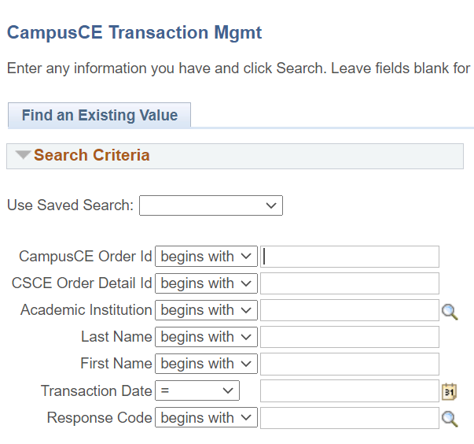
Phase II Pages Created
CampusCE Transaction Mgmt
Search for a transaction or view a list
Completed (COM) or Error (ERR)
Search Results are links

Slide 7
Phase II Pages Created
CampusCE Transaction Mgmt
Search Results are links

Slide 8
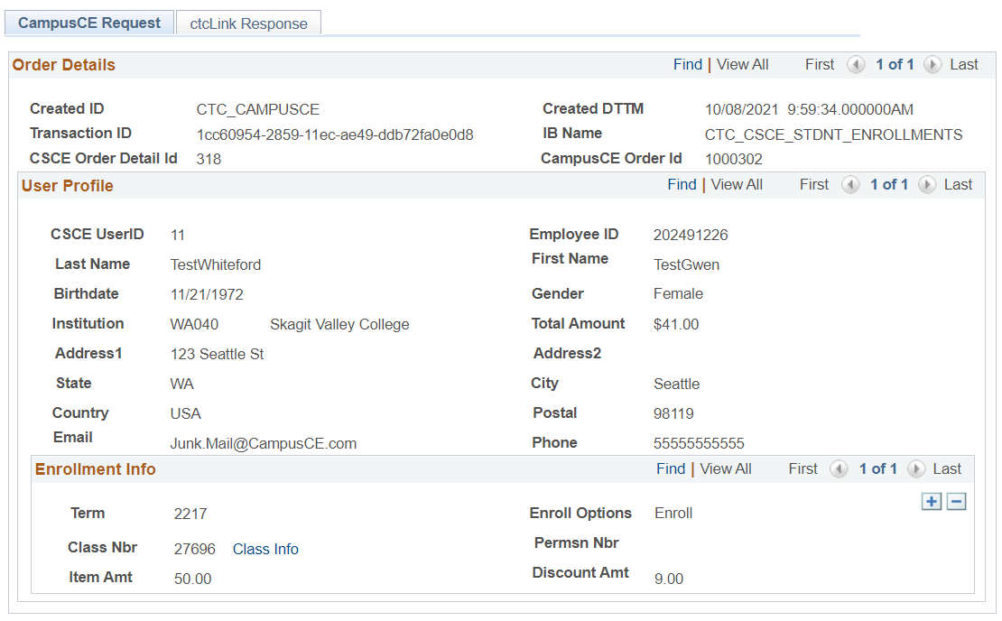
Campusce request tab
Data Received from CampusCE

Slide 9
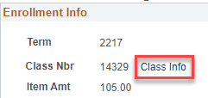
Campusce request tab highlights
Links to Maintain Schedule of Classes so you can see the class information.
Takes you directly to the specific class
Provides the CampusCE Order ID for looking back in CampusCE

Slide 10
ctcLink Response tab
Status of process in ctcLink PeopleSoft
Status
COM, Completed
ERR, Error
Status Detail
COM = Enrollment & Payment processed successfully in ctcLink
ERR = different errors

Slide 11
ctcLink Response tab
Includes links with data passed to search page.
View Enrollment Request – to process enrollments if there was an issue
Search/Match – to identify the correct student when there could be more than one
Add/Update Person – view and fix bio demo
View Student Account – view charges and payments

Slide 12
Testing results of phase ii
Testing Course / Class Fees
Class with a class and course fee
Testing student creation
New student - verify that there is no one in PS with that name.
Student who is already in PS and has an EMPLID and is already in the CNED career.
Student who is already in PS and has an EMPLID and is only in the UGRD career.
Student who is already in PS and has an EMPLID, and there are other students with the same name.
Student who is already in PS and has an EMPLID, different address and there are not other students with the same name.
Student who is already in PS and has an EMPLID, different address and there are other students with the same name.
Testing Classes
Test class with class and course fees
Regular class
Enroll in 2 or more classes at the same time
Make a partial payment (if possible)
Make a partial payment, submit, then complete payment
Make an overpayment (if possible)
Make a full payment with two payment types
Add a fee

Slide 13
What the integration will not do
These are decisions intentionally made by the integration team based on functionality of both systems.
Drops must be done manually. First in CampusCE and then in PeopleSoft. In both systems you will need to determine what to refund and how.
Additional fees can not be added with a class at this time. The integration is only for classes and fees you have on the classes. Discounts WILL work.

Slide 14
What the integration will not do
Backdating. You can register students for a class the day after a class starts if you have it set up this way.
Refunds – this must be done first in CampusCE and then manually in ctcLink PeopleSoft.

Slide 15
Things to know
All payments come over in item type 700000000800 – CampusCE Payment. We will be including the type of payment in the payment type field. For details go to CampusCE.
Payments post in PeopleSoft, even if the enrollment fails. Staff need to address the issue in PeopleSoft in order to get the student to enroll.

Slide 16
College readiness decisions
College decisions are reported to the ctcLink Steering Team on Tuesday October 19th.
Steering Team makes a final decision.
If approved, Phase II will be moved into production with DG5B, and will be available on Wed. 10/27.
Colleges work with CampusCE to select a date they want to start using the integrations.

Slide 17
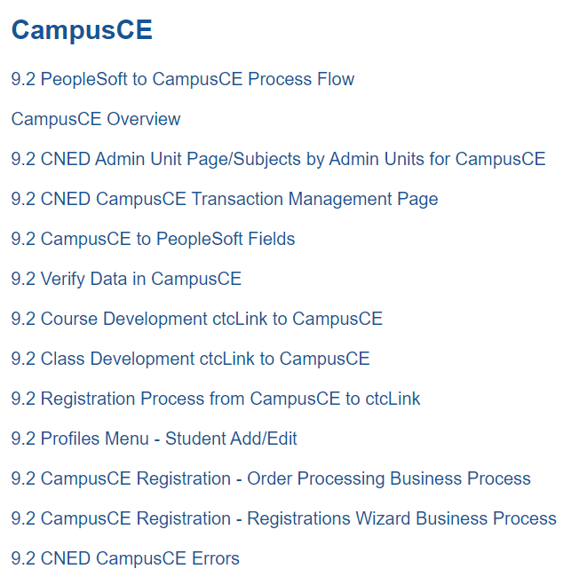
Support
SBCTC Support will need access to college DEV sites in order to troubleshoot.
Reference Center in progress

Slide 18
Testing issues
UAT was in the UAX environment used for DG5 AUT
This was a June snapshot which did not have all the DG2, DG3 and DG4 configuration and CNED classes for 2217 (fall)
REMEDIATION
DG5 can continue to test in UAX
PLY will be made available for DG2, DG3 and DG4. This is data from DG5A conversion.
CampusCE will not be able to connect until 10/25

Slide 19
College readiness decisions
Deployment | College | Yes | No | Abstain | Comments
DG2 | Spokane CC |  | X |  | Testing did not work – environment issues
DG2 | Spokane Falls |  | X |  | Testing did not work – environment issues
DG2 | Clark |  |  | X | Tests with Clark data worked, but Clark staff did not test
DG3 | Edmonds | X |  |  | Backdating is an issue, registration fee –Jan
DG3 | Lower Columbia | X |  |  | Drop and refund – more testing time
DG3 | Olympic |  | x |  | Did not participate in UAT
DG3 | Peninsula |  | x |  | Need env with CNED classes/functionality
DG3 | Pierce |  | x |  | Need additional testing, still setting up cybersource, local bus processes needed
DG4 | Centralia |  | x |  | Env issues, more testing
DG4 | Highline |  | X |  | Discuss internally - NO
DG4 | North Seattle | X |  |  | Will let us know
DG4 | South Seattle |  |  | √ | Still setting up CampusCE
DG4 | Seattle Central | X |  |  | Will let us know
DG4 | Wenatchee |  | X |  | Did not participate in UAT
DG5 | Bellevue | X |  |  | Security issues (worked in UAX but not SVX or PLX) errors (could not validate)
DG5 | Everett | X |  |  | Errors in PLX – could not validate security roles. Could not see courses and classes. Can’t test credit card. Can’t test from student side.
DG5 | Green River | X
DG5 | Skagit | X |  |  | Leaning towards a yes
DG5 | Big Bend |  |  | √ | Still setting up CampusCE

Slide 20
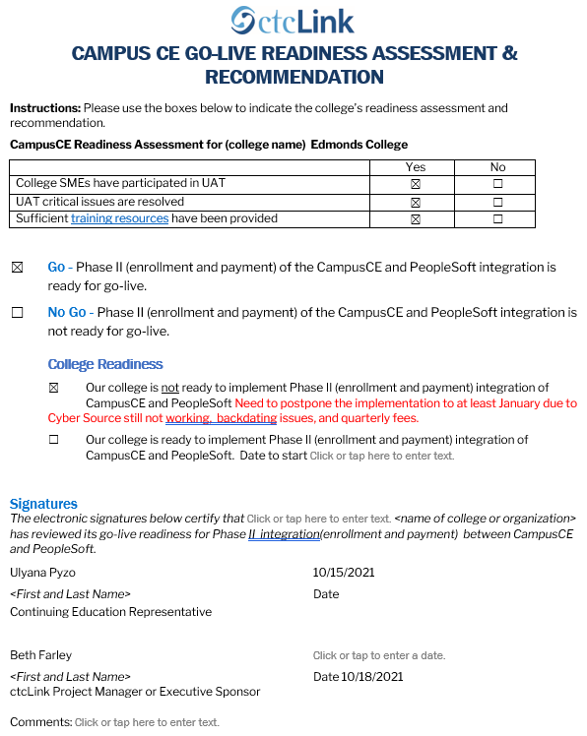

Slide 22
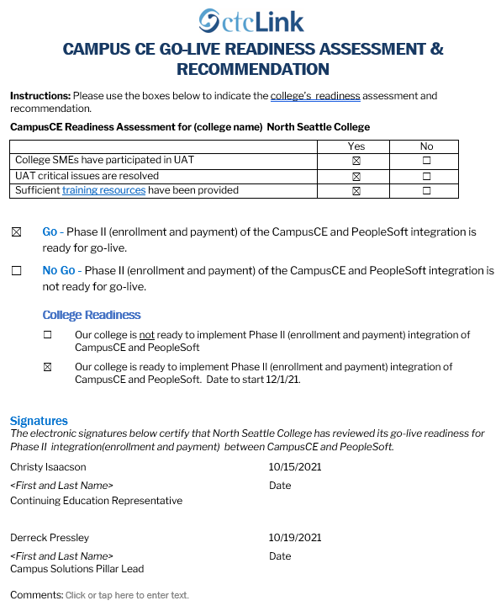

Slide 23
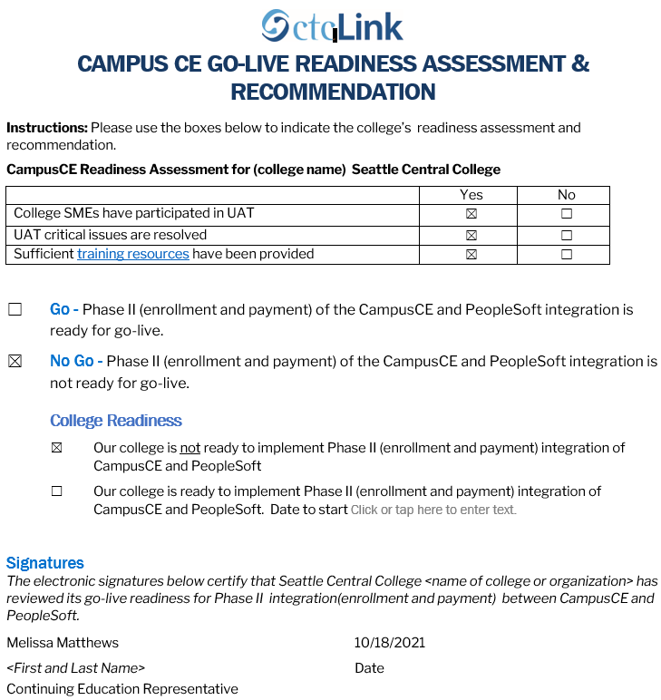

Slide 24
Bellevue

Slide 26
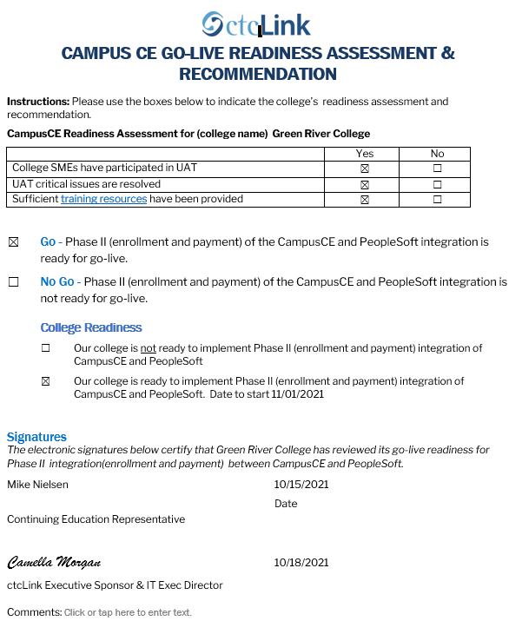

Slide 27
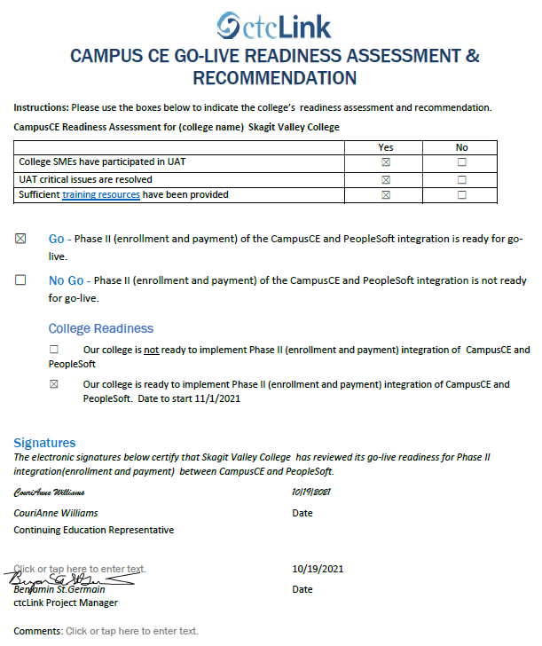

Slide 28
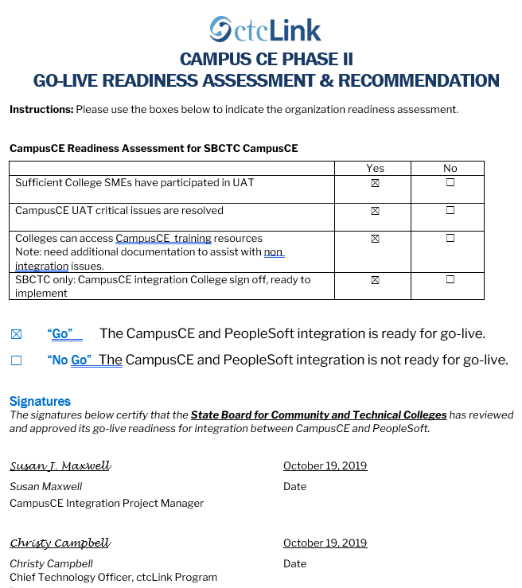

Slide 29
ACTION
DRAFT MOTION: Approve for Phase II (enrolment and payment) of CampusCE integration to be moved to Production (PRD) during the DG5B GoLive weekend 10/22/2021 to 10/25/2021.
Colleges which are live in ctcLink can determine when to begin using this integration, which will be available to use beginning Wednesday 10/27/2021.

Slide 30
Questions?
smaxwell@sbctc.edu
CampusCE and ctcLink in Reference Center
CampusCE Support Team

