Slide 1

What Faculty Need to Know

Slide 2
Meet your ctcLink Faculty Advocates
Jeremiah Allen
Adjunct Faculty, English
Erika Ferreri
Adjunct Faculty, Allied Health - AHE
Audrey Hue
Adjunct Faculty, Institute for Business & Information Technology - IBIT

Slide 3
What is the agenda for today?
What Faculty Advocates do
Activating your ctcLink ID
Changing faculty related BC systems
Review faculty functions in self-service
How you can help students
Future support through this transition
Test your knowledge!
Q&A

Slide 4
What do Faculty Advocates do?
Provide faculty support faculty for ctcLink transition
Zoom and email support
Update Knowledge Base, newsletters & training documents
Website updates
Consolidate faculty concerns and problems – bring to ctcLink Team
Send out ctcLink communications

Slide 5
Accessing Prior Knowledge/Warm up Activity
Please type in your response to each of the following questions in the meeting chat. (Do not click send until we say “GO!”):

Slide 6
Accessing Prior Knowledge/Warm up Activity
Please type in your response to each of the following questions in the meeting chat. (Do not click send until we say “GO!”):
What is the first thing that comes to mind when you hear the term ctcLink?

Slide 7
Accessing Prior Knowledge/Warm up Activity
Please type in your response to each of the following questions in the meeting chat. (Do not click send until we say “GO!”):
What is the first thing that comes to mind when you hear the term ctcLink?
What is the strongest feeling that you associate with the ctcLink transition?

Slide 8
Accessing Prior Knowledge/Warm up Activity
Please type in your response to each of the following questions in the meeting chat. (Do not click send until we say “GO!”):
What is the first thing that comes to mind when you hear the term ctcLink?
What is the strongest feeling that you associate with the ctcLink transition?
What is one thing you think you already know about ctcLink?

Slide 9
What is ctcLink?
ctcLink is a single, centralized system of online functions to give students, faculty and staff anytime, anywhere access to a modern, efficient way of doing their college business.
The ctcLink project is the implementation process to move colleges from the HP Legacy system to Oracle PeopleSoft products (Campus Solutions, Finance, Human Capital Management).
All 34 technical and community colleges in the state are transitioning to ctcLink. You can read more about the benefits and background of ctcLink on this SBCTC page.

Slide 10
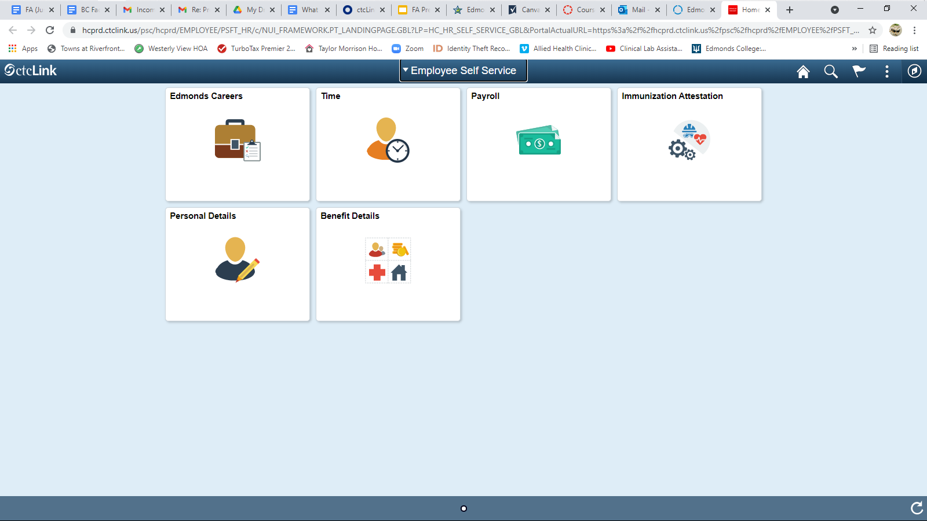
What are the main applications changes affecting faculty?
Instructor Briefcase (IBC)
Employee Earnings
Expense Reports
Course Substitutions
Grade Changes
Advising
Annual & Quarterly Contract Acceptance
Leave Reporting

Slide 11

What are some important dates I need to remember?
ctcLink Go Live Date - 11/12/21 (Faculty)
ctcLink Go Live Date - 11/17/21 (Students)
Post ctcLink ID Student Announcement - 11/17/21
Post ctcLink ID Assignment due date - 11/23/21
Winter Enrollment Begins - 11/29/21
Fall Grades Due - 12/20/21
Winter Quarter Begins - 1/3/22
Additional Support Will Be Available During Key Dates
Note: Faculty Advocates will offer support prior to key dates

Slide 12
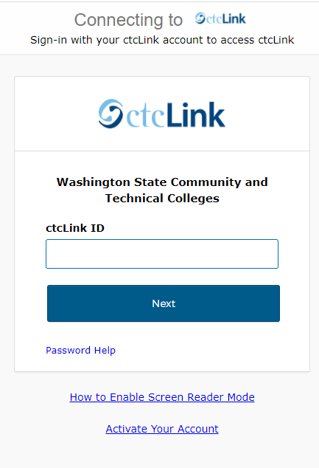
How will I access ctcLink on 11/12/2021?
Activate your account here
Look for upcoming communication with directions on how to sign into the system through the BC website.
  Hard cutover, not gradual
    Canvas not affected.

Slide 13
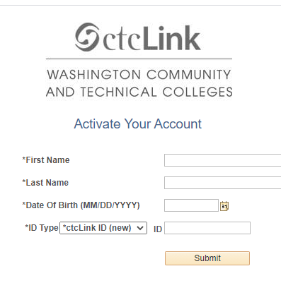
IMPORTANT!
Helpful tips for when you obtain your ctcLink ID:
  Record your ctcLink ID & security questions/answers
  Write down your password
  Already have ctcLink ID? You can skip this part!
Multi-factor authentication
  Provide email and phone number for receiving code

Slide 14
What are some tips for success with ctcLink?
Download class roster before ctcLink GoLive date
Recommended browsers: Microsoft Edge or Firefox
Clear your cache frequently:
  How do you do this with Microsoft Edge?
  How to do this with Firefox?
  How do you do this with Google Chrome?

Slide 15

How can I prepare for ctcLink?
State Board designed asynchronous Canvas Modules for most aspects of ctcLink
Most faculty only really need to focus on 2:
  HCM: ES 100, Employee Self Service
  CS: CF100, Faculty Self Service
This can be taken again later as a review.
Remember this was due for all BC employees as of 5/19/21

Slide 16




What type of support is available to faculty?
Read
Revisit
Explore
Submit
BC Faculty ctcLink Knowledge Base
The Canvas trainings: Faculty Self-Service, Advisor Self-Service, Employee Self-Service, Student Self-Service (Registration Link)
The ctcLink Reference Center
An email or attend a Zoom session if your question has not been answered

Slide 17
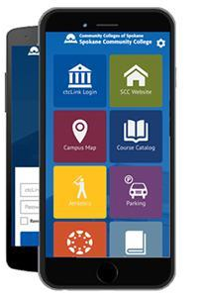
How can faculty help students?
Announce to students to activate their ctcLink accounts on Nov.17th.
Post the ctcLink Student Assignment
Encourage students to download the ctcLink app if they have a smartphone.
Remind students to register for Winter classes using their ctcLink IDs.

Slide 18
Knowledge Review
Please type in your response to each of the following questions in the meeting chat. (Do not click send until we say “GO!”):
What is one thing you think you already know about ctcLink?

Slide 19
Questions?
What we’ve learned so far is that information changes...fast. What we relay right now as accurate information can change by tomorrow, so read ctcLink emails carefully for up-to-date info.

