Slide 1
DG3 gate 5: college readiness
DISCUSSION & APPROVAL
ctcLink Steering Committee
February 18, 2020

Slide 2
agenda
Item | Description | Minutes | Facilitator
1. | Welcome | 2 | Choi/Christy
2. | DG3-A College Readiness & Go-Live Deployment Recommendation Forms DG3-B College Readiness & Go-Live Date Decision & Approval | 73 | Christy, Reuth, All
3. | ctcLink Support Organization Update (if time allows) Organizational Alignment & Staffing Plan (Readiness to support deployments) ctcLink Accessibility – Update Next Steps ctcLink and Guided Pathways – Update, Next Steps | 15 | Grant

Slide 3
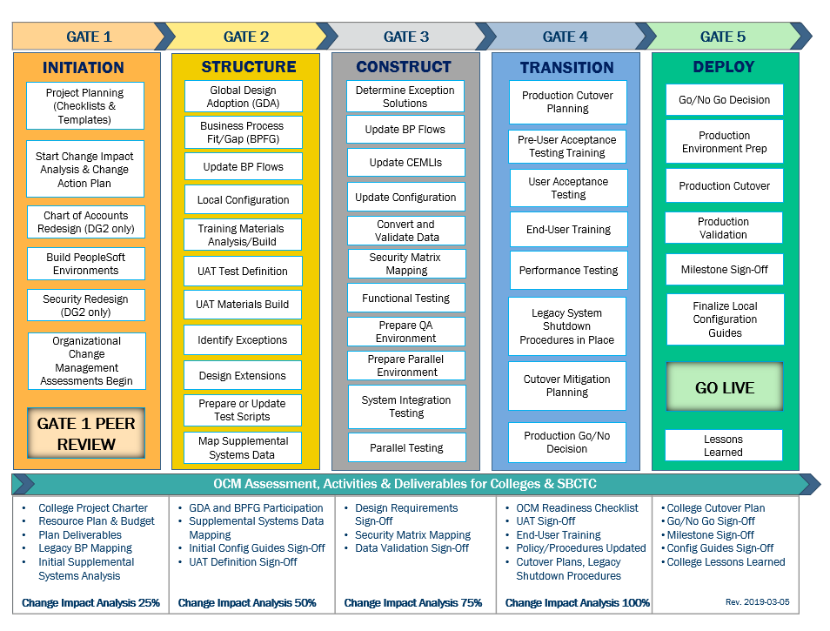
CTCLINK QUALITY GATES & MILESTONES

Slide 4
DG3 readiness ASSESSMENT development
Dec 2019-
Jan 2020
Jan 2020
Jan 2020
Feb. 7, 2020
Feb. 11, 2020
Feb. 18. 2020
College readiness spreadsheet developed by ctcLink PMO team
Reviewed by: ctcLink Team; DG3 PMs, Exec Sponsors, college project team, SMEs; Quality Assurance (Moran & OCIO)
Feedback incorporated and spreadsheet updated
DG3 PMs complete preliminary readiness spreadsheet, submit to Project Management Office
ctcLink Steering Committee review, discussion
KEY ELEMENTS OF QUALITY COLLEGE READINESS ASSESSMENT
Accuracy: true measurement of go-live readiness
Consistency: one tracking tool
Identification of Gaps (for college-specific items)
Establishment of Mitigation Plans
Collaborative Process: Involvement/Assessment by DG3 PMs, ctcLink & SBCTC teams
Transparency: Report Readiness to all levels of ctcLink Governance

Slide 5
Dg3-A (Lower Columbia & Olympic)
Updated College Readiness Assessments
Go-Live Recommendation Forms
Steering Committee approved Go-Live date: March 9, 2020

Slide 6
Lower columbia COLLEGE
College Overview | Current Completion of Readiness Criteria | Estimated Status at Go-Live
Data | 2 of 3 | Green
Security | 0 of 2 | Orange
Testing | 1 of 6 | Orange
Training | 2 of 4 | Yellow
College Support Plan | 3 of 4 | Green
Transition | 7 of 12 | Yellow
Comms & OCM | 5 of 6 | Green
 | RED - Critical system or organization issue, no mitigation available
 | ORANGE - System or organizational issue with workaround (mitigation plan)
 | YELLOW - Somewhat ready for Go-Live, small issues unresolved, doesn't impact Go-Live
 | GREEN - Ready for Go-Live

Slide 7
Lower Columbia college Go-live deployment recommendation form

Slide 8
OLYMPIC COLLEGE
College Overview | Current Completion of Readiness Criteria | Current Status
Data | 2 of 3 | Green
Security | 0 of 2 | Yellow
Testing | 1 of 6 | Yellow
Training | 1 of 4 | Yellow
College Support Plan | 4 of 4 | Green
Transition | 1 of 12 | Yellow
Comms & OCM | 5 of 6 | Yellow
 | RED - Critical system or organization issue, no mitigation available
 | ORANGE - System or organizational issue with workaround (mitigation plan)
 | YELLOW - Somewhat ready for Go-Live, small issues unresolved, doesn't impact Go-Live
 | GREEN - Ready for Go-Live

Slide 9
Olympic college go-live deployment recommendation form

Slide 10
additional perspective
SBCTC Agency/Support
Quality Assurance (Moran Technology Consulting)

Slide 11
SBCTC agency/Support DG3-a go-live readiness
DG3-A Readiness Assessment | Yes | No
Functional resources to support DG3-A colleges | ✓
Technical resources to support DG3-A colleges | ✓
Resources to support security | ✓
Local Configuration Guides Available | ✓
DataLink set up and ready for DG3-A colleges | ✓
Mobile set up and ready for DG-A colleges | ✓
Participation in transition (cutover, go-live post support) | ✓

Slide 12
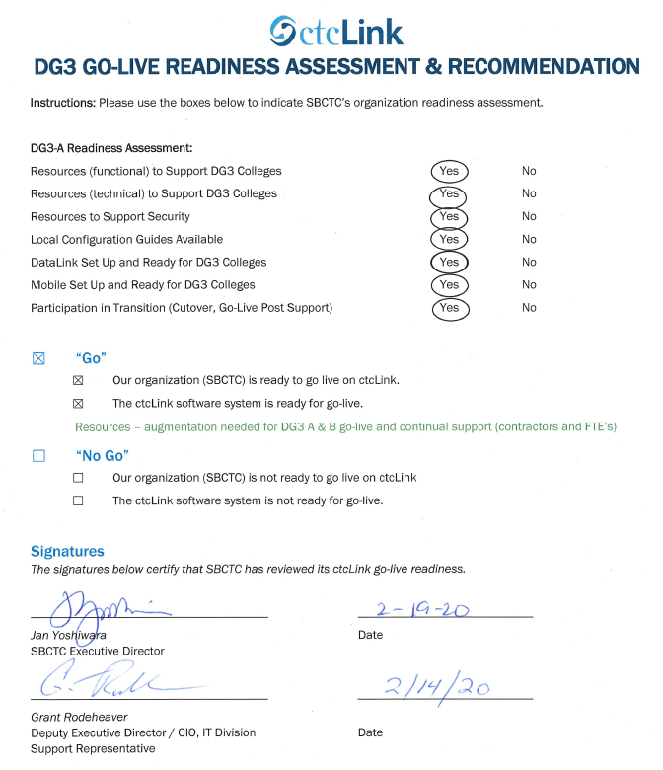
SBCTC agency/Support Organization go-live deployment recommendation form

Slide 13
Dg3–b (Cascadia, peninsula & Pierce)
Updated College Readiness Assessments
Steering Committee Decision & Approval: Go-Live Date: May 11, 2020

Slide 14
Cascadia COLLEGE
College Overview | Current Completion of Readiness Criteria | Current Go/No-Go Status
Data | 2 of 3 | Green
Security | 0 of 2 | Red
Testing | 1 of 6 | Orange
Training | 1 of 4 | Red
College Support Plan | 4 of 4 | Orange
Transition | 4 of 12 | Orange
Comms & OCM | 4 of 6 | Yellow
 | RED - Critical system or organization issue, no mitigation available
 | ORANGE - System or organizational issue with workaround (mitigation plan)
 | YELLOW - Somewhat ready for Go-Live, small issues unresolved, doesn't impact Go-Live
 | GREEN - Ready for Go-Live

Slide 15
PENINSULA COLLEGE
College Overview | Current Completion of Readiness Criteria | Current Go/No-Go Status
Data | 2 of 3 | Green
Security | 0 of 2 | Red
Testing | 1 of 6 | Orange
Training | 1 of 4 | Red
College Support Plan | 4 of 4 | Green
Transition | 3 of 12 | Orange
Comms & OCM | 5 of 6 | Yellow
 | RED - Critical system or organization issue, no mitigation available
 | ORANGE - System or organizational issue with workaround (mitigation plan)
 | YELLOW - Somewhat ready for Go-Live, small issues unresolved, doesn't impact Go-Live
 | GREEN - Ready for Go-Live

Slide 16
pierce COLLEGE district
College Overview | Current Completion of Readiness Criteria | Current Go/No-Go Status
Data | 1 of 3 | Yellow
Security | 0 of 2 | Red
Testing | 1 of 6 | Orange
Training | 1 of 4 | Orange
College Support Plan | 2 of 4 | Orange
Transition | 3 of 12 | Orange
Comms & OCM | 2 of 6 | Yellow
 | RED - Critical system or organization issue, no mitigation available
 | ORANGE - System or organizational issue with workaround (mitigation plan)
 | YELLOW - Somewhat ready for Go-Live, small issues unresolved, doesn't impact Go-Live
 | GREEN - Ready for Go-Live

Slide 17
Ctclink project readiness & Concerns
Discussion led by Christy Campbell, ctcLink Project Director
Activities | Risk /Concerns | Target Completion Date
Student Financials | Student Financials data and flow to General Ledger is still being validated by the project team and has not been tested by the colleges. | Project team complete Sunday, Feb. 16, 2020. College validation by Friday, Feb. 28, 2020. *Risks and solutions are known based on Clark’s deployment.
Security | Colleges have not had an opportunity to validate assignments of their users in the system. | Complete by Monday, March 2, 2020.
UAT / Parallel Testing | Testing has not been completed. | College validation by Friday, Feb. 28, 2020.
Mock Run Cycle 5 | Project team needs to test the cutover plan to ensure a consistent process at go-live. | Feb. 25-27, 2020
Historical Class Load | This activity will be required if more than 2-3 colleges go-live. | Based on Steering Committee Decision
Training | Local college training has been limited due to the dependencies on system training. | All college SMEs should be trained in critical areas by Thursday, March 5 and ongoing training post go-live as desired.
Support Organization | Staffing levels to support six new colleges has not been complete. | Alignment initiated Feb. 10. Additional staffing and contract staff needs to be implemented.

Slide 18
DG3-B MODIFIED SCHEDULE (May 11, 2020)

Slide 19
Deployment group risks/impacts
DG3-B Go-Live Timeframe | Deployment Group 4 | Deployment Group 5 | Deployment Group 6
Any date in May 2020 (or earlier) | Realign some activities for DG4 Cycle 2 Impact to DG4 Go-Live Date (2 months) | Delay DG5 kickoff until late May This moves DG5 BPFG after Fiscal Year End which is a benefit to colleges No impact to DG5 Go-Live Date | DG6 timeline may be adjusted but not significant delay
Any date after May 2020 | Extensive rescheduling of DG4 activities Delays and resource constraints during critical DG4 activities Impact to DG4 Go-Live Date (6-8 months) | Extensive rescheduling of DG5 activities Delays and resource constraints during critical DG5 activities Impact to DG5 Go-Live Date | DG6 timeline will be delayed significantly due to extensive realignments in former deployments

Slide 20
Steering Committee Motion & Recommendation
Approve DG3-B colleges (Cascadia College, Peninsula College and Pierce College District) for May 11, 2020 Go-Live date

Slide 21
CTCLINK SUPPORT ORGANIZATION
Organizational Alignment and Staffing Plan
Readiness to support ctcLink Deployments
ctcLink Accessibility – Update and next steps
Guided Pathways in ctcLink – Update and next steps

