Slide 1
DG3-B gate 5: college readiness
DISCUSSION & APPROVAL
ctcLink Steering Committee
April 21, 2020

Slide 2
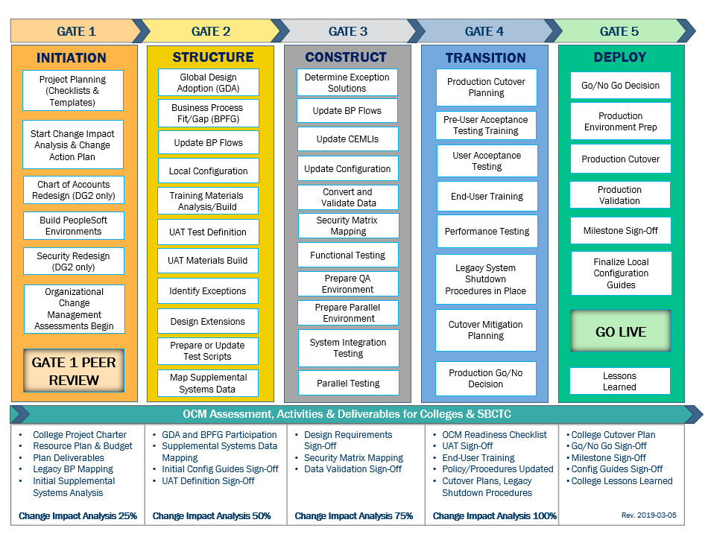
CTCLINK QUALITY GATES & MILESTONES

Slide 3
DG3-B readiness TIMELINE
Mar 2020
Mar – Apr 2020
April 17, 2020
April 21, 2020
May 11, 2020
College readiness spreadsheet reviewed and drafted by ctcLink PMO team and DG3-B PMs
Weekly check-ins and discussion with ctcLink PMO team and DG3PMs
Readiness documents due from DG3-B colleges, ctcLink Project team and SBCTC Support/Org teams
ctcLink Steering Committee review, discussion
DG3-B Go-Live Date
KEY ELEMENTS OF QUALITY COLLEGE READINESS ASSESSMENT
Accuracy: true measurement of go-live readiness
Consistency: one tracking tool
Identification of Gaps (for college-specific items)
Establishment of Mitigation Plans
Collaborative Process: Involvement/Assessment by College PMs, ctcLink & SBCTC Support/Organization Teams
Transparency: Report Readiness to all levels of ctcLink Governance

Slide 4
Dg3-b (Cascadia, peninsula & Pierce)
Updated College Readiness Assessments
Steering Committee Decision & Approval of May 11, 2020 Go-Live Date

Slide 5
CURRENT COLLEGE READINESS STATUS
 | COLLEGE | DATA | SECURITY | TESTING | TRAINING | SUPPORT PLAN | TRANSITION | COMMS & OCM
 | Cascadia College | G | Y | Y | Y | G | Y | Y
 | Peninsula College | G | Y | Y | Y | G | Y | G
 | Pierce District | G | Y | G | Y | Y | Y | Y
*39 core readiness items
 | RED - Critical system or organization issue, no mitigation available
 | ORANGE - System or organizational issue with workaround (mitigation plan)
 | YELLOW - Somewhat ready for Go-Live, small issues unresolved, doesn't impact Go-Live
 | GREEN - Ready for Go-Live

Slide 6
ESTIMATED COLLEGE STATUS AT GO-LIVE College readiness SUMMARY
 | COLLEGE | DATA | SECURITY | TESTING | TRAINING | SUPPORT PLAN | TRANSITION | COMMS & OCM
 | Cascadia College | G | G | G | Y | G | G | G
 | Peninsula College | G | G | G | Y | G | G | G
 | Pierce District | G | G | G | Y | G | Y | Y
 | RED - Critical system or organization issue, no mitigation available
 | ORANGE - System or organizational issue with workaround (mitigation plan)
 | YELLOW - Somewhat ready for Go-Live, small issues unresolved, doesn't impact Go-Live
 | GREEN - Ready for Go-Live

Slide 7
Cascadia COLLEGE READINESS
College Overview | Current Completion of Readiness Criteria | Current Go/No-Go Status | Estimated Go/No-Go Status at Go Live
Data | 3 of 3
Security | 2 of 3 | Y
Testing | 4 of 6
Training | 3 of 5
College Support Plan | 4 of 4
Transition | 11 of 12
Comms & OCM | 6 of 6
 | RED - Critical system or organization issue, no mitigation available
 | ORANGE - System or organizational issue with workaround (mitigation plan)
 | YELLOW - Somewhat ready for Go-Live, small issues unresolved, doesn't impact Go-Live
 | GREEN - Ready for Go-Live

Slide 8
CASCADIA COLLEGE comments & MITIGATION plan
CATEGORY | COMMENTS | MITIGATION PLAN
Data | All pillars are comfortable with the cleanliness of their data, known issues. dataLink is not a reportable for readiness, however. Student EMPLIDs are not available until Sunday, May 10 or Monday, May 11, limiting preparation of student information for UW Bothell. | Known data cleanup issues will be addressed after Go-Live. IS coordinating early access to Student EMPLIDs for dataLink.
Security | Security mapping completed, awaiting confirmation of upload from PMO. Employees are accessing SVX, testing security and reporting issues to Triage Team. | Security Help Desk/Triage Team is trained and in place to support security issues.
Testing | UAT Testing complete. Payroll and Financial Aid Parallel Testing complete and signed-off. Completion of SF Parallel Testing delayed due to inability to access E300 environment. | Complete and sign-off SF Parallel Testing April 17.
Training | Employees actively engaged in Canvas training. Opened SVX training environment on April 15 to initiate employee training. “Customer” administrative task training is being prepared by owning pillars for drop-in session training starting April 27 (e.g. Time/Leave, Travel). Ad hoc query training initiated then delayed until after Go-Live. | Pre Go-Live SVX department training is focused on the first 30-days of ctcLink business process activities. Post Go-Live, SVX training continues for business processes conducted after the first 30-days. Customer administrative task drop-in training sessions will continue indefinitely. Query training to restart in June.
College Support Plan | Updated SBCTC Support Plan provided to colleges on April 15. College Help Desk/Triage Team well practiced through UAT and SVX. Security team is in place, trained, but has limited experience managing security in SVX. | Security Team will continue to massage employee security and practice security management in SVX as users run into issues. Requested pre Go-Live WebEx to review SBCTC escalation plan with college help desk and triage teams.
Transition | dataLink being actively used to provide data to supplemental systems, exception is new Student EMPLIDs, local change checklists still being developed, additional AAR Production build will be completed post Go-Live. | Departments identified processes needing manual processing during cutover and manual update post Go-Live. dataLink data extracts and data feeds to supplemental systems will not be available until after Go-Live.
Comms & OCM | Updating existing communications plan as needed, continuing to update policies, procedures, websites, user adoption and readiness, and OCM sustainability plan. | Continue updating information up until and after Go-Live.

Slide 9
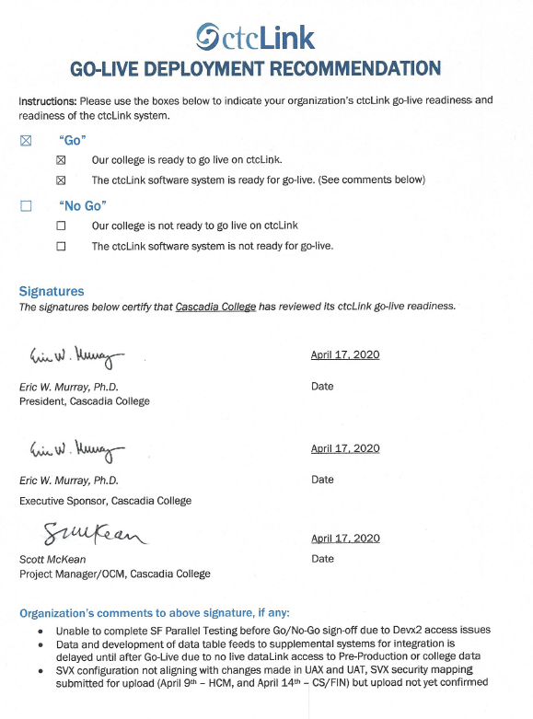
CASCADIA COLLEGE READINESS FORM
Notes:
CASCADIA COLLEGE

Slide 10
PENINSULA COLLEGE READINESS
College Overview | Current Completion of Readiness Criteria | Current Go/No-Go Status | Estimated Go/No-Go Status at Go-Live
Data | 3 of 3 | G | G
Security | 2 of 3 | Y | G
Testing | 6 of 6 | Y | G
Training | 3 of 5 | Y | Y
College Support Plan | 4 of 4 | G | G
Transition | 12 of 12 | Y | G
Comms & OCM | 6 of 6 | G | G
 | RED - Critical system or organization issue, no mitigation available
 | ORANGE - System or organizational issue with workaround (mitigation plan)
 | YELLOW - Somewhat ready for Go-Live, small issues unresolved, doesn't impact Go-Live
 | GREEN - Ready for Go-Live

Slide 11
PENINSULA COLLEGE comments & MITIGATION plan
CATEGORY | COMMENTS | MITIGATION PLAN
Data | Data cleanup still ongoing. Pillar SMEs feel confident in data for conversion.
Security | 4/16/20 Security leads completed workbook, still some outstanding SACR setup to be completed. Leads will continue to review and update security until go-live. | Security roles will continue to be tested and updated in SVX up to April 6th deadline.
Testing | 4/16/20 PC has had firewall issues with test environment for FA dual processing, SME’s have worked through processes and are confident it will work post go-live. UAT 100% complete. Payroll testing completed and signed off. | SF target completion April 17.
Training | EUT training begin early April for key staff, roll out of SVX continues. SME’s participating in SBCTC lead trainings. Week of May 4 will be target for JIT for front line staff. | Desktop procedures being drafted as training in SVX continues. Core/daily users will be target for pre go-live training and will continue post go-live. Faculty change agents will focus on faculty training post go-live.
College Support Plan | Local help desk plan in place, ctcLink support ticketing system created and being tested. Local escalation plan in place and staff selected to submit to Solar Winds post go-live. | Post go-live security assignment process still being developed.
Transition | All critical and high-level production activities completed prior to April 10th deadline, with the exception of FWL that will continue post go-live. Datalink work continues to minimize down time of supplemental systems post go-live. Go-live plan developed and validators have been selected and notified.
Comms & OCM | Policy and procedure updates ongoing. Communications/web team plan is complete and planning cutover timeline. | Continue work on procedures post go-live.

Slide 12
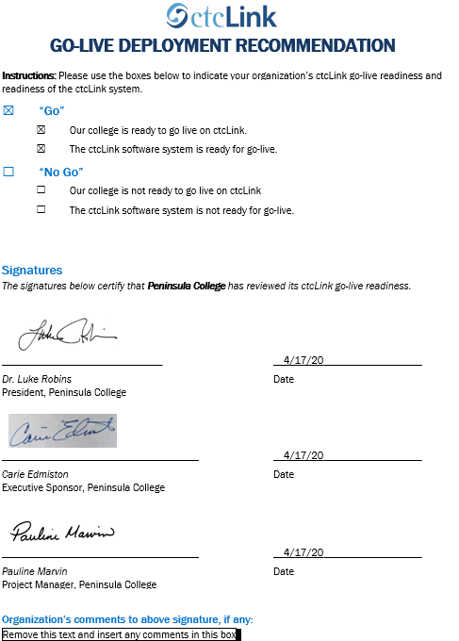
peninsula college readness form
Notes:
PENINSULA COLLEGE

Slide 13
pierce COLLEGE district
College Overview | Current Completion of Readiness Criteria | Current Go/No-Go Status | Estimated Go/No-Go Status at Go-Live
Data | 3 of 3 | G | G
Security | 2 of 3 | Y | G
Testing | 6 of 6 | G | G
Training | 3 of 5 | Y | Y
College Support Plan | 4 of 4 | Y | G
Transition | 11 of 12 | Y | Y
Comms & OCM | 5 of 6 | Y | Y
 | RED - Critical system or organization issue, no mitigation available
 | ORANGE - System or organizational issue with workaround (mitigation plan)
 | YELLOW - Somewhat ready for Go-Live, small issues unresolved, doesn't impact Go-Live
 | GREEN - Ready for Go-Live

Slide 14
PIERCE COLLEGE comments & MITIGATION plan
CATEGORY | COMMENTS | MITIGATION PLAN
Data | Data clean up and data validation has been ongoing, but Pillars are confident about the quality of the data. | Some additional data clean up and/or modifications are expected post Go-Live.
Security | Security role set-up is complete. Security Administrator and Pillar Leads will continue to review and update security roles leading up to implementation. Security roles are being tested via SVX and issues reported. | As employees continue to work and test in SVX, issues and roles will continue to be updated.
Testing | UAT is complete. Payroll, Financial Aid and SF Parallel testing is complete and signed off.
Training | Canvas training courses have been rolled out to the college community and employees are working to complete courses applicable to their specific roles. End users do not have access to SVX environment to apply knowledge gained from Canvas courses. Desktop procedures in process. | Continue developing desktop procedures. Employees will continue Canvas training courses. Local training sessions and materials will continue to be developed post Go-Live.
College Support Plan | Training and information from SBCTC was provided to the colleges on April 15. Help Desk/Tier 1 support plan will be socialized leading up to implementation. Staff have been identified to submit support tickets through Solar Winds post Go-Live. | Continue developing security role assignment process.
Transition | Conversion weekend plans initiated with confirmed cutoff dates and cutover weekend schedule. dataLink connection established but unable to validate supplemental systems due to limited data available. SMEs are continuing to work on course/class fees. SMEs are continuing to add vendors/suppliers. SMEs will continue working on FWL post Go-Live. | Discussed and identified some local changes during contingency planning session. Continue development of Go-Live weekend plan, identify weekend validators, develop checklist for local changes. Vendors/suppliers will continue to be added post Go-Live. FWL will continue post Go-Live. Supplemental systems testing will be ongoing and post Go-Live.
Comms & OCM | Policy and procedure updates are ongoing. Website and resource tool updates are ongoing. OCM adoption is ongoing - staff training, Q&A sessions, Canvas courses, etc. | Continue with staff training sessions, opportunity to support changes, address pressure points. All areas of assessment listed will continue up to and beyond implementation.

Slide 15
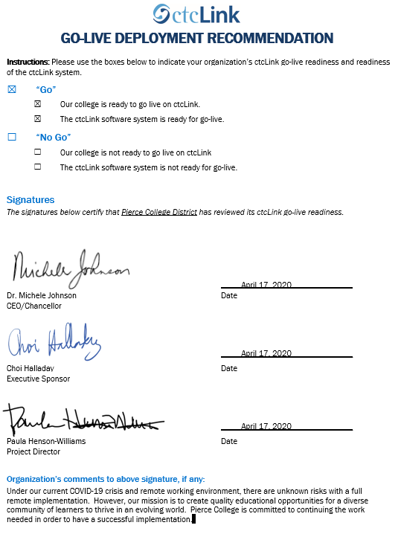
pierce college readiness form
Notes:
PIERCE DISTRICT

Slide 16
Additional perspective
ctcLink Project Team Readiness
SBCTC Agency: Support/Organizations Team Readiness
Quality Assurance (Moran Technology Consulting)

Slide 17
Ctclink project team Go-Live Status:
READY
TOPIC | RISKS/CONCERNS AND MITIGATIONS | TARGET DATE
Student Financials (SF) Parallel Testing & Conversion | Need to post conversion journals to the General Ledger with no SF errors during the parallel testing activities Validate remaining defects during DG3-B Dry Run and resolve defects | 4/17/2020 4/24/2020
Financial Aid Dual Processing Knowledge | Concern regarding level of College SMEs knowledge of dual processing: The FA team delivered FA training (including components of Dual Processing) The FA team will continue to reach out to the colleges to see if additional knowledge transfer is needed | 4/16/2020
Integration Testing | HCM team would like to review the integration testing between HCM and FIN pillars to ensure readiness for DG3-B | 5/1/2020
Remote Delivery over Conversion Weekend | Due to stay-home mandate, we are concerned about the technical team’s internet/bandwidth and stability during conversion weekend. Technical team will monitor/asses this concern during DG3-B Dry Run | 4/24/2020
WebEx Issues at Go-Live | We will need a back-up plan in place as technical issues arise (different tool: Zoom, Microsoft Teams, Skype, Google Hangout, etc.) | 5/1/2020

Slide 18
SBCTC Agency: Support/Organizations Team DG3-B Go-Live Readiness Criteria
DG3-B Readiness Assessment
Functional resources to support DG3-B colleges
Technical resources to support DG3-B colleges
Resources to support security
Local Configuration Guides available
dataLink set up and ready for DG3-B colleges
Mobile set up and ready for DG3-B colleges
Participation in transition (cutover, go-live post support)

Slide 19
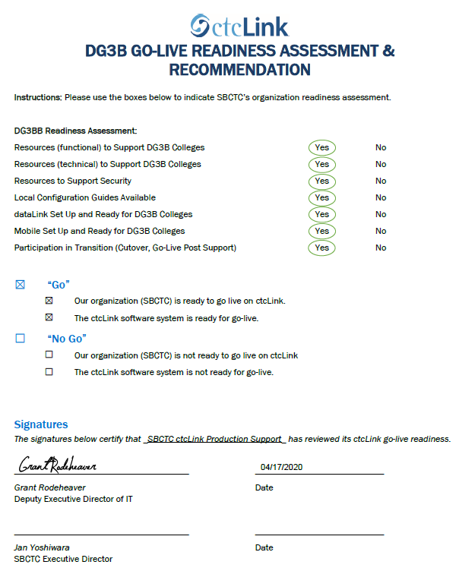
SBCTC ORGANIZATION READINESS FORM

Slide 20
Moran technology perspective
Paul Giebel,
Quality Assurance
(Moran Technology Consulting)

Slide 21
Steering Committee Motion & Recommendation draft MOTION
Approve DG3-B colleges (Cascadia College, Peninsula College and Pierce College District) for May 11, 2020 Go-Live

