Slide 1
DG4-A gate 5: college readiness
DISCUSSION & APPROVAL
ctcLink Steering Committee
January 12, 2021

Slide 2
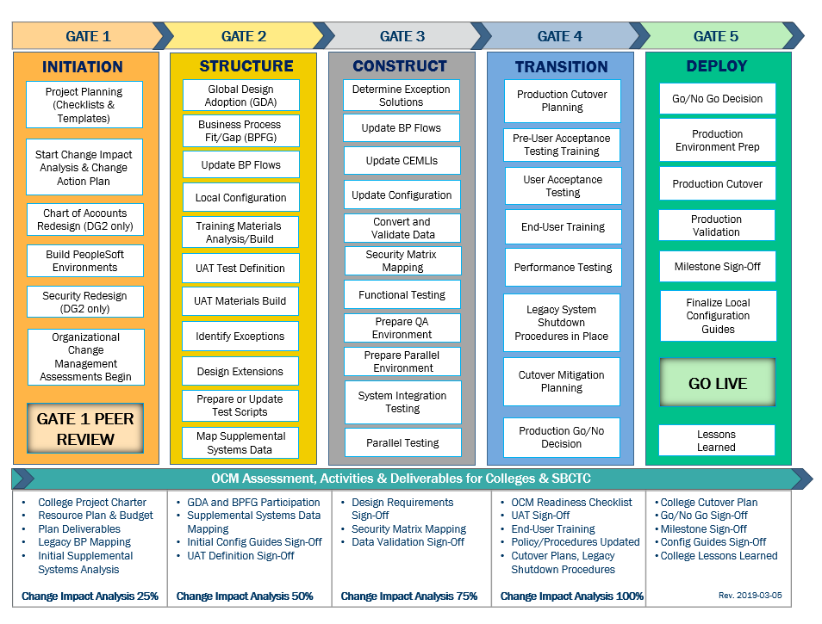
CTCLINK QUALITY GATES & MILESTONES

Slide 3
DG4 readiness TIMELINE
Oct.–Nov. 2020
Jan. 7, 2021 (Group A)
Jan. 21, 2021 (Group B)
Jan. 12, 2021 (Group A)
Jan. 26, 2021 (Group B)
Feb. 8 , 2021 (Group A) Feb. 22, 2021
(Group B)
Nov. 2020-
early Jan. 2021
College readiness spreadsheet reviewed and drafted by ctcLink PMO team and DG4 PMs
Meetings and discussion with DG4PMs
Readiness documents due from DG4 colleges, ctcLink Project team and SBCTC Support/Org teams
ctcLink Steering Committee review, discussion
DG4 Go-Live Dates
KEY ELEMENTS OF QUALITY COLLEGE READINESS ASSESSMENT
Accuracy: true measurement of go-live readiness
Consistency: one tracking tool
Identification of Gaps (for college-specific items)
Establishment of Mitigation Plans
Collaborative Process: Involvement/Assessment by College PMs, ctcLink & SBCTC Support/Organization Teams
Transparency: Report Readiness to all levels of ctcLink Governance

Slide 4
DG4-A colleges (Centralia, Edmonds, highline & Wenatchee valley)
College Readiness Assessments
Steering Committee Decision & Approval of February 8, 2021 Go-Live Date

Slide 5
CURRENT COLLEGE READINESS STATUS
 | COLLEGE | DATA | SECURITY | TESTING | TRAINING | SUPPORT PLAN | TRANSITION | COMMS & OCM
 | Centralia | G | G | O | G | G | G | Y
 | Edmonds | G | Y | Y | G | Y | Y | Y
 | Highline | G |  | Y | G | G | G | G
 | Wenatchee Valley | G | G | Y | G | G | G | G
STATUS LEGEND
R | RED - Critical system or organization issue, no mitigation available
O | ORANGE - System or organizational issue with workaround (mitigation plan)
Y | YELLOW - Somewhat ready for Go-Live, small issues unresolved, doesn't impact Go-Live
G | GREEN - Ready for Go-Live

Slide 6
ESTIMATED COLLEGE STATUS AT GO-LIVE College readiness SUMMARY
 | COLLEGE | DATA | SECURITY | TESTING | TRAINING | SUPPORT PLAN | TRANSITION | COMMS & OCM
 | Centralia | G | G | Y | G | G | G | G
 | Edmonds | G | G | G | G | G | Y | G
 | Highline | G | G | G | G | G | G | G
 | Wentachee Valley | G | G | G | G | G | G | G
STATUS LEGEND
R | RED - Critical system or organization issue, no mitigation available
O | ORANGE - System or organizational issue with workaround (mitigation plan)
Y | YELLOW - Somewhat ready for Go-Live, small issues unresolved, doesn't impact Go-Live
G | GREEN - Ready for Go-Live

Slide 7
CENTRALIA COLLEGE READINESS
College Overview | Current Completion of Readiness Criteria | Current Go/No-Go Status | Estimated Go/No-Go Status at Go Live
Data | 3 of 3 | G | G
Security | 3 of 4 | G | G
Testing | 3 of 7 | O | Y
Training | 6 of 6 | G | G
College Support Plan | 4 of 4 | G | G
Transition | 12 of 14 | G | G
Comms & OCM | 7 of 8 | Y | G
STATUS LEGEND
R | RED - Critical system or organization issue, no mitigation available
O | ORANGE - System or organizational issue with workaround (mitigation plan)
Y | YELLOW - Somewhat ready for Go-Live, small issues unresolved, doesn't impact Go-Live
G | GREEN - Ready for Go-Live

Slide 8
CENTRalIA COLLEGE comments & MITIGATION plan
CATEGORY | COMMENTS | MITIGATION PLAN
Data | Data cleanup has been executed by college SMEs as thoroughly as possible throughout the project lifecycle and will be ongoing.
Security | Centralia's local security administrators have begun validating SVL role assignments against the College Security Workbook as of January 7, 2021. | We plan to leverage SBCTC security support during the first two weeks after Go Live to ensure our employees have the necessary access to perform essential job functions. We will transition to our Local Security Management Plan on February 22, 2021.
Testing | Ten percent of Centralia's UAT tests are presently blocked due to our last-minute transition to KeyBank from a regional bank that could not support required secure transfer protocols for payroll ACH, vendor pay, and bank reconciliation files. | The college is working closely with the SBCTC ctcLink Project Team, the State Treasurer's office, our Assistant Attorney General, and KeyBank officials to finalize a banking services contract so subsequent file configuration and testing can take place.
Training | Campus-wide training is underway. The local project team has provided training trackers to each division/area on campus so the designated department training leads can monitor timely completion of required courses for all employees. | Centralia is utilizing training materials developed by DG2 and DG3 colleges where possible. Wenatchee Valley's Financial Aid department produced concise training documentation targeted to frontline staff and provided it to their DG4 counterparts on Jan. 8, 2021. Highline College delivered synchronous online Advisor Center training for faculty and advisors from the DG4 cohort on Jan. 9, 2021. Excellent collaboration and resource sharing.
College Support Plan | Centralia College IT Department drafted a Local Triage and Support Management Plan that defines service levels, expected response times, roles and responsibilities, and a tiered support model that will be implemented 2 weeks after Go Live. | Training is in progress for employees in Instruction and Student Services departments who provide front line student technical support. The IT Department is developing a lookup tool that will enable students, staff and faculty to retrieve forgotten ctcLink IDs.
Transition | 1. All essential production build tasks are complete enough for Go Live conversion but there will be a significant amount of post Go Live work to finish Enrollment Requirements (course prerequisites) and the Academic Advisement Reports (AARs). The lack of AARs will impact Spring advising which begins one week after ctcLink deployment. 2. The DataLink replication package is still in the beta testing phase and is not wired up to any supplemental systems. | Faculty/Advisors will rely on legacy applications such as Degree Audit and Advisor Data Portal (ADP) for spring advising. Centralia will run canned queries in PeopleSoft to generate required reports and files. Institutional Research and IT staff have set up direct access to the SBCTC DataLink server, and a small number of employees have taken the SBCTC Query and Reporting Training.
Comms & OCM | Communication activities are ramping up as we approach Go-Live. While the initial plan is in place, additional work is still needed to produce the messages and ensure necessary content is loaded to the college website as well as delivered on schedule through previously designated channels. | The SBCTC ctcLink Communications team provided colleges with a detailed DG4-A GO-LIVE COMMUNICATIONS PLAN that includes media protocol and Go Live milestones. Our student-focused group is taking advantage of the excellent SBCTC ctcLink Student Communication Resource Guide.

Slide 9
Centralia college go-live deployment recommendation form

Slide 10
edmonds COLLEGE READINESS
College Overview | Current Completion of Readiness Criteria | Current Go/No-Go Status | Estimated Go/No-Go Status at Go-Live
Data | 3 of 3 | G | G
Security | 3 of 4 | Y | G
Testing | 5 of 7 | Y | G
Training | 5 of 5 | G | G
College Support Plan | 3 of 4 | Y | G
Transition | 12 of 14 | Y | Y
Comms & OCM | 7 of 8 | Y | G
STATUS LEGEND
R | RED - Critical system or organization issue, no mitigation available
O | ORANGE - System or organizational issue with workaround (mitigation plan)
Y | YELLOW - Somewhat ready for Go-Live, small issues unresolved, doesn't impact Go-Live
G | GREEN - Ready for Go-Live

Slide 11
edmonds COLLEGE comments & MITIGATION plan
CATEGORY | COMMENTS | MITIGATION PLAN
Data | Data cleanup has taken place through each conversion cycle, and will continue as needed up to and post go live.
Security | First week of our Winter Term, SVL testing will commence on January 11. | Edmonds has a roll-out plan for pillars to begin testing roles in SVL beginning January 11. Due to some reorganizations, roles in Instruction were not fully assigned in the workbook, and will need to be assigned in SVL.
Testing | Timing of the testing and outstanding OTM tickets result in delays in UAT tests not reaching 100% completion. We have completed HCM and FIN testing at 100%, and are above 90% in CS and consider this within the margin of acceptable risk. | Testers who have not completed have been advised that the UAT environment will still be open throughout January, and testing should continue even though sign-offs will not be included in the State Board statistics. We have been tracking completions in our internal training tracker, and can continue to monitor progress.
Training | We have an acceptable level of training completions, and continue to track training completions. | Our internal training tracker is shared with supervisors so they can be aware of employee readiness, and will be used to review employee tickets and requests for assistance after go-live.
College Support Plan | Our Support team is working on compiling help tools, learning PeopleSoft processes, as well as adjusting to a new ticketing system for our college (MOJO). | We plan to have our support team and triage processes fully fleshed out by go-live.
Transition | The AAR/Transfer rules trainings were late in the game, and production shutdowns limited the ability to complete. We have focused on 12 or our high enrollment/transfer programs. | We have a plan for dedicated time for staff to continue working on AARs, with a target of completion by end of Spring Term.
Comms & OCM | We are working on our Crisis Plans and strategy through the month of January. | We plan to have our crisis communications plan completed by go-live.

Slide 12
Edmonds college go-live deployment recommendation form

Slide 13
highline COLLEGE READINESS
College Overview | Current Completion of Readiness Criteria | Current Go/No-Go Status | Estimated Go/No-Go Status at Go Live
Data | 3 of 3 | G | G
Security | 3 of 4 |  | G
Testing | 2 of 7 | Y | G
Training | 5 of 5 | G | G
College Support Plan | 4 of 4 | G | G
Transition | 12 of 14 | G | G
Comms & OCM | 8 of 8 | G | G
STATUS LEGEND
R | RED - Critical system or organization issue, no mitigation available
O | ORANGE - System or organizational issue with workaround (mitigation plan)
Y | YELLOW - Somewhat ready for Go-Live, small issues unresolved, doesn't impact Go-Live
G | GREEN - Ready for Go-Live

Slide 14
highline COLLEGE comments & MITIGATION plan
CATEGORY | COMMENTS | MITIGATION PLAN
Data | Data clean up has been conducted throughout Initiation and Implementation. There are currently no major areas of concern.
Security | Overall Security Plan: Work in progress for long term goals, but complete for go-live. Security not yet applied to SVL, so not yet verified as of 1/7/2021. | SVL security verification will be an ongoing activity beginning January 11, 2021.
Testing | Some remaining configuration and testing needs to happen in Student Financials. Tech Fee formula not yet working as of 1/7/2021. We assume these will be resolved and tested prior to Go-Live.
Training | There are a few individuals who need to get caught up on training, but overall doing very well. | Training will continue. Even some that have completed training will need refreshers. The QRG resources will be used in conjunction with Canvas courses.
College Support Plan | Additional training to be completed to support the college & SBCTC plans, but this will be accomplished before Go-Live.
Transition | DataLink Validation: limited data exists until Go-Live. Waiting for Lab Fee calculations so we can test. We were informed about the load testing, but would like to know what the final configuration looks like. Will have phone list, etc. for Go-Live Weekend once we receive the Activity Guide from ctcLink Project Team on Monday, January 11, 2021.
Comms & OCM | Still working on Crisis & Media plan with ctcLink Project Communications team. College also has local crisis & media communications guidelines in place for issues affecting general operations.

Slide 15
Highline college go-live deployment recommendation form

Slide 16
Wenatchee valley COLLEGE READINESS
College Overview | Current Completion of Readiness Criteria | Current Go/No-Go Status | Estimated Go/No-Go Status at Go Live
Data | 3 of 3 | G | G
Security | 4 of 4 | G | G
Testing | 3 of 7 | Y | G
Training | 6 of 6 | G | G
College Support Plan | 4 of 4 | G | G
Transition | 14 of 14 | G | G
Comms & OCM | 8 of 8 | G | G
STATUS LEGEND
R | RED - Critical system or organization issue, no mitigation available
O | ORANGE - System or organizational issue with workaround (mitigation plan)
Y | YELLOW - Somewhat ready for Go-Live, small issues unresolved, doesn't impact Go-Live
G | GREEN - Ready for Go-Live

Slide 17
Wenatchee valley COLLEGE comments & MITIGATION plan
CATEGORY | COMMENTS | MITIGATION PLAN
Data | Our data has been relatively clean through the conversion process. | Conversion for DVC4 was at a 99% success rate. I would expect a similar result for go-live.
Security | Security Roles (SVL Validation) - This task will be ongoing. Most security for SMEs was validated in UAT. We hope toget more than 30% validation of all staff with at least one person from every staff population.
Testing | - UAT will be completed next week. Seven testing tasks remain. - SF Parallel - Testing has been started, expecting completion next week. | We expect all testing and related issues to be resolved in the next couple weeks.
Training | More training needs to be done. I believe we have the time to do it, but it is a concern. | Train until Go-Live and beyond
College Support Plan | Training of support team is ongoing. We will be going through process improvement until we go live. | As the SMEs become more and more familiar with the system, our support model will become more effective.
Transition | - AARs will be completed post-go-live. - Supplemental Systems plan is in place. Many of the tables in datalink are still blank. We will need data here to be able to connect our systems. This work will happen post go live. | AARs, Enrollment Reqs, etc. will be an ongoing build.
Comms & OCM | - OCM Sustainability Plan will be an ongoing task that will transition from the project team to the pillars. - Crisis and Media plan will follow our normal established process. | SBCTC communication team has developed a great draft go live communication plan.

Slide 18
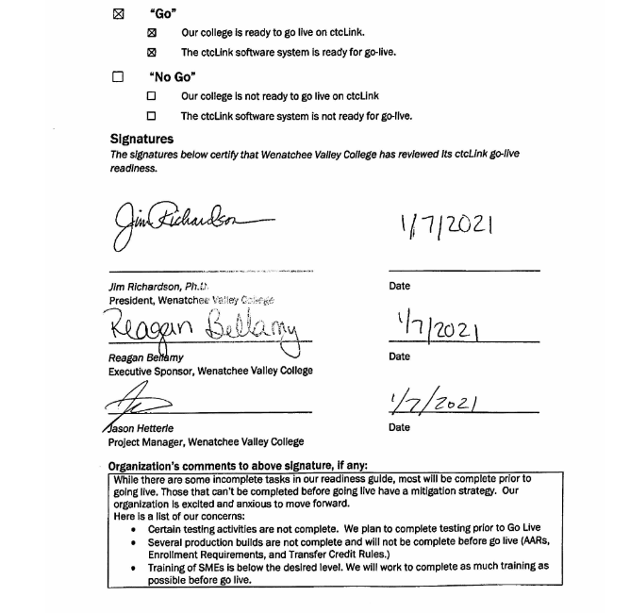
Wenatchee valley college go-live deployment recommendation Form

Slide 19
Additional perspective
ctcLink Project Team Readiness
SBCTC Agency: Support/Organizations Team Readiness
Quality Assurance (Moran Technology Consulting)

Slide 20
ctcLink Team Project Readiness Concerns
STATUS: | Y | → | G
Activities | Risk /Concerns | Target Completion Date/Mitigation
UAT Progress | Overall progress for DG4-A colleges is currently at 80-90% completion rate. | Jan. 8, 2021
 | Concern about Centralia’s and Highline’s remaining test scripts to complete in the last week of testing. Centralia’s remaining test scripts are tied to the KeyBank integration. ctcLink Project team is cautiously optimistic with an 80% test rate for DG4A. This was similar to DG3A stats. | Colleges need to determine if 80% is sufficient in testing the system. Colleges are encouraged to test remaining scripts outside of the main testing process (this is high risk as there is no WebEx support from our testing coordinators).
 | HCM team is concerned about the quality of HCM testing based on the new/latest questions SMEs have been asking. | HCM team is identifying areas to inform training/customer support of knowledge gaps that will need more support post go-live.
 | FIN team is concerned about quality of testing and full testing components for FIN GL due to incomplete testing of Accounts Receivable (AR), Billing, Asset Mgmt.. Approval Work Flow is difficult to test with a small group of SMEs; does not represent the full picture of the approval process. | Data from sprint #2 will provide the FIN team with more info. Lessons learned for the FIN team is to emphasize the order of FIN test scripts to ensure quality testing is achieved.
 | FA & SF teams are concerned about quality of testing and readiness to navigate the system. | One-on-one meetings led by FA & SF teams have helped bridge the knowledge gaps.
Student Financials (SF) Parallel Testing | Highline’s requests for changes to equation engine that drives tuition calculations are a risk, since tuition calculation is the foundation that establishes open charges for conversion. | Closure by Jan. 8, 2021 so it can be ready for conversion execution on Jan.12, 2021.

Slide 21
ctcLink Team Project Readiness Concerns, cont’d
Activities | Risk /Concerns | Target Completion Date /Mitigation
PUM 19 Regression Testing | Regression testing did not happen for Financial Aid (FA) which is the area most impacted by this release. | Mini regression testing for FA planned for (aid year rollover, verification of ISIR load and file review). Does not impact our go/no- go decision, but would like to test before go-live if it is set up.
SF Item Types – General Ledger (GL) | SF Item Types for GL is missing for all colleges in DG4-A (exception is Highline). ctcLink Project team did not include this in the data for UAT and, therefore, the colleges did not get an opportunity to fully test this process/query. | Closure by January 8, 2021 so it can be ready for conversion execution on January 12, 2021.
College Staff Resources Changes | BPFG SMEs are different than the resources that conducted testing. This presents a concern for go-live and a gap in why configuration decisions were made by different resources. | N/A
Dry Run | Tuition calculation has been run on a sample student data set. Technical team is concerned about a real, large scale tuition calculation conversion run during Dry Run activities. | January 28, 2021 (College Validation Date)
CampusCE | Real time enrollment integration will not be ready for DG4 A& B colleges. Highline, Edmonds and Seattle will be able to continue to use their current CampusCE. Centralia and Wenatchee Valley have plans in place until they make decisions to implement CampusCE. | January 20, 2021 Technical team is working on a temporary interface that would allow for the quick admit, enrollment and payment information to process via file upload.
Running Start Data | ctcLink resource needs to be identified on who will manage the Running Start data (via SQL scripts) at go-live conversion. | Needs to be resolved by February 1, 2021.
Notes:
Review items in red

Slide 22
SBCTC Agency: Support Organization Team DG4-A Go-Live Readiness Criteria
DG4-A Readiness Assessment
Functional resources to support DG4-A colleges
Technical resources to support DG4-A colleges
Resources to support security
Local Configuration Guides available
dataLink set up and ready for DG4-A colleges
Mobile set up and ready for DG4-A colleges
Participation in transition (cutover, go-live post support)

Slide 23
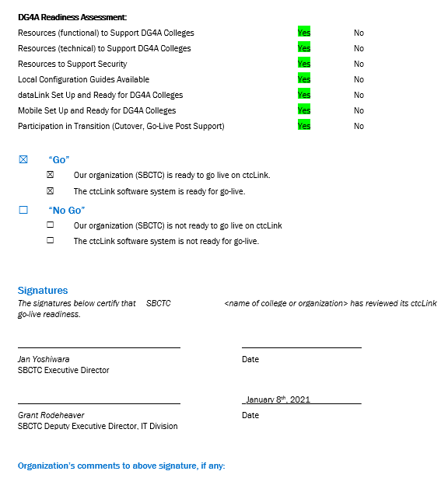
Sbctc support organization go-live deployment recommendation form

Slide 24
Moran technology perspective
Paul Giebel, Quality Assurance (Moran Technology Consulting)

Slide 25
Steering Committee Motion & Recommendation draft MOTION
Approve DG4-A colleges − Centralia College, Edmonds College, Highline College, Wenatchee Valley College − for February 8, 2021 Go-Live

