Slide 1
DG4-B gate 5: college readiness
DISCUSSION & APPROVAL
ctcLink Steering Committee
January 26, 2021

Slide 2
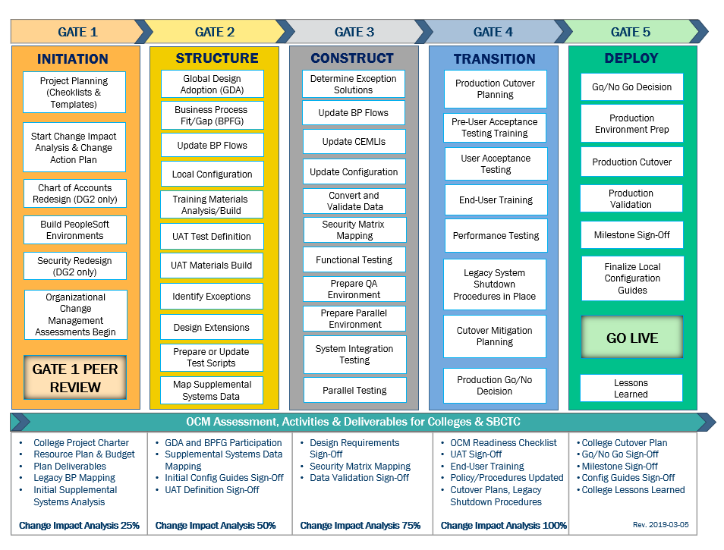
CTCLINK QUALITY GATES & MILESTONES

Slide 3
DG4 readiness TIMELINE
Oct.–Nov. 2020
Jan. 21, 2021 (Group B)
Jan. 26, 2021 (Group B)
Feb. 22, 2021
(Group B)
Nov. 2020-
early Jan. 2021
College readiness spreadsheet reviewed and drafted by ctcLink PMO team and DG4 PMs
Meetings and discussion with DG4PMs
Readiness documents due from DG4 colleges, ctcLink Project team and SBCTC Support/Org teams
ctcLink Steering Committee review, discussion
DG4 Go-Live Dates
KEY ELEMENTS OF QUALITY COLLEGE READINESS ASSESSMENT
Accuracy: true measurement of go-live readiness
Consistency: one tracking tool
Identification of Gaps (for college-specific items)
Establishment of Mitigation Plans
Collaborative Process: Involvement/Assessment by College PMs, ctcLink & SBCTC Support/Organization Teams
Transparency: Report Readiness to all levels of ctcLink Governance

Slide 4
DG4-B colleges (Seattle colleges district)
College Readiness Assessments
Steering Committee Decision & Approval of February 22, 2021 Go-Live Date

Slide 5
Seattle COLLEGEs READINESS
College Overview | Current Completion of Readiness Criteria | Current Go/No-Go Status | Estimated Go/No-Go Status at Go-Live
Data | 3 of 3 | Y | G
Security | 3 of 4 | Y | Y
Testing | 5 of 7 | Y | G
Training | 6 of 6 | Y | G
College Support Plan | 4 of 4 | G | G
Transition | 10 of 14 | Y | G
Comms & OCM | 7 of 8 | Y | G
STATUS LEGEND
R | RED - Critical system or organization issue, no mitigation available
O | ORANGE - System or organizational issue with workaround (mitigation plan)
Y | YELLOW - Somewhat ready for Go-Live, small issues unresolved, doesn't impact Go-Live
G | GREEN - Ready for Go-Live

Slide 6
Seattle comments & MITIGATION plan
CATEGORY | COMMENTS | MITIGATION PLAN
Data | Data cleanup has taken place through each conversion cycle and will continue as needed up to and post go-live. | We have approximately 400 old jobs in PPMS that need the Supervisor updated. Payroll team is working to resolve by Feb. 10.
Security | Developing long term security processes. Validating security in SVL. Security validation slowed by SVL config issues. | SVL security validation will be an ongoing activity from Jan. 18 to Feb. 17. We are prepared to closely manage security changes after deployment.
Testing | Currently 90% UAT complete, some tests working with SBCTC to fix. AR Billing workflow updated and will test Jan. 25 | UAT will continue. Of the 31 still 'In Progress' tests, 14 are in Travel & Expense, and we do not plan to use functionality until Summer.
Training | SF Integration training still needed. Local CS, Finance, and HCM training in progress. Feel good about ERP Support plan. | Full-time pillar leads will continue providing training until Go-Live and beyond.
College Support Plan | IT HelpDesk ready to support students/staff account activation. Based on current status, we will be able to provide strong support at Go-Live.
Transition | Work will continue on Enrollment Requirements and AARs after Production Unlocks on Jan. 28, 2021. Work to integrate supplemental systems continues. PRD DataLink setup and being used. | Focus work on Enrollment Requirements at Central/South after PRD unlock. Faculty/Advisors will rely on legacy applications such as Degree Audit and Advisor Dashboard for spring advising.
Comms & OCM | Student communication plan in action, adding & developing, with a finalized plan on Jan. 26, 2021. | We are actively communicating the change to students.

Slide 7
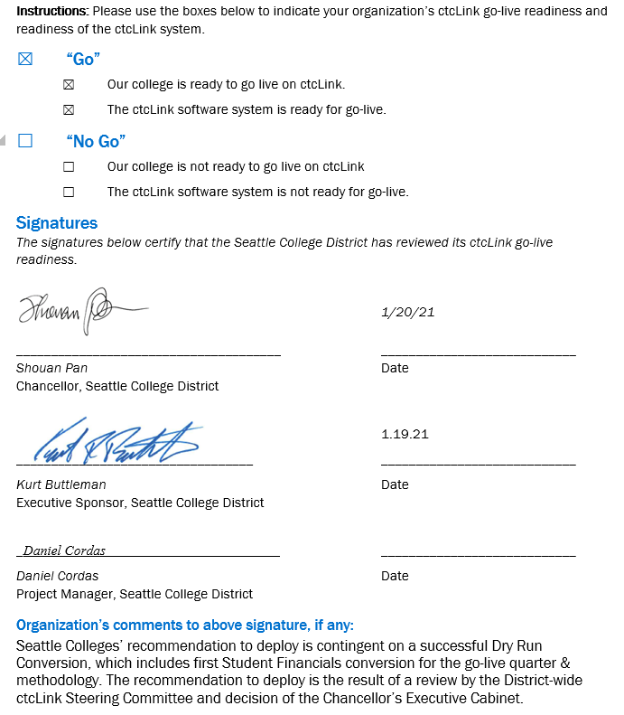
Seattle college go-live deployment recommendation form

Slide 8
Additional perspective
ctcLink Project Team Readiness
SBCTC Agency: Support/Organizations Team Readiness
Quality Assurance (Moran Technology Consulting)

Slide 9
ctcLink Project TEAM dg4-B Readiness Concerns
STATUS | Y | → | G
Activities | Risks/Concerns | Target Completion Date/Mitigation
SF Fees | Seattle Colleges are still validating their fees (examples: technology fees, college remote delivery fee, international student insurance fees). Based on these requests from their college SMEs, SF team has made updates. Seattle SMEs are also testing this. | This was completed as of Jan. 20, 2021.
SF Item Types – General Ledger (GL) | SF Item Types for GL is missing for all colleges in DG4 (exception is Highline). ctcLink Project team did not include this in the data for UAT and, therefore, the colleges did not get an opportunity to fully test this process/query. | This was completed successfully as of Jan. 13, 2021. We are slightly concerned that the College SMEs did not have sufficient time to fully validate chartfields so it will fall to the Customer Support team to assist in resolving issues post go live.
HCM Job Data | The quality of the HCM legacy data that is converted is of concern. Between Sept. 18, 2020 and Jan. 8, 2021, there was a 50% drop in total jobs converted. The number is significant enough to warrant further research by the ctcLink project. | Jan. 29, 2021 The ctcLink HCM & Technical teams would like to do more data analysis of cycle 5 (dry run) and compare with prior cycles. The 2020 calendar year shows a significant number of terminated employees and we would like Seattle to review this for data accuracy.
HCM Missing Supervisor ID Data | Historical Data - Missing Supervisor ID data: DG3-A college = 390 DG3-B colleges = 324 Seattle colleges = 549 total missing supervisor IDs. Of these, 521 do not have supervisor IDs and 28 were not updated and were not converted. The ctcLink HCM team expectation was that this information was cleaned up prior to UAT. During the DG4 call, the ctcLink HCM team will be requesting that the PPMs data is updated with correct supervisor ID before Legacy shut down of PPMs. | Feb. 17, 2021 in alignment with Legacy shut down of PPMS. During go-live weekend, the college SMEs will have to provide the supervisor IDs. If supervisor IDs are not provided then, these will have to be manually updated post go-live. The business process impact is to absence, timesheets, approval work flow, etc. Mitigation strategy – ctcLink HCM team to inject provided supervisor IDs. Caveat - if provided supervisor IDs are not accurate, then Customer Support will be impacted when appropriate supervisor is not able to approve time.

Slide 10
ctcLink Project TEAM DG4-B Readiness Concerns, cont’d
Activities | Risks/Concerns | Target Completion Date /Mitigation
Security Roles | We will need to monitor the role clean-up in SVL to ensure they are meeting college expectations for role assignments. | Feb. 3, 2021 ctcLink team is concerned about security administration/management and local coordination post go-live.
UAT – Quality | FIN team is concerned about quality of testing and full testing components for FIN GL due to incomplete testing of Accounts Receivable (AR), Billing, Asset Mgmt. Approval Work Flow is difficult to test with a small group of SMEs. Does not represent the full picture of the approval process. | Data from sprint #2 will provide the FIN team with more info. Lessons learned for the FIN team is to emphasize the order of FIN test scripts to ensure quality testing is achieved.
FIN College Staff Engagement & Coordination | The ctcLink FIN team is concerned about Seattle’s FIN Department Structure based on the conversations with college FIN SMEs from November. At that time, the project was asked to change the Department structure but was not able to based upon the start of UAT activities. This change to the Department structure may have cross-impact to HCM and Student Financials configuration. | Any changes in Department structure will have to be coordinated with the Support Organization post go-live. This may greatly impacts the SBCTC ctcLink Customer Support organization as the Seattle College District attempts to come to resolution after go-live.
CampusCE | Real time enrollment integration will not be ready for DG4-A & DG4-B colleges. Highline, Edmonds and Seattle will be able to continue to use their current CampusCE. Centralia and Wenatchee Valley have plans in place until they make decisions to implement CampusCE. | Jan. 20, 2021 Technical team is working on a temporary interface that would allow for the quick admit, enrollment and payment information to process via file upload.
Notes:
Review items in red

Slide 11
SBCTC Agency: Support Organization Team DG4-B Go-Live Readiness Criteria
DG4-B Readiness Assessment
Functional resources to support DG4-B colleges
Technical resources to support DG4-B colleges
Resources to support security
Local Configuration Guides available
dataLink set up and ready for DG4-B colleges
Mobile set up and ready for DG4-B colleges
Participation in transition (cutover, go-live post support)

Slide 12
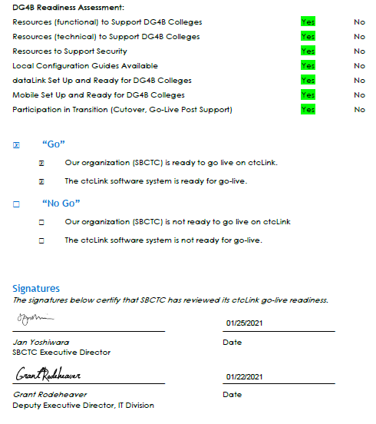
Sbctc support organization go-live deployment recommendation form
Organization’s comments to above signature, if any:
Seattle Colleges have expressed the desire to change their FIN department coding post go-live. This will greatly impact Customer Support and the ability to support this activity. These changes in department structure may have cross-pillar impact to HCM and Student Financials configuration. SBCTC Customer Service will not be able to engage in significant planning and coding changes until next fiscal year (FY22). Planning and coding changes will also be limited while preparing and onboarding DG5 and DG6 colleges. Production Changes/implementation wouldn't be available until FY23, at the earliest.
College SMEs have expressed concern about their own local college engagement and coordination with some of the project activities. This raises concerns for post go-live activities where all areas of the college may not be in alignment with key business processes and greatly impact Customer Support with increased tickets and training needs. Therefore, it is strongly recommended that the Seattle Colleges develop and vet their Local Triage and Support Management Plan to align resources and determine business process flow internally, prior to reaching out to Customer Support. This should in turn help develop a stronger communication loop and alignment at the colleges.

Slide 13
Moran technology perspective
Paul Giebel, Quality Assurance (Moran Technology Consulting)

Slide 14
Steering Committee Motion & Recommendation draft MOTION
Approve DG4-B colleges − Seattle District (North Seattle College, Seattle Central College, South Seattle College) − for Feb. 22, 2021 ctcLink Go-Live.

