Slide 1
DG5-A gate 5: college readiness
DISCUSSION & APPROVAL
ctcLink Steering Committee
September 28, 2021

Slide 2
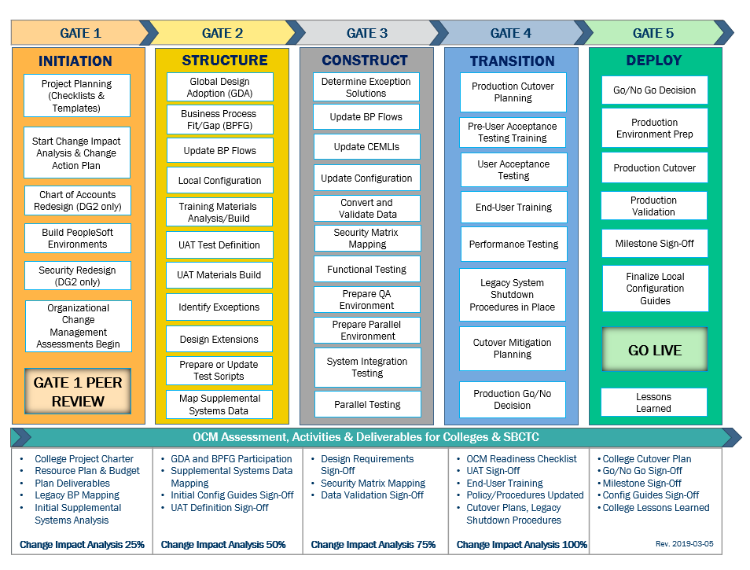
CTCLINK QUALITY GATES & MILESTONES

Slide 3
DG5 readiness TIMELINE
Aug.–Sept. 2021
Sept. 23, 2021 (Group A)
Sept. 30, 2021 (Groups B & C)
Sept. 28, 2021 (Group A)
Oct. 5, 2021 (Groups B & C)
Oct. 11 , 2021 (Group A)
Oct. 25, 2021
(Group B)
Nov. 8, 2021
(Group C)
Aug.-Sept. 2021
College readiness spreadsheet reviewed and drafted by ctcLink PMO team and DG5 PMs
Meetings and discussion with
DG5 PMs
Readiness documents due from DG5 colleges, ctcLink Project team and SBCTC Support/Org teams
ctcLink Steering Committee review, discussion
DG5 Go-Live Dates
KEY ELEMENTS OF QUALITY COLLEGE READINESS ASSESSMENT
Accuracy: true measurement of go-live readiness
Consistency: one tracking tool
Identification of Gaps (for college-specific items)
Establishment of Mitigation Plans
Collaborative Process: Involvement/Assessment by College PMs, ctcLink & SBCTC Support/Organization Teams
Transparency: Report Readiness to all levels of ctcLink Governance

Slide 4
DG5-A: Green River college, Skagit valley college
College Readiness Assessments
ctcLink Project Team Recommendation
Steering Committee Decision & Approval of October 11, 2021 Go-Live Date

Slide 5
CURRENT COLLEGE READINESS STATUS
 | COLLEGE | DATA | SECURITY | TESTING | TRAINING | SUPPORT PLAN | TRANSITION | COMMS & OCM
 | Green River | Green | Green | Green | Yellow | Green | Yellow | Green
 | Skagit Valley | Yellow | Green | Yellow | Yellow | Yellow | Yellow | Yellow
STATUS LEGEND
R | RED - Critical system or organization issue, no mitigation available
O | ORANGE - System or organizational issue with workaround (mitigation plan)
Y | YELLOW - Somewhat ready for Go-Live, small issues unresolved, doesn't impact Go-Live
G | GREEN - Ready for Go-Live

Slide 6
Estimated COLLEGE READINESS STATUS
 | COLLEGE | DATA | SECURITY | TESTING | TRAINING | SUPPORT PLAN | TRANSITION | COMMS & OCM
 | Green River | Green | Green | Green | Green | Green | Green | Green
 | Skagit Valley | Yellow | Green | Green | Yellow | Green | Yellow | Yellow
STATUS LEGEND
R | RED - Critical system or organization issue, no mitigation available
O | ORANGE - System or organizational issue with workaround (mitigation plan)
Y | YELLOW - Somewhat ready for Go-Live, small issues unresolved, doesn't impact Go-Live
G | GREEN - Ready for Go-Live

Slide 7
Green river COLLEGE READINESS
College Overview | Current Completion of Readiness Criteria | Current Go/No-Go Status | Estimated Go/No-Go Status at Go-Live
Data | 3 of 3 | Green | Green
Security | 3 of 3 | Green | Green
Testing | 7 of 7 | Green | Green
Training | 6 of 7 | Yellow | Green
College Support Plan | 5 of 5 | Green | Green
Transition | 13 of 14 | Yellow | Green
Comms & OCM | 8 of 8 | Green | Green
STATUS LEGEND
R | RED - Critical system or organization issue, no mitigation available
O | ORANGE - System or organizational issue with workaround (mitigation plan)
Y | YELLOW - Somewhat ready for Go-Live, small issues unresolved, doesn't impact Go-Live
G | GREEN - Ready for Go-Live

Slide 8
Green river COLLEGE comments & MITIGATION plan
CATEGORY | COMMENTS | MITIGATION PLAN
Data | Caught up as far as our reports, but will continue to clean up to go-live.
Security | We feel good where we are now, but expect some roles and permissions issues after go-live. | List of known issues will be resolved after go-live.
Testing | Parallel testing has completed, but we plan to retest and/or reevaluate identified items that failed or couldn't test.
Training | PHII trainings initiated and are date-specific with last one on 9/30/2021. | PHII Trainings to be complete on 9/30 which occurs after 9/28 Steering Committee Special Meeting: DG5-A Readiness Briefing.
College Support Plan | Solar Winds (SBCTC) GRC SME ticket submitters - Security Team (BAs, PM, IT Security Team) 90+ (Student/Employee) plan in development. | List sent to Dani Bundy on 9/20/2021.
Transition | We will finalize our Legacy closure plan now that we have been briefed by Ray Gartner’s Legacy team on 9/22/2021. | Working on AAR and Transfer Credit Rules and will be completed before Go-Live. Placing Name or Team to each Legacy HP-UX Transition Schedule step that was provided by Ray Gartner’s team to ensure tasks are completed correctly.
Comms & OCM | OCM Stakeholder Readiness Discussions- Working on Classified Union and readiness. | Plan more discussion for Go-Live with emphasis on our high volume traveling, purchasing, etc.

Slide 9
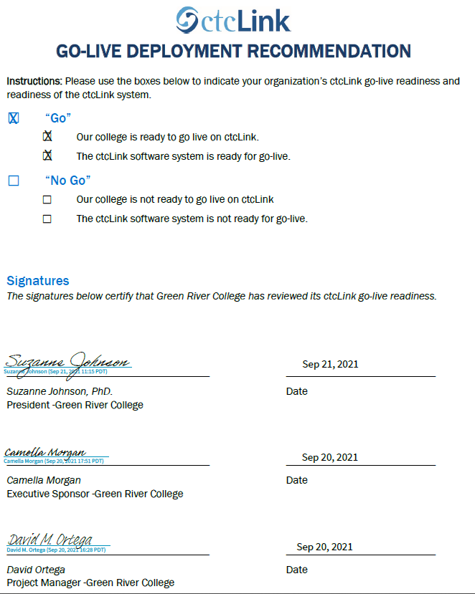
Green river college go-live deployment recommendation form

Slide 10
Skagit valley COLLEGE READINESS
College Overview | Current Completion of Readiness Criteria | Current Go/No-Go Status | Estimated Go/No-Go Status at Go-Live
Data | 3 of 3 | Yellow | Yellow
Security | 3 of 3 | Green | Green
Testing | 7 of 7 | Yellow | Green
Training | 6 of 7 | Yellow | Yellow
College Support Plan | 5 of 5 | Yellow | Green
Transition | 12 of 14 | Yellow | Yellow
Comms & OCM | 7 of 8 | Yellow | Yellow
STATUS LEGEND
R | RED - Critical system or organization issue, no mitigation available
O | ORANGE - System or organizational issue with workaround (mitigation plan)
Y | YELLOW - Somewhat ready for Go-Live, small issues unresolved, doesn't impact Go-Live
G | GREEN - Ready for Go-Live

Slide 11
Skagit valley COLLEGE comments & MITIGATION plan
CATEGORY | COMMENTS | MITIGATION PLAN
Data | Some HCM data can't be cleaned in Legacy and/or before go-live. Still working on catalog/schedule and validation between legacy and PRD. | HCM team will start late Sunday or early Monday after go-live to review and fix data in preparation for first payroll in ctcLink. Instruction plans to be done with Fall and Winter schedule quarter by go-live.
Security | Completed role assignment and are pretty confident in that work, but SACR and UPD needs more work. | Try to complete SACR and UPD work in SVX, or will happen after go-live. Will review and update roles as much as possible before go-live.
Testing | UAT Sprint 1 complete except for two HCM tests that are blocked. UAT Sprint 2 should be close to complete by 9/24. Parallel testing completed without major issue. | May have to delay roll out of non-critical functions if not fully tested and prepared to support right after go-live.
Training | Started early adopter training during UAT, and campus-wide training 9/13. Training plan being updated for post go-live. | Brought back a retired employee to take training lead position and help with go-live training push across the college.
College Support Plan | Local security support plan completed 9/23. Started help desk training. Post go-live project plan being finalized. | Have engaged our IT director, Brian Culver, to assist with all things support related to leverage his experience at Cascadia. Also including our new training lead in this work.
Transition | Working on finalizing legacy shutdown plans week of 9/20, migration plan nearly complete, production build progressing well for go-live. Supplemental Systems can't be focused on until we have data available. | Hired a data analyst to support supplemental system and reporting conversion process, most work will have to take place after go-live.
Comms & OCM | Policies and Procedures in planning, change action plans need to be reviewed and updated, OCM sustainability plan under development. Comms work well in hand with guidance from Marisa Pierce and her experience with go-live at Edmonds. | Able to shift focus to more OCM work for long-term support of change with ctcLink after initial focus on final conversion and supporting basic access to system.

Slide 12
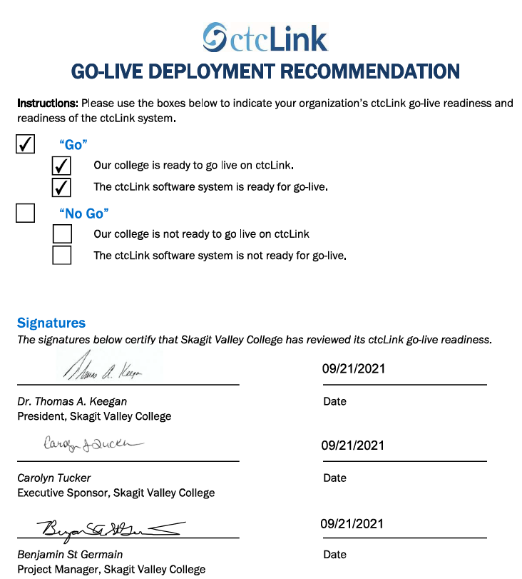
Skagit valley college go-live deployment recommendation form

Slide 13
Additional perspective
ctcLink Project Team Readiness
SBCTC Agency: Support/Organizations Team Readiness
Quality Assurance (Moran Technology Consulting)

Slide 14
Dg5-a ctcLink Team Project Readiness Concerns
STATUS: | Y | → | G
Activities | Risks /Concerns | Target Completion Date/Mitigation
Technical | Clean up issues identified during dry run. | 9/30/2021
Testing | GRC – Sprint 1 = 100%, Sprint 2 = 100% SVC – Sprint 1 = 99%, Sprint 2 = 99% (Metrics as of 9/22/2021)
Security | GRC – Clean up security user profiles in PRD for employees (previously worked at prior ctcLink colleges). Audit query role security assignment for their users. Mitigations are in progress. SVC – No concerns for SVC. | 10/1/2021
Finance | No concerns.
Student Financials | No concerns.

Slide 15
Dg5-a ctcLink Team Project Readiness Concerns
STATUS: | Y | → | G
Activities | Risks /Concerns | Target Completion Date/Mitigation
Financial Aid | No concerns.
Campus Solutions Core | No major concerns to report. Great PRD builds for both colleges and minimal PRD cleanup needed to successfully convert go-live enrollments.
Human Capital Management | GRC – No concern. SVC – Not using Talent Acquisition Management (TAM) at go-live will lead to manual data entry in ctcLink system may cause issues. Also, they need to work with Customer Support to help them making the required changes when they decide to start using TAM. | Post Go-Live
PMO | No concerns.
Legacy | No concerns.

Slide 16
SBCTC Agency: Support Organization Team DG5-A Go-Live Readiness Criteria
DG5-A Readiness Assessment
Resources (functional) to support DG5-A colleges
Resources (technical) to support DG5-A colleges
Resources to support security
Access to documentation to ctcLink Project Team (homework & local/configuration
dataLink set up and ready for DG5-A colleges
Mobile set up and ready for DG5-A colleges
Participation in transition (cutover, go-live post support)

Slide 17
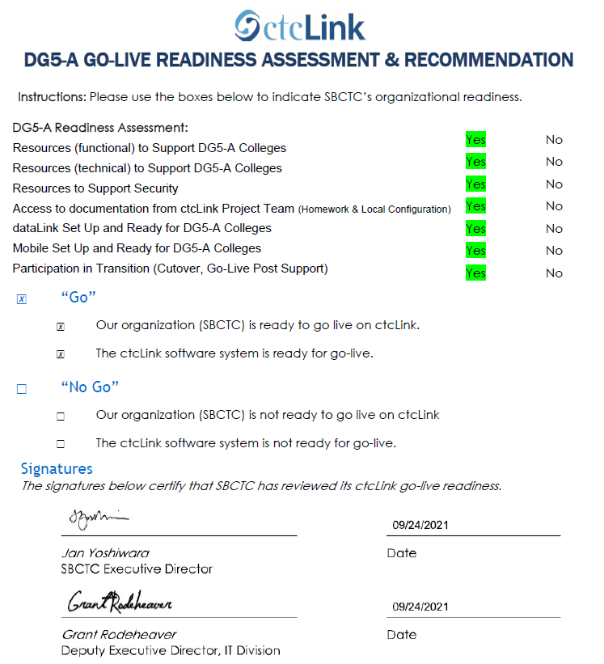
Sbctc support organization go-live deployment recommendation form

Slide 18
Moran technology perspective
Paul Giebel, Quality Assurance (Moran Technology Consulting)

Slide 19
Recommendation to Steering committee
The ctcLink Project Team recommends the ctcLink Steering Committee approve DG5-A colleges (Green River College and Skagit Valley College) to go live on ctcLink on October 11, 2021.

