Slide 1
DG5-C gate 5: college readiness
DISCUSSION & APPROVAL
ctcLink Steering Committee
October 5, 2021

Slide 2
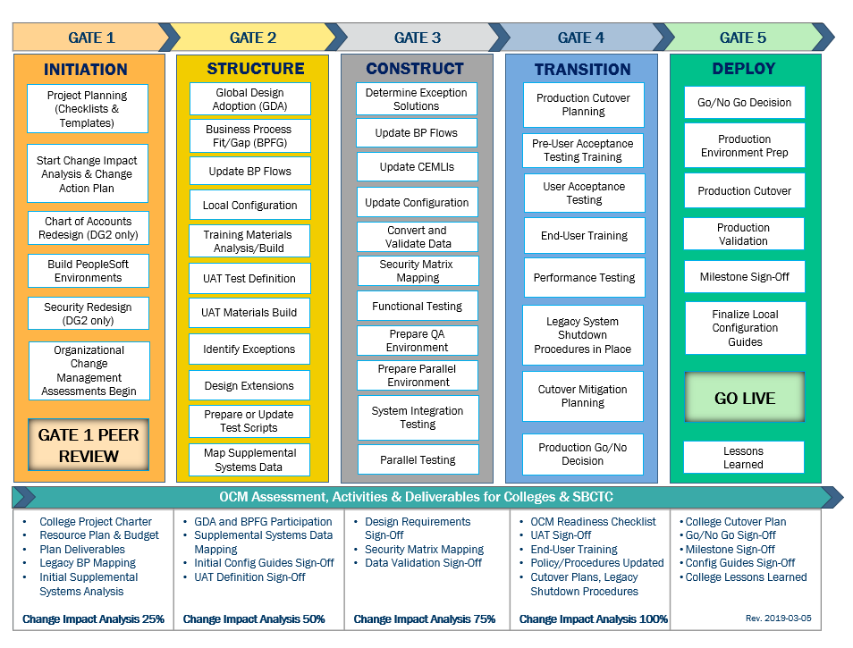
CTCLINK QUALITY GATES & MILESTONES

Slide 3
DG5 readiness TIMELINE
Aug.–Sept. 2021
Sept. 23, 2021 (Group A)
Sept. 30, 2021 (Groups B & C)
Sept. 28, 2021 (Group A)
Oct. 5, 2021 (Groups B & C)
Oct. 11 , 2021 (Group A)
Oct. 25, 2021
(Group B)
Nov. 8, 2021
(Group C)
Aug.-Sept. 2021
College readiness spreadsheet reviewed and drafted by ctcLink PMO team and DG5 PMs
Meetings and discussion with
DG5 PMs
Readiness documents due from DG5 colleges, ctcLink Project team and SBCTC Support/Org teams
ctcLink Steering Committee review, discussion
DG5 Go-Live Dates
KEY ELEMENTS OF QUALITY COLLEGE READINESS ASSESSMENT
Accuracy: true measurement of go-live readiness
Consistency: one tracking tool
Identification of Gaps (for college-specific items)
Establishment of Mitigation Plans
Collaborative Process: Involvement/Assessment by College PMs, ctcLink & SBCTC Support/Organization Teams
Transparency: Report Readiness to all levels of ctcLink Governance

Slide 4
DG5-C: Bellevue college, Everett community college & grays harbor college
College Readiness Assessments
ctcLink Project Team Recommendation
Steering Committee Decision & Approval of Nov. 8, 2021 Go-Live Date

Slide 5
CURRENT COLLEGE READINESS STATUS
 | COLLEGE | DATA | SECURITY | TESTING | TRAINING | SUPPORT PLAN | TRANSITION | COMMS & OCM
 | BELLEVUE | Green | Green | Green | Green | Yellow | Green | Green
 | EVERETT | Green | Green | Yellow | Yellow | Green | Yellow | Yellow
 | GRAYS HARBOR | Yellow | Yellow | Yellow | Orange | Yellow | Yellow | Yellow
STATUS LEGEND
R | RED - Critical system or organization issue, no mitigation available
O | ORANGE - System or organizational issue with workaround (mitigation plan)
Y | YELLOW - Somewhat ready for Go-Live, small issues unresolved, doesn't impact Go-Live
G | GREEN - Ready for Go-Live

Slide 6
ESTIMATED at GO LIVE COLLEGE READINESS STATUS
 | COLLEGE | DATA | SECURITY | TESTING | TRAINING | SUPPORT PLAN | TRANSITION | COMMS & OCM
 | BELLEVUE | Green | Yellow | Green | Green | Yellow | Green | Green
 | EVERETT | Green | Green | Green | Green | Green | Green | Green
 | GRAYS HARBOR | Green | Green | Yellow | Orange | Green | Yellow | Yellow
STATUS LEGEND
R | RED - Critical system or organization issue, no mitigation available
O | ORANGE - System or organizational issue with workaround (mitigation plan)
Y | YELLOW - Somewhat ready for Go-Live, small issues unresolved, doesn't impact Go-Live
G | GREEN - Ready for Go-Live

Slide 7
DG5-C: Bellevue college presenters
Maria Rivas, Project Manager
Rodger Harrison, Executive Sponsor

Slide 8
BELLEVUE COLLEGE READINESS
College Overview | Current Completion of Readiness Criteria | Current Go/No-Go Status | Estimated Go/No-Go Status at Go-Live
Data | 3 of 3 | Green | Green
Security | 3 of 3 | Green | Yellow
Testing | 5 of 7 | Green | Green
Training | 7 of 7 | Green | Green
College Support Plan | 3 of 5 | Yellow | Yellow
Transition | 11 of 14 | Green | Green
Comms & OCM | 7 of 8 | Green | Green
STATUS LEGEND
R | RED - Critical system or organization issue, no mitigation available
O | ORANGE - System or organizational issue with workaround (mitigation plan)
Y | YELLOW - Somewhat ready for Go-Live, small issues unresolved, doesn't impact Go-Live
G | GREEN - Ready for Go-Live

Slide 9
BELLEVUE comments & MITIGATION plan
CATEGORY | COMMENTS | MITIGATION PLAN
Data | Per definition, we are ready for go-live with a few small known issues. | Manual fix after go-live and adjust business processes.
Security | Per definition we are currently in good shape and expect to have a few issues to resolve after go-live. | List of known issues will be resolved after go-live.
Testing | Issues found in UAT are still outstanding question marks; will need to wait and see how they result after go-live.
Training | Query and reporting training is in the planning stage and will occur in October.
College Support Plan | Student and staff triage plan is well under way. We have hired additional support for both populations and have Faculty Advocates for faculty. Plan for training for support resources is in place, will be executed later in October. We should be in good shape by go-live.
Transition | PRD work is in great shape. Low and AAR will be focused on more after go-live.
Comms & OCM | A solid communication plan is in place. We anticipate communication to extend well beyond go-live.

Slide 10
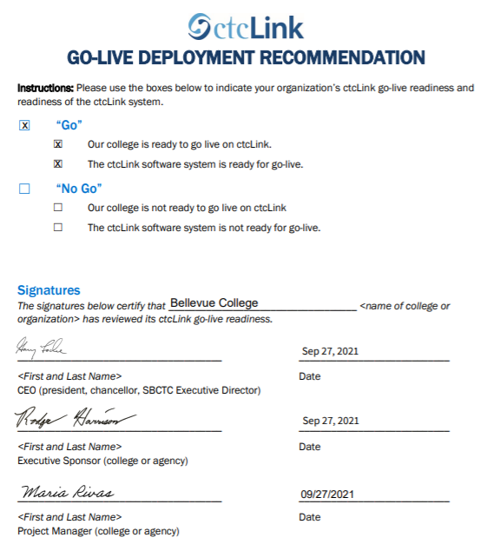
BELLEVUE go-live deployment recommendation form

Slide 11
DG5-C: everett community college presenters
Sindie Howland, Project Manager
Pat Sisneros, Executive Sponsor & speaking on behalf of Dr. Daria Willis, College President

Slide 12
EVERETT COLLEGE READINESS
College Overview | Current Completion of Readiness Criteria | Current Go/No-Go Status | Estimated Go/No-Go Status at Go-Live
Data | 3 of 3 | Green | Green
Security | 3 of 3 | Green | Green
Testing | 4 of 7 | Yellow | Green
Training | 7 of 7 | Yellow | Green
College Support Plan | 4 of 5 | Green | Green
Transition | 12 of 14 | Yellow | Green
Comms & OCM | 8 of 8 | Yellow | Green
STATUS LEGEND
R | RED - Critical system or organization issue, no mitigation available
O | ORANGE - System or organizational issue with workaround (mitigation plan)
Y | YELLOW - Somewhat ready for Go-Live, small issues unresolved, doesn't impact Go-Live
G | GREEN - Ready for Go-Live

Slide 13
EVERETT comments & MITIGATION plan
CATEGORY | COMMENTS | MITIGATION PLAN
Data | Employee bio/demo priority conversion issues. | Plan to have employees go into self-service when they log in to correct bio-demo information.
Security | Security workbook is being audited with SVX. Working on implementing a database for EvCC. Confident in our Security Admin Team to update roles as needed. | Will need to update our final security support plan after the shared database is in place for routing. Will determine any other mitigating strategies needed after DV5 Trial Run.
Testing | Plan to complete UAT prior to go-live. Loss of key SME in SF and FIN has delayed testing. Still have unresolved issues. Parallel testing was completed with critical issues resolved. | Working with State Board to resolve issues. Assistance by PM, VP, and Business Analyst to complete UAT. SEVIS issue with CIP codes. Will make a decision prior to go-live on how to handle this issue.
Training | Started Canvas campus-wide training in September with deadline of end of October. Additional training is being provided. | EvCC Trainer sessions planned for October, November & December.
College Support Plan | Will further test help desk and escalation plan during DV5 trial run. Help Desk training scheduled. Work on Post Go-Live plan still to complete.
Transition | EvCC meetings for legacy shutdown scheduled. Meeting with Ray Gartner not yet scheduled. Finalizing go live weekend plan. Supplemental Systems are not integrated | Meet with Ray Gartner to finalize Legacy shutdown plan. Plan in place for Supplemental System integration prior to and after go-live. Plan in place to clean up CNED Course information.
Comms & OCM | Change action plans have been developed. Developing procedures. Website being developed with tools. Knowledge of system is still an issue regarding OCM. | EvCC trainings prior to go-live and after go-live are being scheduled to assist with knowledge. Employees will also attend State Board Phase III trainings.

Slide 14
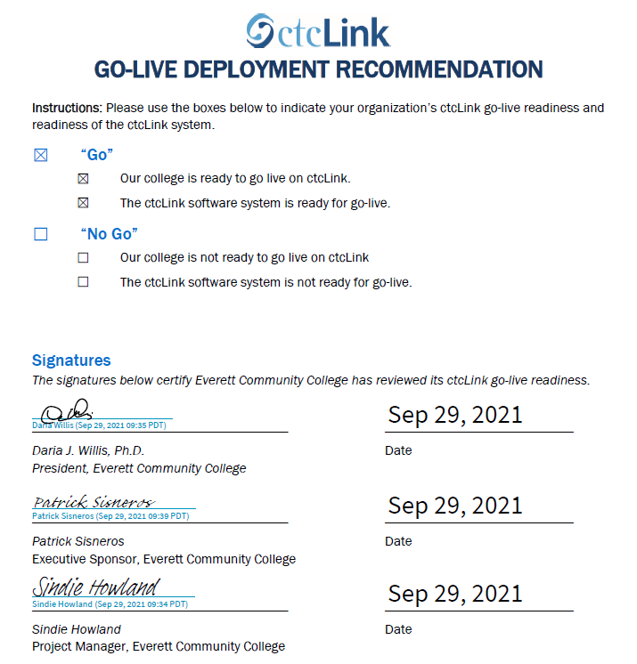
EVERETT go-live deployment recommendation form

Slide 15
DG5-C: grays harbor college presenters
Jason Lake, Project Manager
Darin Jones, Executive Sponsor
Dr. Ed Brewster, President

Slide 16
GRAYS HARBOR COLLEGE READINESS
College Overview | Current Completion of Readiness Criteria | Current Go/No-Go Status | Estimated Go/No-Go Status at Go-Live
Data | 3 of 3 | Yellow | Green
Security | 3 of 3 | Yellow | Green
Testing | 6 of 7 | Yellow | Yellow
Training | 5 of 7 | Orange | Orange
College Support Plan | 4 of 5 | Yellow | Green
Transition | 13 of 14 | Yellow | Yellow
Comms & OCM | 7 of 8 | Yellow | Yellow
STATUS LEGEND
R | RED - Critical system or organization issue, no mitigation available
O | ORANGE - System or organizational issue with workaround (mitigation plan)
Y | YELLOW - Somewhat ready for Go-Live, small issues unresolved, doesn't impact Go-Live
G | GREEN - Ready for Go-Live

Slide 17
GRAYS HARBOR comments & MITIGATION plan
CATEGORY | COMMENTS | MITIGATION PLAN
Data | Some HCM data and student data (students are too old to convert) can't be cleaned up before go-live. | We have a spreadsheet of all staff/students records that need to be revisited after go-live and are organized based on criticality.
Security
Testing | UAT testing will not be complete by the time this document is due. | We have a plan to complete UAT testing by the 10/14 Mock Go-Live. The plan has been initiated and positive results have already been seen.
Training | With so few staff and so little time, many did not have time to complete all necessary trainings. Faculty are in the process of taking their required trainings and that is going well. | OJT/JIT, continue Canvas training post-go live, SMEs encouraged to create desktop procedures documents by referencing QRG and specific Canvas courses.
College Support Plan |  | Post go-live plan will be compiled and completed by 10/12/2021.
Transition | We didn't create change action plans. SMEs didn't contribute change management concerns after BPFG or UAT. | Will cross-reference the Business Process list from BPFG with the QRGs to document changes and ask GHC SMEs to document their processes in PeopleSoft as part of the desktop procedures.
Comms & OCM | After testing and go-live transition, OCM will be the primary concern. | Policies and Procedures will be addressed after go-live. OCM activities and concerns will be primary focus after go-live.

Slide 18
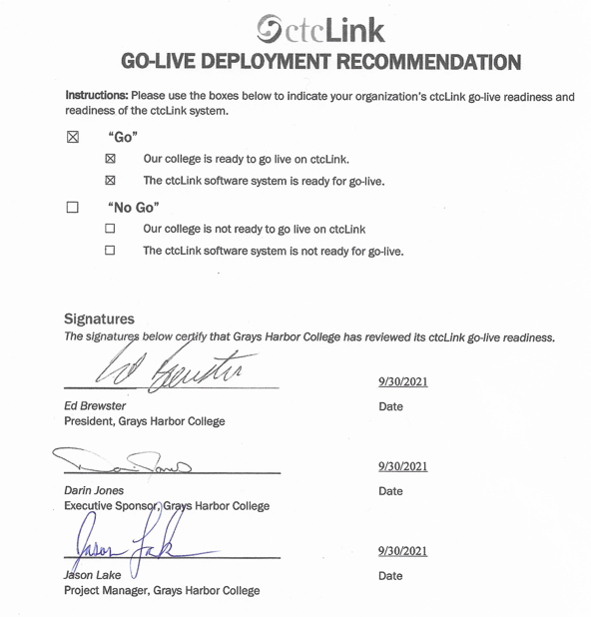
GRAYS HARBOR go-live deployment recommendation form

Slide 19
Additional perspective
ctcLink Project Team Readiness
SBCTC Agency: Support/Organizations Team Readiness
Quality Assurance (Moran Technology Consulting)

Slide 20
Dg5-C ctcLink Team Project Readiness Concerns
STATUS: | Y | → | G
Activities | Risks /Concerns | Target Completion Date/Mitigation
Technical | Clean up issues identified during dry run. | 10/29/2021
Testing (UAT stats as of 10/3/2021) | Bellevue: Sprint 1 = 99% | Sprint #2 = 99% | Overall = 99% Everett: Sprint 1 = 88% | Sprint 2 = 63% | Overall = 76% General Ledger - GL (64%) Grant / Non–Grant Billing (53%) Treasury (12%) Grays Harbor: Sprint 1 = 90% | Sprint #2 = 59% | Overall =75% Payroll testing (27%) Treasury testing (16%) General Ledger testing not started (0%) Payroll, Finance/GL, Banking (Treasury) are critical to college success. Concern about colleges’ ability to complete payroll activities on time, which impacts ALL colleges. Concern about colleges’ ability to have balances in the system and for month-end close and reconciliation activities. | 10/29/2021 10/29/2021
Security | Bellevue and Everett: No concerns. Grays Harbor: Concern about ensuring college resources/staff have completed knowledge transfer for post go-live Security. | 11/1/2021
Finance | Bellevue: No concerns. Everett & Grays Harbor. No concerns beyond the Payroll, General Ledger, Treasury, Grant/Non-Grant Billing testing noted above. | 10/29/2021
Student Financials | Bellevue and Everett: No concerns. Grays Harbor – A minor concern for second journal set for Item Types (specific to GL values). Data requested as we prepare for go-live. If data is not received, this will require more manual data entry for the college. | 10/22/2021

Slide 21
Dg5-C ctcLink Team Project Readiness Concerns
STATUS: | Y | → | G
Activities | Risks /Concerns | Target Completion Date/ Mitigation
Financial Aid | Bellevue and Everett: No concerns. Grays Harbor: General understanding of the system. Additional knowledge transfer and support may be needed | Post Go-Live
Campus Solutions Core | Bellevue: Clean-up files provided by CS Core need to be completed to prevent enrollment conversion fallout at go-live. Everett: Clean-up files provided by CS Core need to be completed to prevent enrollment conversion fallout at go-live. Grays Harbor: No concerns. | 11/1/2021 11/1/2021
Human Capital Management | Bellevue and Everett: No concerns. Grays Harbor: No concerns beyond the Payroll testing noted on previous slide.
PMO | Bellevue: No concerns. Everett concerns: Incomplete/remaining UAT. Loss of staff due to vaccine mandate. Grays Harbor concerns: Incomplete/remaining UAT. Concerned of user adoption of ctcLink due to low participation in training. Challenging post go-live experience due to low resource capacity to stabilize and use ctcLink post go-live. | Project team providing additional knowledge training sessions to Grays Harbor staff to mitigate lack of training participation. ctcLink Support and Project will evaluate and work with Grays Harbor to develop a support/stabilization plan post go-live.
Legacy | No concerns.

Slide 22
SBCTC Agency: Support Organization Team DG5-C Go-Live Readiness Criteria
DG5-C Readiness Assessment
Resources (functional) to support DG5-C colleges
Resources (technical) to support DG5-C colleges
Resources to support security
Access to documentation to ctcLink Project Team (homework & local/configuration
dataLink set up and ready for DG5-C colleges
Mobile set up and ready for DG5-C colleges
Participation in transition (cutover, go-live post support)

Slide 23
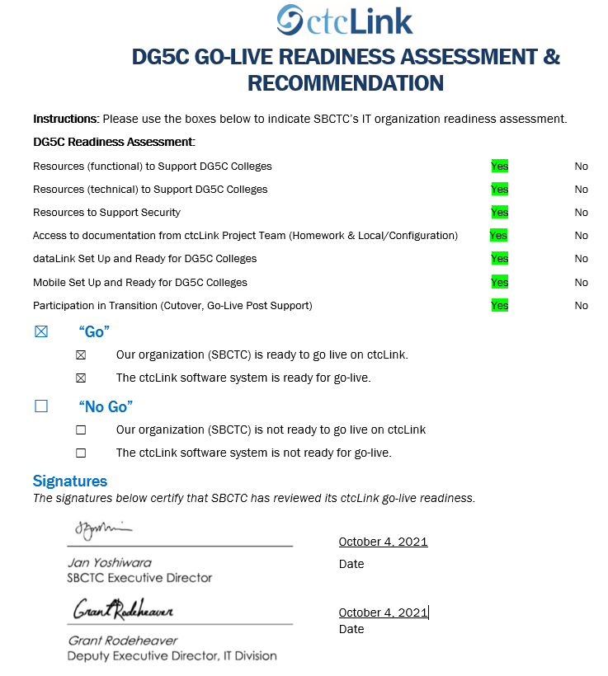
Sbctc support organization go-live READINESS ASSESSMENT & recommendation form
Organization’s comments:
The ctcLink Support Organization has concerns about Grays Harbor College’s (GHC) readiness. The college did not adhere to the implementation methodology in key areas:
Low participation in all of the training activities.
Decision to delay updating existing policies and procedures until after go-live.
Decision to not develop local Change Action Plans to prepare for their new ctcLink business processes prior to go-live.
Decision to not initiate local desktop procedures prior to go-live.

Slide 24
Moran technology perspective
Paul Giebel, Quality Assurance (Moran Technology Consulting)

Slide 25
Recommendation to Steering committee
The ctcLink Project Team recommends the ctcLink Steering Committee approve DG5-C colleges (Bellevue College, Everett Community College, Grays Harbor College) to go live on ctcLink on November 8, 2021.

