Slide 1
DG6-A gate 5: college readiness
DISCUSSION & APPROVAL
ctcLink Project Steering Committee
February 15, 2022

Slide 2
agenda
Item | Description | Time | Facilitator
1 | Welcome, Introduction of Guests & Committee Members | 15 | Tim Wrye, Christy Campbell, All
2 | Review DG6-A Go-Live Readiness Status College Readiness ctcLink Project Team Readiness SBCTC/Customer Support Readiness Quality Assurance (Moran Technology Consulting) Action Item Vote on DG6-A readiness for Feb. 28, 2022 go-live | 70 | Reuth Kim, College PMs, Executive Sponsors, Presidents Christy Campbell Grant Rodeheaver Paul Giebel Steering Committee
3 | Next Steps and Adjourn | 5 | Christy

Slide 3
dg6-A college GUESTS
Lake Washington Institute of Technology
Lauren Heller, Project Manager
Chris McLain, Executive Sponsor
Dr. Amy Morrison, President
Renton Technical College
Lia Homeister, Project Manager
Jacob Jackson, Executive Sponsor
Dr. Kevin McCarthy, President
Shoreline Community College
Joe Chiappa, Project Manager
Phillip King, Executive Sponsor
Steve Hanson, Interim President

Slide 4
CTCLINK PROJECT STEERING COMMITTEE
VOTING MEMBERS | NON-VOTING
College Executive Sponsors Tim Wrye, Highline, ctcLink Project Steering Committee Chair Reagan Bellamy, Wenatchee Valley Kurt Buttleman, Seattle Rodger Harrison, Bellevue Carolyn Tucker, Skagit Valley Chad Stiteler, Bellingham SBCTC Deputy Executive Directors Grant Rodeheaver, Information Technology Choi Halladay, Business Operations Carli Schiffner, Education | Members Christy Campbell, Chief Technology Officer–ctcLink Paul Giebel, Moran Technology Consulting, External QA Rich Tomsinski, OCIO Consultant Chris McLain, LWTech, DG6 Executive Sponsor Clay Krauss, Tacoma, PM Brian Lee, Clover Park, PM Commission Representatives Peter Lortz, North Seattle, Instruction Commission (IC) Ruby Hayden, LWTech, Washington State Student Services Commission (WSSSC)

Slide 5
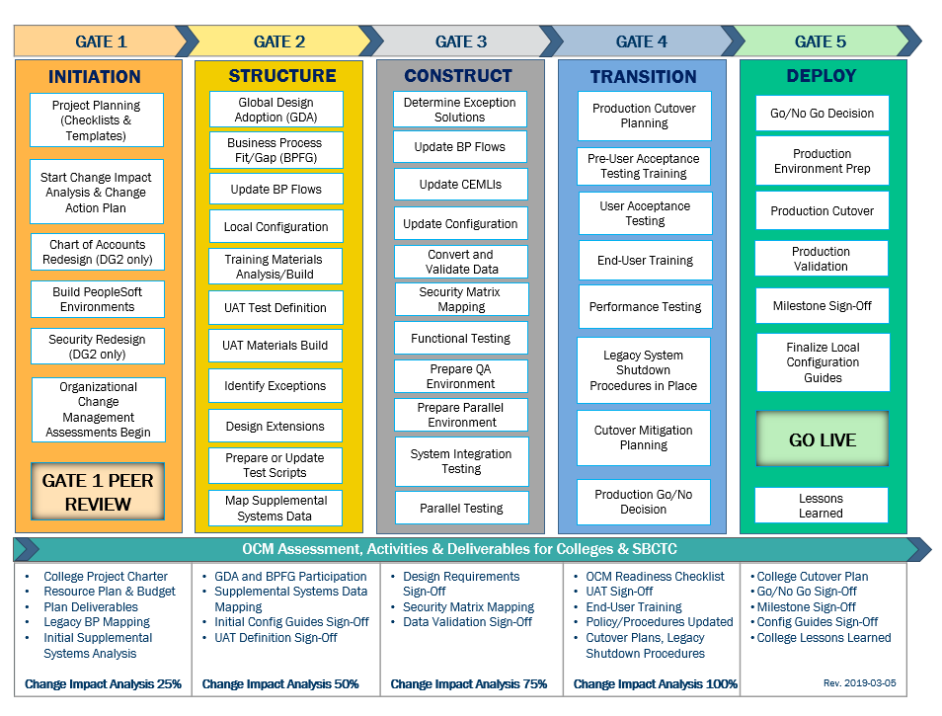
CTCLINK QUALITY GATES & MILESTONES

Slide 6
DG6 readiness TIMELINE
end of Nov. -
Dec. 2021
DG6-A: Feb. 10, 2022
DG6-B: April 1, 2022
DG6-C: April 14, 2022
DG6-A: Feb. 15, 2022
DG6-B: April 5, 2022
DG6-C: April 19, 2022
DG6-A: Feb. 28, 2022
DG6-B: April 25, 2022
DG6-C: May 9, 2022
Starts in
Dec. 2021
College readiness spreadsheet reviewed and drafted by ctcLink PMO team and DG6 PMs
Meetings and discussion with
DG6 PMs
*focused on Group A
(Groups: B & C Optional)
Readiness documents due from DG6 colleges, ctcLink Project team and SBCTC Support/Org teams
ctcLink Steering Committee review, discussion
DG6 Go-Live Dates
KEY ELEMENTS OF QUALITY COLLEGE READINESS ASSESSMENT
Accuracy: true measurement of go-live readiness
Consistency: one tracking tool
Identification of Gaps (for college-specific items)
Establishment of Mitigation Plans
Collaborative Process: Involvement/Assessment by College PMs, ctcLink & SBCTC Support/Organization Teams
Transparency: Report Readiness to all levels of ctcLink Governance

Slide 7
DG6-A: Lake Washington institute of technology, renton technical college & shoreline community college
College Readiness Assessments
ctcLink Project Team Recommendation
Steering Committee Decision & Approval of Feb. 28, 2022 Go-Live Date

Slide 8
COLLEGE READINESS STATUS: current
 | COLLEGE | DATA | SECURITY | TESTING | TRAINING | COLLEGE SUPPORT PLAN | TRANSITION | COMMS & OCM
 | LAKE WASHINGTON | Green | Green | Yellow | Green | Green | Yellow | Yellow
 | RENTON | Green | Green | Yellow | Green | Yellow | Yellow | Yellow
 | SHORELINE | Green | Yellow | Yellow | Green | Yellow | Yellow | Yellow
STATUS LEGEND
R | RED - Critical system or organization issue, no mitigation available
O | ORANGE - System or organizational issue with workaround (mitigation plan)
Y | YELLOW - Somewhat ready for Go-Live, small issues unresolved, doesn't impact Go-Live
G | GREEN - Ready for Go-Live

Slide 9
College readiness status: ESTIMATED at GO-Live
 | COLLEGE | DATA | SECURITY | TESTING | TRAINING | COLLEGE SUPPORT PLAN | TRANSITION | COMMS & OCM
 | LAKE WASHINGTON | Green | Green | Yellow | Green | Green | Green | Green
 | RENTON | Green | Green | Green | Green | Green | Green | Green
 | SHORELINE | Green | Green | Yellow | Green | Green | Green | Green
STATUS LEGEND
R | RED - Critical system or organization issue, no mitigation available
O | ORANGE - System or organizational issue with workaround (mitigation plan)
Y | YELLOW - Somewhat ready for Go-Live, small issues unresolved, doesn't impact Go-Live
G | GREEN - Ready for Go-Live

Slide 10
DG6-A: LAKE WASHINGTON INSTITUTE OF TECHNOLOGY presenters
Lauren Heller, Project Manager
Chris McLain, Executive Sponsor
Dr. Amy Morrison, President

Slide 11
Lake Washington COLLEGE READINESS
College Overview | Current Completion of Readiness Criteria | Current Go/No-Go Status | Estimated Go/No-Go Status at Go-Live
Data | 2 of 3 | Green | Green
Security | 3 of 3 | Green | Green
Testing | 5 of 8 | Yellow | Yellow
Training | 7 of 7 | Green | Green
College Support Plan | 4 of 5 | Green | Green
Transition | 14 of 15 | Yellow | Green
Comms & OCM | 7 of 8 | Yellow | Green
STATUS LEGEND
R | RED - Critical system or organization issue, no mitigation available
O | ORANGE - System or organizational issue with workaround (mitigation plan)
Y | YELLOW - Somewhat ready for Go-Live, small issues unresolved, doesn't impact Go-Live
G | GREEN - Ready for Go-Live

Slide 12
Lake washington comments & MITIGATION plan
CATEGORY | COMMENTS | MITIGATION PLAN
Data | LWTech working on Legacy Cleanup. Will complete by 2/23/2022.
Security | Engaged and dedicated college security resources: ITS Business Applications Team.
Testing | LWTech anticipates UAT completion by 2/16/2022. | CF.002.2.4 Blocked by Ticket #11609 - CyberSource Issues persist. Working with SF & technical team to troubleshoot.
Training | 761 Canvas courses complete 2/10/2022. 52 Key Concepts Sessions attended. Local training plan complete and resources in development.
College Support Plan | LWTech PMO has collegewide escalation plan. Distributed help starts within and escalates through Pillars and then onto local Business/Systems support staff. | LWTech Business Applications Manager will deliver college SolarWinds staff list by 2/18.
Transition | System & Business transition activities in progress. LWTech active engagement in Production Build activities.
Comms & OCM | Change Action Plans in progress throughout entire implementation.

Slide 13
Lake washington go-live deployment recommendation form

Slide 14
DG6-A: renton technical college presenters
Lia Homeister, Project Manager
Jacob Jackson, Executive Sponsor
Dr. Kevin McCarthy, President

Slide 15
Renton technical COLLEGE READINESS
College Overview | Current Completion of Readiness Criteria | Current Go/No-Go Status | Estimated Go/No-Go Status at Go-Live
Data | 3 of 3 | Green | Green
Security | 3 of 3 | Green | Green
Testing | 5 of 8 | Yellow | Green
Training | 7 of 7 | Green | Green
College Support Plan | 4 of 5 | Yellow | Green
Transition | 11 of 15 | Yellow | Green
Comms & OCM | 6 of 8 | Yellow | Green
STATUS LEGEND
R | RED - Critical system or organization issue, no mitigation available
O | ORANGE - System or organizational issue with workaround (mitigation plan)
Y | YELLOW - Somewhat ready for Go-Live, small issues unresolved, doesn't impact Go-Live
G | GREEN - Ready for Go-Live

Slide 16
Renton TECH comments & MITIGATION plan
CATEGORY | COMMENTS | MITIGATION PLAN
Data | Cleanup continues until we go live. No significant issues expected.
Security | Self-paced training completed. Regularly attend weekly security meetings. Active engagement in UAT, Dry Run activities.
Testing | UAT ongoing with predicted completion on 2/18/2022.
Training | RTC maintains 100% attendance at Key Concepts sessions. Mandatory workshops planned for post-go live activities. Desktop procedures initiated and will continue post-go live.
College Support Plan | TSAs have been trained; more frontline staff and SMEs training to come. | Student Services will be equipped with TSA support to help with student transactions for spring quarter. They will also be trained to help students with account activation and login themselves. Other frontline staff will be trained shortly before ctcLink release to students.
Transition | Legacy shutdown processes ongoing. Supplemental systems identified, but cannot be thoroughly validated until post-go-live. PRD cleanup continues until PRD lockout. RTC completed AARs for all credentials. | Checklists for local changes are in progress. Special attention to Financial Aid with dual processing and transition to ctcLink--Support from business analyst with FA background and an additional data analyst to help prepare day-by-day processes.
Comms & OCM | Strong leadership and supervisor-level support of ctcLink. Multiple all-college and department presentations. Regular meetings with Cabinet and BOT. Communication across multiple platforms to college community. | Cheat sheets and handouts being prepared for frontline staff. Frontline staff have been identified and will be trained to help students with commonly asked questions/issues.

Slide 17
Renton go-live deployment recommendation form

Slide 18
DG6-A: SHORELINE community college presenters
Joe Chiappa
Joe Chiappa, Project Manager
Phillip King, Executive Sponsor
Steve Hanson, Interim President

Slide 19
SHORELINE community COLLEGE READINESS
College Overview | Current Completion of Readiness Criteria | Current Go/No-Go Status | Estimated Go/No-Go Status at Go-Live
Data | 3 of 3 | Green | Green
Security | 3 of 3 | Yellow | Green
Testing | 4 of 8 | Yellow | Yellow
Training | 7 of 7 | Green | Green
College Support Plan | 4 of 5 | Yellow | Green
Transition | 10 of 15 | Yellow | Green
Comms & OCM | 8 of 8 | Yellow | Green
STATUS LEGEND
R | RED - Critical system or organization issue, no mitigation available
O | ORANGE - System or organizational issue with workaround (mitigation plan)
Y | YELLOW - Somewhat ready for Go-Live, small issues unresolved, doesn't impact Go-Live
G | GREEN - Ready for Go-Live

Slide 20
SHORELINE comments & MITIGATION plan
CATEGORY | COMMENTS | MITIGATION PLAN
Data | Cleanup is up-to-date and work on the most recent files is underway. No significant issues expected.
Security | Currently working with SBCTC Project Team on a security update to better support students and faculty during registration. Security Team meets regularly with Susan Maxwell and Tara Keen for training sessions to increase knowledge, preparedness. Addressed Mock Go-Live conversion workbook issues.
Testing | UAT is ongoing and testing results are positive. Focusing on Tuition Calculation and continue testing until Go-Live addressing smaller issues. Resource issues have remained a current issue with Student Financial hardest hit, resulting in low UAT 2 Spring 2 numbers. | Worked closely with SBCTC Student Financials and Finance Teams to create a prioritization plan to address issues through Go-Live. Payroll testing, will continue through 2/18 and any remaining items will be evaluated and discussed with Project Team.
Training | Will continue to work on desktop procedures, training materials and facilitated activities Support plan will focus on foundational knowledge prior to Post Go-Live Trainings
College Support Plan | Trained a network of students, staff and faculty to respond and triage both ctcLink and student support questions. This group will serve students, staff and faculty. | Escalation Plan is under review to ensure clean handoffs between our multiple support partners across campus.
Transition | Supplemental systems work will be ongoing through go-live PRD Builds are on track; working with SBCTC Project Team to prepare for FWL Will continue to evaluate transition plans | Will add 1099 balance information post-go live if necessary.
Comms & OCM | Plans continue to be reviewed and updated through go-live. | Readiness discussions are continuing with a focus on making high-quality instructional materials available to students, staff and faculty

Slide 21
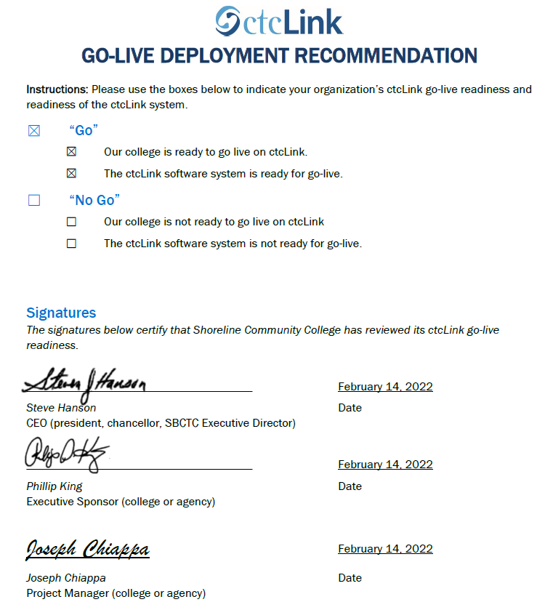
SHORELINE go-live deployment recommendation form

Slide 22
Additional perspective
ctcLink Project Team Readiness
SBCTC Agency: Support/Organizations Team Readiness
Quality Assurance (Moran Technology Consulting)

Slide 23
ctcLink Project team: dg6-A Readiness concerns
STATUS: | Y | → | G
Activities | Risks /Concerns | Target Completion Date/Mitigation
Technical | No technical concerns for DG6- A. Identified and addressed all activities through Dry Run activities.
Testing (UAT stats as of 2/14/2022) | LWTech & Renton TC: No testing concerns. Shoreline: Critical testing concerns. Sprint #1: Faculty Workload (FWL) nearly 97% complete. Hire to Payroll Centralized Absence (82% complete). This impedes college’s ability to start payroll testing, which is critical to the college’s business process. Sprint #2: CS core tests are in progress (92% complete). Student Financials (SF) all five tests have started (23% complete). Finance (FIN) tests are currently at 2.6% completed and Human Capital Management (HCM) currently at 0% completed. We are highly concerned for two areas: SF and Payroll UAT testing. | All target due dates for Shoreline’s items is 2/18/2022. ctcLink team will reach out to the college regarding non-completion of UAT and mitigation plan for completion of UAT and potential impact to post go-live support needs.
Security | LWTech & Renton TC: No security concerns. Shoreline: Concerns for outstanding items in security workbook that were not loaded in SVL. | Shoreline continues to work with ctcLink Security team on ensuring is properly loaded in SVL for go-live.
PMO | No concerns for DG6-A.
Legacy | No concerns for DG6-A.

Slide 24
ctcLink Project team: dg6-A Readiness concerns
STATUS: | Y | → | G
Activities | Risks /Concerns | Target Completion Date/ Mitigation
Financial Aid | No concerns for DG6-A.
Campus Solutions Core | LWTech, Renton TC & Shoreline: Colleges need to focus on Cleanup files prior to go-live. | 2/18/2022
Human Capital Management | LWTech & Renton TC: No HCM concerns. Shoreline: Payroll testing of critical concern. This may impact the first payroll run for all colleges in the system with a short turnaround time post go-live. | ctcLink HCM and Customer Support will need to monitor and support this effort for Shoreline post go-live.
Finance | LWTech: During dry run, two accounts via one bank identified. Needs to be scenario-based testing prior to go-live and is predicted to be a training issue post go-live. Renton TC: For KK (Commitment Control), college has decided to change configuration and this has not been tested prior to go-live. Shoreline: Finance testing concerns as listed in testing section. This may impact month and year end closing. | ctcLink FIN team is still working on this and college needs to make a decision on banking. Expected to be completed by 2/18/2022. 2/18/2022 SBCTC Agency/Customer Support teams will need to monitor and support this effort for Shoreline post go-live.
Student Financials | LWTech: No student financials current concerns. Renton TC: Item Type GL coding file coming soon, no concerns. Shoreline: Item Type GL coding needed for Item types missing codes. | ctcLink SF team met with Shoreline and college is in progress and is expected to be completed prior to go-live.

Slide 25
SBCTC Agency: Support Organization Team DG6-A Go-Live Readiness Criteria
DG6-A Readiness Assessment
Resources (functional) to support DG6-A colleges
Resources (technical) to support DG6-A colleges
Resources to support security
Access to documentation to ctcLink Project Team (homework & local/configuration)
dataLink set up and ready for DG6-A colleges
Mobile set up and ready for DG6-A colleges
Participation in transition (cutover, go-live post support)

Slide 26
Sbctc support organization go-live READINESS ASSESSMENT & recommendation form

Slide 27
Moran technology perspective
Paul Giebel, Quality Assurance (Moran Technology Consulting)

Slide 28
Recommendation to Steering committee
The ctcLink Project team recommends the ctcLink Steering Committee approve DG6-A colleges (Lake Washington Institute of Technology, Renton Technical College, and Shoreline Community College) to go live on ctcLink on February 28, 2022.

